Slide 1
USF
&
Schulman Associates IRB
February 18-19, 2015
Julie Blasingim - Director, Operations
Bette Bayne - Director of Phase 1 & Institutional Services
Justin Osborne - Associate Director, Institutions
Maria Stivers - Client Relations Manager

Slide 2
Agenda
Introductions
Schulman Overview
Schulman Experience
Schulman Point of Contact
Training on eTools
Conclusion/Additional Q&A

Slide 3
Schulman Overview
Currently Schulman oversees more than 1,500 open protocols across over 15,000 sites
All 3 Boards fully accredited by AAHRPP (5 year reaccreditation in 2011)
Schulman has worked with every major Sponsor & CRO
Boards meet daily – Monday through Friday
Dedicated daily expedited review of qualifying
Minimal Risk Protocols
Along with US and Canadian Boards, we have an
Oncology Review Board for all phases of oncology
research

Slide 4
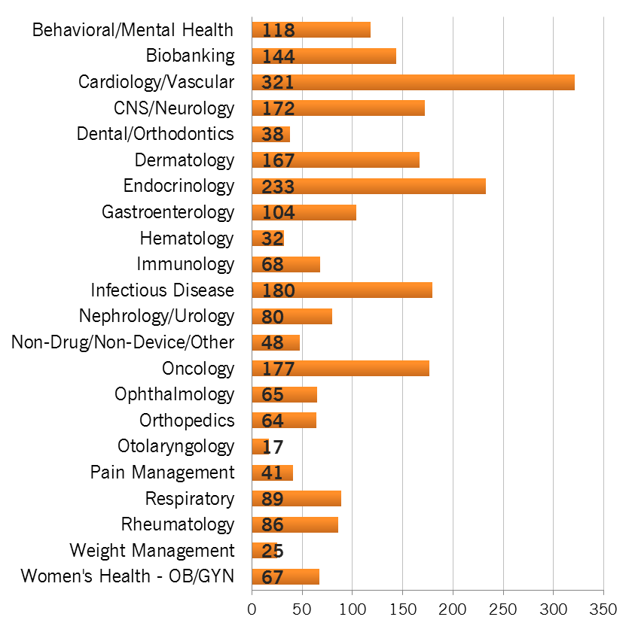
Schulman Review Experience by Therapeutic Area 2012 - 2014

Slide 5
Experience with Institutions (and Local IRBs)
Over 1800 institutional sites and growing
Nearly 200 formal agreements
List of institutions available upon request
Specialized internal institutions team with local IRB experience
Introductory call to establish relationship & identify unique institutional requirements
Upfront agreements & IC template negotiation
Approved IC template & cover page
Central IRB toolkit

Slide 6
Schulman Services – Turn Around Times
Typical time from receipt of submission to:
• Full Board review of new protocol: 5 business days*
• Expedited review: 2 business days*
• Approval documents for site (multicenter study): 1- 2
business days
Review/approval of recruitment materials or study related materials: 2-3 business days
Translated IC: 5-7 business days after approved English version
*Study Status Notifications and draft IC with Board comments are emailed to the study contact within 1 business day of study review (often same day)

Slide 7
Schulman Services – Point of Contact
Dedicated Points of Contact
Dedicated primary point of contact
Conducts Study Startup calls
Answers questions
Provides updates
Provides training
Assists with eTool use
Contact Information:
Justin Osborne
josborne@sairb.com
513-794-5760
Maria Stivers
mstivers@sairb.com
513-794-5743

Slide 8
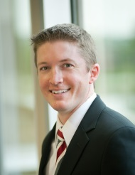
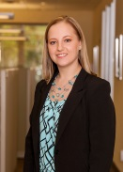
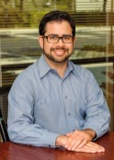
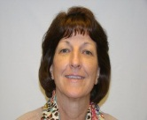
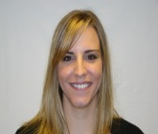
Dedicated USF Operations Service Team
University of South Florida
Justin Osborn
Associate Dir, Institutions
Maria Stivers
Client Relations Manager
Heather Fitzgerald- Operations Manager
Julie Blasingim –
Director of Operations
Kristian Figueras - Operations Coordinator, New Studies
Betsy Casillo- Submissions Coordinator, New Sites
Alecia Lind– Operations Specialist
Cassie Moening- Study Change Coordinator
Tricia Henson– Board Liaison
Diane Barrett - Translations Coordinator
Mary Holtman - Ongoing Review Coordinator

Slide 9
Schulman e-Tools
eSubmission 2.0
SmartForms for initial study & site submissions
Designed for collaboration (Local IRB & Site)
Real-time SiteAccess
Proprietary, easy to use
Customizable alerts & powerful reporting capabilities
Demo Overview

