Slide 1
Quintiles Site Management
Kim Davis, SSRM
June 17, 2014

Slide 2

Quintiles Mission:
Quintiles helps to improve healthcare worldwide by providing a broad range of professional services, information and partnering solutions to the pharmaceutical, biotechnology and healthcare industries.
Our Passion:
Improving patient treatment options by helping our customers deliver new medicines
Notes:
Who is Quintiles?

Slide 3
QUINTILES FACTS
  Founded in 1982
  25,000 professionals in 62 countries
  Range of services from Drug development to commercialization
  Of the top best-selling drugs Quintiles has helped develop or commercialize everyone.
Notes:
Quintiles is very large and has participated in the development of many new drugs over the last 32 years. We have a wealth of knowledge and have some of the most knowledgeable staff in the drug development industry.

Slide 4
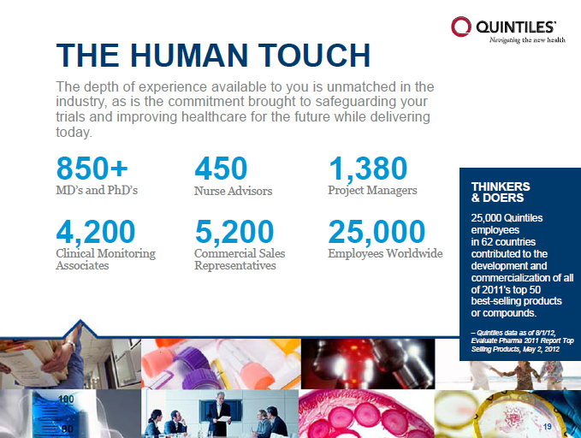
Notes:
With all of this staff and knowledge at our fingertips we still face the same challenges as you do on a daily basis.

Slide 5
Clinical Trial Challenges
  Experienced research sites are saturated with opportunities
  50% of sites enroll 90% of the patients in any given trial
  30% of sites selected and initiated NEVER enroll 1 single patient
  80% of Clinical Trials fail to meet initial enrollment quotas creating
  potential losses between $600,000 to $8M Daily*
* Source: Cutting Edge Information, “Web-Based Patient Recruitment”
Notes:
We are all too familiar with the challenges of conducting clinical trials in the current environment and the need to identify the right site with the right investigator and the right patients, reduce study timelines and recruit to target has never been greater.
Part of the Quintiles strategy to resolve some of these challenges has been to develop a network of Partner and Prime Sites, enabling the clinical trial process to be made more efficient by recruiting more patients from fewer sites.

Slide 6
Clinical Trial Challenges
Site Challenges Include:
Partnership Goals
Competition for studies
Lack of focus on enrollment
Challenges with particular
patient population
Competition for patients to participate in studies
Lack of adequate staffing
Limited knowledge or training
Complex drug/device protocol
Data collection challenges
Protocol errors
Patient retention
Study Opportunities
Patient enrollment focus
Facilitate site selection
Site motivation / focus
Resolution of site issues
Site communication
Patient retention
Improved site quality
Regular performance review
Study Timelines
Decrease Overall Cost

Slide 7

Quintiles Partner Program
A worldwide network of top Investigative sites who conduct their studies to the highest quality standards who have a
strategic alliances and acquisitions in order to enhance timely enrolment of patients on global studies:
  Program initiated in 2004
  Over 1500 worldwide Partner Investigators
  Relationships Matter
  Proven improved site performance
  Improved investigator satisfaction
Notes:
We have developed a global network of over 1500 partner investigators in 18 countries. The investigator partners include strategic alliances and acquisitions.
Sites are recommended to be partner investigators following an initial assessment.
We have proven improved performance and increased investigator satisfaction

Slide 8

Program Goals
  Explore avenues to expand the current investigative site pool
  Develop creative patient recruitment strategies
  Identify high performing investigative sites using qualitative and quantitative data – eliminate non-performing sites
  Improve relationships with quality sites and gain greater efficiencies from start up to close out.

Slide 9

Site Continuum
From Tactical to Strategic to Transformative
Prime Sites
Partner Sites
Partner Sites
Mutual commitment at senior levels to collaborate on all appropriate studies; operational/functional alignment; long-term planning and goal-setting; dedicated alliance manager assigned; joint corporate governance of relationship
Relationship actively managed; exploration of process alignment for efficiency; pipeline comparison to site capabilities for planning of future study placement
Standard Sites
Relationship actively managed; exploration of process alignment for efficiency; pipeline comparison to site capabilities for planning of future study placement
Relationship re-invented with every study; little consistency or value for either party
Tactical
(<1 studies/yr)
Strategic
(1-8 studies/yr)
Transformative
(8-20+ studies/yr)
Therapeutic Alliances
Long term strategy - developmental not prescriptive
Class based on results not ambitions
Support against milestones
Mutual collaboration and aligned goals allows a new type of relationship
Focused patient population
High level of oversight
Volume based on current study mix
Transformative - Beyond the Traditional Site Relationship

Slide 10

Benefits of Partner Site Status
Why do Good Sites Participate?
  Quintiles High Study Volume
  Increased number of trials
  Increased access for patients to new medications
  Differentiation from other physician practices
  Quintiles Operational Expertise
  Advice and tools to improve site’s recruitment
  Sharing best practices to streamline processes at the site
  Sharing of metrics to compare performance to others
  Quintiles Commitment
  Work together on feasibility of relevant protocols
  Insight into industry pipeline for key indications
  Relationship manager to provide high quality customer service around the clock
  An advocate for the site within Quintiles

Slide 11
Right Sites
Globally Partner Site recruitment rates are, on average, 50% higher
Partner Site Outperformance
Enrollment Rate
*Analysis included standard trials with enrollment closed between 2009-2011 and a minimum level of partner site participation.
Notes:
Another key component of the right path is choosing the best sites for your needs.
At Quintiles, we have constructed a network of elite sites around the world that are the best at what they do. These sites are so important to us that we assign staff to ensure a good relationship is maintained. We meet with them monthly to review studies, the site’s metrics, and provide advice. The engagement is working well and as you can see from this data, our partner sites, on average, have an enrollment rate that is 50% higher than our non-partner sites. You can also see that in well-established regions, like North America, the differential is even higher.
Through these relationships, we also talk about upcoming studies so investigators who we trust can better inform our planning.
We will continue to grow this program into more countries and more therapeutic areas to be able to reach the patients that we need.

Slide 12


Partner Site Expectations
What does success look like?
Streamline Site Identification process
Faster Study Start Up
Best in Class Recruitment
Improved Overall Trial Performance
QUALITY
Notes:
Verbally explain expectations of the program (i.e., enrollment factor, no zero enrollers, no critical findings, CDA cycle time24-48 hours, etc).

Slide 13
Current Pipeline

Slide 14
Opportunities Won

Slide 15
Monthly Site Review
Enrollment
Zero Enrollers – If site does not enroll a patient within 100 days of site initiation
Greater Than 100 Days

Slide 16
Monthly Site Review
Zero Enrollers
Less Than 100 Days – new studies awarded in last 100 days

Slide 17
Study Quality
Protocol Deviations are tracked and reviewed

Slide 18
New Study Opportunity Process
Opportunities
  Pre-Award bid defense
  Feasibility – if Quintiles were awarded this study would you be interesed
  Post Award – Relationship Mgr places the best sites on a list
Next Steps
  CDA – USF has a Master CDA however some Sponsors do not accept
    Turnaround time on this is very important
  Right PI – how does OCR know what PI’s want which studies?
  eSIF – to be completed by the PI or Site Director or Study Coordinator
    Turnaround time on this is very important
  Site Selection is made by review of MANY parameters and data
    Performance metrics are very important as the Sponsor & Quintiles select the best sites

Slide 19

How to be a successful Partner Site
  New Study Opportunities
    Pipeline
    New Opportunities communicated to Master Contact
    Quick turnaround on PI interest, CDA Signature & completion of eSIF
  Site/PI Identification
    Right Site, Right PI, Right Patient Population
    Start up – efficiency important
    PI Capabilities very important
  Measure engagement / commitment
    PI interest / capabilities assessment
    Timely response
    Timely start up process
  Key
    Centralized Functions
      Budgets | Contracts | IRB | Regulatory
    Training & Staff Education
    Core Processes & Procedures
    Communication/Relationship with each division/PI conducting research

Slide 20

Questions

