Slide 1
Study Closure
What Happens Next?

Slide 2
Objectives
Review key steps for study coordinator at study closure
Identify Responsibilities of
Sponsor
PI
Site Staff
IRB

Slide 3
Study Closure
Follow your institutional policies regarding study close-out
The official study end date is established by the IRB closure letter
Department administrators must communicate with their study teams to ensure that they are aware when a site is in the closeout phase of a study. All administrative and fiscal responsibilities pertaining to the study should be accomplished prior to the official end date of the study (date of IRB closure letter).

Slide 4
Study Closure, continued
Study coordinators must inform their departmental administrators when an application is being submitted for IRB closure
Responsibilities include but are not limited to:
Updating payroll distribution
Updating blanket POs
Closing all unliquidated POs
Change of chartfield string on any recurring charges (telephone, etc).
Study coordinators should inform the pharmacy of pending study closure in a timely manner so the pharmacy will discontinue generating invoices for the study drug
This is a critical step as fees will no longer be waived

Slide 5
Sponsor Responsibility
Provide final clinical study report to investigator/institutions as well as to the IRB. (FDA, 1996, p. 37)
Should also ensure that the reports in marketing applications meet the standards of the ICH Guidance for Structure and Content of Clinical Study Reports
Advise the site when records can be destroyed
This does not always happen but it could!
FDA: U.S. Food & Drug Administration. (1996, April). ICH E6: Good Clinical Practice: Consolidated Guidance. Retrieved from Science & Research: ICH
Guidance Documents: http://www.fda.gov/downloads/Drugs/GuidanceComplianceRegulatoryInformation/Guidances/ucm073122.pdf
Notes:
If after study closure the sponsor identifies a new risk, the site must be notified so subjects can be informed. I cannot find a source on this; AAHRRP?

Slide 6
Sponsor Responsibilities: 21 CFR 312
Sec. 312.57 Recordkeeping and record retention.
A sponsor shall maintain adequate records showing the receipt, shipment, or other disposition of the investigational drug. These records are required to include, as appropriate, the name of the investigator to whom the drug is shipped, and the date, quantity, and batch or code mark of each such shipment. (b) A sponsor shall maintain complete and accurate records showing any financial interest in 54.4(a)(3)(i), (a)(3)(ii), (a)(3)(iii), and (a)(3)(iv) of this chapter paid to clinical investigators by the sponsor of the covered study. A sponsor shall also maintain complete and accurate records concerning all other financial interests of investigators subject to part 54 of this chapter. (c) A sponsor shall retain the records and reports required by this part for 2 years after a marketing application is approved for the drug; or, if an application is not approved for the drug, until 2 years after shipment and delivery of the drug for investigational use is discontinued and FDA has been so notified. (d) A sponsor shall retain reserve samples of any test article and reference standard identified in, and used in any of the bioequivalence or bioavailability studies described in, 320.38 or 320.63 of this chapter, and release the reserve samples to FDA upon request, in accordance with, and for the period specified in 320.38.

Slide 7
PI Responsibility
Submit financial disclosure (FDF) to the sponsor 1 year following study completion (21 CFR 54.6)
More information on this can be found in the Guidance for Clinical Investigators, Industry, and FDA Staff: Financial Disclosure by Clinical Investigators (link provided in “resource” slides).
Keep records accessible so they can be retrieved if requested
Maintain records for:
2 years following the date a marketing application is approved for the drug for the indication for which it is being investigated
2 years after the investigation is discontinued and FDA is notified if no application is to be filed or if the application has not been approved for such indication

Slide 8
Site Staff Responsibility
Ultimately the investigator is responsible for study documents.
Site staff should provide support to their investigator while following federal regulations and guidelines as well as institutional policies.
Institutional policies may require you to retain documents longer than specified by federal regulations and guidance.

Slide 9
IRB Responsibility
The IRB must retain records for a minimum of 3 years after study closure/completion. (21 CFR 56.115(b))
These documents must be available for inspection by authorized representatives of the FDA at reasonable times and in a reasonable manner.
USF HRPP Policy and Procedure Manual outlines the IRB’s Responsibility in section 19.2, Records and Retention Accessibility.
This policy follows:
21 CFR 56.115(b) and 45 CFR 46.115(b)
Florida Statues §119 and §286
USF System Policy 5-012

Slide 10
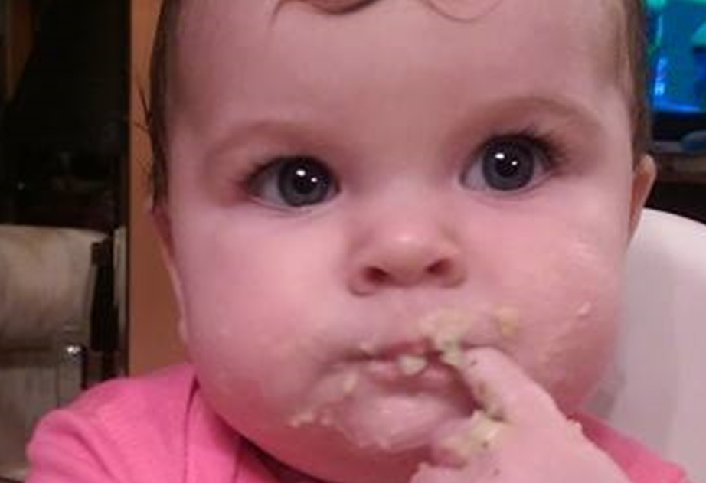
Scenarios: What do I do?

Slide 11
The study has been closed for 2 years and the PI is no longer at my site, what do I do?
Read your Clinical Trials Agreement
Read your institutional policies
Reference HHS regulations (45 CFR 46.115(b).)
See next slide
Take home note: The records can be transferred to another investigator at the site or the someone at the site can assume responsibility of maintaining the records. The PI or site is responsible for notifying the sponsor who at the site is responsible for maintaining the records.
Photo permission and credit: Emily Dayton 10 Nov. 2016

Slide 12
If investigators who have been designated to retain records on behalf of the institution leave that institution, the investigators and the institution should identify the successor responsible for maintaining those institutional records, either at the original institution or wherever the records are relocated, for the period of time required under HHS regulations at 45 CFR 46.115(b).
Office for Human Research Protections
Office for Human Research Protections. (n.d.). Investigator Responsibilities FAQ. Retrieved from U.S. Department of Health & Human Services:
http://www.hhs.gov/ohrp/regulations-and-policy/guidance/faq/investigator-responsibilities/#

Slide 13
Clinical Trials Agreement
Often the CTA details the expectation for record maintenance and retention
Examples could include:
At least 2 years after the last approval of marketing application for the device/compound in the United States, European Union, Japan, and India.
This could be a really long time!
2 years following notification from sponsor that it has formally discontinued clinical development
Institution will notify sponsor prior to destruction of any trial-related records and, if requested by sponsor, shall transfer such records to sponsor at sponsor’s expense.

Slide 14
We started the study start-up process but never opened the trial at our site; what are my next steps?
If the start-up ceased prior to IRB approval, follow your institutional policies on record retention.
If you received IRB approval and did not open the trial at your site you must close the study with the IRB.
IRB documents must be retained for a minimum of 3 years according to federal regulations and guidelines; follow your institutional or IRB policy if required retention is longer.
If requested by the sponsor, you can transfer documents to them at their expense.
This is usually outlined in the CTA if one was signed.

Slide 15
Resources
Electronic Code of Federal Regulations
Title 21 Part 312: Investigational New Drug Application
http://www.ecfr.gov/cgi-bin/text-idx?SID=afd7a85f06174b1115c804874be0bec8&mc=true&tpl=/ecfrbrowse/Title21/21cfr312_main_02.tpl
Title 21 Part 812: Investigational Device Exemptions
http://www.ecfr.gov/cgi-bin/text-idx?SID=afd7a85f06174b1115c804874be0bec8&mc=true&tpl=/ecfrbrowse/Title21/21cfr812_main_02.tpl
Title 45 Part 46: Protection of Human Subjects
http://www.ecfr.gov/cgi-bin/text-idx?SID=afd7a85f06174b1115c804874be0bec8&mc=true&tpl=/ecfrbrowse/Title45/45cfr46_main_02.tpl

Slide 16
More Resources
FDA’s 2013 Clinical Investigator Training Course
This is a PowerPoint with a lot of useful information regarding the Investigator and Sponsor roles and responsibilities as well as information regarding inspections/audits conducted by a regulatory authority
http://www.fda.gov/downloads/Training/ClinicalInvestigatorTrainingCourse/UCM378565.pdf
Guidance for Clinical Investigators, Industry, and FDA Staff: Financial Disclosure by Clinical Investigators
http://www.fda.gov/downloads/RegulatoryInformation/Guidances/UCM341008.pdf

Slide 17
Resources, continued
USF HRPP Policy and Procedure Manual & Regulation and Guidance
https://arc.research.usf.edu/Prod/Rooms/DisplayPages/LayoutInitial?Container=com.webridge.entity.Entity%5BOID%5B1EA9545BED4F0C4BB0310F439ACAF2D4%5D%5D
https://arc.research.usf.edu/Prod/Rooms/DisplayPages/LayoutInitial?Container=com.webridge.entity.Entity%5BOID%5BACDE0E76FC6AE945B08E9C38DF21F154%5D%5D

Slide 18
References
FDA: U.S. Food & Drug Administration. (1996, April). ICH E6: Good Clinical Practice: Consolidated Guidance. Retrieved from Science & Research: ICH Guidance Documents: http://www.fda.gov/downloads/Drugs/GuidanceComplianceRegulatoryInformation/Guidances/ucm073122.pdf
Office for Human Research Protections. (n.d.). Investigator Responsibilities FAQ. Retrieved from U.S. Department of Health &
Human Services: http://www.hhs.gov/ohrp/regulations-and-policy/guidance/faq/investigator-responsibilities/#
U.S. Government Publishing Office. (2002, March 4). Title 21: Food and Drugs 312 Investigational New Drug Application. Retrieved from Electronic Code of Federal Regulations: http://www.ecfr.gov/cgi- bin/retrieveECFR?gp=&SID=13d6f2db34c2f722eb87e4771c73ab61&mc=true&n=pt21.5.312&r=PART&ty=HTML
U.S. Government Publishing Office. (2002, March 4). Title 21: Food and Drugs 312.57 Recordkeeping and record retention. Retrieved from Electronic Code of Federal Regulations: http://www.ecfr.gov/cgi-b in/textidx?SID=74b4f315e3274fd653d6507f10cd82f6&mc=true&node=se21.5.312_157&rgn=div8

Slide 19
Thank you!
Emily Dayton
Clinical Research Coordinator
Tampa General Hospital
Office of Clinical Research
813-844-3802
edayton@tgh.org

