Slide 1
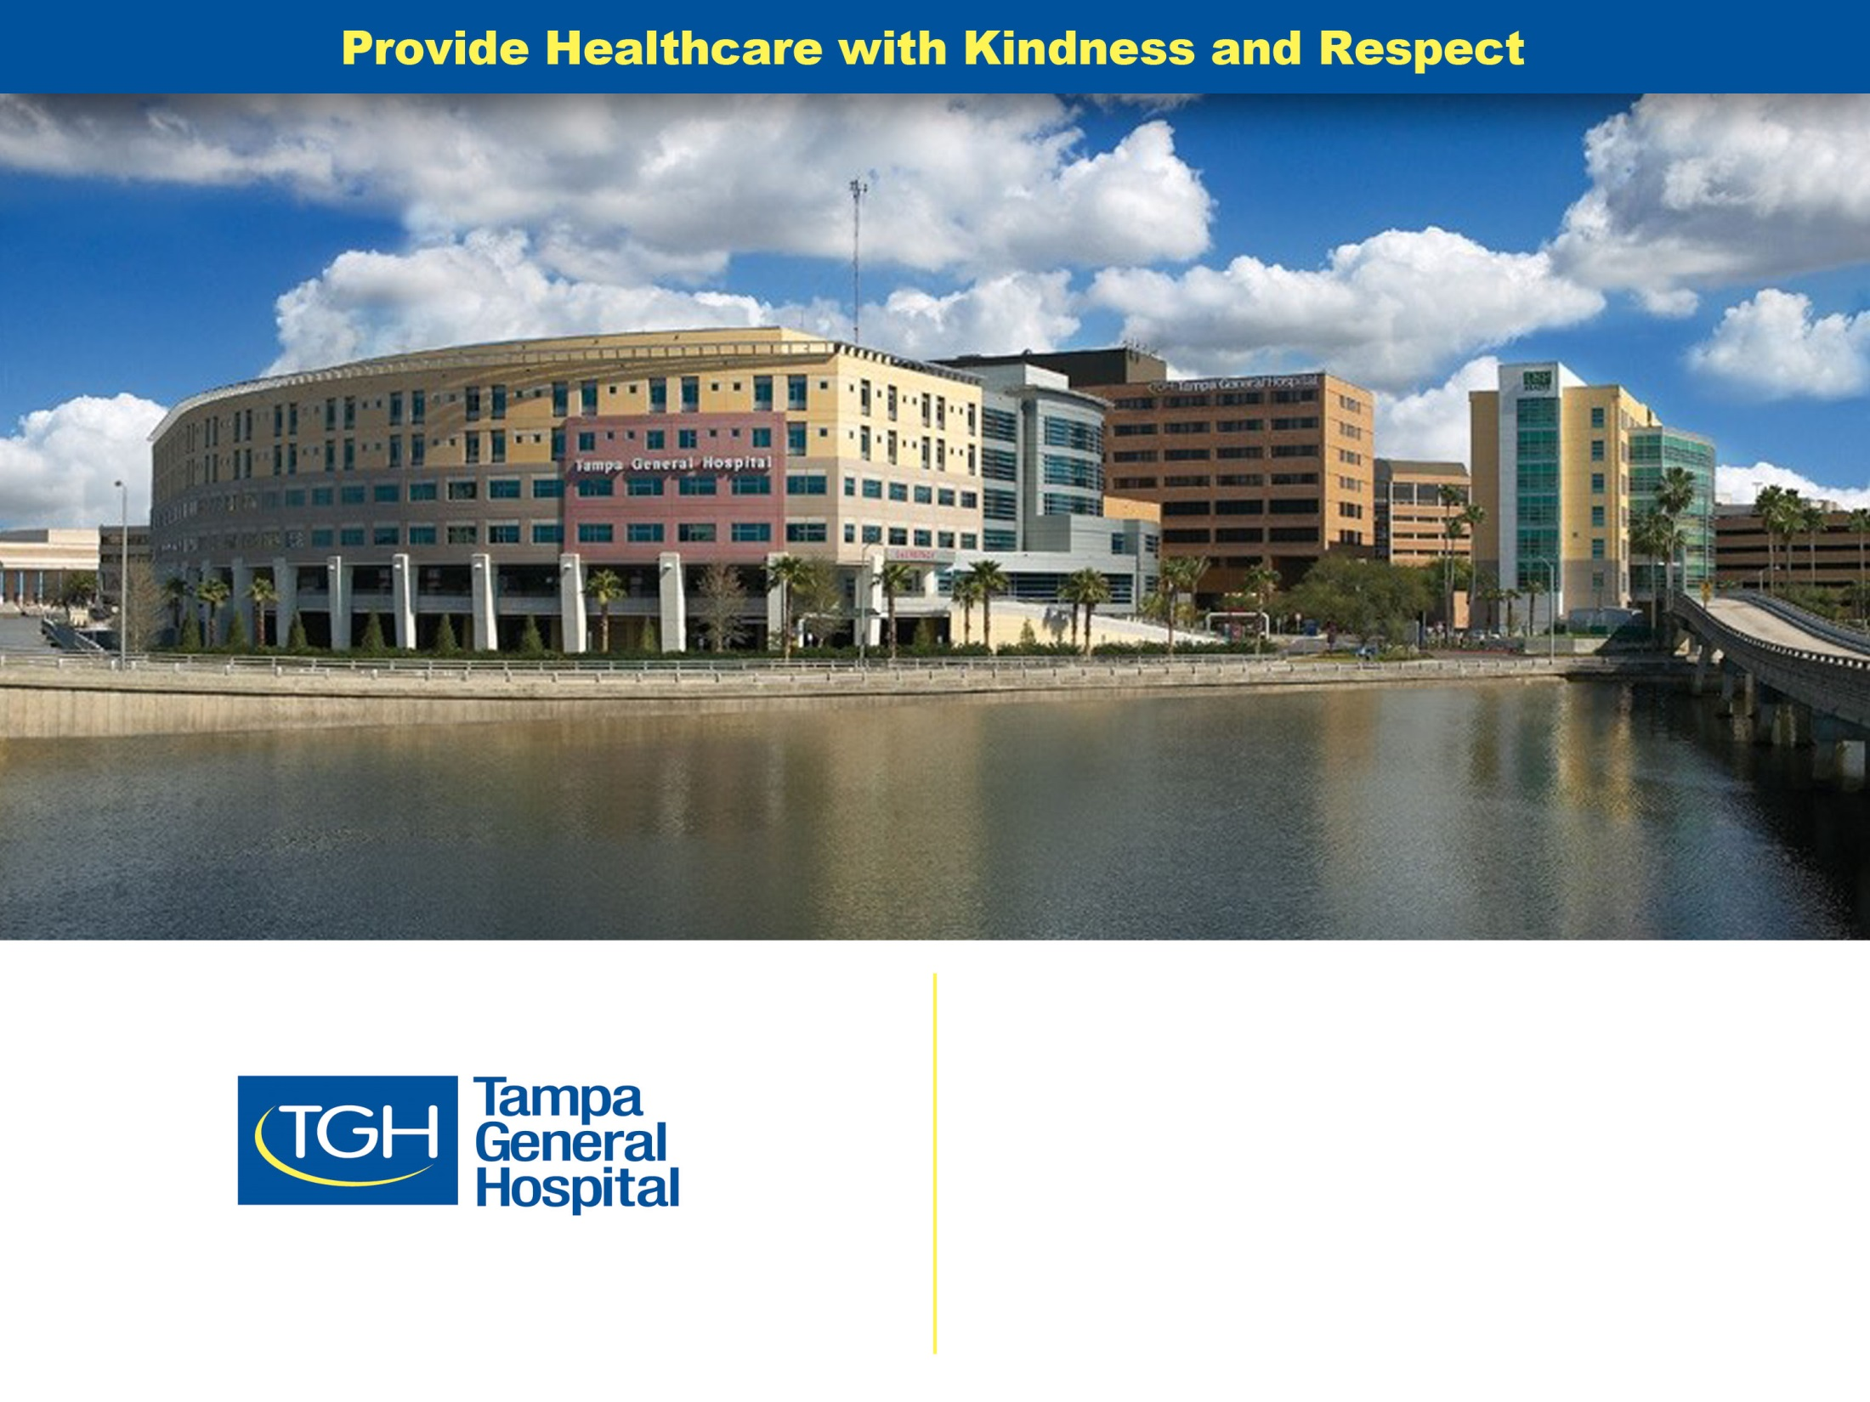
Capturing and Reporting Adverse Events in Clinical Research

Slide 2
OBJECTIVES
Describe Adverse Events, Risks and Problems that can Occur in Human Subjects Research
Compliance with Safety Reporting Regulations in Clinical Research
Identify Current Systems of Patient Care and Patient Safety in Research.
Notes:
It’s all about safety

Slide 3

Adverse Events, Risks and Problems that occur in Human Subjects

Slide 4
Types of Adverse Events
Adverse Events and Adverse Reactions
Suspected,
Serious,
Unexpected
Non Compliance (violations and deviations)
Unanticipated problem
Other ~Research Misconduct

Slide 5
Adverse Events
Any adverse event associated with the use of a drug in humans, whether or not considered related.
  21CFR 314.80

Slide 6
Adverse Events
Any untoward medical occurrence in a patient administered a pharmaceutical product and which does not necessarily have a causal relationship with the treatment

Slide 7
Adverse Event
An unexpected medical problem that occurs during treatment with a drug or other therapy.
Adverse events does not have to be a caused by the drug or therapy

Slide 8


Slide 9
Serious Adverse Events: 6 specific criteria regardless of the relations of the event to the test article
Serious Adverse Events are those associated with the patient’s participation in research that:
Fatal
Disability
Hospitalization
Anomaly
Medically Significant
Life Threatening
Notes:
Serious Adverse Events: 6 specific criteria regardless of the relations of the event to the test article
SAE defined one of more of the following conditions
1.Results in death
2. Life threatening and puts subject in immediate risk of death
3. Results in persistent in significant disability of incapacity
4. Requires or prolongs hospitalization
5. Results in congenital anomaly or birth defect
6. Important medical event that jeopardizes persons health and may lead to one of the above if appropriate intervention did not take place.

Slide 10
Unanticipated Problems involving Risks to subjects or others.
All 3 must be answered Yes
Was it unforeseen or unexpected?
Yes
Is it related or possibly related to study participation?
Yes
Did it cause harm to or lead to a possible increased risk of harm for subjects or others?
Yes
Notes:
1. All three questions must be answered ‘yes’ for the event or problem to be considered an unanticipated problem involving risks to subjects or others
Unexpected in terms of nature severity or frequency) based on the research procedures that are described related documents and in the population being studied
AND
2. Related or possibly related to a subject participation in a trial
AND
3. Suggest that the research places subjects or others at a greater risk of harm (including physical, psychological, economic, or social harm) related to the research than was previously know or recognized.
The reporting pathway for unanticipated problems involving risks to subject or others should be provided in the protocol

Slide 11
Suspected Adverse Reaction (SADR)
Reasonable possibility that the drug caused the event.
It implies a lesser degree of certainty about the causality than an adverse reaction.
Notes:
Reasonable possibility means there is evidence to suggest a causal relationship

Slide 12
Internal and External AE’s
Internal AE’s are those that happen at your site. You hear about them from the patient, investigator or health care providers at the site.
External AE’s are those that happen at another sites that are participating in the study

Slide 13
External AE’s
Site investigators are not often aware of external AEs
.
Notes:
Site Investigators are often not aware of external AE’s since they occur to subjects at other institutions
It’s important to stay in touch with the webinars and newsletters and to read all SUSAR that come to your email and to make sure that the PI is aware of these.
If an external AE or series of events is determined to be unexpected or to represent an increase risk to subjects the study sponsor notifies all investigators of the events. This may also result in a change to the protocol via an amendment or the consent form.
If an external AE or series of events is determined to be unexpected or to represent an increase risk to subjects the study sponsor notifies all investigators of the events. This may also result in a change to the protocol via an amendment or the consent form.

Slide 14
AE’s can include
Physical S/S
Abnormal Lab Values
Changes in v/s or physical exam or ECG
Increase in frequency or intensity (worsening of a condition or illness present before enrollment)
Complications of a surgery or a procedure
Device malfunction or failure
Device user error
Psychological harm

Slide 15
What AE’s are NOT
Procedures or surgeries.
The medical condition that caused the need for the surgery is the AE.
Pre-existing conditions
that do not worsen during the surgery
Notes:
rupture, bleeding is the AE, not aneurysm repair)
Anemia

Slide 16
Question?
Once and AE is captured the severity and relationship of the investigational product of drug can be determined by the clinical research coordinator, if she is a RN?
Notes:
False the Severity and Relationship of an AE/SAE is completed by the PI, not the coordinator. If during an audit it is found that CRC is answering these question, the situation may become very unpleasant. No matter how talented the RC is or how much the PI the RC to complete this for him or her, it remains the responsibility of the physician. In addition to his expertise in this area, it show his or her active involvement and oversight of the subject in the study.

Slide 17
Historical Standards for Human Subjects Protection
Example of Historical Adverse Events are severe.
Human subject protection and GCP along with
Institutionalized policies, and regulations were created to prevent Adverse Events and Research misconduct from repeating
Notes:
Research events have been recorded back as far as the Bible.
When we look at the profound adverse events that have taken place in history we realize how they have
shaped our beliefs, and institutionalized policies, and regulations. And still impact us today
Bible
1202 king of England
1901 Diphtheria antitoxin regulatory Power over antitoxin and vaccine development
1932 Tuskegee study of Syphilis infected sharecroppers deprived of effective treatment
1937 107 deaths mostly children anti freeze
1945 WW2 Medical experiments on prisoners in concentration camps
1947 Nuremberg Code 194
1962 Thalidomide
1966 ethical breaches still occur
1974 National Research act Signed into law
1976 Medical Device Amendment
1978 The National Commission for the protection of human subjection the Belmont report
1980 the Title 21 CFR it continues to be revised and amended
1990 Safe Medical Devises ACT
1999 18 year old died from Organ failure
2000 HIPAA
2005 National registry
Continue to update revise and report CFR

Slide 18

Are study participants in clinical research trials protected ?

Slide 19

Modern Image of Safety in Clinical Trails
Have regulations and policies created a false sense of security for researchers?
Notes:
Discussion Question: Do you think that regulations and policies created a false sense of security for researchers?
Is this enough? We have an Office for Human Research Protection, we do our CITI training.
Are there still gaps in safety? If there are gaps in safety how do they occur?
The competition to get a drug or device to market can be intense.
Science and technology is expanding at such a rapid pace, the drugs and devices and biologics that we are studying are novel.
Absorbable stents?
Drug studies with Monoclonal antibodies are relatively new.
Different therapies and procedures for age old maladies. Example radio frequency oblation of the renal arteries for control of hypertension.
Surgically Implanted device in the trachea for sleep apnea
This is great.. Exciting but what does that mean for those of us conducting the research? We have yet to see the outcome in human subject
We need to be Vigilant in the way we conduct research. Report AE as soon as they occur. Good coordinator practice. Stay in touch with you patient, make sure they are followed in the window. And report AE’s as listed in the protocol.

Slide 20
Examples of Unethical Behavior
In 2012, GlaxoSmithKline (GSK) pleaded guilty to criminal misconduct for several scathing incidents of health-care fraud
Concealed clinical trial data that revealed an increased risk of heart attacks in patients taking Avandia
Notes:
A majority of people responsible for unethical behavior in recent clinical trials have ties to the manufacturers of pharmaceutical drugs and medical devices. The profit margins of these companies often jeopardize transparency in clinical research, which is of vital importance to the people whose lives and well-being depend on their products.
All too often, drug manufacturers pollute the canon of medical literature with biased studies — much to the dismay of physicians who need accurate trial results to make informed health care decisions for their patients. Lawsuits also have exposed companies that buried unfavorable results from clinical trials evaluating the safety of their drugs and devices.
In 2012, GlaxoSmithKline (GSK) pleaded guilty to criminal misconduct for several scathing incidents of health-care fraud.
Prosecutors found the multinational, multibillion-dollar drug manufacturer had bribed doctors to sell its products and marketed several drugs outside of their federally approved indications.
In addition, the company for years concealed clinical trial data that revealed an increased risk of heart attacks in patients taking Avandia, a former blockbuster drug for type 2 diabetes.
The lawsuit resulted in a $3 billion settlement, one of the largest in U.S. history.
Numerous other examples of unethical research and reporting have come to light as common practice in the pharmaceutical industry. Selective reporting of clinical trial results has become a major issue, with extensive research demonstrating that between 25 and 50 percent of clinical trial results remain unpublished several years after completion.
Pharmaceutical companies also have a troubling inclination to design studies to pursue marketing goals rather than help patients or improve collective medical knowledge.

Slide 21
Ethical Duty of Minimizing Risks to Subjects.
Being a Patient Advocate- starts before the study has even started.
Notes:
Review of the Protocol for safety and ethical consideration before a TGH application has even been submitted.
Have the regulations and policies created a false sense of security for researchers?

Slide 22

Compliance and Safety Reporting and Regulations

Slide 23
Question?
Can a sponsor add components to the AE definition in the study protocol? ( in addition to the standard definition)?
Notes:
YEs, the sponsor may add a few other components to the Definition of an AE in the Protocol. Be careful to note your study protocol definition of an AE/SAE in terms or what to capture and not to capture?

Slide 24
Why Collect Adverse Events Data?
Safety
Benefits and Risk Evaluation
Package Inserts
Notes:
AE’s are collected in Clinical Trials to:
Determine the safety profile of a drug, biologic or device~are there any significant concerns that would prevent the product or test article from being used in it’s intended patient population. The Investigator Brochure contains all AE’s reported in trials of the test article to date and describes the number of times specific were reported
Evaluate the benefits and risks of a product~ US food and Drug administration recognizes the need for medical risk-benefit judgment to be made as part of the process of approving a test article for marketing. In this evaluation the FDA considers whether the benefit of the test article outweigh its known side effects and potential risks as well as the need to answer remaining questions about it’s effectiveness. Included in the FDA assessment of the risk-benefit ratio is a careful evaluation of all AEs reported during Clinical trials.
and provide information for the package inserts if the product is approved for marketing ~ Sponsors use AE information to prepare package inserts and user instructions for marketed drugs, biologics and devices. Package inserts, based on scientific facts gleaned from clinical trials , are written to instruct health care providers and patients of potential side effects. The Package inserts also serve as a reference by which the FDA can evaluate additional AE’s reported after marketing. When post marketing AEs not listed on the package insert reported, additional investigations may be required and /or the product may be recalled.

Slide 25
Role and Responsibility Reporting AEs/ SAEs
Investigator ?
Research Nurse/Research Coordinator ?
IRB ?
Sponsor ?
FDA ?
Notes:
What is our role in providing safety in Clinical research? Patient safety minimize risk. How can we do this?
Primary Investigator under federal regulations have an obligation to report certain AEs that affect subject participating in a clinical study. Collecting and reporting to the sponsor or designee all pertinent information about AEs as required by the protocol.
The protocol includes a plan for safety monitoring and reporting AEs and Unanticipated problems.
The protocol outlines the procedure for communicating this information as well as local institution reporting responsibilities to the IRB and other regulatory groups.
Clinical trials require a different Mindset for clinical practice regarding reporting AEs
IRB after initial review and approval of the study the IRB conducts the continuing reviews. The frequency of the reviews is determined by the degree of risk presented by the study. These fulfill the IRB’s responsibility to assure the protection of the rights and welfare of the human subjects.
Sponsor Responsibility: are responsible to both expedited and routine reporting of the AE’s to the FDA. Reporting continues after the test article has been approved. Sponsors are specifically required to notify all participating investigators and the FDA in a written safety report of any adverse experience associated with the use of the drug that is both serious and unexpected. Sponsors are responsible for keeping each participating investigator informed.

Slide 26
Question
Despite what is written in the protocol, who has the final word on what should be submitted to the IRB?
The Sponsor ? or The IRB?
Notes:
The IRB.
As long as you have clear documentation from your IRB off their reporting requirements , the CRA/ sponsor will accept that. Your IRB requirements will then be documented in the Monitoring Visit notes to show that there is no deviation. Follow the study protocol in terms of capturing the AEs and notifying the sponsor. Be aware that the IRB and Sponsor can have different requirements.
Hint: copy of the IRB requirements along site the Case report Forms in the patient binder.

Slide 27
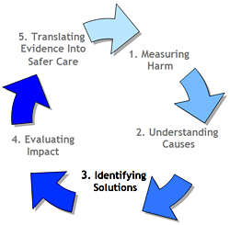
Notes:
Clinical Research coordinator must always have process of evaluation in their awareness.

Slide 28
FDA Guidance for Clinical Investigators, Sponsors and Event Reporting to IRBs
Improving Human Subjects Protection
March 2005 Public Hearing
Notes:
Concern was raised by the IRB community that increasingly large volumes of individual adverse events reports submitted to the IRB often lacked context and detail.
That this large volume of nonspecific information was actually inhibiting rather that enhancing the ability of the IRBs to protect human subjects.
Know your protocol and sponsor and IRB requirement in regard to what is reportable. The definitions stated above are general

Slide 29
Question
True or False ?
A Primary Investigator can refuse to categorize something as an AE?
Notes:
True a PI can trump the sponsor. No matter what is in the protocol if the PI flatly refuses to categorize something as an AE the sponsor needs to be made aware of this and thorough clear documentation must present in the chart as to why the PI feels this event should not be an AE.
The sponsor cannot make the PI agree to an AE at anytime. They can strongly suggest and recommend it be captured.
Clear documentation and good communication present with the sponsor. This decision will be documented in the Interim Monitoring Visit Report and the in the F/U letter. If you do not see it documented in the IMV ask the CRA about this.

Slide 30

Currents System of Care and Patient Safety in Clinical Research
Notes:
We know our responsibilities and regulations. What about the systems that we work in, the hospitals, Universities the departments departments private industry

Slide 31
3 Most Common Causes of Medication Related AE’s are Caused by:
Failure to standardize ( procedures and equipment)
Failure to implement safety Checks and Safe Medication Practice
Failure to coordinate Research Staff with Clinical Staff providing care

Slide 32
Safe Medication Practice
Independent double Checks
Communication and Coordination
Informatics and Automation
Notes:
Independent double Checks~
identified high risk medication and procedures
IV pumps and Calculations
Communication and Coordination~
Establish roles and Responsibility in Workflows
Increase amount of Patient education and access to coordinator
Access patients health literacy and understanding
Informatics and Automation~
Managements of Alerts
Procedure for Connecting data in computerized data bases

Slide 33
Institution System Safety Reporting
Notes:
Tampa General
USF

Slide 34
Examples
Classification of System Failure
Knowledge Deficit
Lack of Standardization
Health Care provider Communication
Work Flow
Labeling and Documentation
Computers/automation/informatics
Notes:
Unsafe labeling,
Knowledge transfer,
Lack of Standardization,
Health Care Provider Communication.
How important is it for all members of the health care team to know that the patient is in a research study? For example the come into the ER and end up in ICU. Do you want or need to Know? How many trials have you been involved in where documentation that you the research coordinator communicated the study participants involvement in the study
Lack of standardization
Work Flow. The more prepared and routine you can make your work flow the less likely you are to encounter a study protocol deviation or AE.
How many of you have notice that the first participants in a study inevitable have something go wrong.
A dry run or talking over the visit with a college can help.
It’s also important to know work flow of the environment your patient is going to be in. ICU routine labs times, stat results, etc. More cooperation from the staff the less disruptive you are to their routine.

Slide 35
Minimizing Risk to Subjects
Know Risks ~Unknown Risks
Allergies
Exclusion Criteria
Drug Food Interaction
Monitoring
Results exams and procedures
Infrastructure Risk
Policies and Procedure
Equipment
Roles and Responsibilities
Culture

Slide 36
Managing Adverse Events
Identify and prevent avoidable harm
Know the risks of the trial
Anticipate problems
Notes:
Identify and prevent avoidable harm
Safe Medication Practices
Safe Expertise
Systems thinking
Know the risks
know your patient history/ physical
idiosyncrasies
Exclusions

Slide 37
Corrective Action and Quality improvement
Take action to minimize the likelihood of reoccurrence
The IRB reviews all proposed actions for appropriateness
Notes:
Take action to minimize the likelihood of reoccurrence of the events should be based on the system failure that led to the event
The IRB reviews all proposed actions for appropriateness and likelihood to reduce the risk in the system
Action Plans Primarily based on education counseling, discipline, emails, and other temporal measures may be insufficient to prevent future failures

Slide 38
General Safety Reporting Tips
If in doubt….. Clarify and Report!
If reportable with available information, report immediately ( do not wait for additional information or conformation)
If a cascade of events, report causal events not each individual symptom

Slide 39
Take Home Message
Conduct a Self Assessment of Medication Practices
Develop a reporting system medication errors in clinical research
Prevent 3 most common causes of medication related problems
Begin or review research quality assurance program
Notes:
Conduct a Self Assessment of Medication Practices
Develop a reporting system, data base or analysis plan to capture and report medication and medication errors in clinical research
Prevent 3 most common causes of medication related problems
Begin or energize HRPP quality assurance program

Slide 40
Questions?

