Slide 1
Using Schedule Planner in OASIS
(how to find and register for classes)

Slide 2
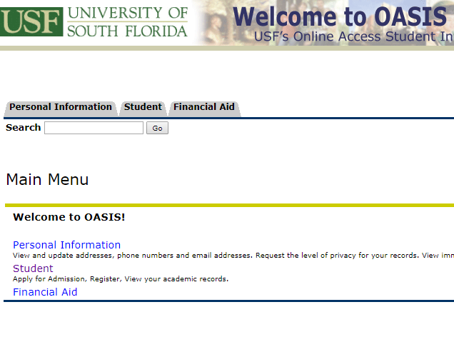
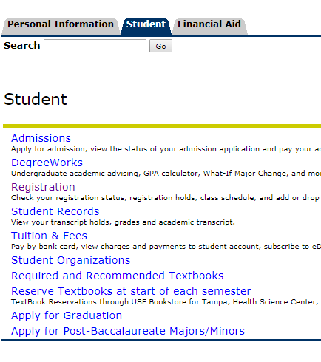
Click “Student”
Click “Registration”

Slide 3
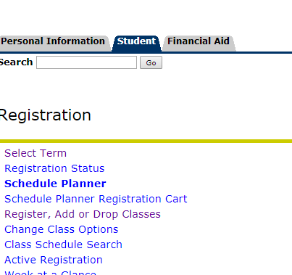
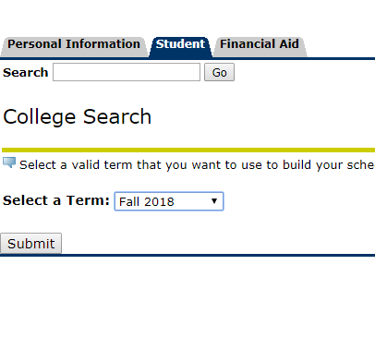
Click “Schedule Planner”
Select the correct term

Slide 4
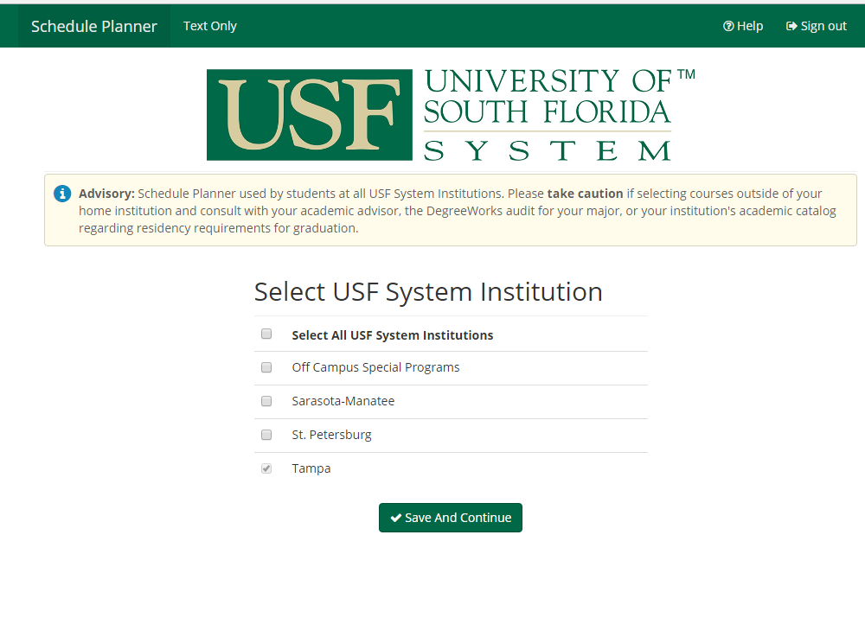
Select “Tampa” and click “Save and Continue”

Slide 5
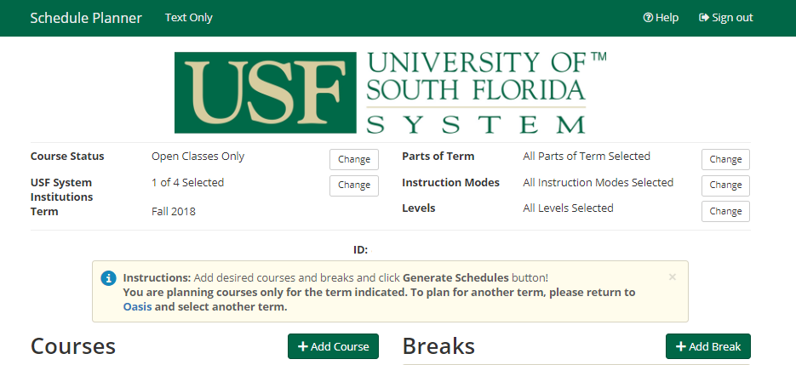
Click “Add Course”

Slide 6
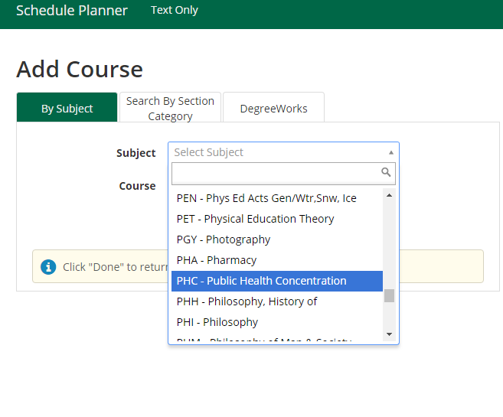
For Subject, go to PHC courses…

Slide 7
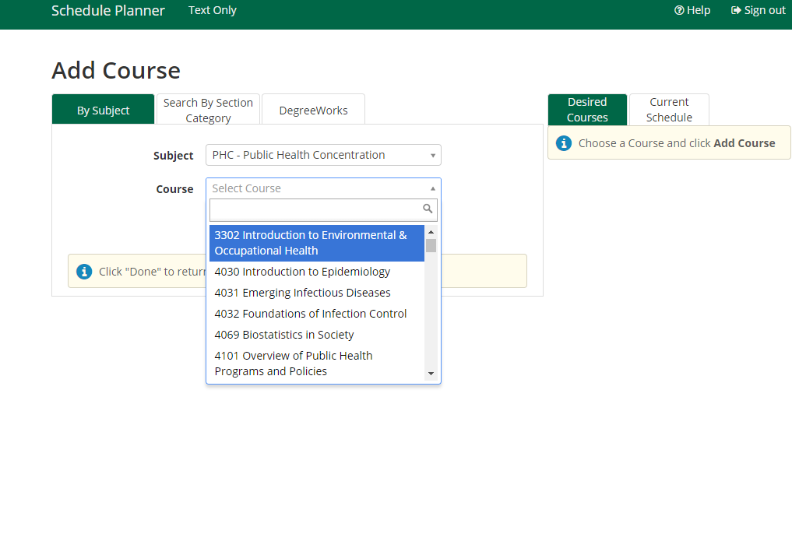
In our example, we are going to find and register for PHC 3302 and PHC 4101.
You will register for the courses your Program Plan indicates.
If you are not sure which courses to take, please consult with your Academic Advisor http://health.usf.edu/publichealth/apply/graduate-admissions

Slide 8
Once you have found one of your courses, click “Add Course”

Slide 9
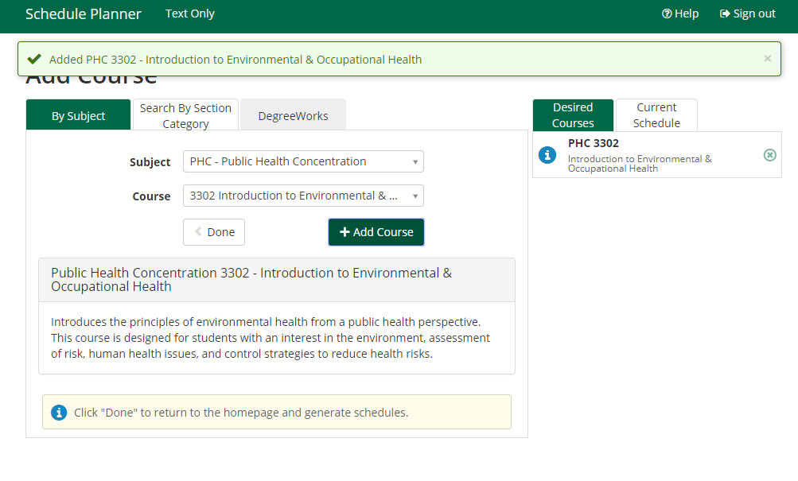
Once a course is added, it shows up here…
Now repeat for PHC 4101.

Slide 10
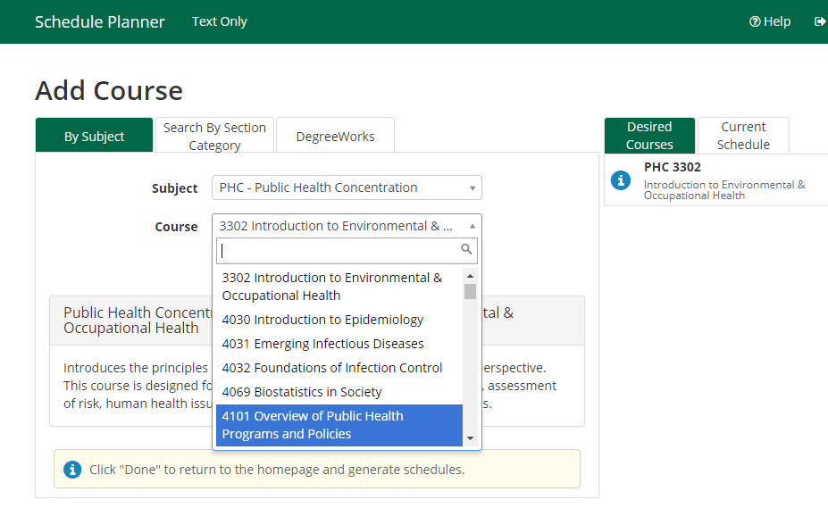
Select “4101” and then “Add Course”

Slide 11
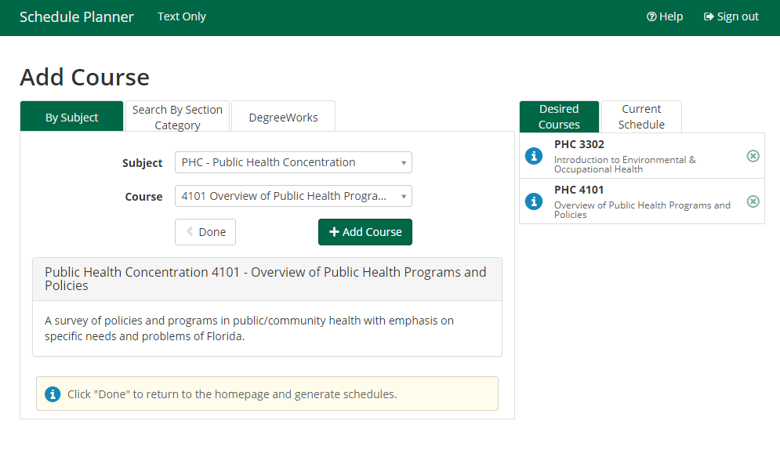
Both courses are now listed after clicking on “Add Course”
To progress, click “Done”

Slide 12
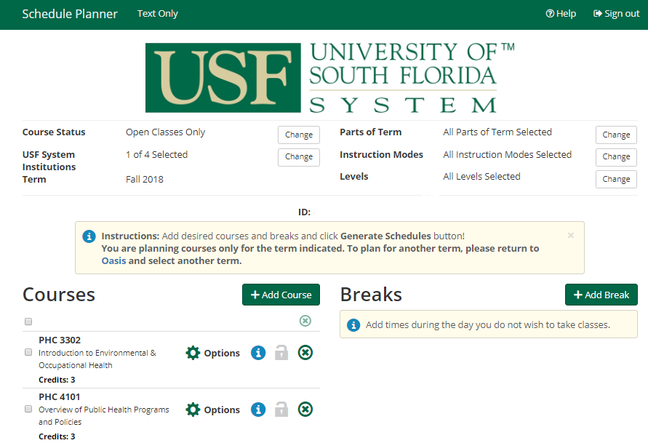
Click on “Options” to learn more about the schedule

Slide 13
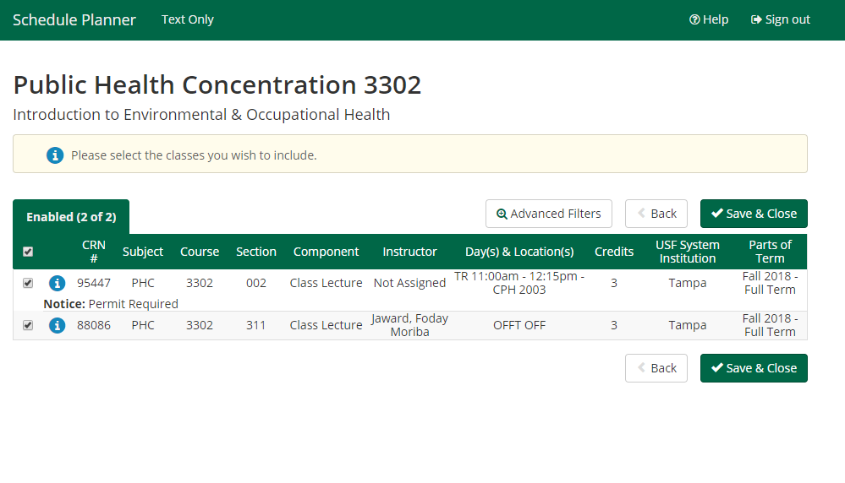
Any notices including required permits are listed here
Indicates an online course

Slide 14
Click “Generate Schedules” to see your schedule options

Slide 15
*For some semesters, you may not have this many schedule options. View your schedule options and choose the one that works best for you.
Once you see the schedule you like, click “View” on that specific option again.

Slide 16
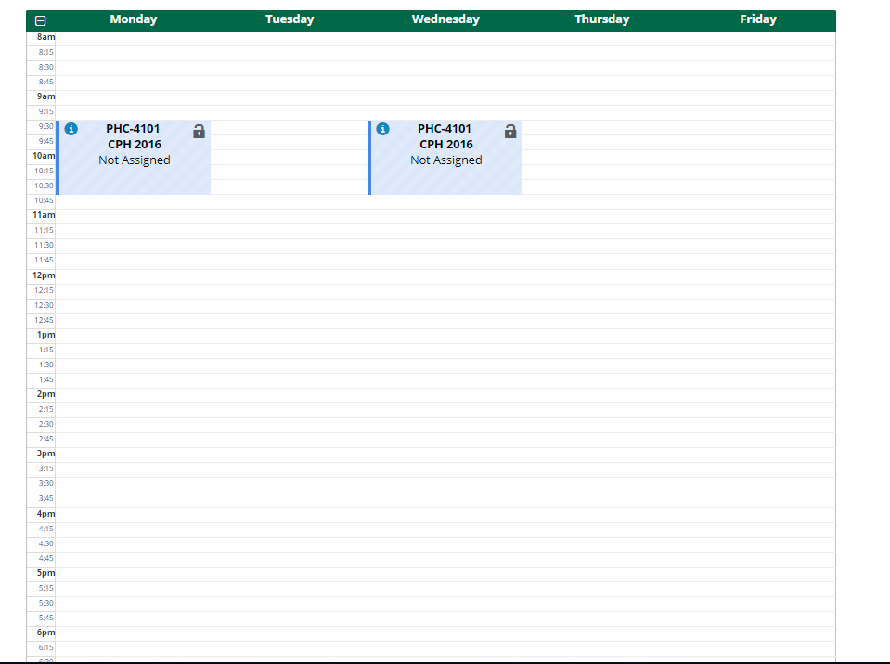
Where is
PHC 3302????
One of the two courses is online (PHC 3302), so it will not show up in a weekly schedule.

Slide 17
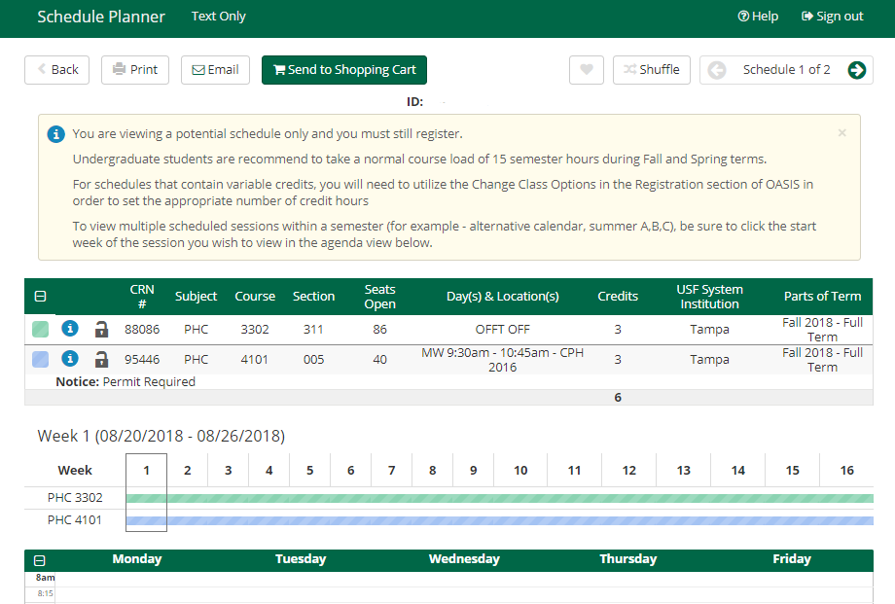
If you like the schedule, click “Send to Shopping Cart”

Slide 18
Open Oasis in a new tab and click Student > Registration > Register, Add or Drop Classes > scroll to bottom of page*
Copy & Paste the “CRN #” into the boxes.
When done, click “Submit Changes”
If you have any additional questions, please email your Academic Advisor directly.

Slide 19
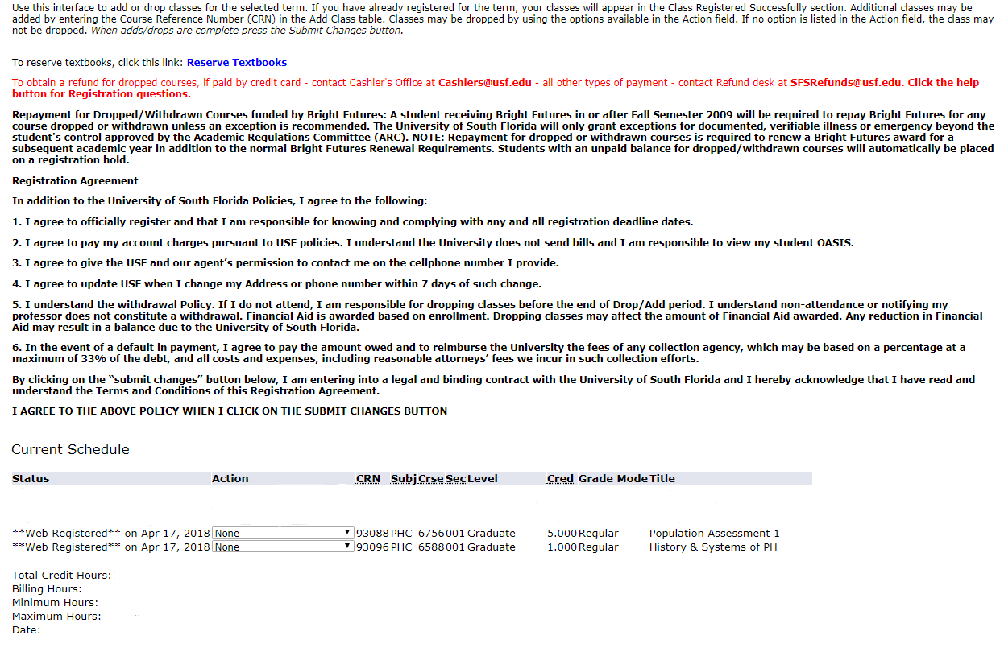
Final result

Slide 20
We know it may be a bit daunting at first, but please explore the program or the help videos located in the “Help” section.
If you have any trouble, please call our front desk 813-974-4633 or contact your Academic Advisor:
http://health.usf.edu/publichealth/undergrad/advising

