Slide 1
State of the College
September 26, 2016

Slide 2
Our Theme: Focus
Focus on
Our faculty, staff and students
Our what we do
Our strategic plan, Vision 2022
Our future

Slide 3
Our Faculty, Staff & Students New to the College
Insert our new faculty & staff
I assume you’ll put Joanne Bohn here?

Slide 4
Our Faculty, Staff & Students Faculty Recognitions
John Adams, Distinguished USF Professor
Michael White, Distinguished USF Professor

Slide 5
Our Faculty, Staff & Students Faculty Promotions
Allison Oberne, Instructor II
Deirdre Orriola, Instructor II

Slide 6
Our Faculty, Staff & Students Faculty in New Roles
Ellen Daley named Associate Dean for Translational Research and Practice
Goal of the office is to create research and practice opportunities for faculty as well as to bring PhD & DrPH students together for broader doctoral training

Slide 7
Our Faculty, Staff & Students Faculty in New Roles
Rita Debate (HPM) named Assistant Vice-President for Health and Wellness

Slide 8
Our Faculty, Staff & Students USF Awards
Jaime Corvin (GLH) – Teacher of the Year (PHSA)
Russ Kirby (CFH) – USF Research Achievement Award
Jane Lundh (EPB), USF Outstanding Staff Award

Slide 9
Our Faculty, Staff & Students Faculty Recognitions & Awards
Dennis Kyle (GLH) – American Association for the Advancement of Science (AAAS) Fellow
Bill Sappenfield (CFH) – John MacQueen Annual Lecture Award (Assn of MCH Programs)
Rita Debate (HPM) – Editor-in-Chief, Journal of Health Behavior Research
Wil Milhous (GLH) – Professor Emeritus, Walter Reed Army Institute of Medicine
Adewale Troutman (CFH) – Outstanding Leadership in Health & Wellness Award from 100 Black Men

Slide 10
Our Faculty, Staff & Students Student Awards
Lissette Ortiz (BSPH) receives Benjamin A. Gilman Scholarship to study abroad in Costa Rica
Cauchavius Watts (HPM) awarded Robert Wood Johnson internship
Vickie Lynn (CFH) and Tobi Ozoya awarded FPHA scholarships
Isabella Chan (GLH) received the Inter-American Foundation Grassroots Development Fellowship to work in Peru
Jillian Edge (PHP) receives Fulbright in Malaysia

Slide 11
Our Faculty, Staff & Students Student Awards
Malinee Neelamegam (EPB) awarded Endeavor Research Fellowship on Aging & American Association of University Women International Fellowship
Mindy Spyker (GLH) received Borlaug Fellowship for research in Tanzania
Shana Geary earned Council of State and Territorial Epidemiologists Applied Epidemiology Fellowship
Rema Ramakrishnan (EPB) won student paper award at the Society for Pediatric and Perinatal Epidemiological Research conference

Slide 12
Our Faculty, Staff & Students Alumni Recognition
Michael Pentella (EOH) received 2016 COPH Outstanding Alumni Award
Elizabeth Dunn (GLH) receives 2015 Human Rights Award
Catherine Burney (CFH) and Richard Hartman (EOH) received USF’s Fast 56 Award
Terrill Curtis () appointed Presidential Management Fellow at Social Security Administration
Seena Salyani (HPM) named CEO of Gastro Florida

Slide 13
Academics Enrollment in COPH Courses

Slide 14
Academics Masters Programs

Slide 15
Academics New Programs, New Accreditations
Our Master of Health Administration (HPM) was fully accredited by CAHME
Our new MSPH in Genetic Counseling (GLH)was approved and in the final stages of accreditation
The program will provide a unique concentration on public health; medical genetics & genomics; health education, communication & counseling; and direct patient care
Applications being accepted for a Fall 2017 start
Our new MPH in Nutrition & Dietetics and Internship Program was provisionally accredited by ASCEND
Taking applications for a Summer 2017 start, expected to have a first cohort of 30 clinical dieticians mixing online education with clinical internships

Slide 16
Academics Doctoral Programs

Slide 17
Academics Enhancing Doctoral Education
Established first cohort of all incoming doctoral students, participating in 1 credit hour research methods course (18 doctoral students)
Creating an on-going program of skill-building & professional development throughout the year for PhD students
Tested & implemented a model of increasing research skills and writing opportunities for doctoral students through the creation of small, topic specific groups
Students participate through taking role of 1st author on a paper & co-author on all other papers
4 groups, 15 students, resulting in multiple paper & abstracts submitted & accepted

Slide 18
Academics BSPH Program

Slide 19
Academics BSPH Program
Completed a comprehensive review of the BSPH program
Cross-walked BSPH competencies with all UG courses
Reduced the number of UG courses and minors
Divided UG courses into 3 categories: required, content and skills
Initiated the process for a 2+2 degree with Hillsborough Community College
Created and taught mini-mester courses during winter and spring break
Increased study abroad opportunities for undergraduates

Slide 20
Focus on Research Proposal Submissions (add proposals + requests)

Slide 21
Research Awards & Expenditures

Slide 22
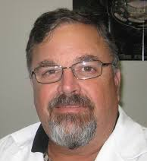
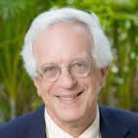
Research 6 COPH Faculty in the Top 20 Investigators at USF

Slide 23
Research New Faculty, New Awards
Cheryl Vamos (CFH) – MCH Pipeline Training Program (HRSA)
Troy Quast (HPM) – National Institute of Aging
Alicia Best (CFH) – H. Lee Moffitt Cancer & Research Institute, Inc./American Cancer Society
Rays Jiang (GLH) – H. Lee Moffitt Cancer & Research Institute, Inc.
Kevin Kip (EPB) – Dept. of the Army

Slide 24
Research Supporting Student Research

Slide 25
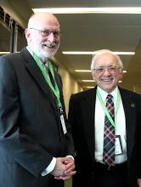
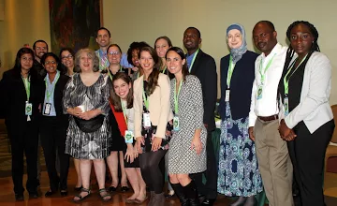
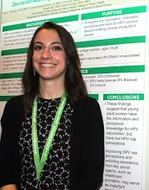
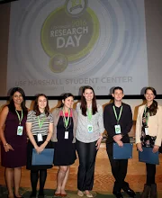
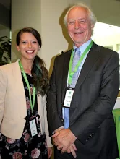
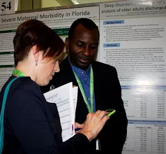
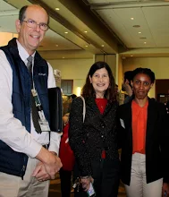
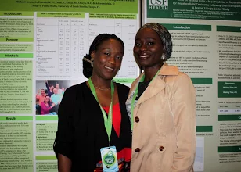
Student Research USF Health Research Day 2016

Slide 26
Student Research USF Health Research Day
80 COPH students participated at USF Health Research Day
Student Oral Awards & Presenters
Allison Roth (GLH doctoral student), receives USF Health Vice-President’s Award for Outstanding Graduate Student Oral Presentation
Ngozichukwuka Agu, CFH doctoral student
Best College of Public Health Poster Presentations
Omonigho Michael Bubu, EPI-BIO, doctoral student
Athena Failla, GH, MSPH
Kate LeGrand, GH, MPH student
DeAnne Turner, CFH, doctoral student
Tora Suggs, CFH, MPH student
Kristina Harand, EOH, MSPH student
Christopher Rice, GH, Post-doctoral student

Slide 27
Research USF Graduate Student Research Symposium
16 COPH graduate students contributed to the 8th annual USF Graduate Research Symposium
Lindsay Womack (EPB), received an award for her outstanding poster presentation
14 COPH grad students submitted abstracts for the poster competition, and 2 students participated in the three minute oral thesis competition

Slide 28
Research Engaging Undergrads in Research
Marie Bourgeois (EOH) served as mentor for the CREATTE program, where 22 students taught 595 children/youth in 25 classes at 3 elementary and 1 middle school
Twelve BSPH majors presented posters at the Undergraduate Research and Arts Colloquium. Two students won awards
Mary Alao, mentored by Alison Oberne
Raaven Goffe, mentored by John Adams
Thanks also to Marie Bourgeois, Humberto Lopez Castillo, Elizabeth Dunn, Patrick Gardner, Laurie Wright, Dennis Kyle, Amy Stuart, Christopher Rice, Ryan Michael and Steve Maher for their roles in mentoring our students

Slide 29
Focus on Global Initiatives
With the looming closure of the Peace Corp Masters International program, COPH submitted a proposal to participate in the Peace Corps Coverdell Fellows Program
Bob Novak (GLH) secured active partnerships with the Cambodian National Malaria Committee, the WHO (Mekong Delta Region), USAID/PMI Cambodia, & the Clinton Health Advisory Initiative Cambodia
Tom Unnasch (GLH) chaired the Ugandan Onchoceriasis Elimination Expert Advisory Committee
Arturo Rebellon (GLH doctoral student) developed an app to help fight Zika

Slide 30
Global Initiatives
This fall we celebrate our 10th Anniversary of working in Panama
Over the past year we remained active academically
International Health Education course (spring 16) and International Perspectives in Women’s Health (summer 16) offered in-country experiences
COPH UG students participated in a study abroad experience in Summer 16
Arlene Calvo (CFH) taught the fifth Clinical Research Diplomado for Panamanians interested in continuing education
As well as through research activity
Working with the Gorgas Institute on CDC’s regional study on influenza
Represented on the Gorgas Institute’s Bioethics Committee
Submitted numerous proposals for funding

Slide 31
Focus on The Chiles Center
The Chiles Center celebrates its 20th anniversary this year of serving Florida’s women, children and families
The Center broadened its mission to expand its focus on women’s health
During the past year, the Center received $7.8M in external funding, the highest funding level in its history
The Florida Perinatal Quality Collaborative received the 2016 Sapphire Award for an Organization, recognizing leadership, excellence and innovation in non-profit community health leadership and programming in Florida.

Slide 32
Focus on #whyCOPHrocks
The College’s Office of Engagement & Constituent Relation has worked hard to share our stories of #whyCOPHrocks
COPH’s social media presence is growing fast, with a 32% increase in likes for our Facebook page, 235 new followers on Twitter since January, 154 new followers on Instagram since November, and more than 2,600 members of the College’s LinkedIn page.
Karen Liller (CFH)’s video on injury prevention, “Together we will change lives”, directed by Zack Murray, was recognized as a Bronze Winner in the 37th Annual Telly Awards, which honors local, regional, and cable TV programs for outstanding work in video productions, online commercials, videos and films.

Slide 33
Focus on Faculty Governance
COPH’s Faculty Assembly completed the review and update to its governance manual, creating three empowered committees:
Education, Dr. Steve Mlynarek, Chair
Research, Dr. John Adams, Chair
Faculty Affairs, Dr. Marti Coulter, Chair
In the spirit of better coordinating college governance, the chairs of these committees are now part of the College leadership team, attending monthly executive committee meetings
Thanks to Tom Mason, for serving as the President for the past 6 years and for shepherding this process to completion
Congratulations and welcome to Aurora Sanchez-Anguiano as the new President of the Faculty Assembly

Slide 34
Focus on Efficiency
The College has spent the last year focused on reviewing our internal processes and prioritizing those we want to move to move into Archivum, our electronic business process management system
In our first year we:
Created a student record to house key student data in one place
Developed the program of study, for MPH, MHA, MSPH, PhD and DrPH students
Transitioned the student hiring process to an electronic environment
Automated academic forms for contract courses
Change of mentor process
In year two we will continue to look at our academic forms and processes, with an eye to those that enhance our preparation for our self-study

Slide 35
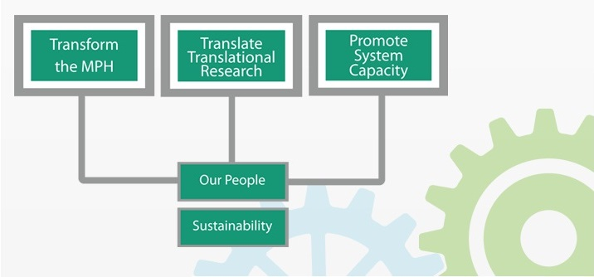
Focus on Vision 2022 Our Strategic Plan (insert slide)

Slide 36
Vision 2022 How are we doing?

Slide 37
Vision 2022 How are we doing? (insert slide)

Slide 38
Vision 2022 Transforming the MPH: Key Successes
Fall 14 launched TMPH core with 37 students
Fall 15 enrolled 43 students in TMPH core
Fall 16 have 149 students in History & Systems and 120 students in Population Assessment II

Slide 39
Vision 2022 Translating Translational Research: Key Successes (pubs & presentations)

Slide 40
Vision 2022 Enhancing System Capacity: Key Successes
COPH hosted conferences in the US and beyond on a variety of topics including:
3rd Vaccinology in the Tropics (Panama)
Ecology & Evolution of Communicable Diseases (Ecuador)
The role of dental providers in preventing HPV and oropharyngeal cancers
24th Social Marketing Conference
29th Annual Graven’s Conference on the Physical and Developmental Environment of the High Risk Infant
5th Annual Florida Perinatal Quality Conference
Service Dogs and Veterans Mental Health panel
The New Face of Food Insecurity: OCEP Research that Matters Symposium

Slide 41
Vision 2022 Enhancing System Capacity: Key Successes
Through our conferences and other programs, COPH provided training and continuing education to over 41,000 individuals.
Key contributors to this were:
OSHA Training Institute
Harrell Center for the Study of Family Violence
The Chiles Center
The Florida Prevention Research Center

Slide 42
Vision 2022 Our People: Key Successes
The College continues to invest in the professional development of our faculty and staff through
Faculty (3) and Staff (11) professional development awards
16 programs to enhance teaching skills, including use of technology
2 programs to enhance research skills of our faculty
4 general professional development programs
We are very proud to recognize all our faculty and staff who have earned the CPH!!!

Slide 43
Faculty and Staff Certified in Public Health
Claudia Aguado Loi | Ann Armstrong | Brian Bernard
Tom Bernard | Saran Bonnema | Emily Bronson
Somer Burke | Jaime Corvin | Elizabeth Dunn
Donna Haiduven | Ellen Kent | Karen Liller
Humberto Lopez-Castillo | Matawal Makut | Jennifer Marshall
Alison Oberne | Kathleen O’Rourke | Deidre Orriola
Mahmooda Pasha | John (Tory) Peek | Kay Perrin
Donna Petersen | Zachary Pruitt | Saba Rahman
Arturo Rebollon | Jill Roberts | Aurora Sanchez-Anguiano
Bill Sappenfield | Ryan Tokarz | Adewale Troutman
Ronee Wilson | Janice Zgibor

Slide 44
Vision 2022 Our People: Key Successes
COPH created a Diversity committee, chaired by June Lake
Over the past year, the College and the Diversity Committee
Developed metrics for our strategic plan that reflects goals across faculty, staff and students
Created a web site to highlight our activities, programs and goals
Hosted several programs focused on diversity topics
Organized training programs on Title IX and the Violence Against Women Act
Designed and delivered the College’s first Diversity Climate Survey
Vision 2022nhancing System Capacity:

Slide 45
Our People Our People: Key Successes
Diversity Climate survey was completed by 496 individuals, including
88 faculty
118 staff
1 certificate student
157 undergraduate students
93 masters students
39 doctoral students

Slide 46
Our People Diversity Initiatives in COPH
The findings indicate areas in need of attention and improvement
First, in our interactions and our behaviors
Second, in our curricula

Slide 47
Our People Diversity Initiatives in COPH
Our interactions and our behaviors
While scores are generally high, we fall short in a few areas
Respondents perceive or experience
apathy (9.4%)
bias (13.64%)
discrimination (4.9%)
exclusion (7.61%)
isolation (8.28%)

Slide 48
Our People Diversity Initiatives in COPH
When asked what these perceptions are based on, those who responded to the earlier question indicate:
Race (16 people)
Ethnicity (12 people)
Political ideology (10 people)
Age (9 people)
Gender (9 people)
Other (17 people)

Slide 49
Our People Diversity Initiatives in COPH
Our curricula
College course content regarding diversity has been:
Adequately addressed in all courses (27.75%)
Adequately addressed in some course (36.47%)
Not adequately addressed in any courses (4.59%)
Not Applicable (31.19%)

Slide 50
Our People Diversity Initiatives in COPH
Our curricula
The areas that need to be addressed include:
Gender Identify (68 people)
Race (58 people)
Ethnicity (54 people)
Body image (51 people)
Religious beliefs (50 people)
Disability (44 people)
Political ideology (36 people)
Socio-economic level (35 people)

Slide 51
Our People Diversity Initiatives in COPH
 | Agree | Neutral | Disagree
The majority of the members of the College community are interested in issues of diversity and inclusion | 68.86% | 27.74% | 3.41%
The majority of the members of the College community are interested but struggle with how to handle these issues | 40.61% | 40.88% | 18.49%
Issues of diversity and inclusion are seen as the responsibility of ALL College community members | 66.42% | 29.44% | 4.14%
I would recommend the College as an environment that welcomes diversity | 79.81% | 18.24% | 1.95%

Slide 52
Vision 2022 Sustainability: Key Successes

Slide 53
Vision 2022 Sustainability: Key Successes
Increased donations to support student scholarships
College received $, raising our rolling three-year average to $66,948, an increase over last years average of $44,046
Increased the amount of college funds used to support students to $2,748,739
Over the last three years, the College has invested over $7.7M in support of our students

Slide 54
Focus on Our Future
Focusing on our future has three key, intertwined elements
Investing in our faculty
Internal and external pressures on our financial resources
Our upcoming accreditation

Slide 55
Our Future Investing in our Faculty
College leadership believes that key to our shared future is the ability to recruit and retain our outstanding faculty
Due to years of no or minimal raises and market increases, we have a challenging salary compression problem for many of our ranked faculty
To remedy that, COPH leadership benchmarked time in rank and the tenure earning percentage of our faculty against national data
We submitted the plan to the union; pending approval by the union and USF’s Board of Trustees, we intend to implement the plan in January 2017
Over three years, we expect to invest directly in and create opportunities for over $1M in salary and benefit increases
More details will follow once the CBA has been approved and ratified

Slide 56
Our Future Our Resources (insert all source budget)

Slide 57
Our Future Our Resources: Challenges (insert table for summer & fall enrollment)

Slide 58
Our Resources: Challenges
Internally
Enrollment decreases mean decrease in tuition revenue
Impacts our tuition collections, differential tuition, and fees that support ETA & online education
Internal competition for enrollment along with increased external competition
USF’s RCM model still in development & planning FY 18 implementation
USF’s RCM model for the allocation of F&A in development for FY 17
USF Health VP reviewing cost allocation models for expenses to support USF Health
Externally
Shifting focus to performance based funding
State budget office projecting deficits beginning in FY 19
Federal funding climate remains challenging

Slide 59
Focus on Our Upcoming Accreditation
CEPH will visit us in December 2018
We are in the first round of reviews under the new criteria!
Our self-study will be due in early spring 2018
We will know in the next few weeks what the final criteria will look like and will have to get to work immediately
We will convene a self-study oversight group this fall and will use our new committee structure and any ad hoc groups we need
But first, we must continue and bring to conclusion the discussions we have had for the past year

Slide 60
Our Upcoming Accreditation
Over the past 18 months, we have had many conversations about the challenges we face
We convened faculty workgroups to review our degree programs (BSPH, MPH, PhD), and to consider how we teach and how we evaluate the quality and effectiveness of our teaching, the PHP program, how we use technology to augment the educational experience of our students, and how we will develop our faculty

Slide 61
Our Upcoming Accreditation
We discussed the challenges we all face with our workload
We agreed that we need to be more efficient in how we work
To that end we:
Hired professional academic advisors for our MPH students
Eliminated redundant faculty credentialing processes
Streamlined admissions for the MPH degree program
Began moving processes into Archivum

Slide 62
Our Upcoming Accreditation
Goals of the extensive criteria revision process:
Assure quality
Increase flexibility
Reduce reporting burden
Increased flexibility means we have important decisions to make

Slide 63
Our Upcoming Accreditation
Sweeping changes to CEPH accreditation criteria, combined with the reality that we just do not have the time or resources to do everything, means that we must complete the review of our academic portfolio
We have 53 separate concentrations
We have up to 35 variations of our dual degree programs
We have 27 certificates
And CEPH will likely require at least one unique faculty member per each of these – which means we do not have enough faculty to meet this requirement

Slide 64
Our Upcoming Accreditation
Beyond resource questions, we will need to address new criteria around curricula including
Concentration or track competencies (all degrees)
Applied Practice Experiences (MPH and DrPH)
Integrated Learning Experiences (MPH and DrPH)
MSPH and PhD requirements
And around academic and career advising

Slide 65
Our Upcoming Accreditation
And around
Community engagement
Workforce development
Faculty extramural service (need those AFAR’s to be complete!)

Slide 66
Focus on key upcoming events
COPH’s Length of Service Award Ceremony on November 18th, where we will recognize 47 COPH faculty and staff
Other?

