Slide 1
State of the College
October 13, 2015

Slide 2
Today’s Overview
The year that was
Highlight new initiatives for 2015-16
Moving our College forward
Notes:
We will review the past year through the lens of our strategic plan, Vision 2022.
We will look at several key strategic areas that we working on this year.
And finally we will discuss the process by which we are ensuring our College is at the forefront of public health education

Slide 3
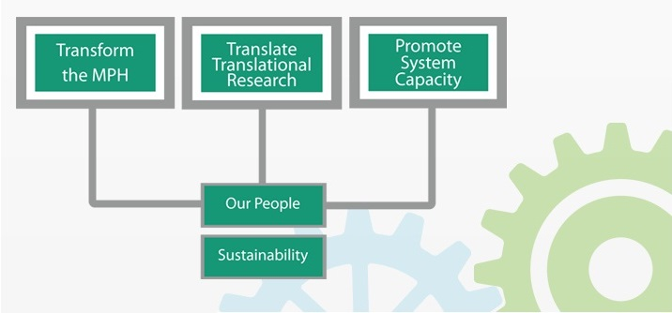
Strategic Vision 2022
Transform
the
MH
Translate
Translational
Research
Promote
System
Capacity
Our People
Sustainability

Slide 4
Strategic Plan Indicators Data
Notes:
We have 5 goals
Total of 16 objectives and 59 indicators today. This is a living plan, and with our strategic plan oversight committee, we will continue to review our plan and update it to ensure it reflects who we want to be.
Of the 59 indicators, to date:
12 have been met
2 have not been met
10 are not due to be met yet – ie due by Fall 2016 for example
23 are trending positively to support that trajectory
12 are trending downward and we need to attend to them

Slide 5
Transforming the MPH
Notes:
Goal: Provide an MPH core education that is integrative, comprehensive, and interdisciplinary, while allowing for flexibility based on prior learning and professional development goals
We have 2 objectives with 3 total indicators
To date we have:
1 met
2 Not due and in progress

Slide 6
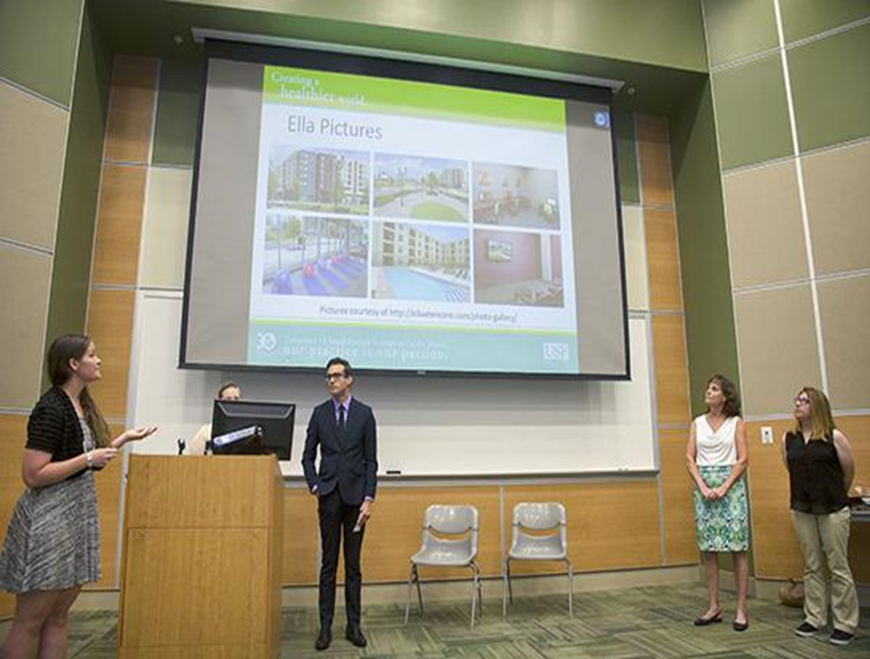
Transforming the MPH
F14 launched MPH core with 37 students
F15 43 students enrolled in TMPH
Goal is to have all incoming MPH students (online and on-campus) enrolled in the TMPH core by F16
Notes:
In July, the first group of TMPH students made their final presentations for their community-based projects before moving on to the concentration coursework

Slide 7
Other Academic Highlights
#21 ↗ #16 USNWR
New MPH food safety & social marketing concentrations
Revised global disaster management, humanitarian relief & homeland security
Notes:
COPH remains a leader in online education, with over 5,000 students taking online courses contributing to their bachelors, masters, and doctoral degrees as well as certificate programs.
USF was voted among the most friendly universities for student veterans
The USF Office of Veterans Affairs named the COPH the most veteran-friendly College at USF
USF’s BSPH program earned the #1 spot on College Factual’s “Top 10 Veteran-Friendly Public Health Schools” list published in Military Times

Slide 8
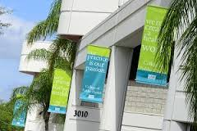
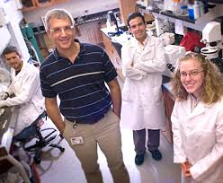
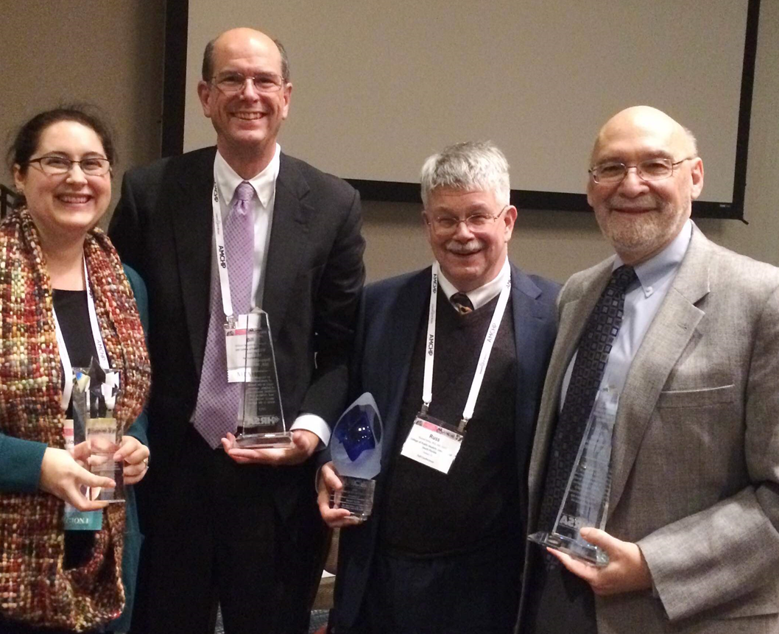
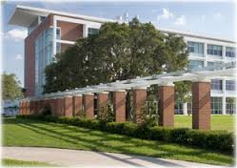
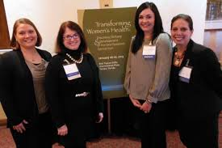
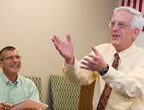
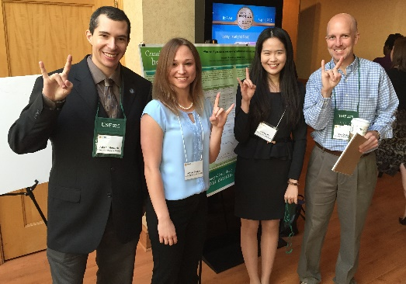
Translating Translational Research
Goal
The USF COPH will be known as a leader of interdisciplinary, transformational research
Notes:
Goal: The USF COPH will be known as a leader of interdisciplinary, transformational research
It is about creating an environment that supports interdisciplinary research, about disseminating knowledge to the scientific and lay community, and about working with our community partners

Slide 9
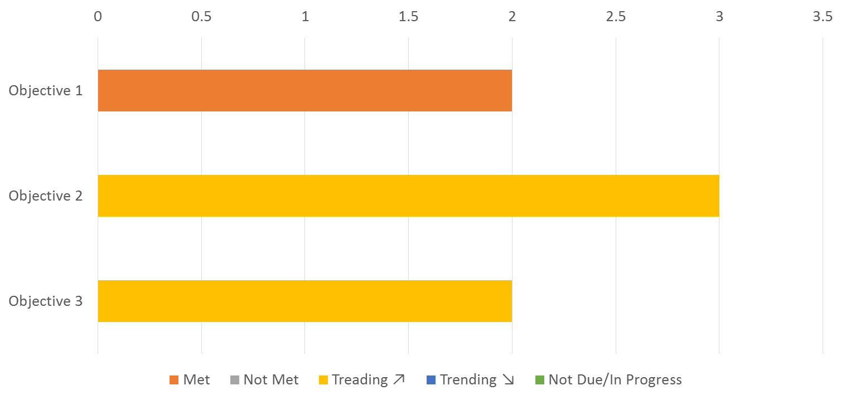
Translating Translational Research
Notes:
The goal has 3 objectives and 7 indicators
To date we have:
2 met indicators
5 trending positively

Slide 10
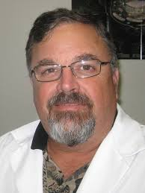
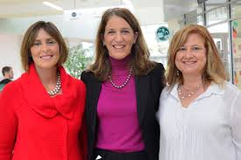
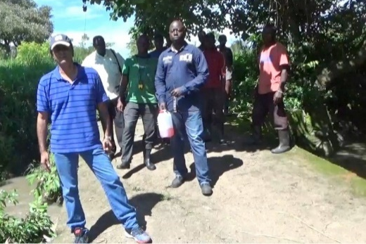
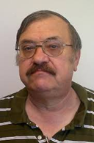
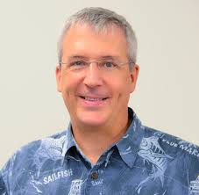
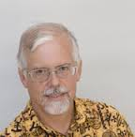
Translating Translational Research
A PEFECT 10 FOR BRAIN-EATING AMOEBA
NIH scored a perfect 10 for a $425K grant to identify fast acting drugs for deadly infections caused by free-living amoeba (FLA) which could total $1.7 million over 5 years.
NAVIGATORS ARE NATION’S BIGGEST AND BEST
Program received $5.9M of a three year $17.2M award to support our Navigators. Received $5.38M in 2014 and $4.2M in 2013. Florida has signed up more people for than any other state in the nation and has the largest award in the nation (by over $2.0M)
GATES EXPANDS SUPPORT OVER $16M TO DATE
$400K seed funding for $7 million per year multi-year malaria eradication initiative using GIS in Zambia, Cambodia and Haiti. $1.8M extension of novel liver-stage malaria. NCE for enabling technologies of vivax malaria culture. NCE for Rive Blindness Eradication

Slide 11
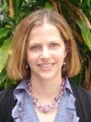
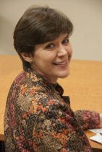
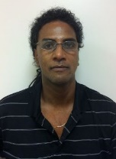
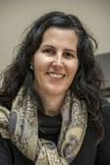
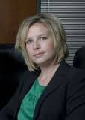
FY15 Multidisciplinary Internal Grant Awards
Amy Alman: Development and Pilot Testing of an Asthma Self-management Mobile App to Improve/Promote Adherence to Treatment and Asthma Outcomes. Co-Authors: Kathleen O'Rourke Andrew Brian Raij (COE), Marisa Couluris (COM), James Lindenberger
Julie Baldwin:The Syndemic Nature of HIV/AIDS Among Indigenous Populations in Latin America: Risk and Resilience. Co-Authors: Dina Martinez Tyson, Martha Coulter, Lauri Wright, Arlene Calvo, Ismael Hoare, Ricardo Izurieta
Ben Jacob: Eigenvector Extrapolations and Stochastic Cartographis abstractions for inperpolation of county-level hyperEndemic Tuberculosis foci in Florida. Co-Authors: John Sinnott (COM), Ulyee Choe (COM), D.A. Holt (COM)
Dinorah Martinez Tyson: Psychometric Assessment of a Supportive Care Needs Measure for Hispanic Female Cancer Survivors. Co-Authors: Ellen Daley, Susan McMillan (CON), Claudia Aguado Loi, Coralia Vazquez Otero, Clement Gwede (COM)
Cheryl Vamos: Development of an Innovative Patient-Centered Intervention to Improve Sexual Reproductive Health Literacy. Co-Authors: Jaime Corvin, Stephanie Marhefka, Ellen Daley, Kay Perrin, Joseph Puccio (COM)
Notes:
We allocated almost $500,000 of our resources to 5 projects that include 18 faculty from CFH, Global Health, and Epidemiology & Biostatistics along with faculty from the Colleges of Engineering, Medicine and Nursing

Slide 12
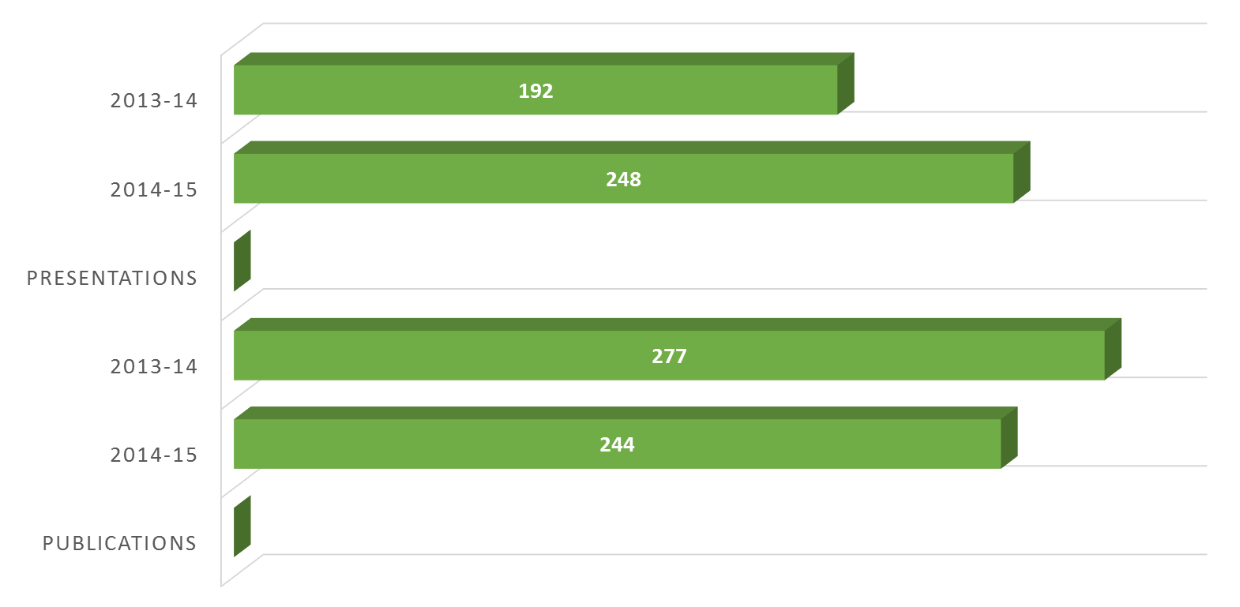
Translating Translational Research
Notes:
Presentations increased to 248 from 192 last year.
Publications decreased from 277 last year to 244 this year. The average publication per tenure track faculty was 4.88.

Slide 13
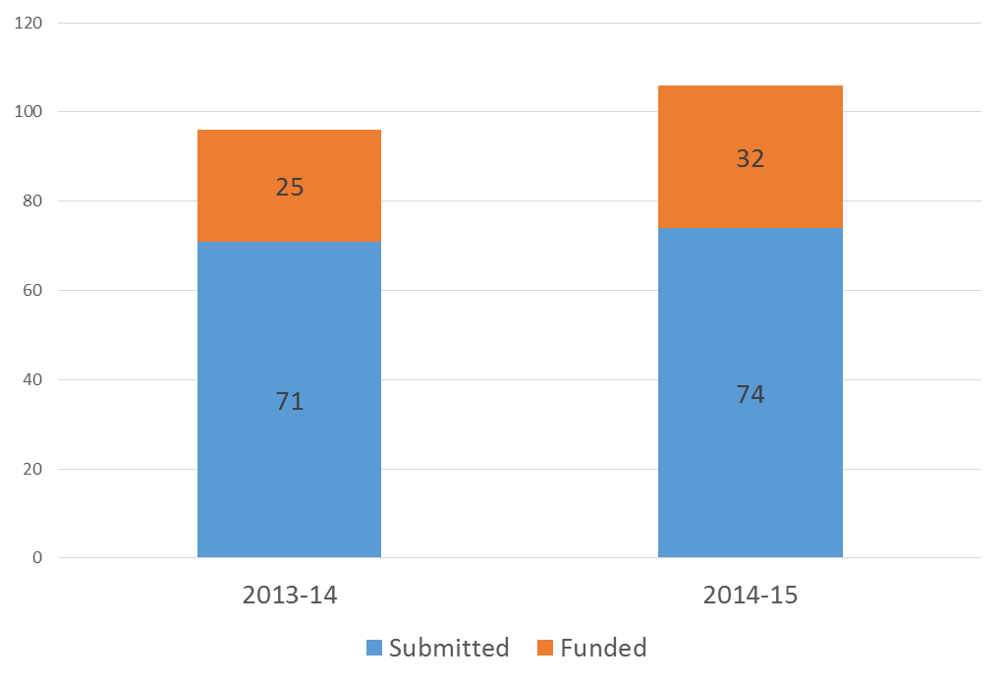
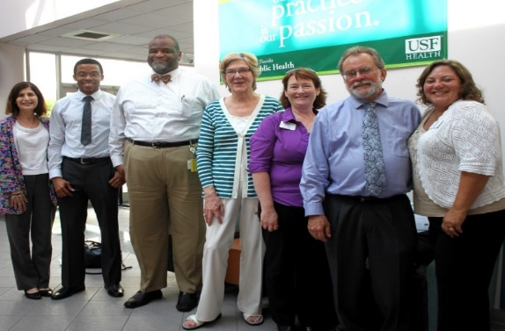
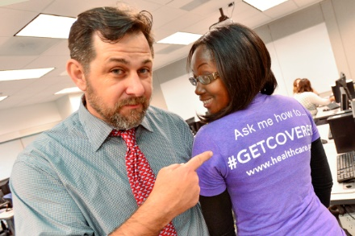
Community Partnerships
Proposals Submitted vs. Awarded
Notes:
COPH faculty submitted 74 proposals with our community partners in 2014-15.
These projects include our work with health care Navigators, our global partners,
and a unique project where COPH faculty worked with the Hillsborough county health department to coordinate 5 local public health projects.
Champions for Children, Boot Camp for New Dads: Improving Child Outcomes through Fathers
Feeding America, Meals for Minds: Expanding and Evaluating a School Pantry Program
Florida Institute for Community Studies, Campos a Casa/Fields to Home: Assessing Rural Workers’ Awareness of Environmental and Occupational Health Safety
Latinos Unidos para un Nuevo Amanecer (LUNA), ENLACxC – Educacion y Navegacion para Latinos Adectacios pr al Cancer
Tampa Bay Network to End Hunger, Raising Awareness of the Hunger-Health Connection among Food-Insecure Individuals and the Tampa Bay Community

Slide 14
Notes:
A catalyst for health, the college has a strong international presence. We have hubs in Panama, Ecuador and Kenya, as well as field schools in Belize and Malaysia.
We have had 55 faculty and students conduct research and studies in 17 different countries.

Slide 15
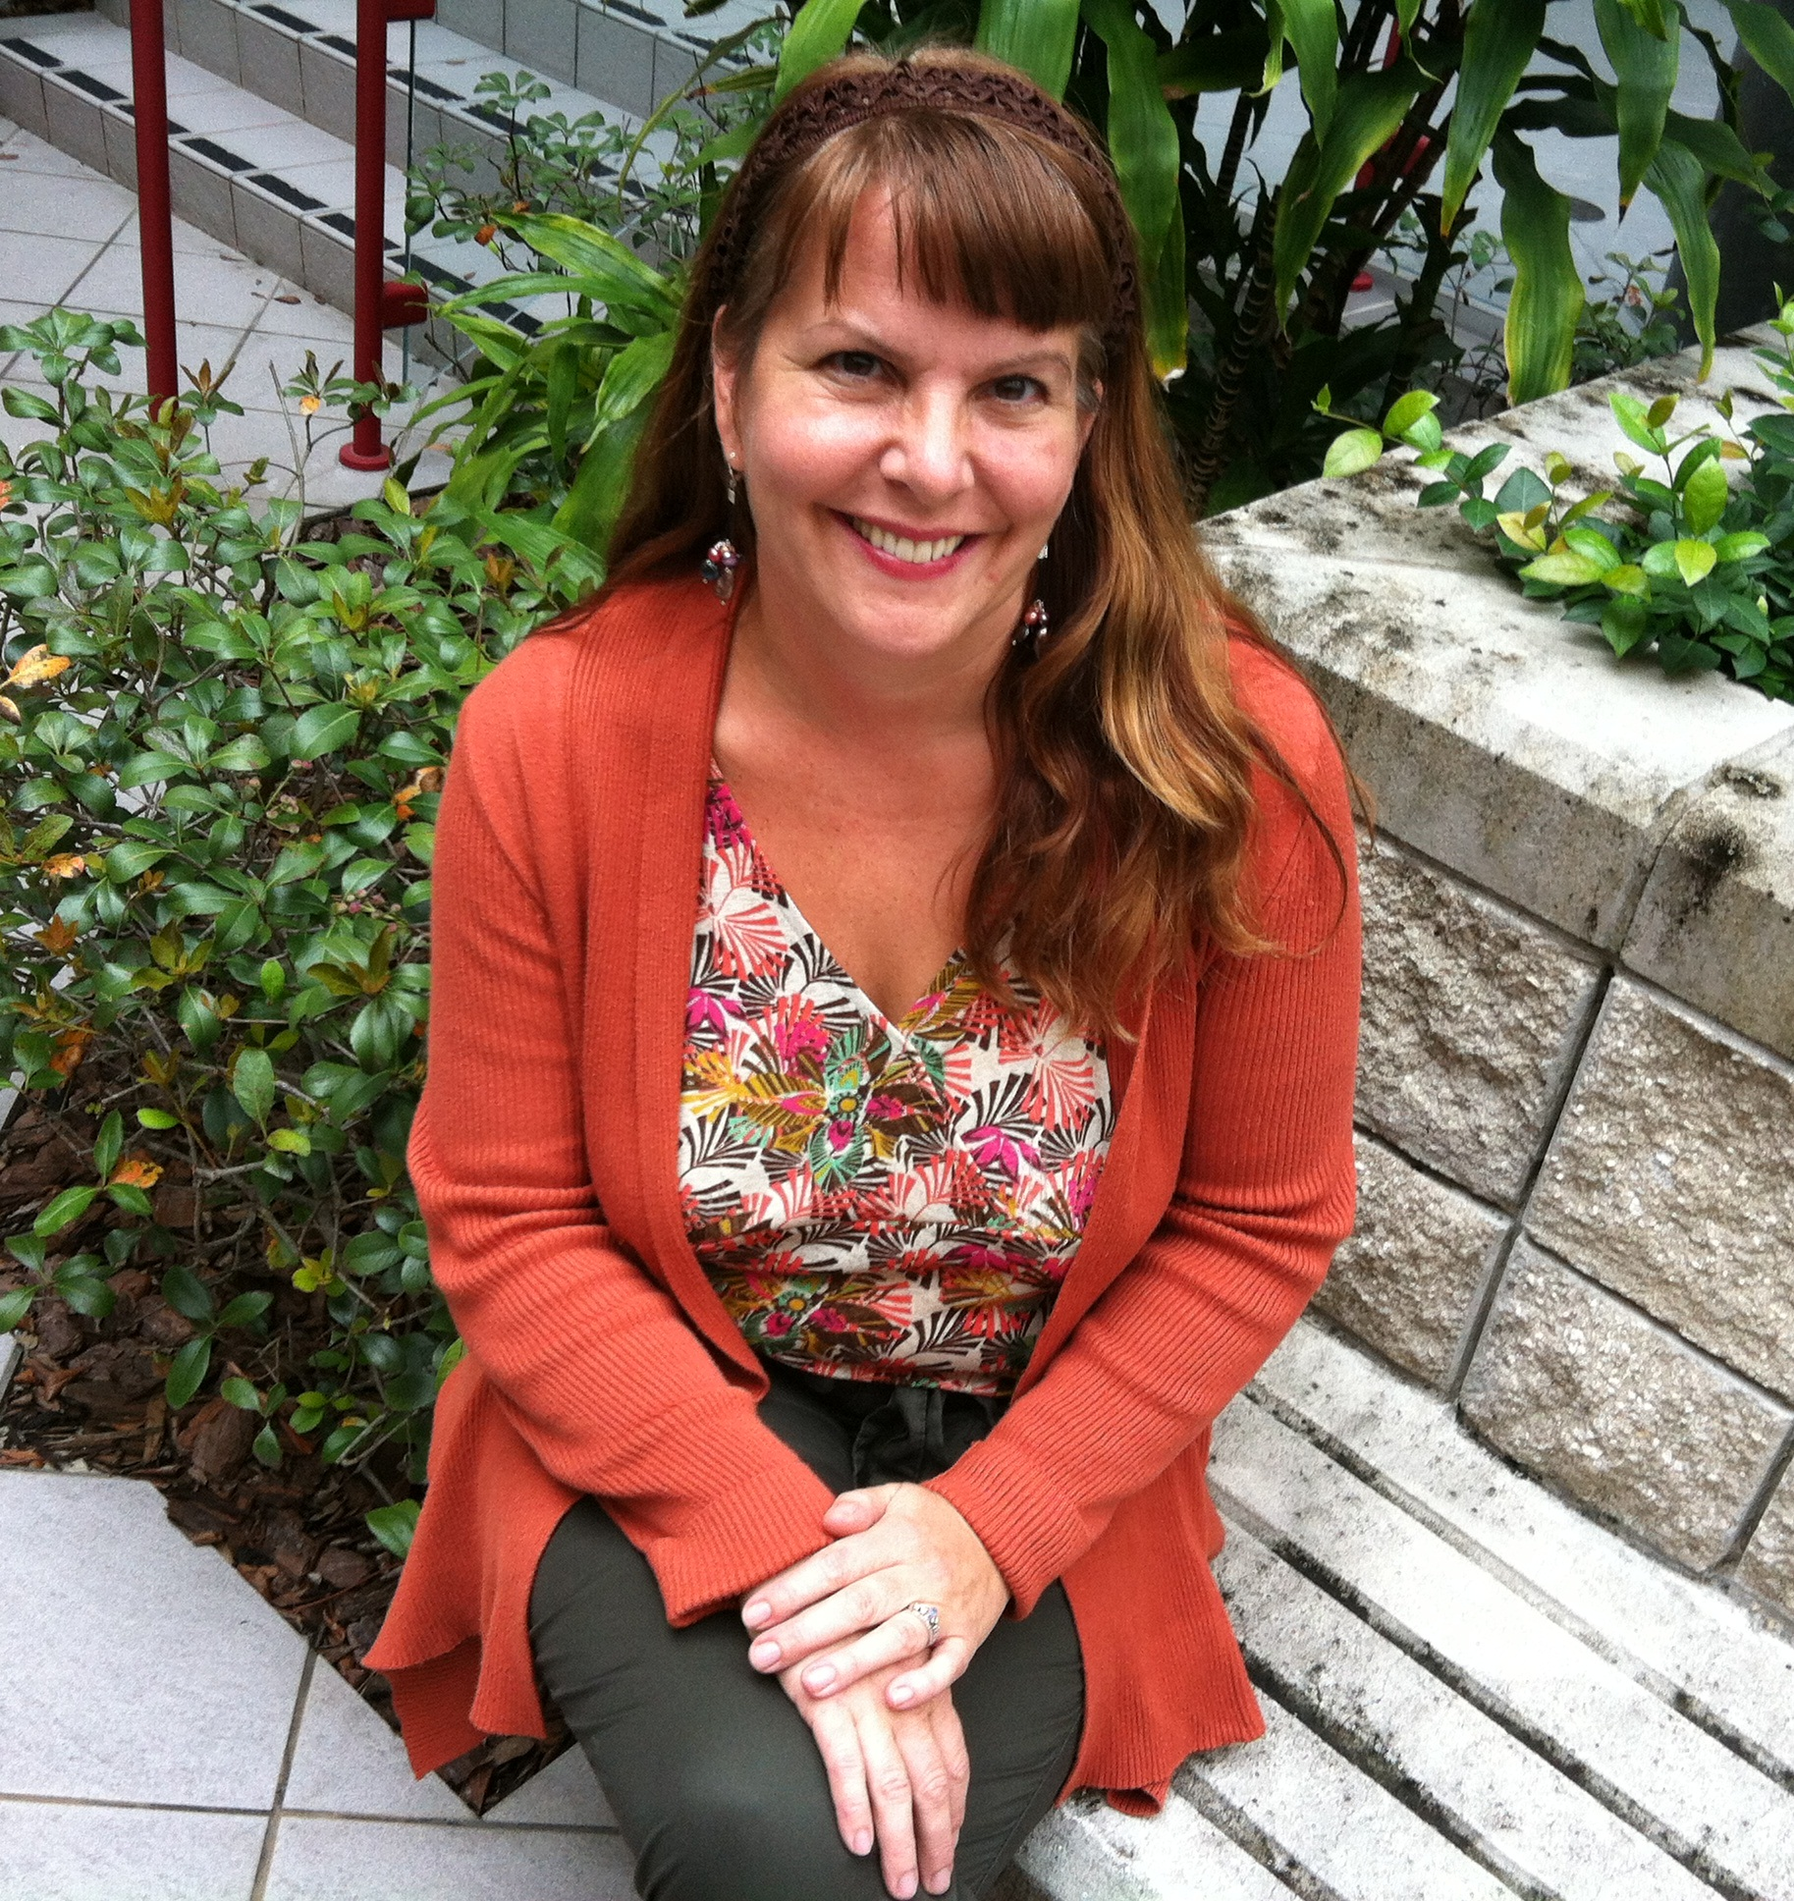
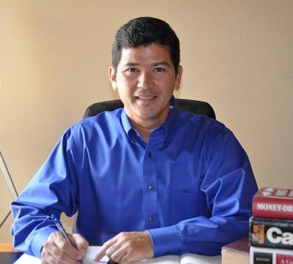
Translating Translational Research in Action
Barbara Orban (HPM) wrote a policy brief for the Florida College of Emergency Physicians on the overuse of emergency departments by uninsured psychiatric patients
Jennifer Marshall (CFH) is chair of the USF Community Gardening Research Collaborative and chaired the 2015 Research that Matters Sustainable Food Conference
Etienne Pracht (HPM) provided “An Analysis of the Georgia Trauma System” for the Georgia Trauma Care Network Commission

Slide 16
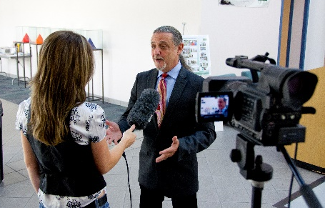
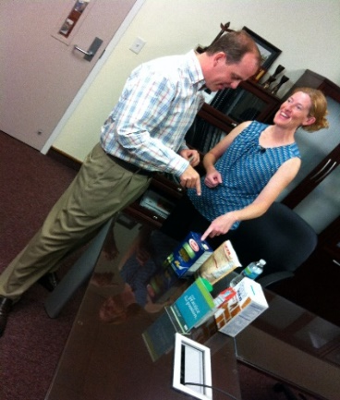
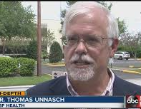
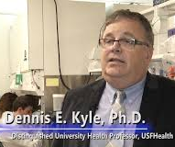
As Seen on TV
Jay Wolfson
Jodi Ray
Jill Roberts
Lauri Wright
Dennis Kyle
Tom Unnasch
Notes:
COPH faculty are frequently called up on to discuss their work as well as to provide expert commentary on issues in the local and national news. Here are the college’s top media stars for 2014-15 listed in order of most media hits. Obviously, media requests are driven by current events. If you see news happening that you can address, please reach out to Natalie Preston in-house or Anne Delotto Baier with USFH.

Slide 17
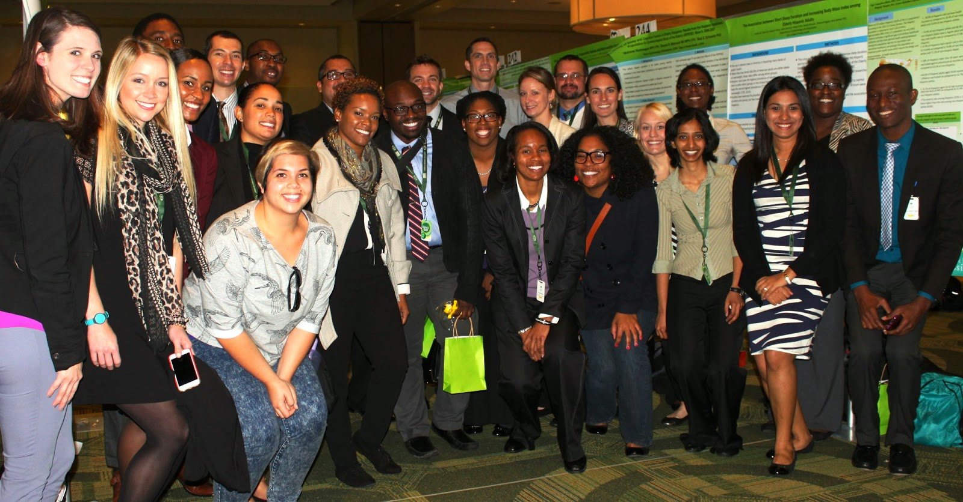
USF Health Student Research Day 2015
51 submissions with 11 awards
(10 grad students/one post-doc)
Notes:
Student research within the College is critical to not only supporting our research program but training the next wave of public health researchers
Last year we provided 115 graduate research assistant positions to students.
Opportunities to highlight their work through USF Health Research Day, APHA, the Florida Public Health Association, as well as national and international meetings is important to their development and our progress as a research institution. Plus, our students are consistently recognized with awards in the aforementioned venues. Most recently, three COPH students received a scholarship or poster presentation award at this year’s FPHA annual meeting in Orlando.

Slide 18
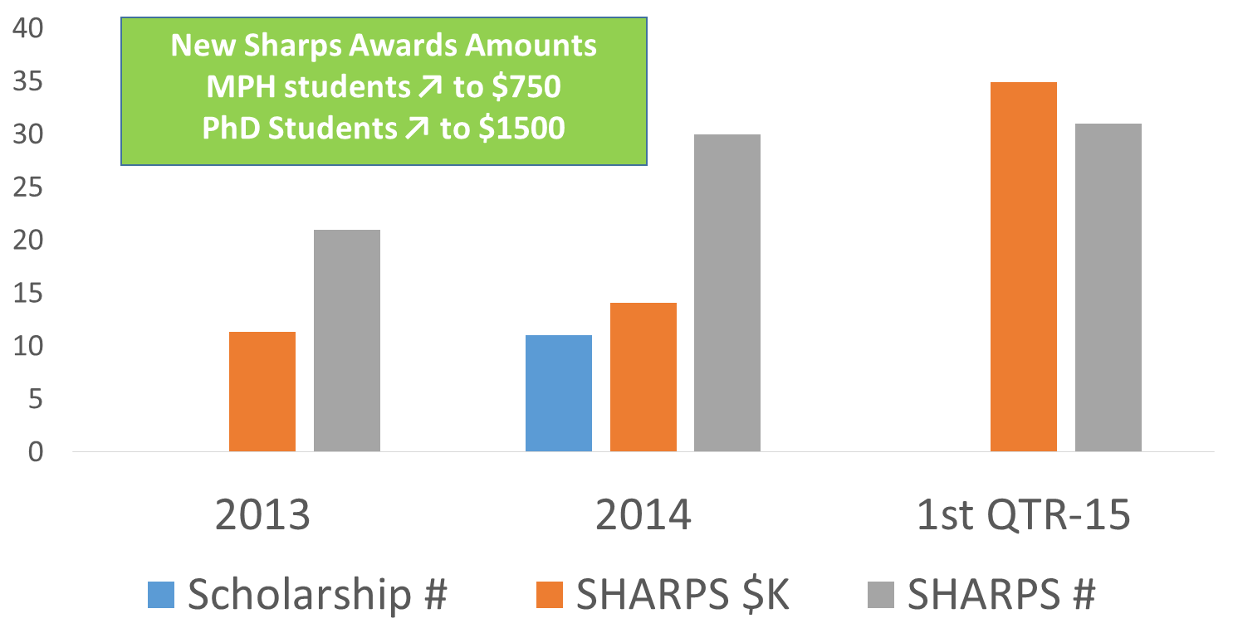
A “SHARP” Increase in Student Awards
Notes:
Providing support to our students to allow them to present at national and international conferences is critical to their professional development. Last year we provided about $30,000 in student travel support; we have allocated almost that much this year already as we have increased the award amounts in an effort to more fully fund these trips. New 1st quarter already exceeds FY14

Slide 19
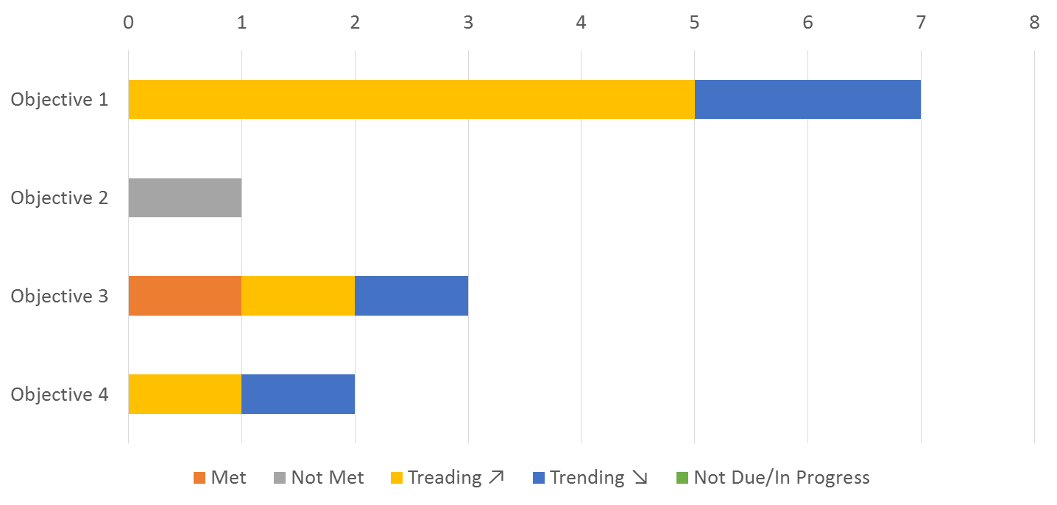
Enhancing System Capacity
Notes:
Goal: The USF COPH will be recognized as a leader in promoting public health system capacity locally, statewide, nationally and internationally
This goal is about how we engage with public health professionals
through continuing education and workforce development
Formal academic training through graduate certificates, public health practice program, and our DrPH
This goal has 4 objectives and 13 indicators. As you can see we
1 Met
1 Didn’t meet
7 Trending upward: 4
4 Trending down

Slide 20
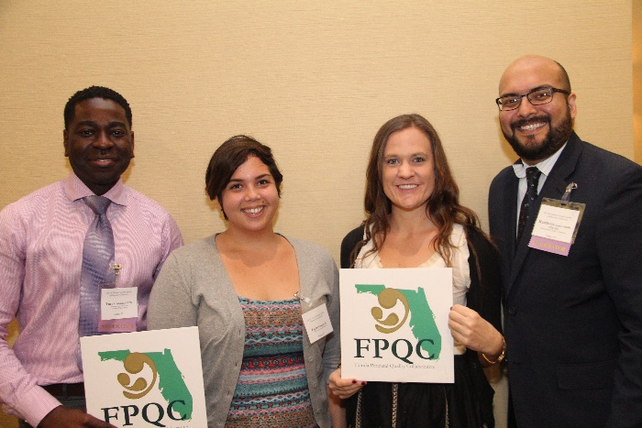
Enhancing System Capacity Workforce Development
An estimated 30,000 public health professionals reached through trainings, continuing education, and conferences
Notes:
Examples of our good work with community partners:
In collaboration with partners, the Florida Perinatal Quality Collaborative had some of its largest impact on improving health care quality over 18 months. In 31 participating hospitals that account for more than half of Florida’s birth, the initiative improved health care practice for obstetrical hemorrhage by increasing maternal assessment of risk on admission from 14% to 79% of deliveries, and quantification of blood loss for vaginal deliveries from 4% at baseline to 62%.
Coming Together to Advance Health Equity

Slide 21
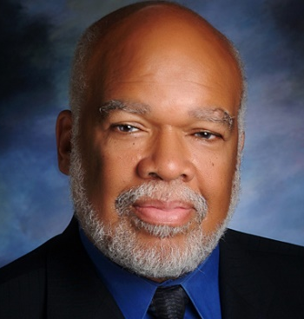
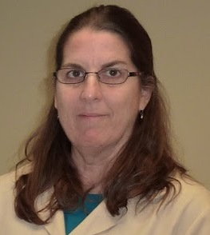
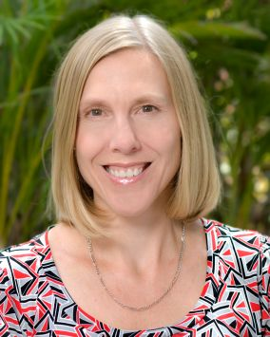
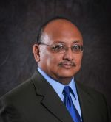
Capacity Building in Action
With Adewale Troutman’s (CFH) leadership, COPH co-sponsored with PolicyLink the first of three national meetings of universities and health departments focused on advancing health equity
Donna Haiduven (GLH) was selected by CDC & ORISE to serve as one of the trainers to prepare healthcare workers to work in Ebola treatment units in Africa
Linda Detman (CFH) served on the maternity action team of the National Quality Forum, producing the Playbook for the Successful Elimination of Early Elective Deliveries, a nationwide guidebook to reduce elective delivery rates
Ismael Hoare (GLH) worked with PAHO to develop a policy document to create a national human resources for health policy in Grenada

Slide 22
Enhancing System Capacity Through Academic Programs
DrPH
Fall 2014 cohort: 7
Fall 2015 cohort: 19
PHP
Fall 2015: 110 students
2014-15 Graduates: 34
Grad Certificates
2014-15: 23
500% increase in applications for Fall 2015
Notes:
Academic numbers
DrPH –
Fall 2014 cohort – 7
Fall 2015 cohort – 19
500% increase in applications for Fall 15
PHP numbers
Fall 2015 – 110 students
2014-15 Graduates – 34
Grad certificates
2014-15 – 23

Slide 23
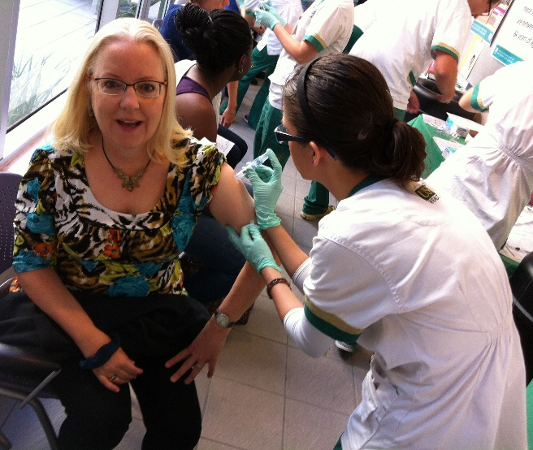
Bettering Florida
USF SafetyFlorida, the state’s free and confidential small business safety and health consultation program funded through OSHA, celebrates 15 years of protecting Florida workers
Hosted annual Flu Shot Day offering 1,228 free vaccinations to members of the USF and local communities
Receiving the largest Navigator award in the country, Jodi Ray and her team work across the state to ensure Floridians have access to health care
COPH partnered with US Rep. Kathy Castor and CDC to boost HPV vaccination campaign

Slide 24
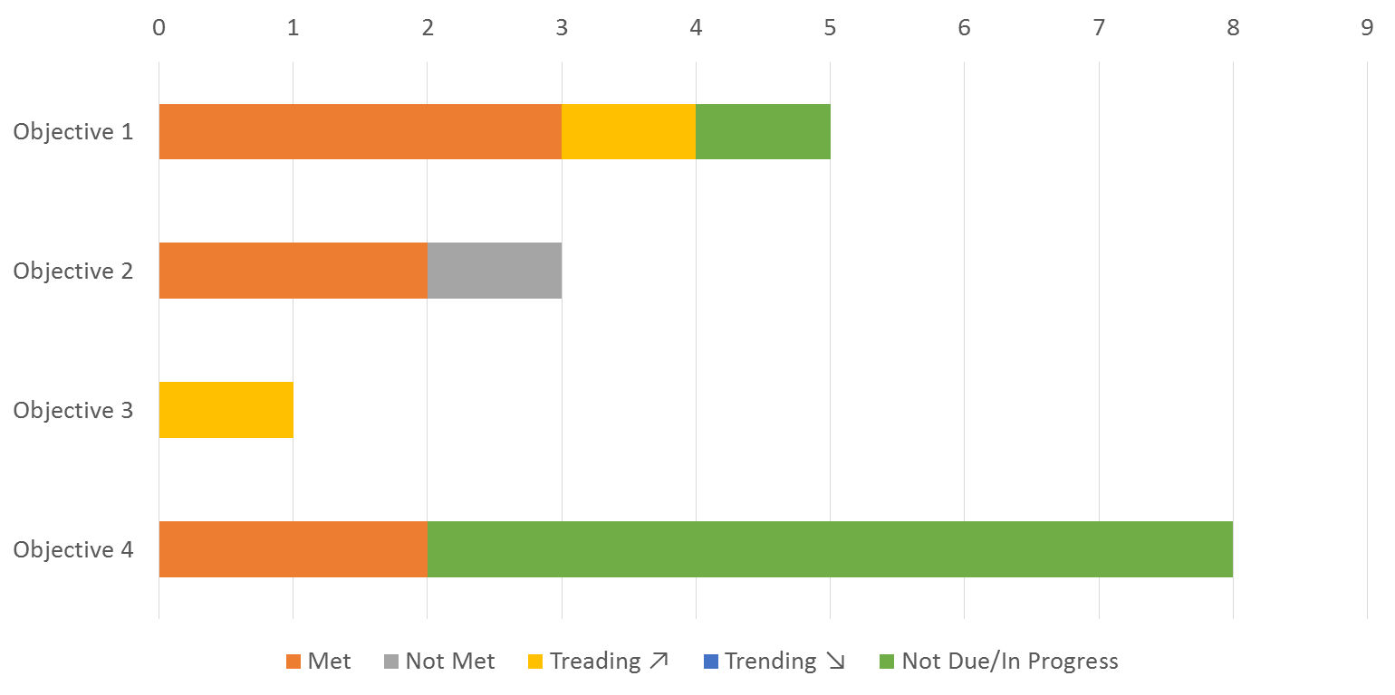
Our People
Notes:
Goal: The USF COPH will create an atmosphere that embraces diversity, fosters a sense of community & collegiality, encourages life-long learning, and supports faculty and staff in their quest to fulfill their professional goals while contributing to the mission and overall success of the College
Our people is about the people that make this college the great place it is. Who we are, what we do to support and grow our people, and our efforts to support, grow and respect the diversity of our faculty, staff and students.
Our people has 4 objectives and 17 indicators. Over the last year we
7 met
1 didn’t meet
7 weren’t due to meet
2 trending positively

Slide 25
Notes:
Founded in July 1984, the college wrapped up a yearlong celebration of educating and training public health professionals in June of this year. Some of the 30th anniversary year highlights include:
Regional events in Orlando, New Orleans, Chicago and Washington, D.C.
In January, hosting an international panel with health leaders from Uganda, Ecuador, Malaysia and Panama
Community building activities like a tailgate and USF football game, fall networking social during homecoming, Super Bowl party and spring BBQ
In February, participating in the Gasparilla Distance Classic with more than 50 public health Bulls on Team #USFCOPHRocks
Featuring at least three alumni in my monthly dean’s lecture series
In March, celebrating more than 150 organizations who partner with us to improve the public’s health
Over the course of 12 months, raising almost $70,000 in new commitments to student scholarships in the college
If you weren’t here or just want to catch up on the anniversary year, then visit the 30th anniversary website. There you’ll find highlights from the year, as well as 12 in depth stories. Milestones like the ones depicted here that share the remarkable impact our college has had in our short 30 year history
In a minute or less, you can see the anniversary year in review with this cool video HIT PLAY

Slide 26
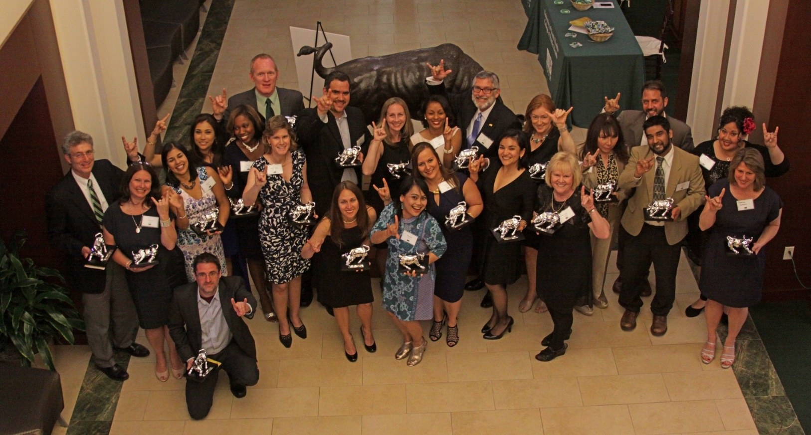
Our People Include Outstanding Alumni
Notes:
As you just saw, the culminating event of the anniversary year was the college’s inaugural alumni award ceremony on May 2. More than 180 supporters of the college traveled from as far as Indonesia to honor 28 of our outstanding alumni. Special guests included former COPH deans Levin and Mahan, USF trustee Scott Hopes, and USFAA president Bill McCausland
The call for nominations for the 2016 alumni awards will go out later this month with a December 15th deadline for nominations

Slide 27
Connecting With Our People
Notes:
During the anniversary year we introduced a new hashtag #USFCOPHRocks! It sums up who we are as a college—we’re young, vibrant and pretty darn awesome!
Because each of you are an integral part of who we are, we invite you to connect with us on social media and embrace the #USFCOPHRocks. We are more than 2,500 strong on LinkedIn and are just shy of 2,000 likes on Facebook. Thanks to our amazing videographer Zack Murray we’ve produced more than nine new videos since February. One video touting how we save lives through injury prevention was accepted for next month’s ASPH Global Public Health Film Festival in Chicago.
To connect with us on social media, simply visit the college’s home page and scroll to the footer.

Slide 28
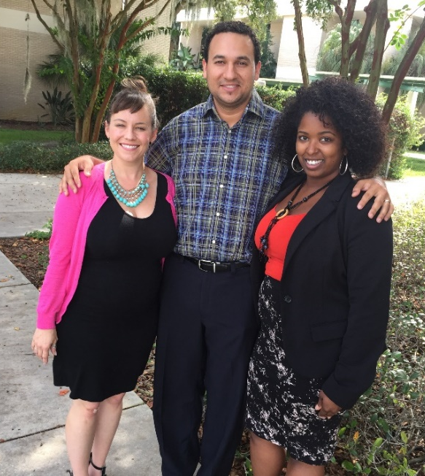
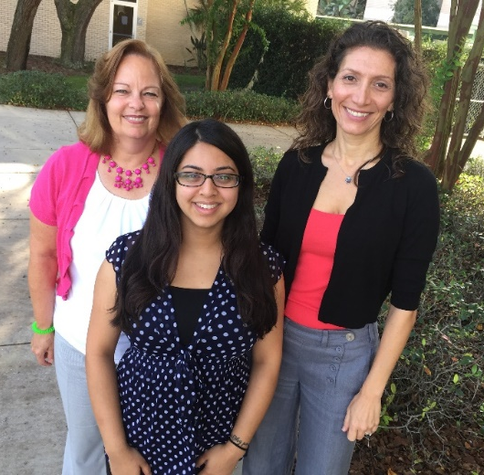
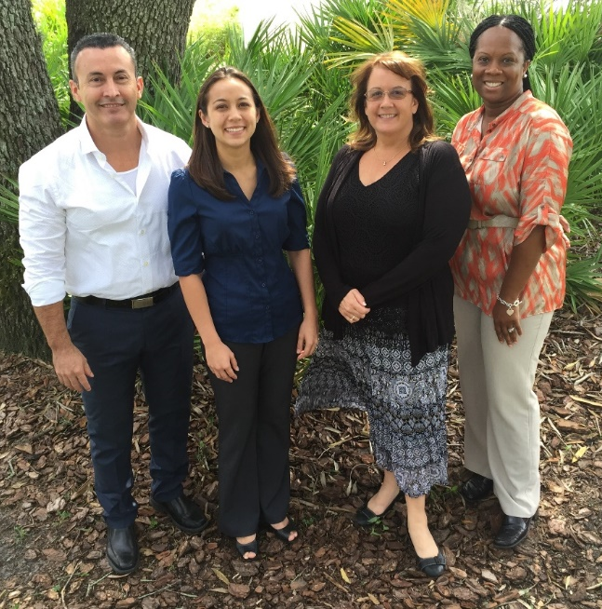
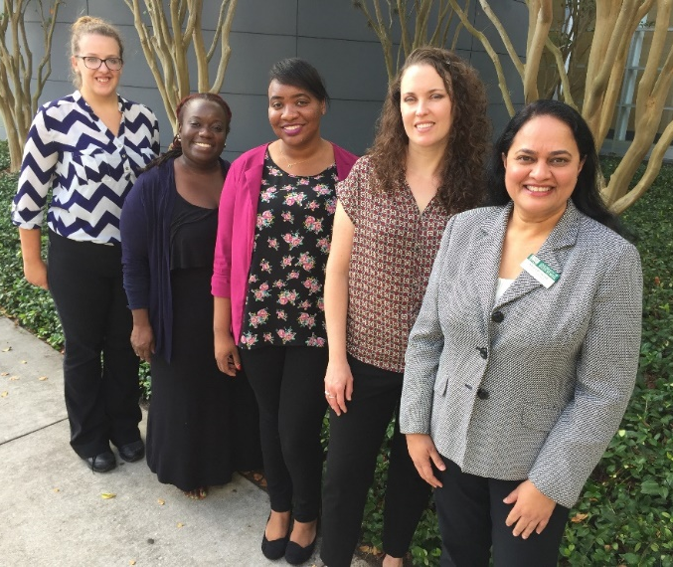
Welcome to Team #USFCOPHRocks
Community & Family Health
Dean’s Office
Florida Covering Kids and Family
Office of Graduate Studies
Notes:
Now, introducing the newest staff to join team #USFCOPHRocks …
TOP LEFT (FCKF)
Catherine Roders, LRCC - Program Planner Analyst
Manuel Mayor, Program Planner Analyst
Ashley Richards, LRCC - Program Planner Analyst
Not pictured—Ashley Brunson, LRCC - Program Planner Analyst
(Dean’s office)
Carlos Montoya, ETA – Instructional/Multimedia Developer
Anna Mayor, Communication & Marketing Officer
Lisa Zickefoose, COPH Research - Mgr, Fiscal & Bus Adm
Pamela McLean, Office of Disparity & Com Engagement
(CFH)
Pamela Hachey, CFH – Academic Svcs Adm
Saba Rahman, CFH – TOPS Project - Program Planner Analyst
Tali Schneider, CFH-PRC – Program Planner Analyst
(Office of Graduate Studies)
Danielle Reidel, COPH OGS – Academic Program Specialist
Carletta Hagin Hughes, COPH OGS – Academic Program Specialist
LaTonya Davis, COPH OGS – Academic Program Specialist
Kristin Moretto, COPH OGS – Instructor/Director
Kamala Dontamsetti, COPH OGS – Assistant Director
Other new team members not pictured:
Luis Silva, EOH-OSHA - Program Planner Analyst
Deborah Rose, GH IDRB Labs – Sr. Biological Scientist
Walter Albeldano, GH IDRB Labs – Sr. Biological Scientist

Slide 29
Notes:
Not be outdone, our newest faculty on team #USFCOPHRocks will introduce themselves …
We also welcome two new post-docs to the team …
Laura Mayhew Purcell – BSH (Nicole Johnson)
Jennifer Armistead – GH IDRB Labs (Adams)

Slide 30
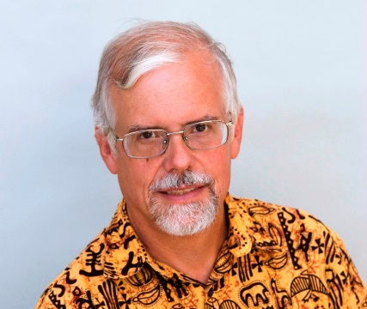
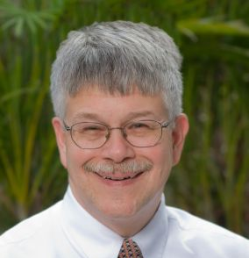
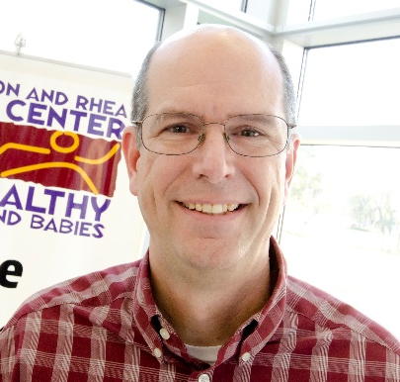
Our People Are Nationally Recognized
Tom Unnasch (GLH) named Fellow of the American Society of Tropical Medicine & Hygiene
Dennis Kyle (GLH) nominated for Fellow of American Association for the Advancement of Science
Russ Kirby (CFH) named USF Distinguished Professor and recipient of the COPH Outstanding Faculty Award and the John MacQueen Award
Bill Sappenfield (CFH) received U.S. Dept. of HRSA’s Maternal & Child Health Bureau Director’s Award

Slide 31
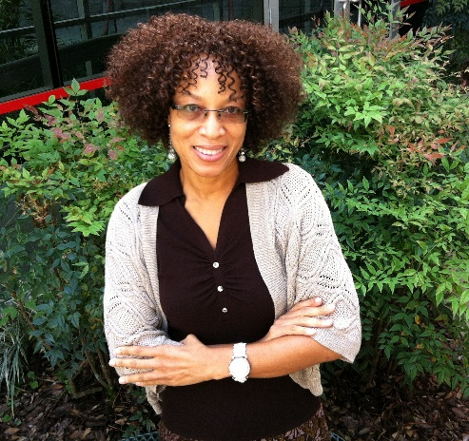
Our People Do Good Things
John Adams (GLH) recognized as Distinguished USF Health Professor
Marie Bourgeois (EOH) named President of the Southeastern Society of Toxicology
Jacqueline Wiltshire (HPM) appointed to Florida Alzheimer’s research board
Graduate student Paige Hammond (CFH) named a “Top 30 health educator under 30” by the Society of Public Health Education
Alumna Hanifa Denny (EOH) named Dean at Diponegoro University

Slide 32
Our People Are Diverse
Students
42 percent
minority enrollment
20 percent Black
12 percent Asian
6 percent Hispanic
Faculty and Staff
38 percent
minority
17 percent Black
11 percent Asian
10 percent Hispanic

Slide 33
Sustainability
Notes:
Goal: The USF COPH will develop and maintain academic and financial practices and a physical environment that will ensure the sustainability of the College through 2022 and beyond
Sustainability is about those things that help us tracking our progress against BOG, USF and our own goals. It refers to our resources, financial as well as our physical environment.
Sustainability has 3 objectives and 18 indicators. Over the last year we
1 didn’t meet
9 trending positively
8 trending negatively
1 not due/in progress

Slide 34
COPH Award Amounts FY12-FY15 Federal vs. Non-Federal
Notes:
In FY 15 COPH researchers generated over $25M in external funding from 101 proposals
In the 1st QTR of FY16 we have received 34 proposal totaling over $13M
In FY15 COPH faculty submitted over $68M in proposals
In the 1st QTR of FY16 to date we have submitted 30 proposals requesting $14M

Slide 35
Grant Amounts vs. Awards FY11- FY15
Notes:
COPH faculty submitted 101 proposals for extramural funding during FY 15.
Slightly down in number, but increased in the total amount requested from FY 14.

Slide 36
Six COPH Investigators Rank in USF’s Top 25
Notes:
#4 Jodi Ray
#7 John Adams
#12 Yehia Hammad
#20 Dennis Kyle
#21 Tom Bernard
#25 Jay Wolfson

Slide 37
Total COPH Research Expenditures: FY 10-15
Notes:
These expenditures include 20 active NIH awards, including 7 RO1 and 5 R21 awards.

Slide 38
Sustainability
Notes:
Students by the numbers
Total active students, fall 2015 (or compared to last three years)
2012-13; 751 UG; 868 Grad
2013-14; 842 UG; 914 Grad
2014-15; 876 UG; 875 Grad
2015-16; 801 UG; 845 Grad
As you can, graduate student headcount has declined for 3 consecutive years. BSPH students had a 8% decline this year.

Slide 39
Sustainability
Notes:
Graduates over the past year
BSPH = 2012-13, 230; 2013-14, 351; 2014-15, 353
Masters= 2012-13, 218; 2013-14, 227; 2014-15, 247
Doctoral = 2012-13, 15; 2013-14, 26; 2014-15, 14
You can see that UG students graduations have increased over the last 3 years, as have graduations at the graduate level.

Slide 40
COPH Funded Enrollment Summary
Notes:
Over the last four years our total student FTE has continued to increase. Last year our UG FTE continued to increase, while we experienced a slight decrease in our Grad FTE

Slide 41
FY15 All Source Expenditure Summary
Notes:
You can see that grants are almost half of our $47M in expenditures, with our state & tuition being the other largest portion of our dollars.
E & G/TUITION 42% $19,884,590
GRANTS 47% $22,012,429
AUXILIARY 6% $2,621,634
RIA 2% $880,121
FOUNDATION 2% $872,597
CONVENIENCE 2% $929,984
TOTALS $47,201,355

Slide 42
Sustainability
Faculty-Staff Campaign
Our very own Oscar!
Faculty-Staff Participation
Notes:
Because of you giving increased from 32% in 2014 to 57% in 2015, shattering the 2015 goal of 35%. Several of the 30th anniversary events, like the Super Bowl party, Giving Tuesday, etc. included a giving component
COPH alumni giving percentage is 3.4%, compared to MCOM – 5.1% and Nursing – 2.7%. The national alumni giving average is 4%.

Slide 43
Student Support and Scholarships
Donations to Support Student Scholarships $44,046
Financial Support
Tuition and scholarships
$2,738,291

Slide 44
Looking Ahead

Slide 45
FY 2015-2016 All Source Budget
Fund Source | Projected Budget
E&G/Tuition | $19,202,977
E&G Carry-forward | $1,624,806
Grants | $19,713,795
RI/Overhead Accts | $4,332,736
Auxiliary Funds | $3,360,638
Foundation | $2,223,167
Convenience | $1,141,647
Total | $51,5599,766
Notes:
Our E&G budget includes our tuition, general revenue, differential tuition & lottery funds. Tuition is about $13M annually to the College.
Of our general revenue, almost 20%, over $1M, is now performance based funding.
Of the $19M in E&G and tuition, about $13M is tuition. As you can see, we control part a large part of our resources through our educational missions. In short, our state & tuition dollars equal approximately our anticipated expenditures in that area.
Grants are a moving target, but we expect that to go up as the year moves forward.

Slide 46
Investing in Ourselves
FY 2015-16 initiatives through the COPH Strategic Investment Fund
Faculty Professional Development Awards
Staff Professional Development Awards
International Program Development Awards
Tuition support for Study Abroad Programs
Graduate Assistant support for Tenure Earning Faculty
COPH Doctoral and Masters student fellowships
Faculty & TA support for the TMPH pilots
Notes:
As in years past, the College leadership team has agreed to continue funding to activities that support our strategic plan through our Strategic Investment Fund
We are continuing to look for other opportunities for investments and will hopefully have other new initiatives to announce as the year moves forward.

Slide 47
Financial Issues to Watch
Continued challenges in pursuit of federal research dollars
State shift to performance based funding and accountability measures
USF moves to Responsibility Centered Management (RCM)
Potential review within USF Health of how central Health offices are funded
Notes:
Regarding USF Health, we are now paying for positions as part of the WELL and Health HR. We have always funded dedicated support within USF Health IS.

Slide 48
New Programs Under Development
MPH/MSGC – MPH with a MS from COM in Genetic Counseling
Precision Medicine an essential aspect of medical care in many specialties and has large impacts to the overall public health system.
No public or private genetic counseling program exists in Florida, and no public health genomics programs either.
Bureau of Labor Statistics predicts ~50% more GCs will be needed in the US by 2022.
Florida has the smallest number of genetic healthcare specialists per capita among the 10 most populous states.
Nutrition & Dietetics
The MPH in nutrition & dietetics will provide graduate education that will soon be an accreditation requirement to hospital-based dietetic internships in the Tampa Bay area and will enhance our relationship with Tampa General Hospital through a coordinated internship program housed at TGH.
Notes:
In addition to the academic benefit, creation of genetics counseling program will create opportunities to provide continuing education opportunities to physicians, nurses and other healthcare providers in Florida and beyond.

Slide 49
Working Smarter
The College and Health IS have been partnering to use intelligent business process management (IBPM) to work smarter.
IBPM allows us to measure the steps in a business process and allows for automatic or human driven adjustment of the steps to the desired outcome.
COPH is piloting the use of IBPM at USF through the use of Appian’s cloud-based software platform
Who is Appian?
Many eyes are on us!
Notes:
As a College, we must learn to work smarter and more efficiently
Appian is a multi-national company based in the US with clients across all industries – except US higher ed. You might have heard of some of their clients – Bank of America, Sprint, Ryder Truck company among many.
Our project is being watched, within Health, across the campus and country. This program has already been featured in articles in Yahoo Finance, eCampus News and via a requested presenation at Gartner Symposium & IT Expo.
While standard across business, what we are doing is new to higher ed. And who better to pilot this than us?

Slide 50
Launching iBulls
iBulls is the name of our IBMP platform at USF & in the COPH
Developed using an approach that focuses on quickly releasing products so that they can be used and get feedback for enhancements
The goal is to release good products quickly, not perfect projects developed over long periods of time
The applications we develop will need your feedback
We have a created a governance structure to prioritize the projects to best meet our needs
iBulls
Notes:
The governance structure includes reps from the faculty, staff, chairs and office of Research, Academic & Student Affairs, and Finance & Operations.

Slide 51
What Can You Expect in iBulls?
Each student and faculty have their own “pages” (records)
The student record with critical information to aid in the advising process
For faculty, an easy link to each faculty member’s advisees
Automated program of study worksheet, including information on when courses were taken and grades earned
Change of advisor
Ability to track processes
Infrastructure enhancements to our student databases
Notes:
Our first releases are focused on the student advising experience
Student record has elements such as contact information, degree & concentration, residency status, GPA, and probation status.
Automated program of study worksheet will allow students and faculty to work together to develop their program of study for upcoming semesters
Ability to track processes – we hope to eliminate lost paperwork and to ensure that our processes move as smoothly as possible
Infrastructure enhancements to our student databases allow easier linkages between existing databases and iBulls, and will reduce future programming time need to launch other student applications

Slide 52
Welcome to iBulls

Slide 53
Launching iBulls
We released the pilot to HPM faculty
and students two weeks ago
This week, all COPH faculty and students will receive information on how to access iBulls – from your desktop or mobile devices!
A web page will launched as a home for iBulls with all the information you will need
Hands on training will be provided – stay tuned!

Slide 54
Moving COPH Forward

Slide 55
Why did we start these conversations?
The budget crisis of 2013-2014 . . . leading to new fiscal realities for the University, USF Health, and eventually COPH
Changing state funding models
Faculty expressing exhaustion
Growing interest in promoting quality
Increasing competition
Changes in the external environment
Approaching CEPH re-accreditation site visit in 2018

Slide 56
What factors influenced our discussions?
Performance based funding
Advancements in CEPH criteria
Online programs & courses
Need to focus on doctoral degree programs
Faculty effort & time commitments
Increased focus on accountability
Need to be more efficient in all we do
The impact of our organizational structure on what we do

Slide 57
What are the immediate results of our discussions?
We will hire professional advisors for our MPH programs
Implement new MPH admissions process
Build portfolio of experiential learning opportunities within the MPH degree program
Create Dean’s Awards for core mission areas
Eliminate or modify inefficient processes
Review all administrative processes

Slide 58
Next Steps
Transform faculty assembly committee structure & revise By-Laws
Rebuild MPH and graduate certificate offerings
Thoroughly evaluate the Public Health Practice program
Thoroughly evaluate the BSPH program
Thoroughly evaluate ETA and technology-enhanced learning
Redevelop our PhD program

Slide 59
Next Steps
Create and implement a more robust process for teaching evaluation
Implement a robust faculty development program
Create an organizational structure that enables our continued success
Realign budget and financial incentives and assignment of faculty time to promote greater efficiency and alignment with College goals

Slide 60
In Conclusion
From the launch of our TMPH pilot through our first-ever awards dinner, our 30th year was one to remember
Looking ahead, we have much to do to make sure our next 30 years are just as outstanding
I have no doubt that with our amazing people, we can accomplish all that we want to
THANK YOU for all you have done, all you do, and all we will do together to make this THE College of Public Health

