Slide 1
TACKLING THE ACGME SURVEY
Anne L. Champeaux, M.D
Associate Professor of Pathology & Cell Biology, Morsani College of Medicine
Pathology Residency Program Director
University of South Florida, Tampa FL

Slide 2
Disclaimer
I’m a program director (15 years experience)
I am not speaking on behalf of the ACGME nor any of its Residency Review Committees
The following material is to assist programs in navigating, not ensuring, a successful Annual ACGME Resident and Faculty Survey
No financial disclosures
It is what it is……..

Slide 3
ACGME Survey
ANNUAL ANONYMOUS REQUIRED survey rendered by the ACGME to all residents/fellows and CORE faculty (January-June)
“Additional method” used to monitor GME and provide early warning of potential non-compliance with ACGME accreditation standards

Slide 4
Next Accreditation System (NAS)
Programs are accredited ANNUALLY (continuous accreditation)
No more 3, 4, or 5 year cycles
No more Program Information File (PIF)
RRCs ANNUALLY look at program data

Slide 5
What Data is Reviewed?
All Data in WEB ADS (ACGME data base)
# residents, #faculty, changes in numbers, PD
Scholarly activity
Response to questions (safety, QI, supervision, duty hours, responses to previous citations)
ACGME case logs
ACGME faculty and resident survey data
Board pass rate and % of residents/fellows who took the boards

Slide 6
Few notes
SAME survey distributed to ALL programs (not specialty specific)
Does create some issues how various questions are interpreted
Practice Habits – Pathology RRC started to “ignore” this questions as majority of ALL pathology programs are “flagged”

Slide 8
ACGME Faculty and Resident/Fellow Survey
Two components
COMPLIANCE
Resident: 70% completion rate
Faculty 60% completion rate
SURVEY RESULTS
Program mean, trends year to year within program
Program mean vs. national mean

Slide 9
Just a little more information….
Resident Survey Reports – When at least 70% of a program’s residents/fellows have completed the survey and at least 4 residents/fellows have responded, reports will be available annually. For those programs with less than 4 residents/fellows who meet the 70% compliance rate, reports will only be available on an aggregated basis after at least 3 years of survey reporting has taken place.
Faculty Survey Reports – When at least 60% of a program’s faculty members have completed the survey and at least 3 faculty members have responded, reports will be available annually. For those programs with less than 3 faculty members scheduled to participate who meet the 60% compliance rate, reports will only be available on an aggregated basis after at least 3 years of survey reporting has taken place.

Slide 10
Need to know who is getting the survey…..
Residents/Fellows
CAN adjust for residents on LOA
Faculty
Physicians only
CORE
Program Director

Slide 11
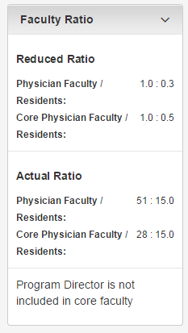
Core Faculty Check
Do this ANNUALLY
Faculty come/go, roles change
Core vs. Non-Core
ACGME survey distributed to CORE faculty, physicians
Need to balance
Competency and teaching abilities/capabilities
Compliance with evaluations/SURVEY
Scholarly Activity
RRC requirements

Slide 12
In case you forget…on the website…
Who will be scheduled to complete the survey?
Not all faculty members will be scheduled to complete the survey. Physician faculty members will be surveyed based on their level of involvement in the program. The program director will always be surveyed. Non-Physician faculty members (as indicated on your program's faculty roster) will NOT be surveyed. Ensure your faculty members’ information is up to date on the Faculty tab within the Accreditation Data System (ADS).

Slide 13
How hard can it be to get to 60-70%???
Does take some effort
USF has had a program in prior years with failure to comply with completion rate
Failure is worthy of program citation

Slide 14
TACKLING COMPLETION
Programs receive EMAIL notification of survey window
It is the PROGRAM’s responsibility to notify residents, fellows, faculty
Dr. Anne Champeaux,
The following program has been scheduled to complete the ACGME Faculty Survey:
Pathology-anatomic and clinical program, University of South Florida Morsani Program - [3001131078]
Survey begins: March 9, 2015
Survey deadline: April 12, 2015 at 11:59pm CST
Scheduled faculty: 29
Required response rate: 60% (programs with fewer than three scheduled faculty must obtain 100%)
Programs are responsible for notifying and reminding faculty members. The ACGME DOES NOT contact survey takers directly.
To view the faculty members that are scheduled in your program, log into the Accreditation Data System (ADS). Click the "Overview" tab and locate the "Faculty Survey" section. Click "View" to access your list of scheduled survey takers and their default login information (only accessible during your survey window).

Slide 15
Tips and Tricks
Communication, communication, communication…
Emails: Use READ RECIEPT. May have to knock on doors for those folks who “don’t read email”
Make it a competition.
First to 100% gets…….
SET TIME ASIDE
Use of part of department meeting, resident didactic time, work into clinic schedule
Make adjustments in Web-ADS if necessary BEFORE window starts (residents on LOA, sabbaticals, legitimate adjustments)
Monitor compliance

Slide 16
Dr. Anne Champeaux,
This is a reminder that the following program has been scheduled to complete the ACGME Faculty Survey:
Pathology-anatomic and clinical program, University of South Florida Morsani Program - [3001131078]
Survey begins: March 9, 2015
Survey deadline: April 12, 2015 at 11:59pm CST
Current response rate: 51.0% - [15] completed of [29] scheduled
Required response rate: 60% (programs with fewer than three scheduled faculty must obtain 100%)
Programs are responsible for notifying and reminding faculty members. The ACGME DOES NOT contact survey takers directly.

Slide 17
Don’t….
Single out folks
ACGME lists assigned pending surveys
Use non-compliance for negative feedback (evaluations, milestones, disciplinary actions)
Assume your coordinator will take care of this
PROGRAM DIRECTOR RESPONSIBILITY
Remember: Make completion of the survey into a POSITIVE experience

Slide 18
MONITOR COMPLIANCE AS A PROGRAM QUALITY INDICATOR
Ensure compliance rate is reviewed and discussed as part of the ANNUAL PROGRAM REVIEW

Slide 19
ANNUAL PROGRAM REVIEW
PROGRAM QUALITY*****
SURVEY COMPLIANCE RESIDENTS
SURVEY RESULTS
RESIDENT PERFORMANCE
FACULTY DEVELOPMENT*******
SURVEY COMPLIANCE FACULTY
SURVEY RESULTS
GRADUATE PERFORMANCE

Slide 20
Winding up the survey….
Thank residents and faculty for participation
Positive buy-in (Use the survey to show the ACGME how fantastic the program is…rather than how many problems the program has….)
EVERY PROGRAM HAS PROBLEMS AND AREAS FOR IMPROVEMENT

Slide 22
PRE-SURVEY “INSTRUCTIONAL COACHING”
Coaching…NOT COAXING.
It can’t hurt. I may not help.
Sit personally (if you can) with residents and faculty
You can’t tell them HOW to answer the question, but you CAN explain HOW your program accomplishes the intent of the question
No longer have sample survey
Use last year survey
Use categories from ACGME website
Use glossary of terms
Make a “cheat sheet”
Distribute scholarly activity and QI activities

Slide 23
SURVEY CONTENT
DUTY HOURS – go over definitions, show new innovation data
FACULTY EVALUATION- go over your evaluations (when, how many, what evaluations are ANONYMOUS)
EDUCATION CONTENT -
RESOURCES- Note improvements especially
PATIENT SAFETY – training modules, meetings, actual practice (time outs, call-backs)
TEAMWORK – List the teams (multidisciplinary tumor boards, multidisciplinary rounds with nursing, nutrition, pharmacy, committee work)
PRACTICE HABITS- set aside time “today we are going to discuss practice habits”, give a form “this is the data on your practice habits”

Slide 24
UNDERSTAND THE DEFINITIONS: ACGME Definitions
1) RESIDENT/FELLOWS LEVEL OF TRAINING
2) DUTY HOUR DEFINITIONS

Slide 25
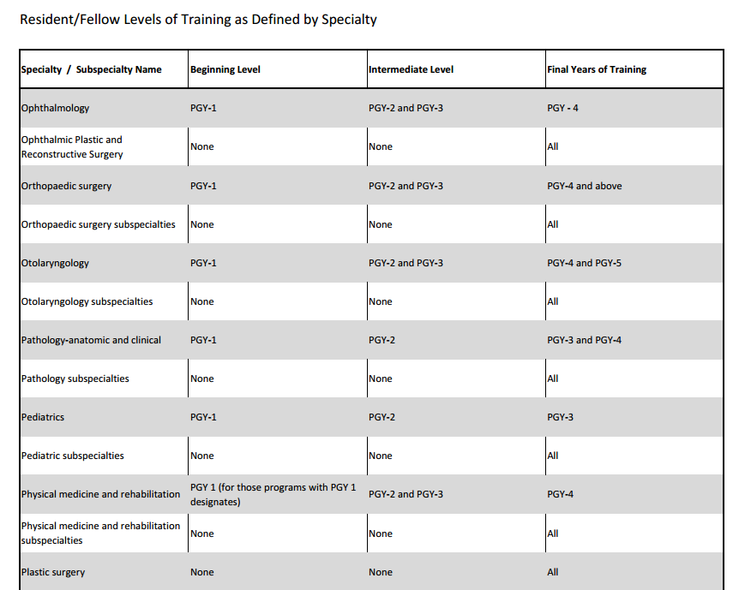

Slide 26
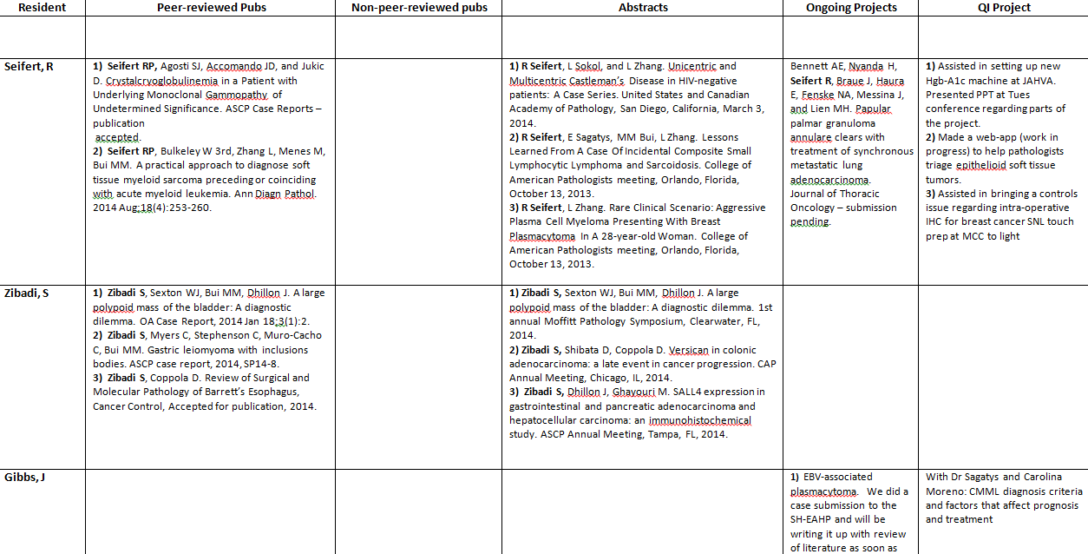
Scholarly Activity Cheat Sheet

Slide 27
DEFINITIONS..not always straight forward…….
EVALUATION:
A confidential evaluation by a resident means that resident responses cannot be identified. Many data collection systems can identify who has and has not responded and this does not compromise confidentiality. (???ANONYMOUS)
Residents must have access, upon request, to their current and previous performance evaluations in electronic or hard copy.
The program must use the results of the residents’ assessment of the program, together with other program evaluation results, to improve the program.

Slide 28
Up to this point…
Make sure your program data is up to date
You were notified of your survey window
Provide instructional “coaching”
Distribute survey log-in instructions
Monitor compliance

Slide 29
Sit and wait……
Results sent via electronic mail.
Results are posted in ACGME (survey results)
Results are accessible to GME office (institutional oversight)

Slide 30
What do I do?
Look at resident survey
Look at the faculty survey
Survey results are REVIEWED annually in conjunction with PROGRAM EVALUATION COMMITTEE and ANNUAL PROGRAM REVIEW
*Set your own benchmarks (%, trend, etc)

Slide 31
Annual Program Review
REQUIRED FOUR AREAS
Resident Performance
Program Quality ************
Survey
Faculty Development*********
Survey
Graduate Performance

Slide 32
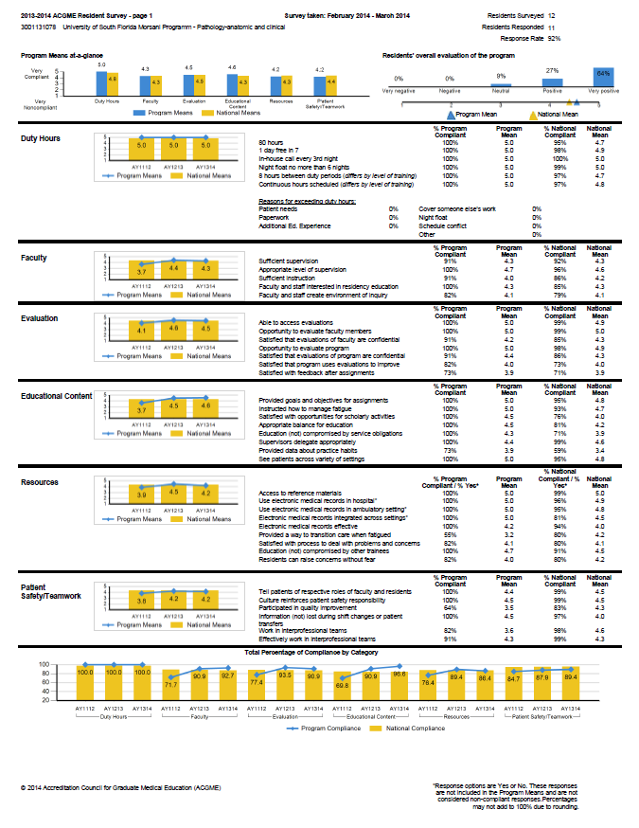

Slide 35
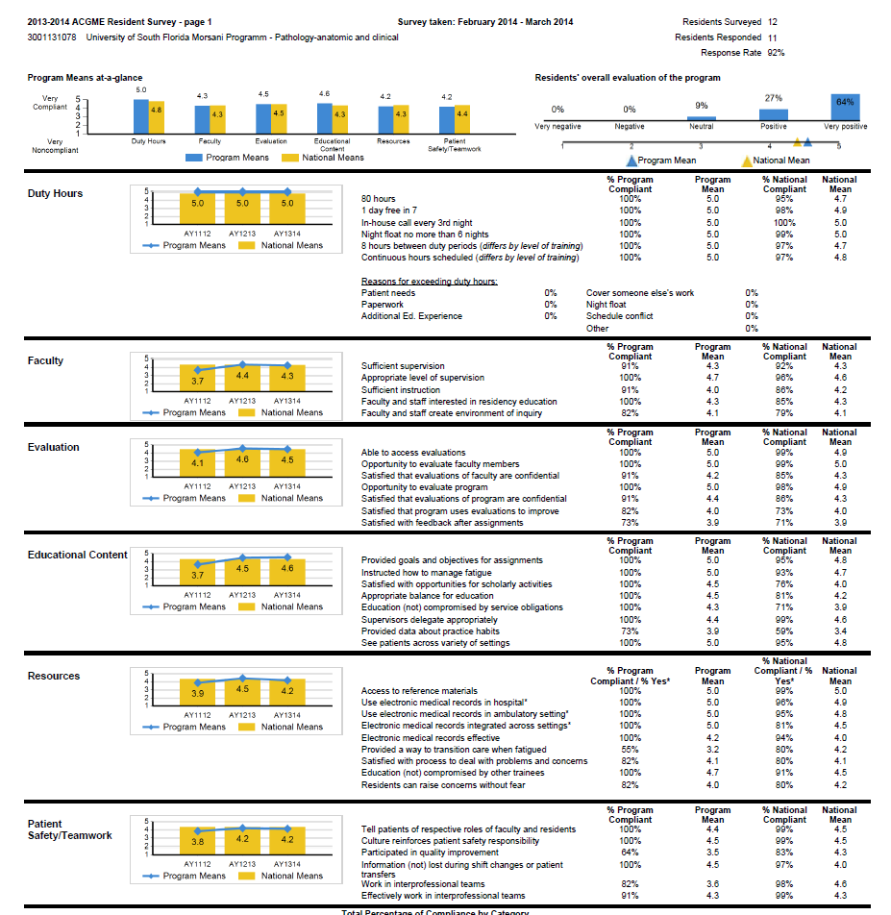

Slide 36
Need to decide what to do with the information
Act sooner than later
Act on “outliers” (less than 80%, below National mean, etc..)
Ideas:
Make command decisions/change policies
PEC meeting/ ad hoc PEC meeting
Develop Action Plan
“The Letter”
Develop Action Plan based on response

Slide 37
“The Letter”
Resident driven
Resident signed
Include and file with surveys, annual program review data
Immediate documentation
Creates the dialogue with the intent not to single out anyone
“What were the residents really thinking?”

Slide 38
The Letter…….
Dear Dr. Champeaux,
The results of our ACGME anonymous resident survey was discussed both at a resident meeting and over an email thread dated 7/15/2014 with all program residents. The specific survey items addressed included (1) “Satisfied with feedback of assignments,” (2) “Provided data about practice habits,” (3) “Provided a way to transition care when fatigued,” and (4)“Participated in Quality Improvement.” Residents were given a week to provide feedback. The issues were addressed as follows:
1. No specific issues were identified; however some residents have expressed frustration with the paper Medical Autopsy and Frozen Section evaluation forms to me in the past. If these forms can be transitioned to electronic they may be easier to distribute and collect. Also some residents in general feel the volume of evaluations is too great.
2. During the feedback period, one resident told me she marked this low because she did not understand what it meant. Frankly, I am not sure what it means. Do they mean about our own practice habits during our rotations? If so, we now have mid-rotation and mid-month eval forms to correct poor habits early.

Slide 39
Use “The Letter” to guide what the responses REALLY meant (at least in the eyes of the responders)
Gives some documentation to explain low percentages for misunderstanding the question, resident confusion, lack of knowledge of program content, procedures or policies
Gives ideas on potentially to correct non-compliance areas from a resident point of view

Slide 40
FACULTY SURVEY DATA
Due to the nuisances of USF, I have left review under the PEC/APE
Single institution – chair more influential (protected time, etc***)
Remember: Who is your core faculty? Core faculty buy-in
Could also create “the letter” led by another faculty member

Slide 41
USF DATA

Slide 42
In the end…
It is a SURVEY
Internet surveys more likely to incur negative responses than telephone or in person
Margin of error (not given and ALL surveys have margin of error)
Early warning of potential non-compliance. A low score may or may not mean you are in non-compliance. Don’t freak out!

Slide 43
If you get an ACGME letter…
Don’t panic
You may be in compliance..they just need further information based on survey
If asked (and only if asked), respond PROMPTLY with a WELL constructed letter. (have another program director read it)
Send letter VIA GME office
Remember “areas of concern” on acceditation letter DO NOT require responses (though your own INTERNAL response or response to GME/DIO should be advised)…only citations require responses

Slide 44
Questions
achampea@health.usf.edu
Brainstorm with other program directors
www.acgme.org
Contact your RRC

