Slide 1
How to See the Milestones with the CCC
Candice Mateja, DO
Assistant Professor, Chair of Clinical Competency Committee
Internal Medicine

Slide 2
Agenda
Brief overview of a Clinical Competency Committee
Brief overview of the Reporting Milestones
Importance of educating residents on the role of the CCC
Discuss ideas how the residents can be engaged in the process

Slide 3


Who are we?
Let’s start with some basic background questions and generate some discussion…
Notes:
First, I recently had the privilege to be a member of a Collaborative Learning Community through AAIM, which worked on developing strategies to improve the Milestone Reporting system. I was then in a subcommittee, that focused on resident engagement and interaction with the CCC during the whole reporting process. This CLC expanded the course of 2 years, and my subcommittee was able to present our findings at a national workshop this past October. We did a project assessing the residents’ general knowledge of what CCC’s were all about as well as the Milestones. This was accomplished via a survey. We then held focus groups to get a better understanding of what their knowledge is on the whole process of CCC’s/Reporting Milestones/and what they would want out of this process.

Slide 4

Who here knows what a CCC is?
Notes:
It is okay if you are unfamiliar with this term, as I will briefly go over the role of a CCC in a few slides…Hoping the majority of you are familiar and comfortable with this concept.

Slide 5
Clinical Competency Committee
V.A.1.b) There must be a written description of the responsibilities of the Clinical Competency Committee.^{(Core)}
V.A.1. The program director must appoint the Clinical Competency Committee.^{(Core)}
  V.A.1.a) At a minimum the Clinical Competency Committee must be composed of three members of the program faculty.^{(Core)}
  V.A.1.a).(1) Others eligible for appointment to the committee include faculty from other programs and non-physician members of the health care team.

Slide 6
Clinical Competency Committee
V.A.1.b).(1) The Clinical Competency Committee should:
  V.A.1.b).(1).(a) review all resident evaluations semi-annually; ^{(Core)}
  V.A.1.b).(1).(b) prepare and assure the reporting of Milestones evaluations of each resident semi-annually to ACGME; and, ^{(Core)}
  V.A.1.b).(1).(c) advise the program director regarding resident progress, including promotion, remediation, and dismissal.^{(Detail)}
ACGME Common Program Requirements
Approved: February 7, 2012; Effective: July 1, 2013
Approved focused revision: June 9, 2013; Effective: July 1, 2013

Slide 7
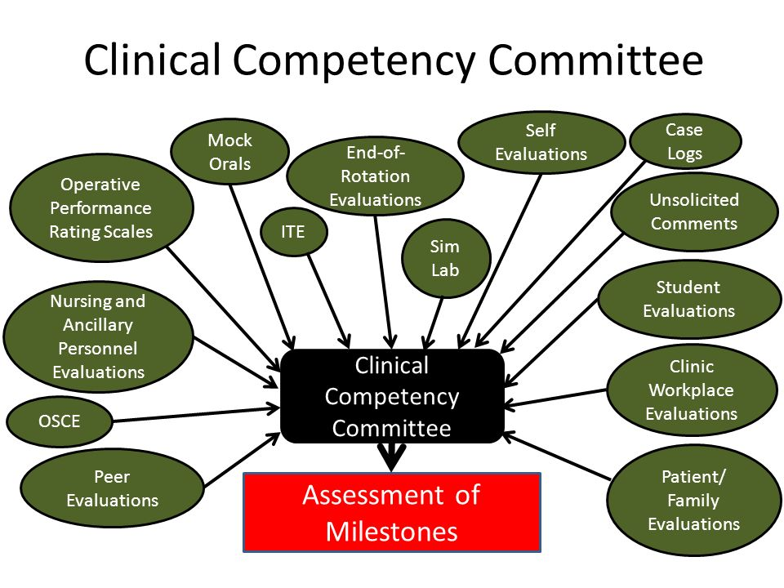
Clinical Competency Committee
Notes:
The basic ways the CCC’s gather information to then translate into the assessment of the milestones.

Slide 8
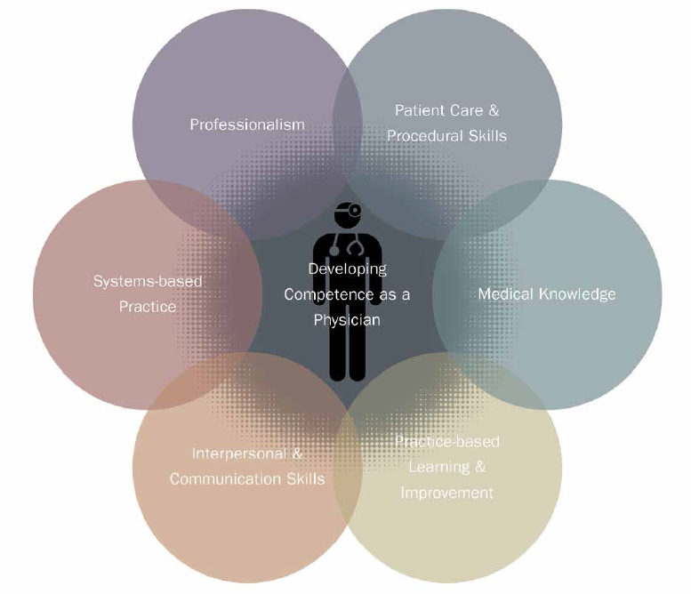
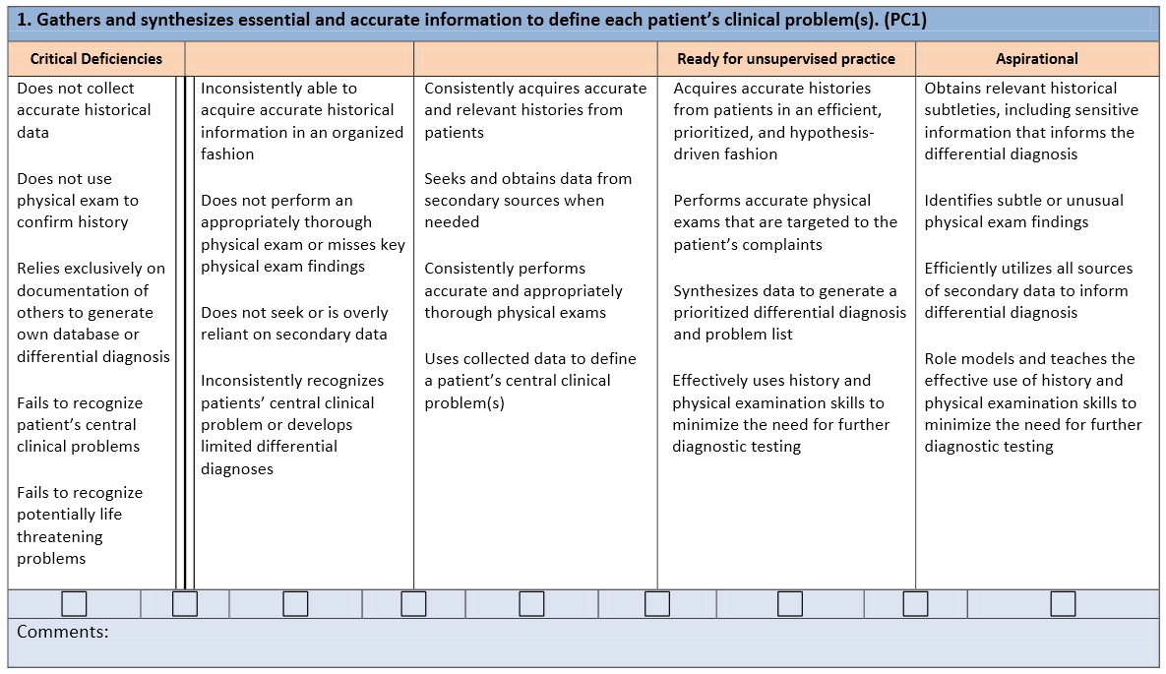
What are the Reporting Milestones?
Notes:
Simply defined, a milestone is a significant point in development. For accreditation purposes, the Milestones are competency-based developmental outcomes (e.g., knowledge, skills, attitudes, and performance) that can be demonstrated progressively by residents and fellows from the beginning of their education through graduation to the unsupervised practice of their specialties.
Why Milestones?
First and foremost, the Milestones are designed to help all residencies and fellowships produce highly competent physicians to meet the health and health care needs of the public. To this end, the
Milestones serve important purposes in program accreditation:
Allow for continuous monitoring of programs and lengthening of site visit cycles
Public Accountability – report at a national level on aggregate competency outcomes by specialty
Community of practice for evaluation and research, with focus on continuous improvement of graduate medical education
For educational (residency/fellowship) programs, the Milestones will:
Provide a rich descriptive, developmental framework for clinical competency committees
Guide curriculum development of the residency or fellowship
Support better assessment practices
Enhance opportunities for early identification of struggling residents and fellows
And for residents and fellows, the Milestones will:
Provide more explicit and transparent expectations of performance
Support better self-directed assessment and learning
Facilitate better feedback for professional development

Slide 9

Moving forward
Now that the background has been laid, lets find out more about ourselves….

Slide 10
Does your program regularly give direct feedback from the CCC to each individual resident?
Yes
No
“Kind of”

Slide 11
How is feedback from your program’s CCC given to individual residents?
During the semi-annual (SAR) with PD/APD
At a meeting with a designated faculty advisor/mentor/member
In a summary statement on our evaluations website/equivalent
Only residents noted by the CCC to have concerns are provided with feedback
None of the above

Slide 12
How are your residents involved in the CCC process?
They are not
They complete a self-assessment at their SAR
They receive feedback and do as suggested
Residents develop an individual learning plan based on CCC information
None of the above

Slide 13
Do you think your residents know what the CCC really does?
Yes
No

Slide 14
Back to my Resident Engagement Subcommittee and what we learned….
Notes:
So like you (or unlike you) depending on the results
When we thought about our own residents we felt
That: Learners do get regular feedback from their CCCs
That there are a variety of ways they get feedback
But 3 of us started to think about just how passive our processes were and the limitations of the passivity
And we all started to wonder what our residents really knew about CCCs
Therefore we wanted to assess the situation and think of ways to make it work better for the biggest stakeholders: the trainees

Slide 15
What did we learn?
74% of residents
didn’t know
what the
CCC is all about
Notes:
As you all know, the ACGME requires that we all have a CCC. CCCs do a lot of great work to help the trainees and the program.
But the worry that trainees might not know much about a instrumental part of their assessment sparked us to learn more.
What we found was both humbling and disheartening. We found that from our 4 programs 74% of residents didn’t know what the CCC is all about.

Slide 16
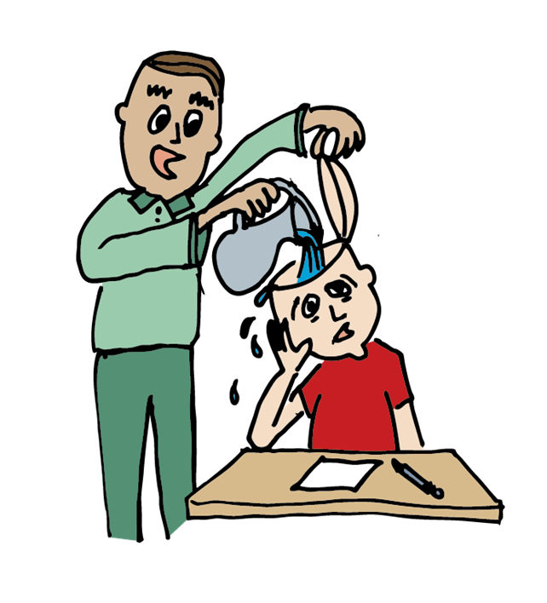
Status of Resident Engagement
Notes:
We started our exploration of this process by surveying our 12 other collaborative colleagues.
Although there were some programs way ahead of the game, in general, we found 3 themes:
Many of our colleagues weren’t sure what their residents actually knew about CCCS in general
Most reported that their residents had little engagement in their CCCs
And they noted that if their residents were engaged with the CCC, then engagement was very passive.
In general, when residents heard anything from their CCC, they were told what the CCC decided about the them but did not participate in the process

Slide 17
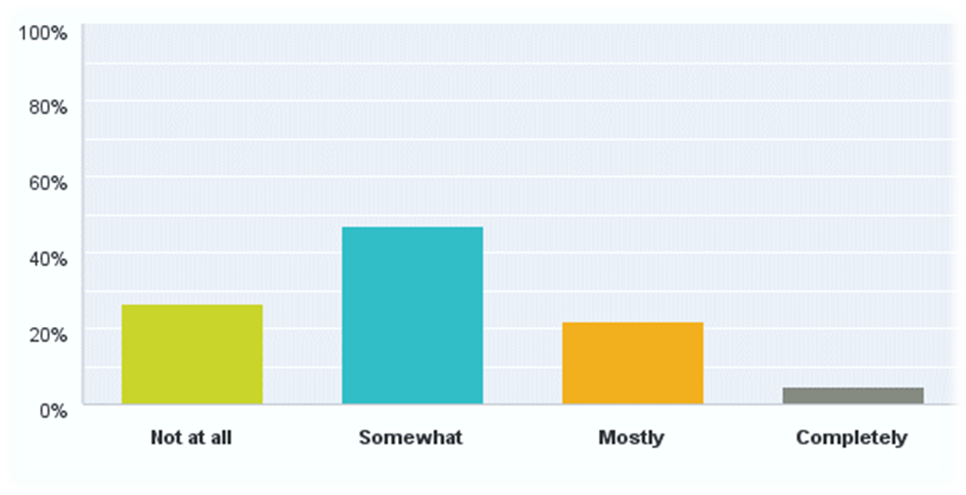
“I understand the role of the CCC”
234 Respondents

Slide 18
Why are we here?
CCCs must
  Measure residents’ progressive attainment of competence
  Review all resident evaluations semiannually and report on milestones to the ACGME
  Make residents “active agents in this system”
But HOW?
Notes:
It was clear to us that we had a long way to go. The CCC plays such an important role in resident assessment yet residents have little idea what it is or what it does
The ACGME requires that that CCCs
Measure resident’s progressive attainment of the competence
Review and report on resident milestone performance semi-anually.
And Make residents active agents in this system
BUT The HOW to do this is not clear.

Slide 19
“Tell me and I forget,
teach me and I may remember
involve me and I learn”
Benjamin Franklin
Notes:
WE all know and agree with the ACGME that active engagement is best for the learner.
Ben Franklin summarized this well when he said. “Tell me and I forget, teach me and I may remember, involved me and I learn.”

Slide 20
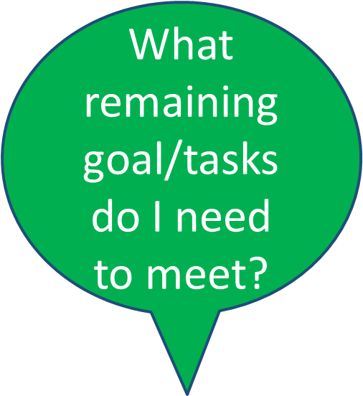
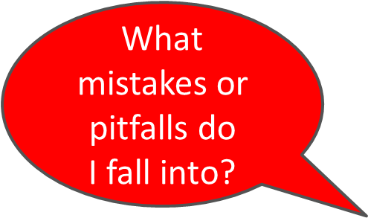
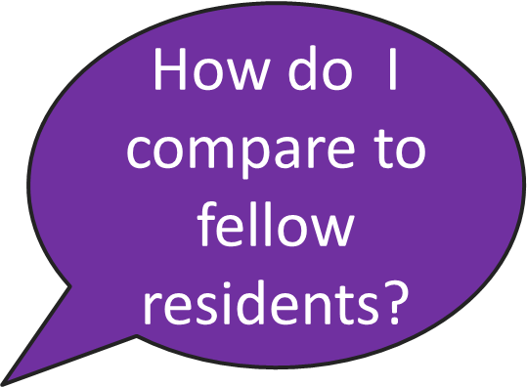


What do the Stakeholders want?
Notes:
For the learner, It’s all about ME and it should be. We found in our study that learners want to know things like:: >>>>>>>>>>>>>>>>> The best way to guide them and to promote success is to involve them in the process.

Slide 21



How do we engage them?
Resident
CCC
Notes:
So how do we do this? How can we help them see what the CCC is all about and get them engaged?

Slide 22


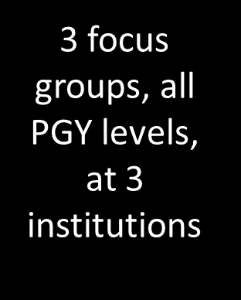
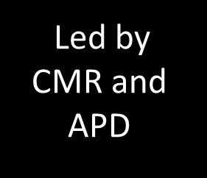

Focus Group Overview
Notes:
WE turned to the stakeholders/the residents to see how they feel they can be best engaged
The Focus Groups were held at Brown University, University of South Florida, and University of Minnesota at the Minneapolis VA hospital.
3 focus groups were held, each with 8-12 residents
All PGY levels were represented roughly equally in each focus group.
The protocol was as follows: A chief resident and an APD moderated the discussion. Focus groups were transcribed and analyzed for themes.
First: The moderator started the discussion by first describing the role of the CCC to the group.
Second: The moderator then discussed the fact that residents should be engaged in the process to promote their own success.
Third: Lastly, The moderator asked residents in what ways they feel they could best be engaged in the process.

Slide 23
Focus Group Themes
1.) Education on role of the CCC
2.) Specific feedback from the CCC
3.) Personalized improvement plans
4.) Involvement in Milestone Reporting
5.) Point of care evaluations
Notes:
What did we find?
The above are essentially the major themes we were able to categorize our data into from our focus groups. Next, I would like to share with you some of the responses we received regarding a few of these above themes. One of the hand outs we provided you is more extensive data from our FG broken into the various themes. Please look over the resident responses to help start thinking about how these responses maybe similar at your institution and any potential solutions you may already be using or have thought of at this time

Slide 24
Theme 1 – Educate Residents
I didn’t know there was a CCC
Role of CCC is to “punish”
We are “afraid” of the CCC
How are the milestones “rated”
Education on the CCC is needed
Notes:
Above are just some excerpts of responses residents gave during the focus groups that were categorized in the general “education” category about CCC’s. It’s quite evident many residents, regardless of level of training do not know much about CCC’s, milestones, and their overall goals and objectives.
Unfortunately, this lack of knowledge leads to a lot of fear to the role of the CCC’s and potentially the negative impact the reporting milestones may have on the residents. connotation to the role of the CCC in regards to simply delivering “punishment”, many residents as already mentioned do not understand the roles of the milestones, and do not understand
Aside from just fear and there being an overall negative how the information reported is obtained. Continued education to our residents on not only the role of the CCC, but also the process of the milestones reporting will likely help to mitigate the overall concerns residents currently have.
Consider now, what your institution does to educate your residents on the roles of the CCC and the reporting milestones
I did not know CCC existed. We need education on what CCC is and what it does.
We think we are only discussed in CCC when we have a problem. CCC is there to punish us. CCC means we are in “trouble”
We are afraid of the CCC. We are afraid we will not graduate if we are brought up at CCC.
How are the milestones rated? Where is this information coming from?
Have interns be introduced to the concept of the CCC and milestones from the beginning
Most people do not know what the CCC is and may have a negative connotation

Slide 25
Theme 2 - Specific Feedback
Comparison to peers
Certification of procedures
Feedback on documentation skills
Feedback from the onset of residency
Summary paragraph from CCC’s milestone reporting meeting
Notes:
This theme gives examples as to how the residents would like their feedback from the CCC. Examples given were at times general, but other times quite specific, for example the suggestion that the CCC could “Certify” someone for their procedures, which could help graduating seniors when applying for privileges at various institutions. Overall, the resident’s feeling was the more feedback received, the better, as well as the more specific the feedback the better. Unfortunately, it was seen by several institutions that the residents perceived the feedback received there was in general subpar, and can be improved upon.
How does your institution currently handle feedback from the CCC? Or even after you report the Milestones?
Would like to see how I compare to my peers
CCC should certify my competency on procedures. I have difficulty when applying to jobs
More feedback on documentation skills
Need more feedback from the get go from beginning of residency. Our program can improve on delivery of feedback
Summary paragraph from CCC’s milestone reporting meeting
CCC can develop the strengths, weakness, and goals for each resident

Slide 26
Theme 3 – Improvement Plans
Fellowship goals
Professional development
Personal goals
  “Self reflection is difficult”
Notes:
Expanding upon the last theme a bit more in regards to specific feedback, there were several comments from the focus groups that really discussed individualized evaluations that would not only help professional development in regards to potentially obtaining the desired fellowship or job after graduation, but also to help a resident to develop on a professional level. Several respondents lamented that it is difficult to self-reflect and to evaluate their own personal strengths and weaknesses, and even more difficult to develop an action plan for improvement. It was suggested by some respondents that this can be the goal of the CCC to help individual residents to develop these action plans.
In your programs, do your CCC’s develop personalized improvement plans for each individual in your program? If so, how do you accomplish this?

Slide 27
Theme 4– Milestone Input
Goals should be mutually agreed upon
Milestone placement should be a discussion
Accuracy of milestones reports
Use the SAR to generate discussion
Ask residents what they would like to improve upon
Notes:
It was clear several residents across the institutions would like to have direct involvement when it comes to the reporting of their milestones. It was at one point suggested that the milestone placement should be used as a discussion point, and the resident would like to have input and be able to “present their side” to determine where they should be placed on the milestones. They feel that the feedback received from the CCC’s regarding the milestones should be a mutually agreed upon goal, rather than the CCC just simply telling the resident what they need to improve upon.
Appears most residents only discuss their milestones with either their PD or the APD, and it was suggested that they should be able to discuss directly with the CCC members that rate them.
There was also concerns being expressed on the accuracies of the milestone reporting based upon potentially limited exposure with attendings or limited evaluation information received by the CCC’s.
Overall, there was definitely a general belief that the residents would like to have some sort of input into the milestone reporting process and it was even suggested that the Semi-Annual review could be a venue to start the discussion process.
At your institutions, how are the residents involved in the milestone reporting? Consider the concepts of before, during, and after. Majority of programs rely on either self-evaluations before hand, or after the milestone reporting hearing feedback at their semi-annual reviews. Does your program do anything DURING the milestone reporting that allows your residents to be involved?

Slide 28
Theme 5– POC Evaluations
Educate faculty
Be specific
More evals on less “popular” milestones
Provide milestone based checklist to the residents
More 360 evals and direct observations
Give concrete expectations/guidelines
Use technology, i.e. smart phone
Notes:
There were quite a few responses from the residents that fell into the category of improving the evaluation process, particularly at the point of care. Several respondents discussed how they feel the feedback they receive on a whole is generic and not specific. They feel that educating the faculty on how to provide more specific milestone based feedback could potentially improve this issue. They commented on how they receive plenty of feedback on certain competencies, but practically none at all on several others. For example, most residents have heard “You have great bedside manner and interpersonal communication skills”, but rarely do they receive feedback in regards to how they can improve in the competency of Systems Based Practice.
Going back to one of our previous themes, residents admitted they themselves do not know what the milestones are, and feel if they were provided these at the beginning of their rotations, it would help them improve their evaluations of the interns.
Residents feel they receive more concrete feedback during 360 evaluations or direct observations, which leads to true “Point of care” evaluations.
Aside from the ACGME mandated “Goals and objectives” for each rotation, residents would like to be given concrete expectations on their performances from the beginning of their residency.
Residents would also like to be able to use their personal technology to help with them with the evaluation process, for ensuring they themselves are being evaluated by a preceptor, as well as being able to complete evaluations of their learners in a timely manner. A great example of this would be the Armis application via New Innovations
At your institutions, do you do faculty development for your faculty on how to give good evaluations? Do you have any information regarding the milestones that you distribute to your residents prior to their commencement of residency? Are you using Armis or anything similar?

Slide 29






How do we engage the residents?
Targeting Resident Engagement.
Before

Slide 30
Before

Slide 31








Six “Before” Activities
IEP based on evaluation review
Resident seeks own input for portfolio
On line PBLI assessment tool
Resident completes reporting milestone self assessment
Resident identifies 2 challenges and 2 stretch goals
Notes:
Members of our collaborative have used a variety of mechanisms to engage residents before the CCC meets. This slide lists some examples.
1st the residents create their own individualized learning plan based on review of their evaluations and present this plan to the CCC
2nd, a program constructed online allows residents to access the information that the CCC reviews, The resident can then provide clarification and interpretation of this data.
3rd, residents seek out information from sources that they feel will provide the CCC with further information about their performance
4th residents complete a reporting milestone self assessment
5th residents complete an online problem based learning assessment tool for the CCC to review
6th the resident identifies two challenges and 2 stretch goals to be reviewed by the CCC

Slide 32
Before, During
and After

Slide 33

Notes:
For the DURING example, I am going to give you a whole example of one program’s dynamic change they instituted in the past 2 years. This will include both engagement BEFORE/AFTER, but since DURING is the most difficult for majority of programs, I am going to highlight their implemented changes now.

Slide 34
Prior Process
Residents informed about the CCC at orientation and during SAR meetings
Self-assessments done before SAR but never discussed at CCC
Very brief CCC “evals” created on evaluation portal for each resident after CCC meetings
“At-risk” residents met with someone, depending on situation (PD/APD/advisor/chiefs)

Slide 35
Prior Process - Problems
Circle never closed
One way subjectivity
Resident insight and knowledge limited
Resident fears, especially after dismissal(s)
NO ACTIVE ENGAGEMENT, as we saw it

Slide 36
Culture Change – HOW
“Residents must be active agents in this system.”
Residents prepare and present at CCC
Spotlight 2 clinical competencies
  PBL+I
  Professionalism
Faculty discuss residents after

Slide 37
Before CCC meeting
Residents scheduled for presentations in Fall and Spring
Pre-work:10-page worksheet completed by each resident
  Review their performance via online evaluation portal
  Formal self-assessment
  PBLI thoughts
  Professionalism thoughts

Slide 38
During CCC meeting
Residents present their “portfolio”
Only focused on the two milestones of
  PBLI
  Professionalism
Presented to a panel of CCC members
  About 6
Kept presentations short, only about 5-10 minutes per resident

Slide 39
After CCC
Each resident’s advisor completes a review form
  Improvement goal
  Stretch goal
This is separate from PD meetings
Notes:
After the presentations, each resident’s advisor completes a review form with an improvement goal and a stretch goal. This is all separate from meetings with the program directors(s). (after)

Slide 40
Post change thoughts
Felt comfortable presenting to CCC (88%)
Short time frame was long enough (88%)
“My voice was heard” (91%)
It was helpful and gave me the chance to reflect.
I think keeping the panel smaller will help ease the anxiety.
It was a good introspection into residency, made me think of things which I would not have thought of otherwise.
…felt like I was making a not-guilty plea in front of a jury. Not too sure what to make of this experience. The questions on the self assessment were good. Helped me to reflect on my performance.
Notes:
This program surveyed their residents and received these responses. Overall, it has been a very positive change which has allowed the program to engage the residents Before, During and After the CCC process. Also, they were ACTIVE members of the process.

Slide 41
Post-Change Thoughts
Residents
  Generally very positive
  Thought of things I didn’t think to think about
  Courtroom stress but made me reflect
Faculty
  Felt more empathy
  Pleasantly surprised at their insights
  They were really invested in the process

Slide 42
Before, During
and After

Slide 43
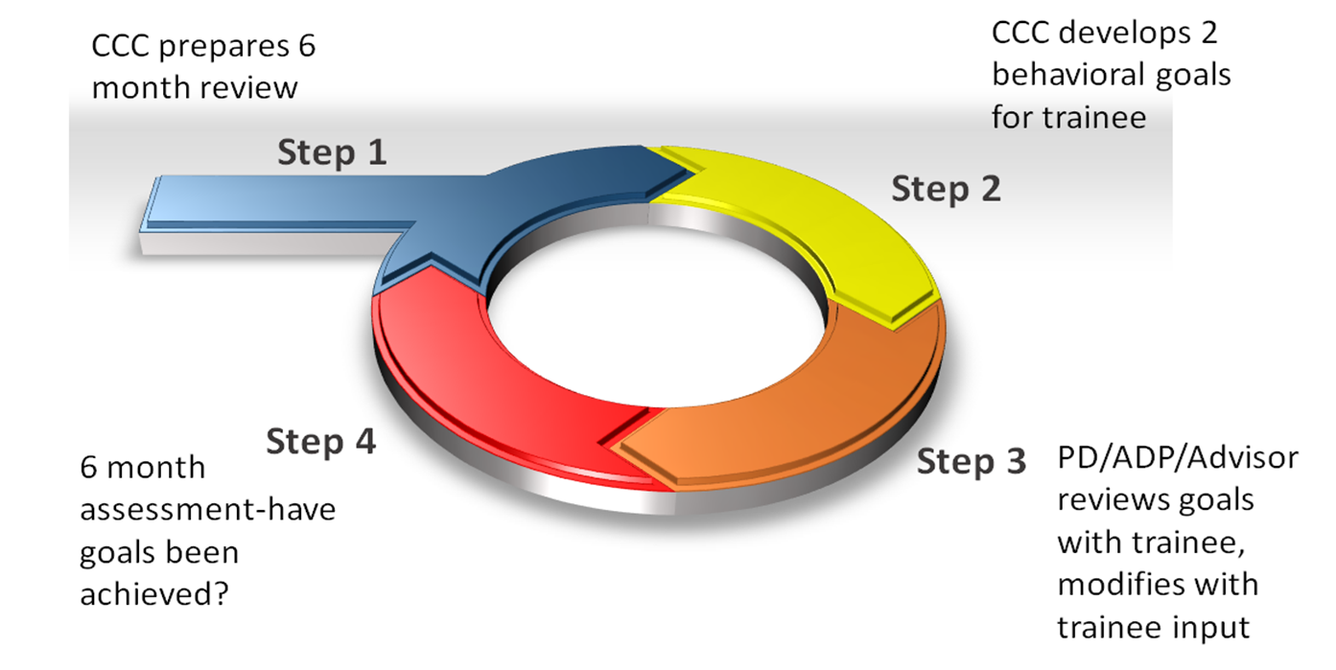
Another model for after
Notes:
This tool engages the resident in development of a personalized action plan after the CCC meets
Step 1, the assigned CCC member reviews all materials available for resident evaluation. In addition to providing recommendations on the subcompetencies to the CCC, the CCC member notes areas of strengths and weaknesses.
Step 2, Based on the data available, the member creates behavioral goals for the trainee based on reported strengths as weaknesses. The member is asked to either utilize a comment describing an observed behavior or notes a behavioral trend in the evaluations. The CCC member then create a goal linked with an activity to achieve this goal. These goals can reflect areas of weakness that require improvement or an area of success that with further refinement would bring the resident to a higher level of achievement.
For example; the resident is noted to have a score below the class average for MK2 with two clarifying evaluation comments regarding over-ordering of tests. The CCC member therefore suggests the following activity : review sensitivity and specificity of tests when ordering and include how this information will inform medical decision making your progress notes.
Step 3; At the next semi annual review, the resident’s program director or designee reviews this suggestion, asks for acceptance, modifies as needed and engages resident in discussion of how this suggestion will be implemented including who will oversee and how success with be measured.
Step 4: At the next semi annual review, This goal is reassessed to determine success or need for further improvement.

Slide 44
Strengths and Limitations
Strengths
Limitations
Resident part of action plan
Based on multiple evaluations
Described in specific behavioral terms
Success can be measured
Only addresses limited number of issues
Initial goal not resident driven
Requires CCC member skill to identify relevant goals and provide behavioral suggestions

Slide 45
Summary
Important to engage residents
  Before
  During
  After
Residents want to be ACTIVE members of the evaluation/milestone reporting process

Slide 46



Slide 47
Thank you!!
Special thanks to my subcommittee members
  Jacqueline Darcey, MD
  Nacide Ercan Fang, MD
  Jennifer Jeremiah, MD

