Slide 1
You Can’t Fix by Analysis What You’ve Spoiled by Design: Survey Design Tenets Applied to Evaluations
Jeffrey LaRochelle, MD, MPH, FACP
Associate Professor of Medicine
Director, Integrated Clinical Skills
-- Learning to Care for Those in Harm’s Way --

Slide 2
Disclosures
None
The views expressed in this presentation are those of the author and do not necessarily reflect the official policy or position of the Uniformed Services University of the Health Sciences, Department of Defense, nor the U.S. Government.

Slide 3
Learning Objectives
Recognize a systematic framework for survey design
Demonstrate how to apply survey design tenets to the development of evaluations
Identify common item-writing pitfalls
Define the purpose of expert validation, cognitive interviews, and pilot testing
The presenters are U.S. Government employees. The views expressed in this presentation are those of the authors and do not necessarily reflect the official policy or position of the Uniformed Services University of the Health Sciences, Department of Defense, nor the U.S. Government.

Slide 4
Consider this…
The puppy problem
Revised item…
- The poodle has 9 puppies.
- The collie has 5 puppies.
- How many more puppies does the poodle have?
- The poodle has 9 puppies.
- The collie has 5 puppies.
- How many more puppies does the poodle have than the collie?
Students’ common response…
“None”
Why?
“It said she had 9 puppies, but it didn’t say she had any more, so it’s none.”

Slide 5
And this…
Your opinion is that the global economy is the second most important issue in the world today.
The global economy is the most important issue in the world today.
strongly disagree | disagree | neither agree nor disagree | agree | strongly agree
How important is the issue of the global economy in the world today?
not at all important | slightly important | moderately important | quite important | extremely important

Slide 6
Evaluations as Surveys
Survey
Abstract concepts
Attitudes
Opinions
Beliefs
Create action items
Improve attitudes
Understand deficits
Conversation
With respondents
Evaluations
Abstract concepts
Communication skills
Clinical reasoning
Professionalism
Create action items
Improve skills/abilities
Provide feedback
Conversation
With faculty

Slide 7
Principle #1: You can’t fix by analysis what you’ve spoiled by design.
Critical to get it right at the design phase
Measure multi-dimensional concepts
Poorly written items lead to “bad data”
Inconsistent results – fairness issues
Difficult to develop actionable items
Appropriate feedback

Slide 8
Common Language
Construct or Concept
Communication Skills
Dimension or Facet
Major components of your construct, e.g.
Communication Skills
Opening the discussion, Gathering information, etc…
Items (or “indicators”)
Individual questions/statements
Scale
> 3 items intended to measure a construct/dimension

Slide 9
Common Language
Response anchors (aka, “response options”):
All the named points along the response scale
Satisficing:
Respondents compromise standards
Don’t put forth effort to answer thoughtfully
Clear fail | Borderline | Clear pass | Exceeds expectations | Exceptional
for example
never true | rarely true | sometimes true | often true | true nearly all of the time
Poor FOK | Limited FOK | Solid FOK | Outstanding FOK | Not observed

Slide 10
ITEM(S)
CONSTRUCT
Common In-Patient Milestones
SCALE
RESPONSE ANCHORS

Slide 11
7-Step Design Process
Step 1: Literature Review
Step 2: Interviews & Focus Groups
Step 3: Synthesize
Step 4: Develop Items
Step 5: Expert Validation
Step 6: Cognitive Interviewing
Step 7: Pilot Test

Slide 12
Step 1: Literature Review
Critically evaluate the literature
How is the construct defined in prior studies?
Identify existing scales
What items/scales currently exist?
Appraise quality

Slide 13
Step 2: Interviews & Focus Groups
Goal
Identify initial dimensions of the construct
Interview experts
Local faculty
Apply open-ended questions
Avoid yes/no, multiple-choice questions

Slide 14
Step 3: Synthesize Literature & Interviews
Goal: Arrive at consensus/agreement
Literature
Experts
Target Population

Slide 15
Step 4: Develop Items
Goal: Develop items using vocabulary your target population can understand
Considerations
Vocabulary and wording
Response anchor selection
Ratings vs. rankings; Likert-scale items; yes/no items?
Item formatting
Visual design, item order, instructions, etc.

Slide 16
Step 4: Develop Items (examples)
Communication Skills – Standardized Patient Encounter (full scale = 7 items)
Rate the student on the following communication skills:
The student introduced themselves properly
The student treated you with respect
The student used appropriate, open-ended questions
The student listened intently, and let you tell your story
The student showed interest in your symptoms and concerns
response anchors
Poor 1 | Fair 2 | Good 3 | Very Good 4 | Excellent 5

Slide 17
Step 4: Develop Items (examples)
Course Importance (a belief; the full scale = 6 items)
How important was it for you personally to perform well in this course?
How important were the practical applications of the information provided in this course?
How important was the content of this course?
How important was it for you to learn the material in this course?
response anchors
not at all important | slightly important | moderately important | quite important | extremely important

Slide 18
Principle #2: The questions guide the answers.
9) What topic(s) of study are you most interested in pursing while at USU? (Total N = 11)
Financing of health care
Global health, joint operations
Policy development with regard to military and operational
Health policy, health economics
Health care admin and policy
Total Word Count = 25
Mean Word Count = 5.0
Ver 1: Lots of Space
(5 lines)
(n = 5)
Ver 2: Small Amount of Space
(1 line)
(n = 6)
-Public health
-International health
-(blank)
-(blank)
-Health insurance
-Policy
Total Word Count = 7 Mean Word Count = 1.2
Cohen’s d = 2.62
t(9) = 4.63, p < .001

Slide 19
Principle #2: The questions guide the answers.
N = 91 Faculty
89%
37%
Version 1
Version 2
Pearson χ²(1) = 4.90, p < .05

Slide 20
Principle #3: A survey is a conversation between you and your respondents.
A note about providing a reason
“because…” or “so that…”
8) As some of you may know, the university is debating whether to move some parts of the university to a new section of campus in Rockville. Do you think the university should move to Rockville?
8) As some of you may know, the university is debating whether to move some parts of the university to a new section of campus in Rockville. Do you think the university should move to Rockville so that the school can have more space?
Yes = 12.5%
Yes = 55.6%
n = 8
Pearson χ²(1) = 3.44, p = .06
n = 9

Slide 21
Common Pitfalls
Creating double-barreled items
Example Item: “Assess the risk for venous thromboembolism for a hospitalized patient and develop an appropriate prevention plan?”
What if one is good and the other is bad?
Solution: split into two items
“Ability to assess risk…?”
“Ability to develop a prevention plan…?”
Create a double-barreled response anchor??

Slide 22
Common Pitfalls
Creating double-barreled items
Construct = Elaboration
Item 40. When I study for this course, I write brief summaries of the main ideas from the readings and online discussions
Cronbach’s alpha = 0.546

Slide 23
Common Pitfalls
Creating negatively worded items
Unnecessary cognitive burden
Promotes satisficing
“In an average week, how often are you unable to start rounds on time?” (rarely-often)
Solution: make sure “yes” means “yes” and “no” means “no”
“In an average week, how often do you start rounds on time?”

Slide 24
Common Pitfalls
Using statements instead of questions
Example Item: “The learner is respectful to patients based on their gender.”
People are better at answering questions
Use questions with construct-specific anchors
“How often is the learner respectful to patients based on their gender?”
Rarely to Always response anchors (frequency)
Not at all true | A little bit true | Somewhat true | Mostly true | Completely true

Slide 25
Common Pitfalls
What does it mean to “strongly agree” anyway?
Section II: In this section, each question will ask you to indicate how you understand a commonly used phrase by marking an “X” at the appropriate place on the line.
25) When you say that you “strongly agree” with somebody else, what do you mean? Indicate on the line below where “strongly agree” is by marking an “X” on the line.
100%
Disagreement
100%
Agreement

Slide 26
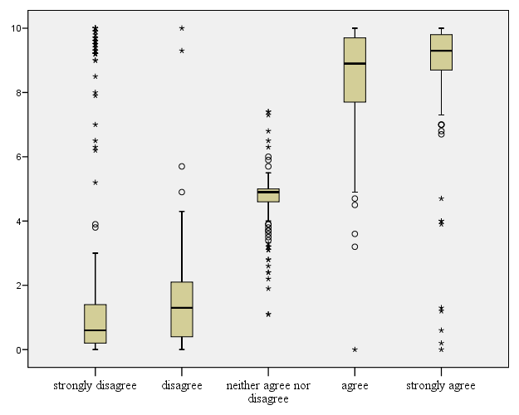
Strongly Disagreeable Ranges

Slide 27
Common Pitfalls
Using too few or too many response anchors
Influences reliability within a set of survey items
Too few (<4) → less reliable
Too many (>7-9) → diminishing return; false impression of precision
Example Item: “How useful was the rotation in emergency medicine?”
Not at all useful | Moderately useful | Very useful
?
Not at all useful | Slightly useful | Moderately useful | Quite useful | Extremely useful
Not at all useful | Minimally useful | Slightly useful | Somewhat useful | Moderately useful | Quite useful | Very useful | Extremely useful

Slide 28
Survey Design: 7-Step Process
Step 1: Literature Review
Step 2: Interviews & Focus Groups
Step 3: Synthesize
Step 4: Develop Items
Step 5: Expert Validation
Step 6: Cognitive Interviewing
Step 7: Pilot Test

Slide 29
Step 5: Expert Validation (aka, content validation)
Goal: Make sure the items “ring true” to experts
Depending on your needs, experts can consider the following for each of your survey items…
Clarity
Construct relevance
Language level
Missing facets/aspects
Difficulty

Slide 30
Step 6: Cognitive Interviewing
Goal: Make sure respondents understand the items as intended by you (the developer)
Recruit members of the targeted population
e.g., students, teachers, patients, locals, etc.
Conduct one-on-one interviews, in “laboratory” or other location
THEN: Make informed decisions, with cognitive interview as one source of input

Slide 31
Step 6: Cognitive Interviewing
Example
“In the last year, have you been bothered by pain in the abdomen?”
What problems do you anticipate?
What time period are you thinking about?
What does “bothered by pain” mean to you?
Where is your “abdomen?”

Slide 32
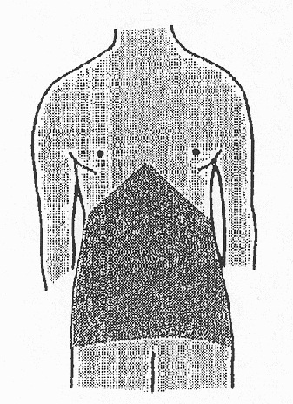
Step 6: Cognitive Interviewing
Example
“Please look at this diagram. During the past 12 months, have you had pain in this area (the area shaded on the diagram)?

Slide 33
Step 7: Pilot Testing
“Get to know” your descriptive statistics
Do individual survey items “hang together”?
Factor analysis and reliability analysis
Scale #1
Item 1
Item 4
Item 7
Item 8
Item 10
Item 15
Relation to other dimensions as you would expect?
(+) correlations with Clinical Reasoning
(-) correlations with Clinical Exam Skills
Patient Care
calculate a mean score

Slide 34
Questions?
If you remember nothing else, remember…
Principle #1: You can’t fix by analysis what you’ve spoiled by design.
Principle #2: The questions guide the answers.
Principle #3: A survey is a conversation between you and your respondents.
Jeffrey La Rochelle, MD, MPH jeffrey.la-rochelle@usuhs.edu
The presenters are U.S. Government employees. The views expressed in this presentation are those of the authors and do not necessarily reflect the official policy or position of the Uniformed Services University of the Health Sciences, Department of Defense, nor the U.S. Government.

