Slide 1
The Annual ACGME Faculty and Resident Survey: Friend or Foe?
Anne L Champeaux, MD
Anatomic & Clinical Pathology Residency Program Director
February 16, 2017

Slide 2
ACGME Survey
ANNUAL ANONYMOUS REQUIRED survey rendered by the ACGME to all residents/fellows and CORE faculty (January-June)
“Additional method” used to monitor GME and provide early warning of potential non-compliance with ACGME accreditation standards

Slide 3
Next Accreditation System (NAS)
Programs are accredited ANNUALLY (continuous accreditation)
No more 3, 4, or 5 year cycles
No more Program Information File (PIF)
RRCs ANNUALLY look at program data

Slide 4
What Data is Reviewed?
All Data is WEB ADS (ACGME data base)
# residents, #faculty, changes in numbers, PD
Scholarly activity
Response to questions (safety, QI, supervision, duty hours, responses to previous citations)
ACGME case logs
ACGME faculty and resident survey data
Board pass rate and % of residents/fellows who took the boards

Slide 5
Who will be scheduled to complete the survey?
Not all faculty members will be scheduled to complete the survey. Physician faculty members will be surveyed based on their level of involvement in the program. The program director will always be surveyed. Non-Physician faculty members (as indicated on your program's faculty roster) will NOT be surveyed. Ensure your faculty members’ information is up to date on the Faculty tab within the Accreditation Data System (ADS).

Slide 6
Core Faculty Check
Do this ANNUALLY
Core vs. Non-Core
ACGME survey distributed to CORE PHYSICIAN faculty and the PD
Need to balance
Competency and teaching abilities/capabilities
Compliance with evaluations/SURVEY
Scholarly Activity
RRC requirements

Slide 7
ACGME Faculty and Resident/Fellow Survey
Four components
INSTRUCTIONS
Faculty and Residents need to UNDERSTAND the content (ACGME mumbo jumbo…….)
COMPLIANCE
Resident: 70% completion rate
Faculty 60% completion rate
SURVEY RESULTS
Program mean, trends year to year within program
Program mean vs. national mean
ACTION PLAN
Using the data to IMPROVE the program
Responding to ACGME “Areas for Improvement” or Citations

Slide 8
PRE-SURVEY “INSTRUCTIONAL” COACHING
It can’t hurt. It may not help. At least you tried.
Sit personally with residents and faculty
No longer have sample survey
Use most recent survey
Use categories from ACGME website / Resident survey “key terms”, duty hour rules
Make a “cheat sheet”
Remind folks when they complete anonymous evaluation of program/faculty, show duty hours, remind them of patient care teams
Distribute scholarly activity/QI activity

Slide 9
FACULTY CHEAT SHEET EXCERPTS
Evaluation after rotations and educational assignments: All residents complete an end of rotation evaluation. These evals are available at any time on request. At the end of each academic year the evals for each site are compiled and given to the site director and rotation supervisor. The PEC and APE process has oversight.
Faculty performance evaluated: This can be discussed on the rotation evaluations, but faculty are evaluated ANONYMOUSLY annually (spring each year by the residents). The complied evaluations are distributed to the faculty member and his/her supervisor at their institution to use in their own evaluation process. The PEC and APE process has oversight.

Slide 10
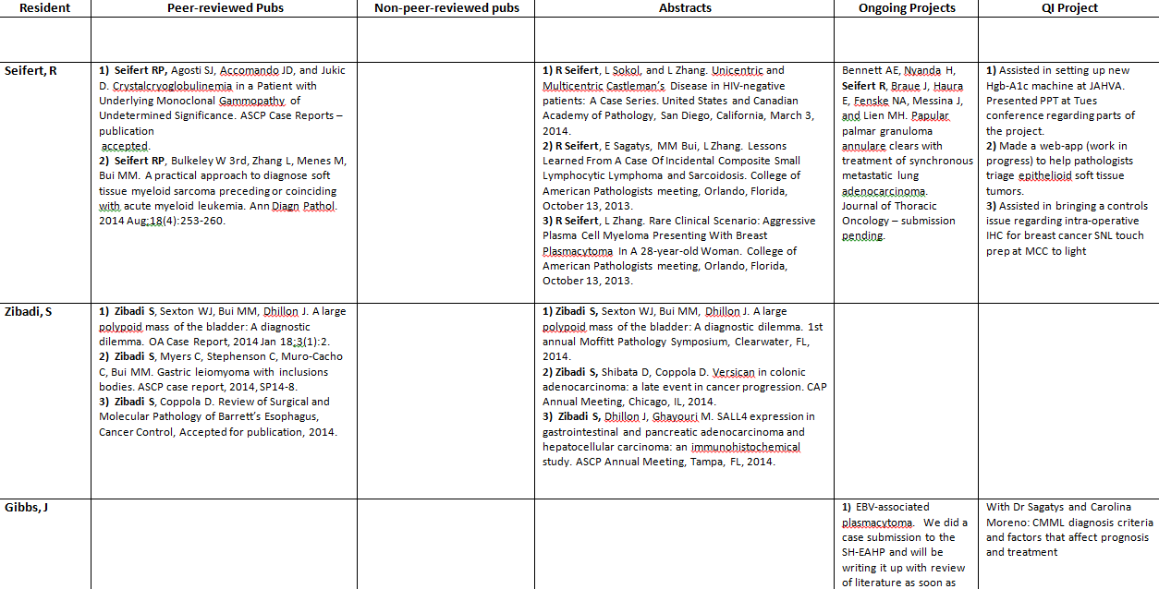
SCHOLARY/QI DISTRIBUTION

Slide 11
Instructions
Probably “Foe”
SAME survey given to all programs and fellowships
Who really knows what “practice habits are”
The week of the survey I went through our “fatigue mitigation” practices and education and still not 100%.........

Slide 12
ACGME Faculty and Resident/Fellow Survey
Four components
INSTRUCTIONS
Faculty and Residents need to UNDERSTAND the content (ACGME mumbo jumbo…….)
COMPLIANCE
Resident: 70% completion rate
Faculty 60% completion rate
SURVEY RESULTS
Program mean, trends year to year within program
Program mean vs. national mean
ACTION PLAN
Using the data to IMPROVE the program
Responding to ACGME “Areas for Improvement” or Citations

Slide 13
Compliance: Tips and Tricks
Communication, communication, communication…
Emails: Use READ RECIEPT. May have to knock on doors for those folks who “don’t read email”
Make it a competition.
First to 100% gets…….
Monitor the compliance (weekly).
SET TIME ASIDE (AKA “This is serious!”)
Use of part of department meeting, resident didactic time, work into clinic schedule

Slide 14
Don’t….
Single out folks
Use non-compliance as punitive….
Threaten or bribe individuals to answer a certain way.

Slide 15
TRANSPARENTLY MONITOR COMPLIANCE
Ensure compliance rate is reviewed and discussed as part of the ANNUAL PROGRAM REVIEW
Thank residents and faculty for participation
“Buy in”. Everyone should realize the survey is important. It’s important to you (PD), the program, and the ACGME. Use the survey as positive communication rather than the tool to complain to the ACGME…..
“Let’s show the ACGME how good our program is!”

Slide 16
Compliance
Both “friend” and “foe”
Takes some effort to remind folks to complete
Generally though can easily meet minimal compliance if not 100% (friend)

Slide 17
ACGME Faculty and Resident/Fellow Survey
Four components
INSTRUCTIONS
Faculty and Residents need to UNDERSTAND the content (ACGME mumbo jumbo…….)
COMPLIANCE
Resident: 70% completion rate
Faculty 60% completion rate
SURVEY RESULTS
Program mean, trends year to year within program
Program mean vs. national mean
ACTION PLAN
Using the data to IMPROVE the program
Responding to ACGME “Areas for Improvement” or Citations

Slide 18
Sit and wait……
Results sent via electronic mail.
Results are posted in ACGME

Slide 19
Just a little more information….
Resident Survey Reports – When at least 70% of a program’s residents/fellows have completed the survey and at least 4 residents/fellows have responded, reports will be available annually. For those programs with less than 4 residents/fellows who meet the 70% compliance rate, reports will only be available on an aggregated basis after at least 3 years of survey reporting has taken place.
Faculty Survey Reports – When at least 60% of a program’s faculty members have completed the survey and at least 3 faculty members have responded, reports will be available annually. For those programs with less than 3 faculty members scheduled to participate who meet the 60% compliance rate, reports will only be available on an aggregated basis after at least 3 years of survey reporting has taken place

Slide 20
Tip
For those programs who do NOT receive annual aggregated results, recommend own INTERNAL anonymous survey
USF GME survey
Some data probably better than no data
Use similar questions (fear, practice habits, supervision, etc)

Slide 21
Results are back: What do I do?
1) Look at resident survey
Administrative box (correct program, dates, compliance)
Results. Compare to prior
Identify “problem” areas
Arrange residents to construct “The Letter”
2) Look at faculty survey
Administrative box (correct program, dates, compliance)
Results. Compare to prior
Identify “problem” areas
Arrange for “flags” to discuss next PEC
3) Don’t take the results personally

Slide 22
Results
Set your benchmarks (compared to national mean, own internal benchmark, downward trend) 80%
Circle lines which you feel need to be addressed (didn’t meet benchmark)

Slide 23
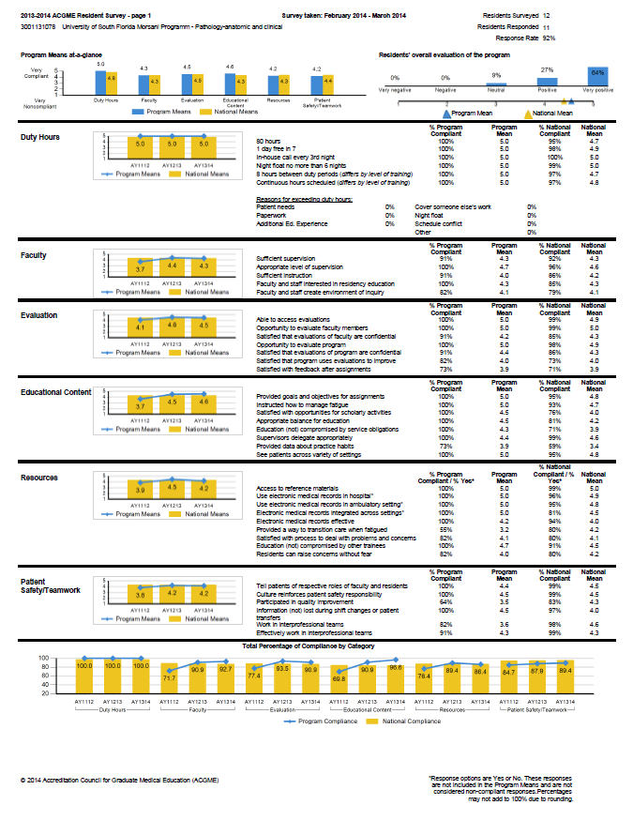

Slide 25
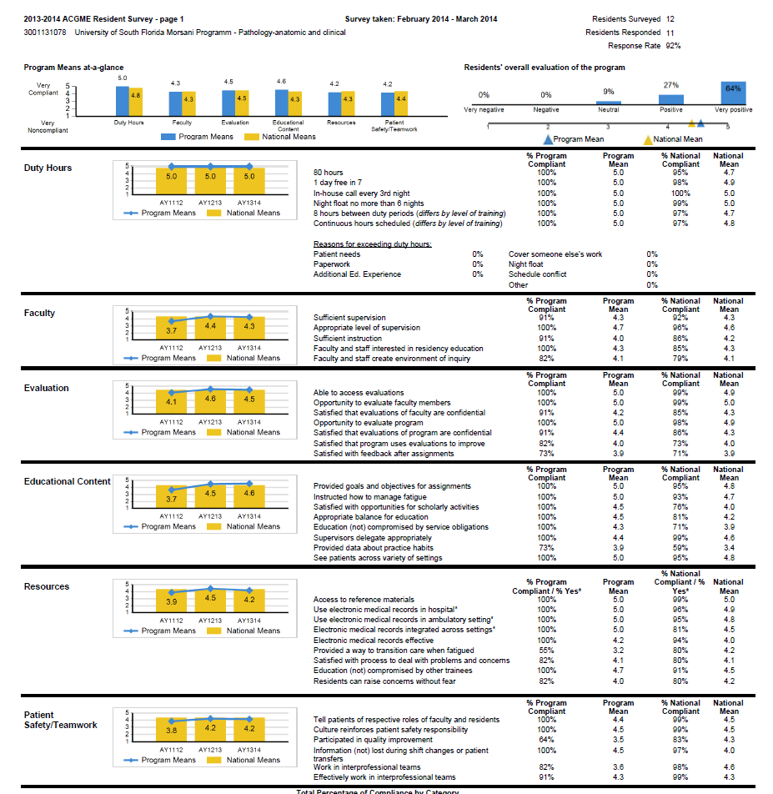

Slide 28
“The Letter”: A tool for Resident Survey Follow-up
Resident driven
Resident signed
Include and file with surveys, annual program review data
Still maintains anonymity
Gives residents sense of active participation in program improvement
It allows the PD and faculty a potential glimpse into “what were the residents thinking…..”

Slide 29
The Letter…….
Dear Dr. Champeaux,
The results of our ACGME anonymous resident survey was discussed both at a resident meeting and over an email thread dated 7/15/2014 with all program residents. The specific survey items addressed included (1) “Satisfied with feedback of assignments,” (2) “Provided data about practice habits,” (3) “Provided a way to transition care when fatigued,” and (4)“Participated in Quality Improvement.” Residents were given a week to provide feedback. The issues were addressed as follows:
1. No specific issues were identified; however some residents have expressed frustration with the paper Medical Autopsy and Frozen Section evaluation forms to me in the past. If these forms can be transitioned to electronic they may be easier to distribute and collect. Also some residents in general feel the volume of evaluations is too great.
2. During the feedback period, one resident told me she marked this low because she did not understand what it meant. Frankly, I am not sure what it means. Do they mean about our own practice habits during our rotations? If so, we now have mid-rotation and mid-month eval forms to correct poor habits early.

Slide 30
Resident Survey
Areas identified which need to be addressed MUST be part of your PEC activities and your ANNUAL PROGRAM EVALUATION
Develop an ACTION PLAN to address the areas
Annotate in WEBADS your program improvement process

Slide 31
FACULTY SURVEY DATA
Could construct a letter (I have not done)
Definitely review problem areas via PEC/APE and document similar to resident data

Slide 32
Results
Both friend and foe
Foe: the ACGME is DEFINITELY using survey results to generate AFI/Citations
Friend: This is data the ACGME is giving you to use in the improvement process and development of action plans

Slide 34
Questions?

