Slide 1

Role of Research Synthesis in Healthcare
Rahul Mhaskar
Director
Office of Research, Innovation and Scholarly Endeavors (RISE)
Associate Professor
Department of Internal Medicine
Morsani College of Medicine, University of South Florida
November 12, 2019

Slide 2
Learning objectives
Describe need of research synthesis and its impact of clinical decision making
Understand the differences between a review paper and a systematic review
Understand the design and conduct of a systematic review and meta-analysis
Understand the role of appraisal of methodological quality of trials in a systematic review

Slide 3

Case
A 60 year old woman with multiple myeloma is referred to a cancer center for the management of his bone disease. The attending physician wants to decide whether the patient should be treated with bisphosphonates?
Does bisphosphonates help in reducing fractures and improving overall survival in patients with multiple myeloma?

Slide 4
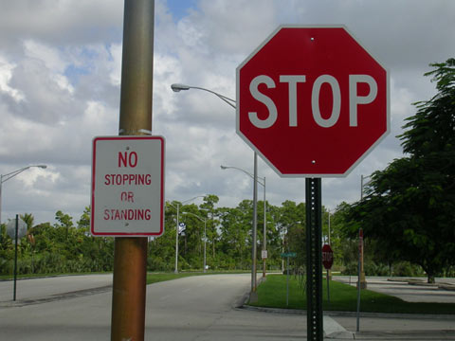
The (conflicting) evidence !
Randomized controlled trial 1:
  Bisphosphonates reduce the number of vertebral fractures in patients with multiple myeloma and improves overall survival
Randomized controlled trial 2:
  Bisphosphonates have no effect on vertebral fractures and in fact bisphosphonates can lead to osteonecrosis of jaw (ONJ).

Slide 5

The need for research synthesis
Health care decision makers need to access research evidence to make informed decisions for both individual patients and populations.
There are only few important questions in health care which can be informed by consulting the result of a single empirical study.
Selective citation
Totality of evidence

Slide 6
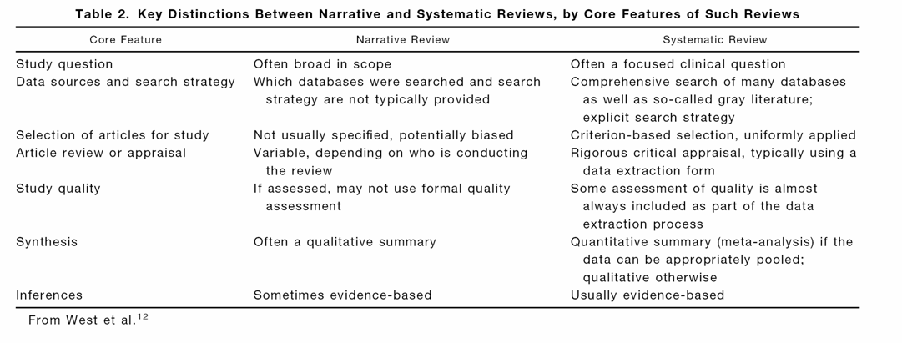
Systematic vs. narrative reviews

Slide 7
Research synthesis: systematic review and meta analysis
Systematic Review (SR)
  "The application of strategies that limit bias in the assembly, critical appraisal, and synthesis of all relevant studies on a specific topic. Meta-analysis may be, but is not necessary, used as part of this process.“
Meta-Analysis (MA)
  " The statistical synthesis of the data from separate but similar, i.e. comparable studies, leading to a quantitative summary of the pooled results."
Last JM. Dictionary of Epidemiology, 2001

Slide 8
Rise of SRs

Slide 9
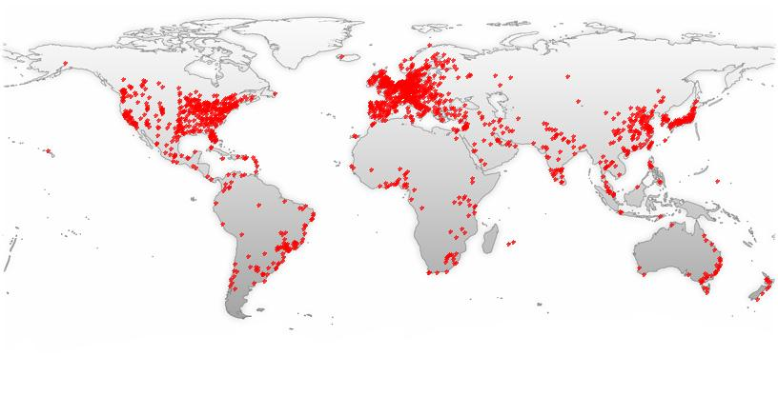
SR/MA publications: World
Notes:
GoPubMed

Slide 10
Ethical and (regulatory) obligations
Clinical trials should be preceded by a systematic review and should be reported with a discussion of assessing the trial’s results in the context what is already known
  Ethical requirement for updating systematic reviews
Mandating search or conduct of a systematic review before a new clinical trial is done
  Required in UK, Denmark, Holland
  Peer-reviewed high impact journals require discussion of current findings in the context of a SR. (Lancet, JAMA etc.)
JAMA 1998;280:280-282;Lancet 2001:358:1648
Chalmers I. Clin Trials 2005;2:229-31;
Young C, Horton R. Lancet 2005;366:107-8
Courtesy: Dr. Djulbegovic

Slide 11
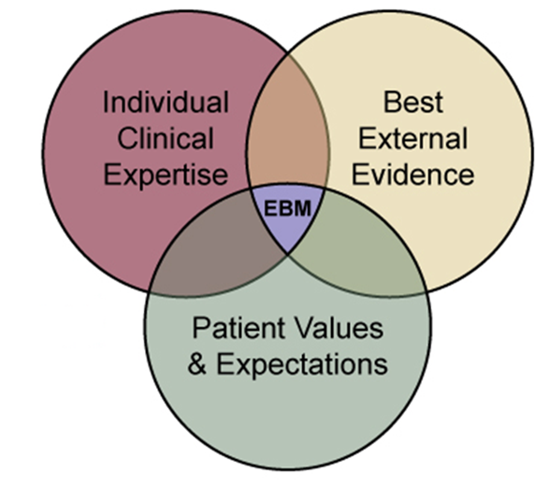
Case studies: rationale for SR/MA
Systematic review/
meta analysis

Slide 12
Case Study 1: “Egg on their faces: the story of human albumin solution”*
Human albumin solution, a blood product, has been used in the treatment of blood loss and burns since the attack on Pearl Harbour over half a century ago.
In 1996, the global albumin market was worth $ 1.5 billon
But is human albumin administration beneficial?
*1. Roberts I, et al. Egg on their faces. The story of human albumin solution. Eval Health Prof. 2002;25(1):130-8.
2. Cochrane Injuries Group Albumin Reviewers. Human albumin administration in critically ill patients: systematic review of randomized controlled trials. BMJ 1998;317:235-40.
Courtesy: Dr. Pai

Slide 13
“Egg on their faces: the story of human albumin solution”
SR of RCTs comparing albumin with crystalloid was conducted by the Cochrane Injuries Group.
30 RCTs including 1,419 randomised patients identified.
Meta-analysis showed that the risk of death among those treated with albumin was higher than in the comparison groups.
The pooled risk ratio was 1.68 (95% CI 1.26, 2.23)
Roberts I, et al. Egg on their faces. The story of human albumin solution. Eval Health Prof. 2002;25(1):130-8.

Slide 14
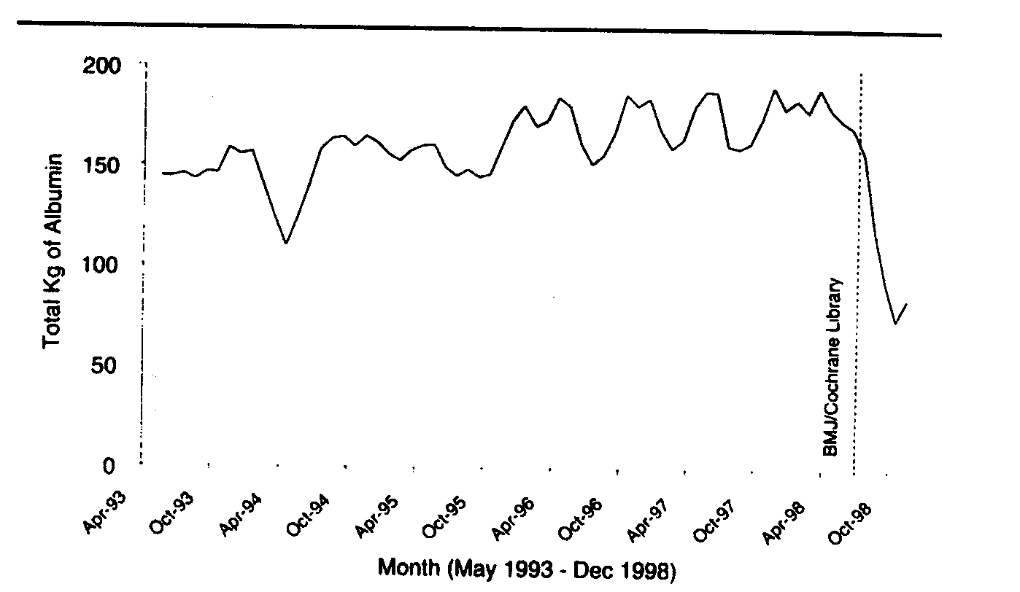
“Egg on their faces: the story of human albumin solution”
Roberts I, et al. Egg on their faces. The story of human albumin solution.
Eval Health Prof. 2002;25(1):130-8.

Slide 15
Case study 2: “Is passive smoking harmful?”
A topic of great debate and controversy for many years
First few epidemiologic studies were published in 1918
Vigorously attacked by the tobacco industry
  Too small an association
  Potential bias
  Potential confounding
  Lack of biological proof
Evidence accumulated over the next 2 decades
It was not until about 15 years ago when several official bodies/agencies concluded that passive smoking is a cause of lung cancer
  The tobacco industry continues to dispute this claim!!
Hackshaw AK et al. BMJ 1997;315:980-88.
Hackshaw AK. Stat Meth Med Res 1998;7:119-136.
Courtesy: Dr. Pai

Slide 16
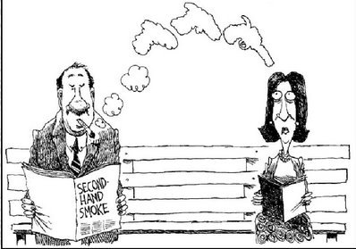
“Is passive smoking harmful?”
Hackshaw et al. conducted a SR in 1997:
  They identified 37 published studies that reported risk of lung cancer among lifelong non-smoking women according to the husband’s smoking status
  Their meta-analysis revealed that the overall risk of lung cancer among lifelong non-smoking women was 1.24 times higher when their husbands smoked, as compared to those women whose husbands did not smoke.
Hackshaw AK et al. BMJ 1997;315:980-88.
Hackshaw AK. Stat Meth Med Res 1998;7:119-136.

Slide 17
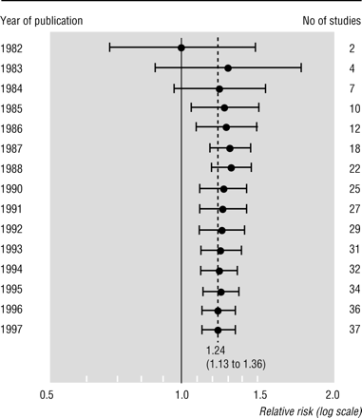
“Is passive smoking harmful?”
Yes it is !
Hackshaw AK et al. BMJ 1997;315:980-88.
Hackshaw AK. Stat Meth Med Res 1998;7:119-136.

Slide 18
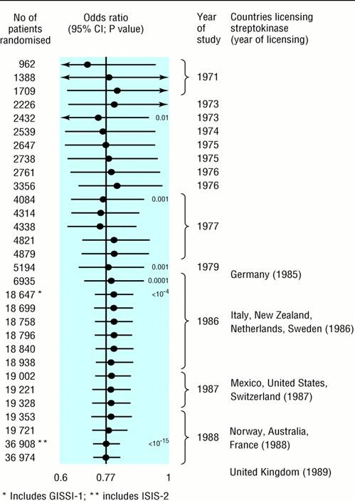
Case study 3:Streptokinase in acute myocardial infarction
Total mortality
Licensing would have
been possible in 1973
More than 17,000 patients were treated in placebo arms from 1974 to 1988.
Streptokinase reduced mortality by 20%.
Avoidable deaths
approx. 1000 patients
Egger M, BMJ 1997; 15:1371
Lau et al., NEJM 1992; 327: 248
Notes:
LAU, NEJM 1992
BACKGROUND. The large volume of published randomized, controlled trials has led to a need for meta-analyses to track therapeutic advances. Performing a new meta-analysis whenever the results of a new trial of a particular therapy are published permits the study of trends in efficacy and makes it possible to determine when a new treatment appears to be significantly effective or deleterious. We describe the use of such a procedure, cumulative meta-analysis, to assess therapeutic trials among patients with myocardial infarction. METHODS. We performed cumulative meta-analyses of clinical trials that evaluated 15 treatments and preventive measures for acute myocardial infarction. RESULTS. An example of this method is its application to the use of intravenous streptokinase as thrombolytic therapy for acute infarction. Thirty-three trials evaluating this therapy were performed between 1959 and 1988. We found that a consistent, statistically significant reduction in total mortality (odds ratios, 0.74; 95 percent confidence interval, 0.59 to 0.92) was achieved in 1973, after only eight trials involving 2432 patients had been completed. The results of the 25 subsequent trials, which enrolled an additional 34,542 patients through 1988, had little or no effect on the odds ratio establishing efficacy, but simply narrowed the 95 percent confidence interval. In particular, two very large trials, the Gruppo Italiano per lo Studio della Streptochinasi nell'Infarto Miocardico trial in 1986 (11,712 patients) and the Second International Study of Infarct Survival trial in 1988 (17,187 patients) did not modify the already established evidence of efficacy. We used a similar approach to study the accumulating evidence of efficacy (or lack of efficacy) of 14 other therapies and preventive measures for myocardial infarction. CONCLUSIONS. Cumulative meta-analysis of therapeutic trials facilitates the determination of clinical efficacy and harm and may be helpful in tracking trials, planning future trials, and making clinical recommendations for therapy.
GISSI: Death in control arm 13%, ISIS-2: 12%. Assumming a mortality rate of 12% in the control arm, more than 400 deaths could have prevented.

Slide 19
Steps of SR/MA

Slide 20
Steps of a systematic review
  Research protocol
  Formulating a research question
  Search of relevant literature
  Data extraction and quality appraisal
  Synthesis (+ / - meta analysis)
  Interpretation

Slide 21
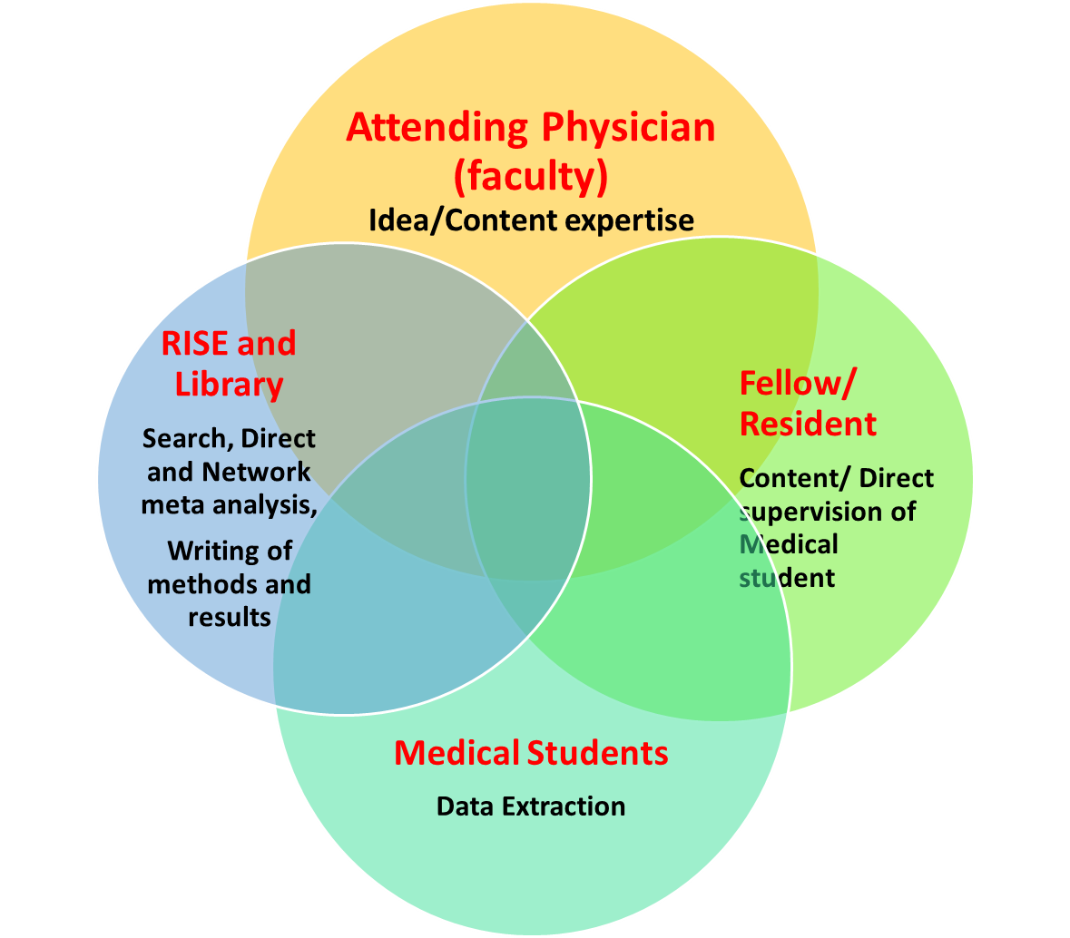
A successful team

Slide 22
Protocol Cochrane Library
Type of SR: Intervention / diagnostic etc.
Title
Authors
Background
Objectives (research question in PICO format)
Methods
Criteria for considering studies for this review
  Types of studies
  Types of participants
  Types of interventions
  Types of outcome measures
Search methods for identification of studies
Data collection and analysis
  Data extraction and assessment of methodological quality
Data synthesis (meta analysis)
  Sensitivity analysis
Contributions of authors
Declarations of interest

Slide 23
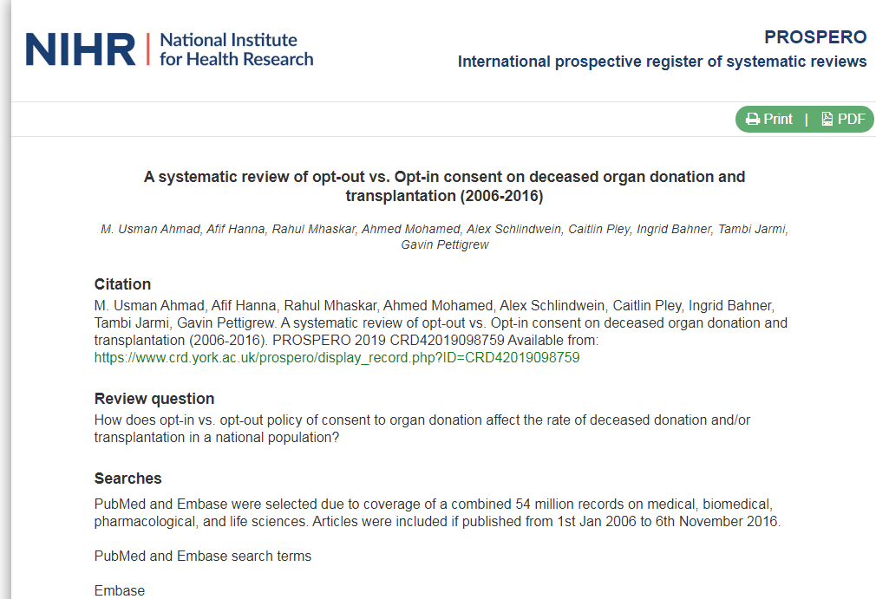
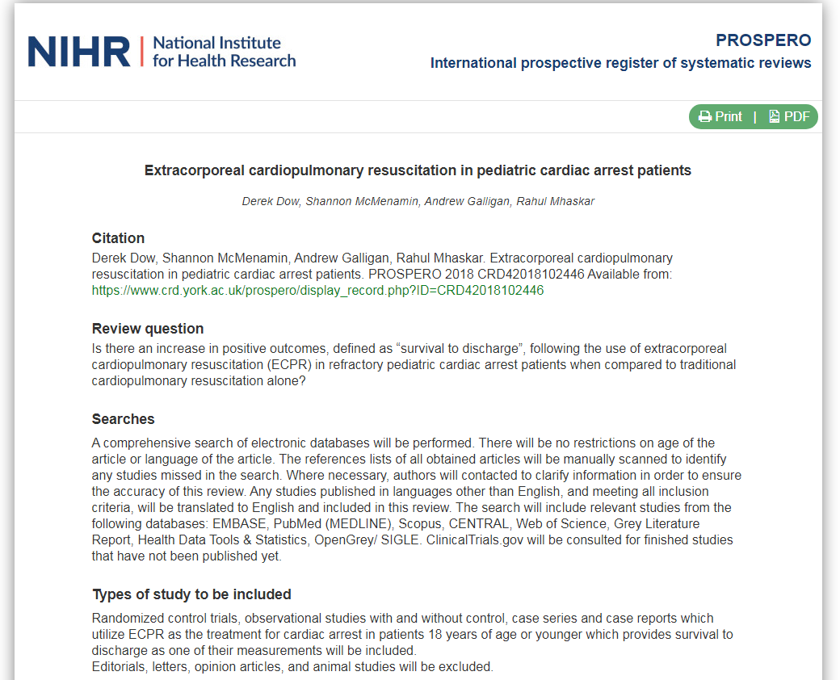
PROSPERO: Database of systematic review protocols

Slide 24
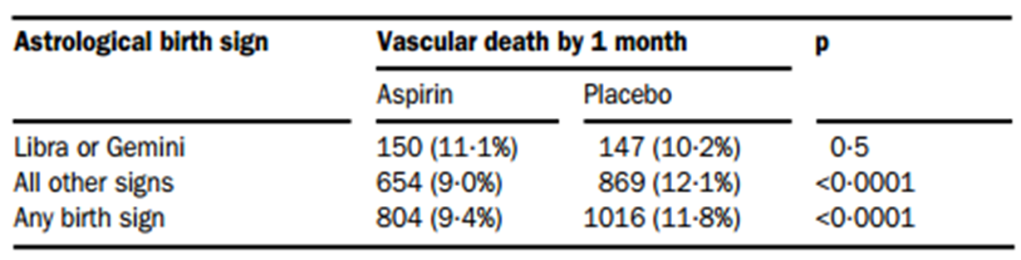
Astrology in the International Study of Infarct Survival trials
All of the patients had their date of birth entered as an important 'identifier'.
Divided study population into 12 subgroups by astrological star sign.
For Gemini and Libra: aspirin had a non-significant adverse effect.
ISIS-2. ISIS-2 (Second International Study of Infarct Survival) Collaborative Group. Lancet. 1988 Aug 13;2(8607):349-60.
Debate: Subgroup analyses in clinical trials: fun to look at - but don't believe them! Curr Control Trials Cardiovasc Med. 2000; 1(1): 25–27.

Slide 25

Research question
Patients: patients diagnosed with multiple myeloma
Intervention: bisphsophonates
Control: placebo / no treatment / other bisphosphonates
Outcomes: vertebral and non vertebral fractures

Slide 26
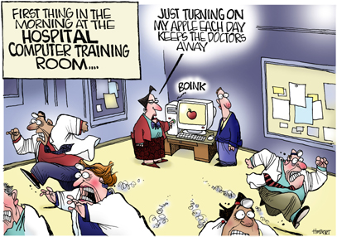
Searching made easy ☺ at Shimberg Library

Slide 27
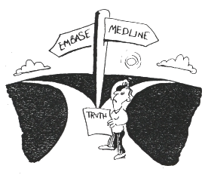
Literature search
Talk to the Librarian (Ms.Laura for HCA Colleagues).☺
Electronic databases: Medline, Cochrane library, Embase, Lilacs etc.
Meeting abstracts: ASH, ASCO etc.
Web: WWW.clinicaltrials.gov
(((“MultipleMyeloma”[Mesh]OR“Plasmacytoma”[Mesh]ORmultiplemyelomaOR plasmacytomaOR plasmacytom*ORmyelom*)
AND(bisphosphonatesOR pamidronate OR zoledronateOR etidronateOR ibandronate OR clodronateOR “Clodronic Acid”[Mesh]
AND ((clinical[Title/Abstract] AND trial[Title/Abstract]) OR clinical trials[MeSH Terms] OR clinical trial[Publication Type] OR random*[Title/Abstract] OR random allocation[MeSH Terms] OR therapeutic use[MeSH Subheading])

Slide 28
Process of inclusion and exclusion
Create one Endnote library
Review all citations and put them into one of the three categories:
    Included studies
    Excluded studies (provide reasons for exclusion)
    Need more information
Two review authors need to complete this process independently
Senior author to resolve discrepancies

Slide 29
Inclusion and exclusion criteria
Included studies: RCTs in which interventions consist of bisphosphonates against placebo or no treatment or other bisphosphonates in multiple myeloma patients.
Excluded studies: Duplicate reports, sub group analysis and studies with fewer than 10 patients.

Slide 30
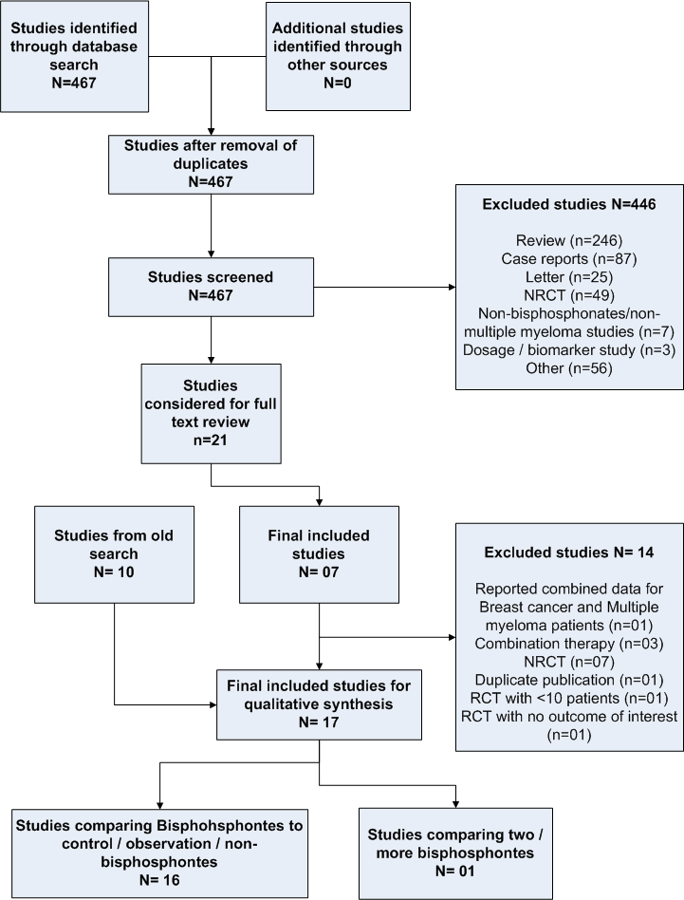
Notes:
Unit of analysis diff. pt and RCT. Add flow chart

Slide 31
Data extraction
Define the outcomes a priori:
  Number of participants with disease progression, time to progression, presence of pain (as defined by individual authors),
  incidence of hypercalcemia (defined as: =>2.65 mmol/L),
  adverse events (grade III/IV)
Two review authors will extract all data, and resolve disagreements by consensus.
After the extraction, a third review author will re-check all data.

Slide 32

Methodological quality assessment
Risk of bias
Random error

Slide 33
Methodological quality of the included studies
Quality assessment tool for RCTs
Assessment of risk of bias
  Generation of randomization sequence
  Allocation concealment
  Description of withdrawals and drop-outs
  Intention to treat analysis
  Blinding methods and who were blinded
Assessment of risk of random error
  Pre-specification of alpha and beta error
  A priori calculation of sample size
Newcastle Ottawa scale for observational studies

Slide 34


The Good The Bad The Ugly (studies)
We need to include ALL the studies that fulfill the a priori set inclusion criteria. Then:
Conduct a critical appraisal of ALL the included studies.
We do not pick and choose..

Slide 35

Meta analysis is not simple addition !

Slide 36
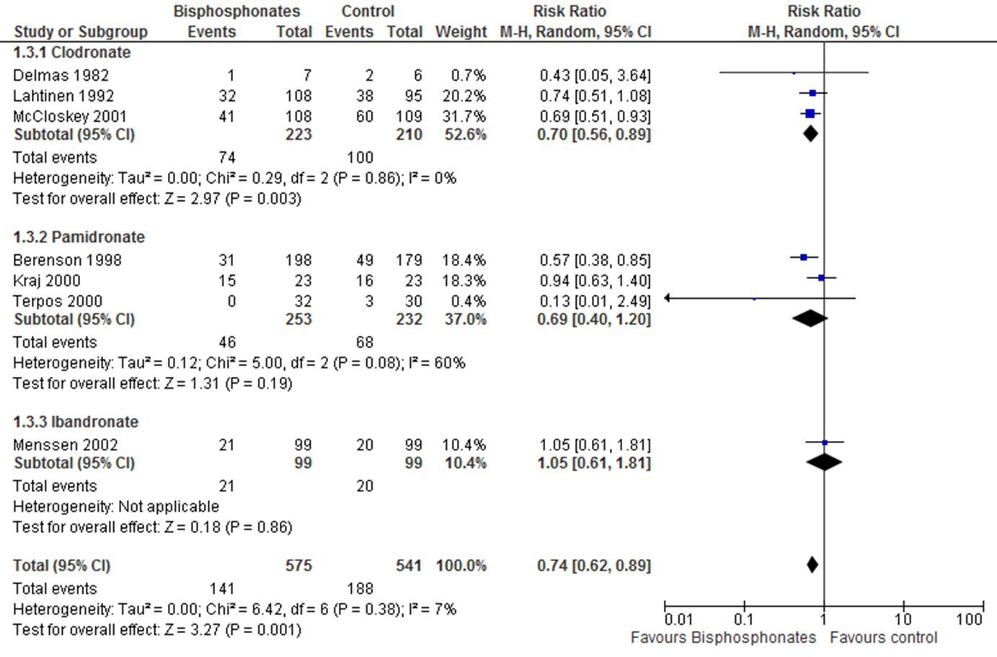


Slide 37
Key statistical principles of meta-analysis: two stage process
Remeber: the unit of analysis of a systematic review is an individiual study.
Patients in one trial are not directly compared with those in another trial
Each trial is analysed separately
Summary statistics are calculated for each trial
These summary statistics are added together in the meta-analysis

Slide 38
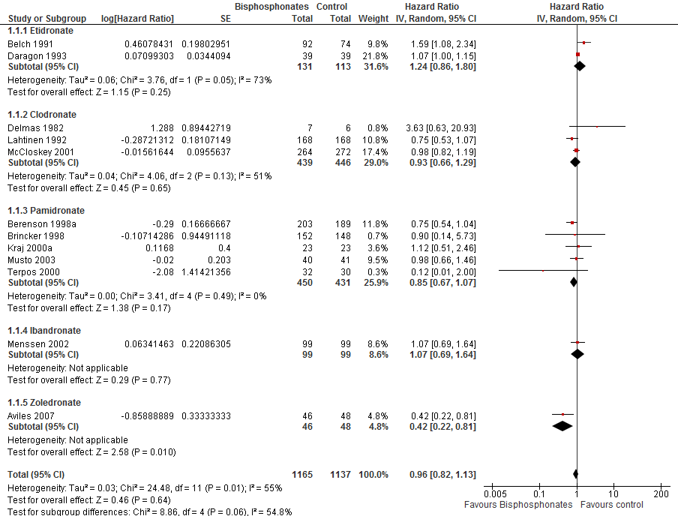

Slide 39
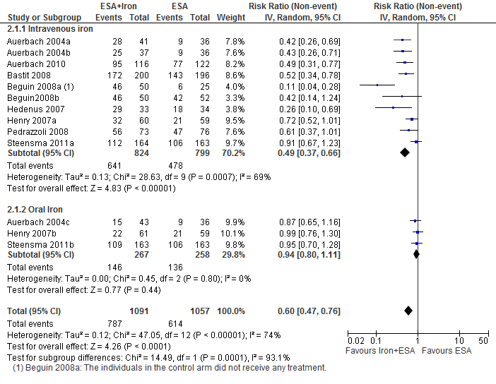
IV Iron
Oral Iron

Slide 40
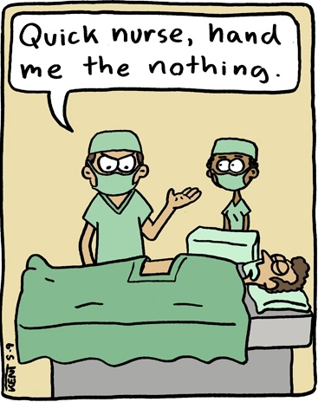
Network meta analysis
Placebo
Rx B
Rx A

Slide 41
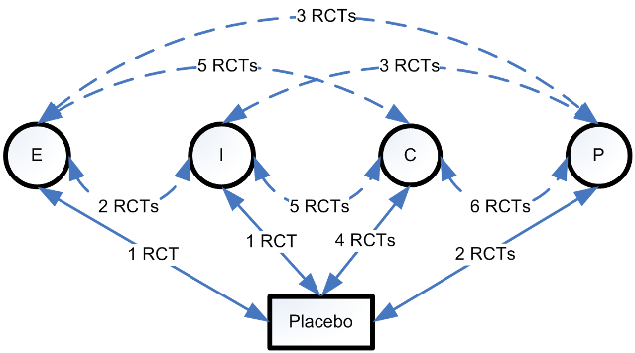
Network meta analysis

Slide 42
Grading of Recommendations, Assessment, Development and Evaluation (GRADE): Summary of findings
Evidence profiles

Slide 43
Factors that can reduce the quality of the evidence | Factors that can increase the quality of the evidence
Limitations in study design or execution (risk of bias): Limitations in the study design and execution may bias the estimates of the treatment effect. | Large magnitude of effect: Risk ratio: >2 or <0.5 (based on direct evidence, with no plausible confounders) Very large magnitude of effect: RR: >5 or <0.2 (based on direct evidence with no serious problems with risk of bias or precision, i.e. with sufficiently narrow confidence intervals)
Inconsistency of results: refers to an unexplained heterogeneity of results. | All plausible confounding would reduce the demonstrated effect or increase the effect if no effect was observed
Indirectness of evidence: Direct evidence consists of research that directly compares the interventions which we are interested in, delivered to the populations in which we are interested, and measures the outcomes important to patients. | Dose-response gradient : may increase our confidence in the findings of observational studies and thereby increase the quality of evidence.
Imprecision: Imprecise results (gauged by wider 95% confidence intervals) lead to lower quality evidence
Publication bias: systematic under-estimation or an over-estimation of the underlying beneficial or harmful effect due to the selective publication of studies

Slide 44
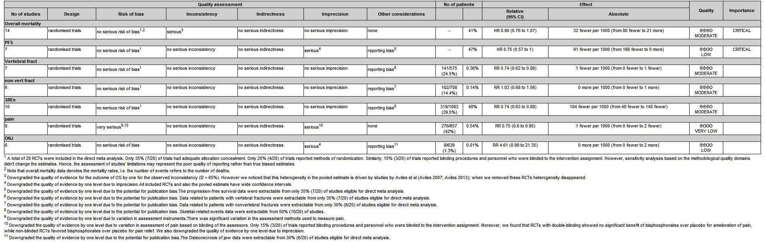

Slide 45
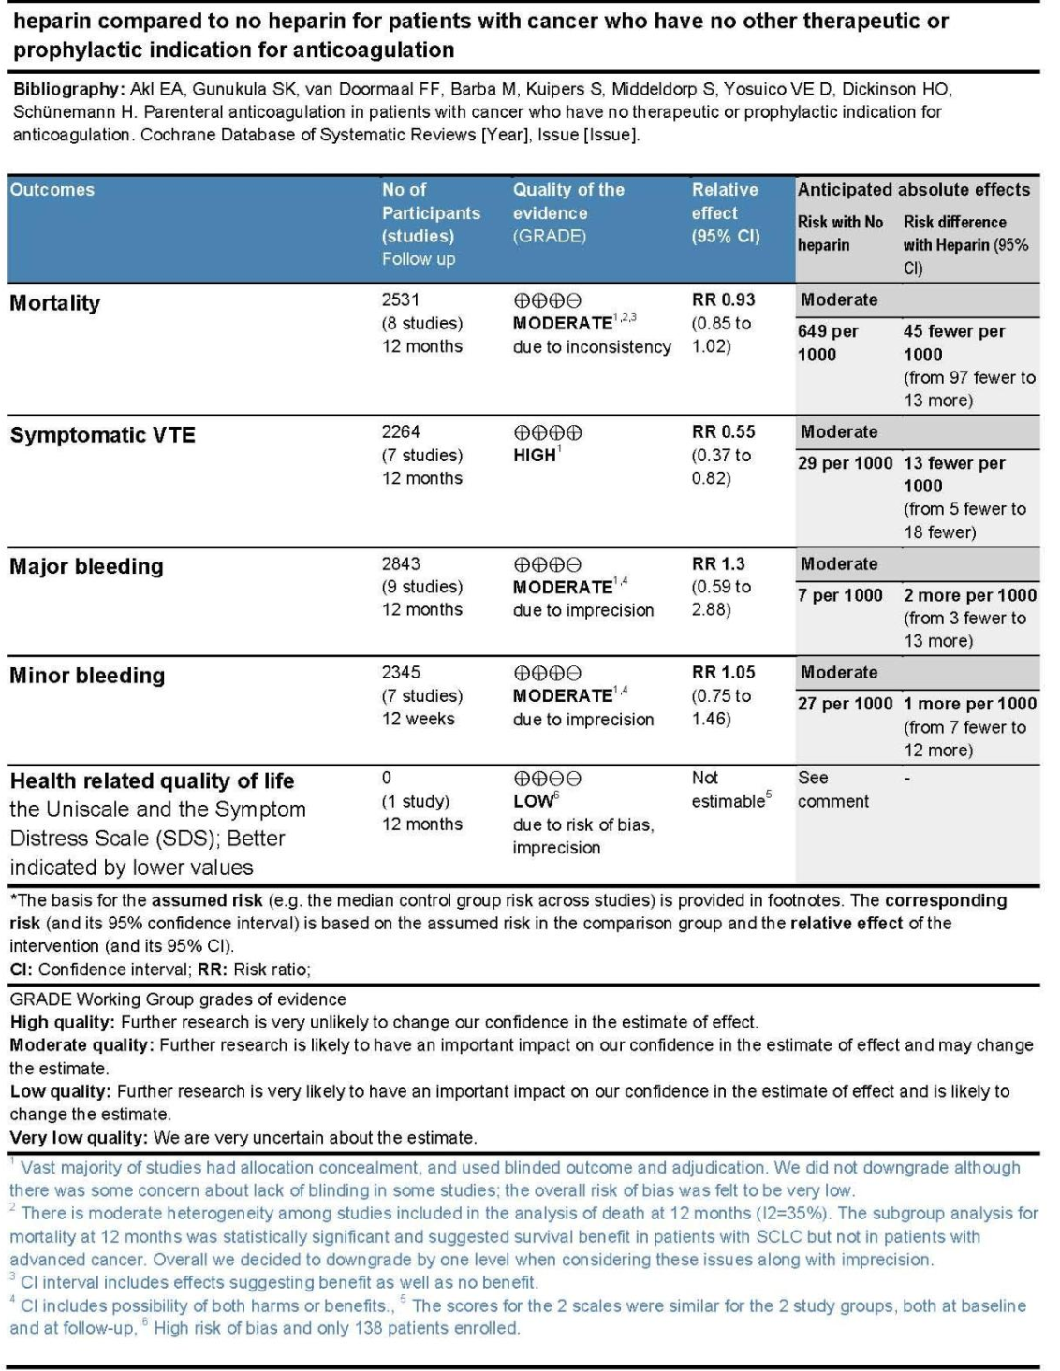
Summary of all relevant findings and quality of evidence at one place
Quality of evidence for each outcome
Relative and absolute effects of each outcome
Reasons for downgrading quality

Slide 46
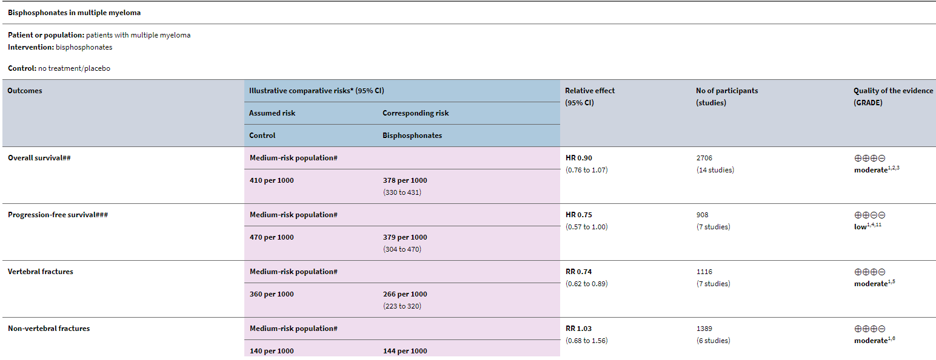
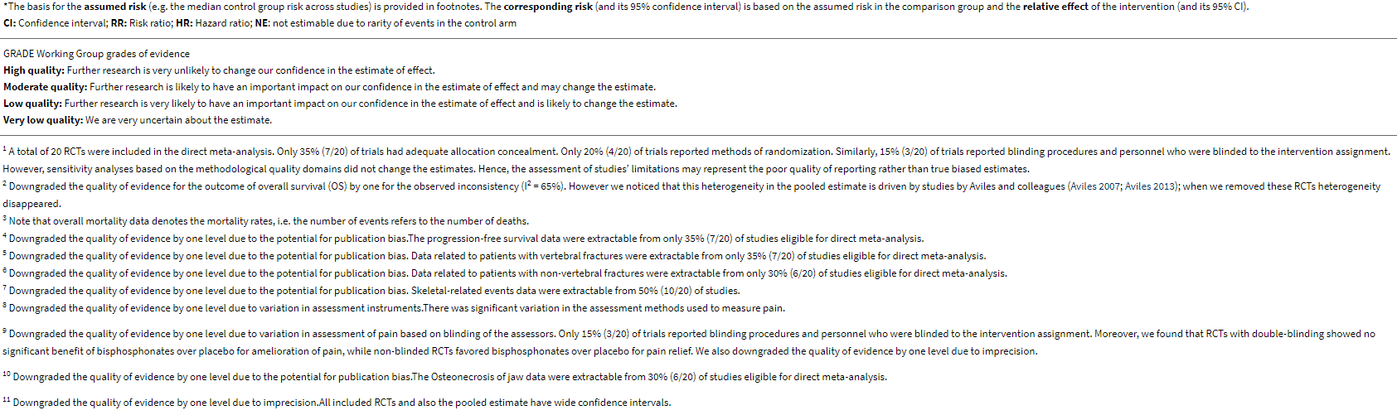

Slide 47
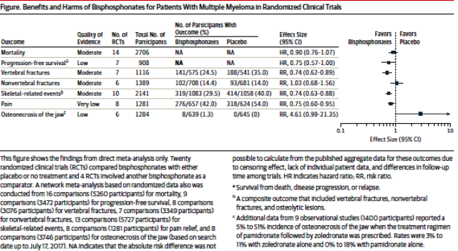

Slide 48
Systematic reviews and clinical practice guidelines

Slide 49
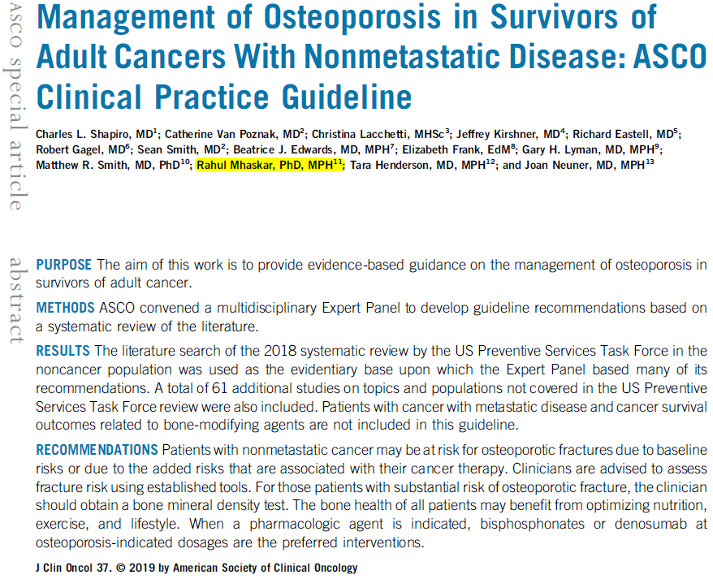

Slide 50
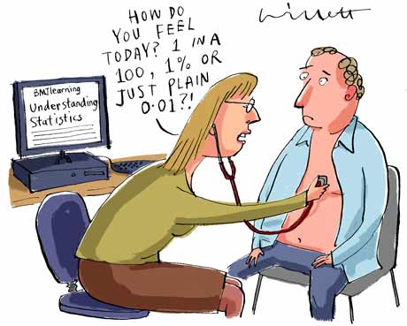
Applying the evidence to the individual
What do the results “mean” on average?
What do they mean for this individual?

Slide 51

Where to look for SR/MA?
Clinical queries
http://www.ncbi.nlm.nih.gov/pubmed/clinical
Cochrane Collaboration

Slide 52
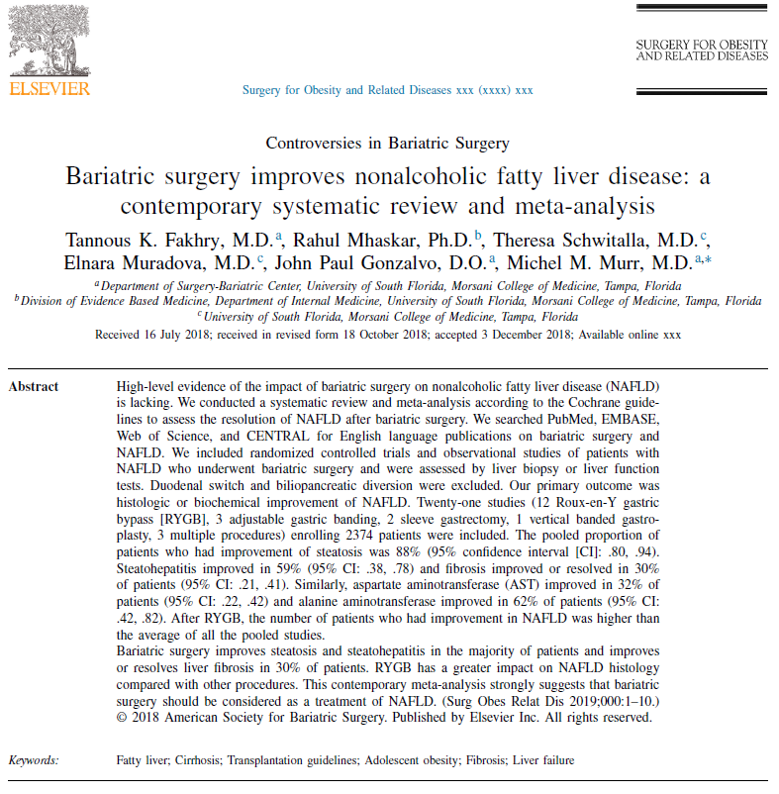
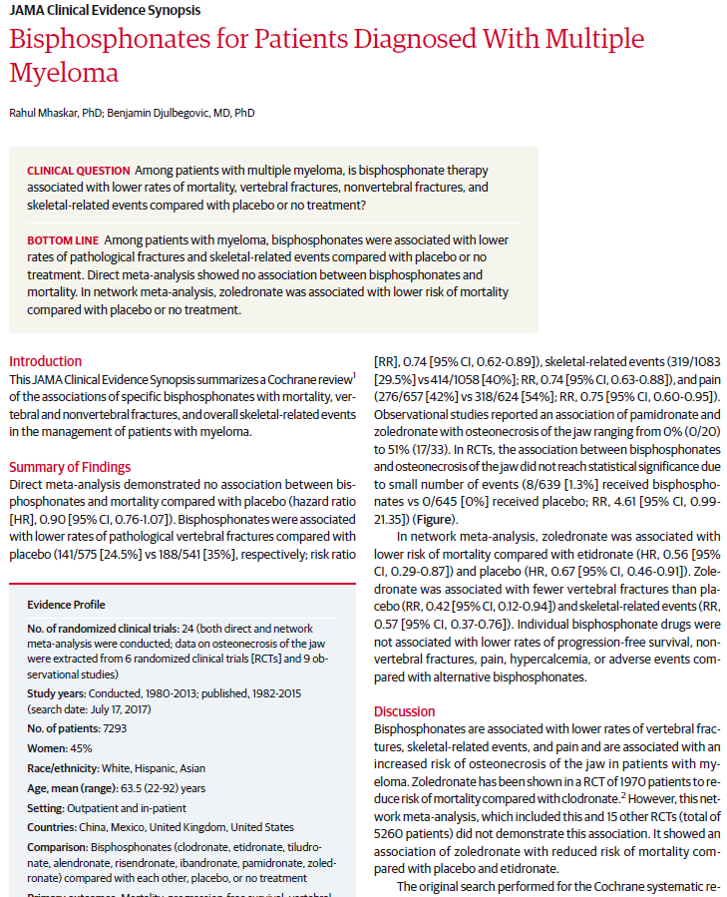
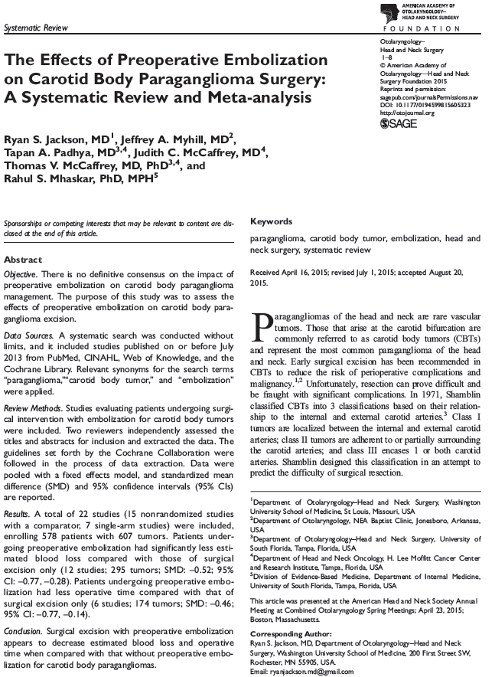

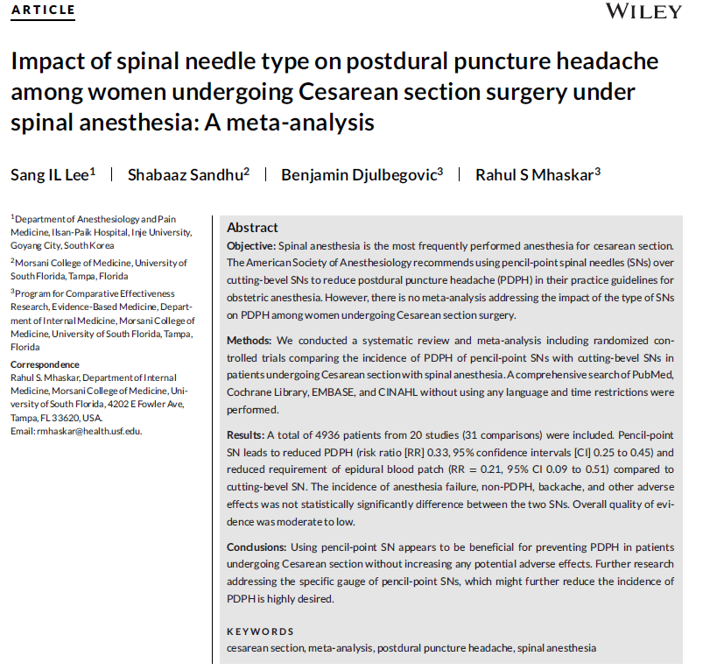
v

Slide 53
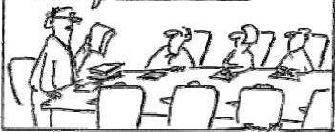
Questions
The latest research shows that we should do something with all this research !

Slide 54

GME research needs assesment
https://usfhealth.az1.qualtrics.com/jfe/form/SV_cwpYPX4N6sCPqK1

Slide 55
Thank you.
For additional questions: please send an email or call: rmhaskar@usf.edu
Cell Phone: 765 337 5899

