Slide 1
Teaching Clinical Reasoning
A FACULTY DEVELOPMENT WORKSHOP Shanu Gupta MD FACP Acknowledgements: Roshini Pinto-Powell MD FACP - Dartmouth Joel Appel DO – Wayne State

Slide 2
This speaker has nothing to disclose
Disclosure
Notes:
2

Slide 3
Objectives
Reflect on personal educational experiences of teaching and learning clinical reasoning as a novice and as an expert
Describe the steps involved in clinical problem solving
Develop a plan for facilitating the clinical reasoning process for learners in the clinical setting
Notes:
Emphasize that 1 and 2 are brief discussions as our priority is number 3

Slide 4
Audience

Slide 5
A Case
Notes:
Who’s here?
Clerkship directors
Co-ordinators
Other Education specialists
Where do you explicitly teach clinical reasoning?
Do you have students write a problem representation during clerkship?
How do you evaluate clinical reasoning?

Slide 6
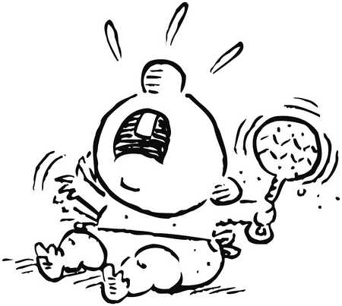
12 day infant presents with vomiting and bloody stool
Onset: 6 days old
Vomiting, followed by irritability and diarrhea
Abdominal x-ray:
bowel gas paucity in the RLQ suggestive of intussusception
Transferred for surgical consultation
Switched formula, did not relieve symptoms.
Six days later:
bloody stools with mucus
periods of inconsolable crying
Notes:
Bacterial enteritis, milk protein allergies, intussusception, swallowed maternal blood, lymphonodular hyperplasia. Rarer causes of neonatal GI bleeding: volvulus, AVMs, NEC, Meckel diverticulitis

Slide 7
Contrast enema:
equivocal data
contrast media failed to progress at the hepatic flexure
suspicious for intussusception, although atypical
Abdominal examination “benign”
Continued crying spells
Small bowel follow-through:
malrotation!
Ultrasonography:
no intussusception
Patient underwent an uncomplicated surgical correction for the malrotation.

Slide 8
What happened?
Notes:
Think-Pair-Share, then large group discussion

Slide 9
What is Clinical Reasoning?
Clinical reasoning:
Integrate and apply different types of knowledge
Weigh evidence
Critically think about arguments
Reflect upon the process
Reduce diagnostic error rates
Facilitate the learning process

Slide 10
Dual Process Theory of Decision Making
System 1 is FAST
System 2 is SLOW
Notes:
System 1 is FAST: intuitive, effortless, using information that is readily available (often visual), and usually occurring without our knowing (pattern recognition)
System 2, is SLOW, analytical and deliberate. It relies on the active assembly of collected information (logic and probabilities)

Slide 11
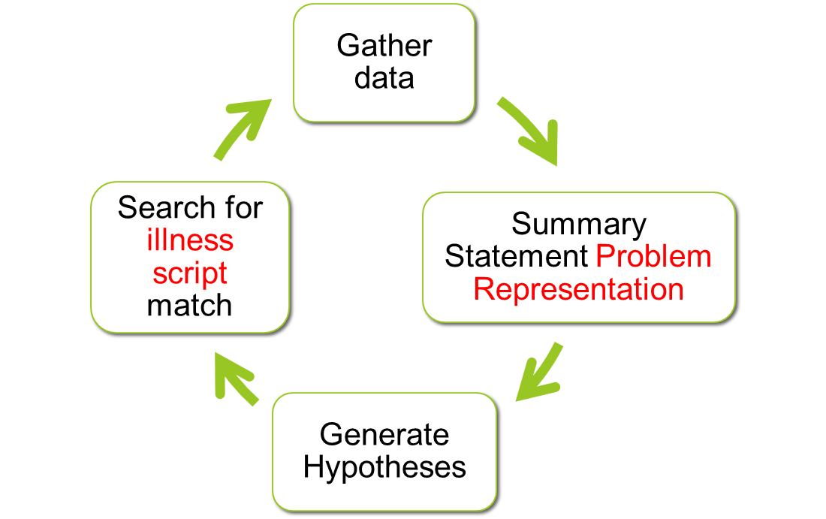
Clinical Reasoning Process An Iterative Cycle
Chief Complaint
Bowen: NEJM 2006

Slide 12
Clinical Reasoning Process Key Steps
Organizing knowledge and gathered clinical information
Data synthesis & problem representation development
Illness script scanning & differential diagnosis formation
Awareness of cognitive biases

Slide 13
Clinical Reasoning Process Organizing Knowledge
What are the key features from the history and PE?
e.g.,
Tempo/course of the CC/HPI
Age, exposures, other risk factors
General appearance on exam and key findings
Recognize pertinent positive AND negative findings

Slide 14
Organizing & Interpreting Clinical Information Case example
History:
12 day old with vomiting and bloody stool.
Symptoms began on day 6 with irritability and diarrhea. Change of formula did not help.
Day 12 presents with diarrhea (blood and mucus) and inconsolable crying (?pain)

Slide 15
Organizing & Interpreting Clinical Information Key & Differentiating Features
Differentiating Feature
(unique to a subset of diseases: Possible genetic predisposition, medical emergency)
Key Feature
(unique to that disease: abdominal mass)
Differential
Constellation of signs and symptoms that are common to several diseases: vomiting, bloody diarrhea, colicky pain)
Intussusception
Milk protein allergy
Volvulus/
Malrotation
Bowen, 2006
Organizing Knowledge and Information, Dr. Catherine Lucey
Notes:
Clues that can help generate a differential diagnosis and distinguish between diseases with shared characteristics

Slide 16
Clinical Reasoning Process Key Steps
Organizing knowledge and gathered clinical information
Data synthesis & problem representation development
Illness script scanning & differential diagnosis formation
Awareness of cognitive biases

Slide 17
Data Synthesis Problem Representation: Case
Patient demographics (age, gender)
+ chief complaint
12 day old infant with vomiting and bloody diarrhea
12 day old infant doing well until day 6, presents with diarrhea and irritability progressing to vomiting and bloody diarrhea
Patient demographics
+ findings in the history
12 day old infant with acute vomiting, bloody diarrhea and a benign abdominal exam with x-ray and US findings atypical for intussusception
Patient demographics
+ findings in the history +
findings on physical examination/data
In one’s clinical documentation, the problem representation is articulated as a summary statement.

Slide 18
Data Synthesis Problem Representation (Summary Statement)
Guides hypothesis generation and development of the differential diagnosis
Requires deliberate practice
A good Problem Representation includes:
Epidemiology (demographics, risk factors)
Key findings (symptoms, PE, imaging/labs)
Important qualifying adjectives = semantic qualifiers
Notes:
Guides hypothesis generation and development of the differential diagnosis
Requires deliberate practice
A good Problem Representation includes:
Epidemiology (demographics, risk factors)
Key findings (symptoms, PE, imaging/labs)
Important qualifying adjectives, i.e., semantic qualifiers

Slide 19
Case example Summary Statement
12 day old infant with acute onset of vomiting, bloody diarrhea, intermittent inconsolable crying and a benign abdominal exam. X-ray and US findings are atypical for intussusception.
Studies show that learners given the synthesized summary statement for a case were able to come up with a better differential than those just given the case alone.

Slide 20
Clinical Reasoning Process Key Steps
Organizing knowledge and gathered clinical information
Data synthesis & problem representation development
Illness script scanning & differential diagnosis formation
Awareness of cognitive biases

Slide 21
Illness Scripts Illness Script for Intestinal Malrotation
Epidemiology: Congenital anomaly of the rotation of the midgut, occurs between 1:200 to 1:500 live births. Most asymptomatic. 1:6000 symptomatic
Pathophysiology: Disruption of the normal embryologic development of the bowel. Many variations.
Clinical Presentation: sudden onset of bilious emesis with diffuse abdominal pain out of proportion to exam. Ischemic bowel leads to bloody diarrhea.
Time course: sudden onset, progressive symptoms once symptomatic

Slide 22
Illness Script Scanning & Differential Diagnosis Formation Prioritizing the Differential Diagnosis
(less likely; milk protein
allergy)
Disease C?
(poor match; unlikely intussusception)
Disease B?
Disease D?
Disease A?
(best match; most likely malrotation)
Disease E?

Slide 23
Illness Script Scanning & Differential Diagnosis Formation The Working Diagnosis
Hypothesis-driven data gathering
Data interpretation
Hypothesis testing
Hypothesis revision
Working diagnosis
most likely
change at any point
Notes:
The Working Diagnosis is the one most likely at a given point in the data gathering process.
The Working Diagnosis can change at any point based on new clinical information

Slide 24
Clinical Reasoning Process Key Steps
Organizing knowledge and interpreting clinical information
Data synthesis & problem representation development
Illness script scanning & differential diagnosis formation
Awareness of cognitive biases

Slide 25
3 Common Cognitive Errors
Anchoring bias
Latch onto first symptom or finding, failing to adjust
E.g. Pulmonary embolism can cause chest pain and shortness of breath, so it must be that. Ignore the fever of 102.
Availability bias
A recent case
E.g. Just saw a case of pneumothorax present just like this, so this patient likely has a pneumothorax.
Ascertainment /Stereotype bias
Stereotype
E.g. People who smoke get pneumonia, so that’s probably the cause of this patient’s symptoms.
Croskerry, Acad. Med 2003
Notes:
Anchoring bias
Tendency to latch on to first symptom or finding, failing to adjust despite information that does not fit
e.g., Pulmonary embolism can cause chest pain and shortness of breath, so it must be that. Ignore the fever of 102.
Availability bias
Tendency to have a recent case influence your judgment
e.g., Just saw a case of pneumothorax present just like this, so this patient likely has a pneumothorax.
Ascertainment /Stereotype bias
Tendency to let a stereotype explain the symptom
e.g., People who smoke get pneumonia, so that’s probably the cause of this patient’s symptoms.

Slide 26
Clinical Reasoning
Mind the GAP
Gathering data
Appraising the data appropriately
Probe for others (bias, context)
Notes:
Furthermore, in streamlining Audetat, under DIAGNOSIS:
> G data gathering, identifying clues
> A generating an hypothesis, prioritizing, synthesizing data, seeing
> the big picture, elaborating a management plan, invoking pattern
> recognition vs. hypothetico-deductive reasoning P cognitive biases,
> heuristics

Slide 27
How can you teach it?
Gathering data
Appraising the data appropriately
Probe for others (bias, context)
Direct Observation and Feedback
Role Modeling
Think Aloud
Notes:
Helpful to ask:
What else could this be?
Does anything NOT fit in this story?
Could more than 1 thing be happening in this patient?
Think aloud exercises – do not include real-time feedback, as you would with debriefing exercises. Thinking aloud should not be interrupted with prompts. The stream-of-conciousness exercise provides great insight into cognition and experience.

Slide 28
How Can You Trigger Reasoning?
1. Ask for a commitment
“What do you think is going on?
2. Probe for evidence
“Why do you think that?”
3. Teach general rules
“Generally...”
“If...then...”
4. Reinforce behaviors that are: Specific, Repeatable, Effective
“Your history was complete and your presentation was organized and easy to follow”
5. Correct mistakes and adjust behavior
Involve the learner; Be part of the solution; Commit to one, maybe two points.
Notes:
Encourage the expression of clinical reasoning
“What are you thinking?”
“Can you compare diagnosis X with Y?”
Seek Commitment
“What do you believe is most likely …?”
“What do you want to do next …?”
Solicit Support
“Why do you believe …?”
Verify/Challenge leading diagnosis
“What finding(s) is/are not explained by this diagnosis?”
“Does this dx make sense (rational pathophysiology)?”

Slide 29
The 5 Microskills
What?
Why?
Rule
Good
Bad
(Neher JO, Gordon KC, Meyer B, Stevens N. A five-step “microskills” model of clinical teaching. The Journal of the American Board of Family Practice. 1992 Jul 1;5(4):419-24)

Slide 30
Deliberate Practice
Divide into groups of 3
Take turns playing
Intern
Attending
Observer
Practice cases:
Medical, Surgical, OB, Psych
Debrief as a group

Slide 31
Debrief

Slide 32
What is your commitment?
What’s one thing you’ve learned today that you will put into your teaching practice?

Slide 33
Take Home Points
Steps to clinical reasoning:
Problem representation
Illness scripts
Prioritize problem list
Ask triggering questions
5 microskills
Think aloud
Mind the GAP!

Slide 34
What’s Next?
https://bit.ly/HCAUSFMeetandGreet

Slide 35
Thank you
shanugupta@health.usf.edu

