Slide 1
Meaningful Assessment – When and How?
January 23, 2020
Shanu Gupta MD, Anna Lama MA , Suzanne Minor, MD
Notes:
SHANU Open

Slide 2
When do you assess learners?
Notes:
SHANU 5 minutes – LARGE GROUP WONDERING:”, or in what ways do you assess your learners?
[facilitate discussion, use white board for “When do you assess learners grouping of ideas] Likely responses: residents or students at the end of rotation vs advising vs CCC vs simulations
SHANU - ADD POLL EVERYWHERE to involve the folks videoing in

Slide 3
Notes:
Poll Title: Untitled word cloud https://www.polleverywhere.com/free_text_polls/FPA5f42UNlcscxWEQNYfi

Slide 4
Objectives
Distinguish between feedback and assessment
Identify barriers to providing a meaningful assessment
Practice using an assessment rubric
Craft useful narrative assessment comments
Notes:
SHANU 1 min – Review the session objectives

Slide 5
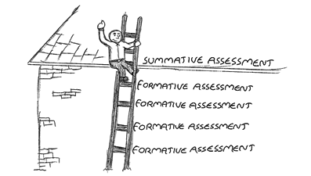
Forms of Assessment
Notes:
SHANU
Formative vs summative assessments - ASK THE GROUP - “What are the assessments that you are doing that are formative and what are the assessments that you doing that are summative?”
Residents: Rotation, Semi-Annual Milestone ,Mini-CEX,In-training examinations
Medical Students: Rotation, Mini-CEX, EPAs

Slide 6
What are your challenges with completing meaningful assessment?
ACTIVITY: THINK AND SHARE
What are your challenges with completing meaningful assessment?
Notes:
SUZIE 5 minutes TABLE TALK: Pick a scribe at your table, make notes on the following, “What are your challenges with completing meaningful assessment?” What is most difficult for you about accurately assessing others? What is it that makes assessing someone hard or challenging? [ONLINE LEARNERS – Leave answers in comments]
[facilitate discussion – make notes on whiteboard – advise groups to keep notes for future discussion.
Examples: Time vs technology vs struggling learner vs “stakes” vs likeability of learner vs lack of training in completing assessment vs culture of assessment (role modeling, support, permission). Fears (student response; relationship concerns; hurt career; dealing with the fallout; time/litigation): Time, Technology, Struggling learner, “Stakes”, Likeability of learner, Lack of training in completing, Assessment , Culture of assessment (role modeling, support, permission), Fear of learner response, Relationship concerns, Fear of hurting learner’s career, Fear of dealing with the fallout, Fear of litigation, Other
Shanu - add Polleverywhere wordcloud to engage online audience

Slide 7
Notes:
Poll Title: What are your challenges with completing meaningful assessment? https://www.polleverywhere.com/free_text_polls/NgFrACXuO4bFKOE611SRC

Slide 8
Who cares about accurate assessment?
Patients
Clinical Faculty
Students Residents
Hospitals & Accreditation Groups
PDs, Deans, Promotions Committee, CCCs
Government
Taxpayers
Notes:
SUZIE 2 minutes - So, who cares about accurate assessment? Anyone who works with patients or physicians: Patients, learners, clinical faculty, hospitals, accrediting groups, school administration, government and taxpayers. PDs, deans etc. care about your assessments as part of the program evaluation. (this can help to understand that assessment is at individual level and also at program level). These are tools for that purpose.

Slide 9
Is there a difference between FEEDBACK and ASSESSMENT?
Notes:
SUZIE
5-7 Minutes LARGE GROUP WONDERING – “Is there a difference between feedback and assessment?” as it is easy to conflate the two terms. [facilitate discussion]; Post It Easel pad and markers
Assessment should NOT have anything on it that wasn’t in the feedback.
There are similarities, but assessment is the formal

Slide 10
Specific information relating
a learner’s observed behavior
to expectations
Frequent & Timely
At end of rotation
Should not include new information
Feedback
Assessment
Limited
Comprehensive & Global
Consider Setting
Paper or electronically
Relationship-building to support in-time, continual learning
High stakes (for grades, CCC, learner promotion)
Based on Direct Observation
Helps Learners Grow
Notes:
SUZIE 5 minutes - There is some overlap between feedback and assessment.
Feedback is for the purpose of improving the learner’s skills.
Assessment is a judgment of the learners’ behavior, supported by an example or detail. Assessment may be used for grading, accreditation, and as data for those overseeing curriculum. Assessment should NOT have anything on it that wasn’t in the feedback.
Feedback and Assessment have lots of overlap – both involve your judgment of an observation. When this is communicated to the learner usually verbally, it’s feedback. When this is communicated to the clerkship director or course director, it’s usually more formal and in writing, it’s assessment.

Slide 11
Feedback
Students like praise most.
Students improve with feedback!
Student satisfaction does not reflect the quality of feedback.
Boehler ML, Rodgers D, Schwind C, Mayforth R, Quin J, Williams RG, et al. An investigation of medical student reactions to feedback: a randomized, controlled trial. Med Educ. 2006;40:746–9. http://www.ncbi.nlm.nih.gov/pubmed/16869919
Notes:
SUZIE
This is such a cool study! Second year medical students were put into 2 groups and both groups were given identical instruction on two-handed surgical knot-tying. Group 1 received specific, constructive feedback on how to improve their knot-tying skill. Group 2 received only general compliments. The students’ knot tying was videotaped before and after instruction and after receiving feedback or compliments. Subjects completed the study by indicating their global level of satisfaction. Faculty observed and scored the videotapes of each performance.
So, which group do you think improved in their knot-tying? That’s right – the feedback group.
And which group do you think reported higher satisfaction? That’s right – the complement group!
The takeaway from this study is twofold – 1) learning is a function of feedback, and 2) student satisfaction is not an accurate measure of the quality of feedback.
Another way of thinking about the repercussions of this study is that if we are receiving all perfect ratings from students, we as faculty may not be giving effective, appropriate feedback.
So note - we want our learners to like us. Giving difficult feedback can be uncomfortable for the learner, and maybe they will be less satisfied. And that’s OK!
Just like patients asking for antibiotics!

Slide 12
ACTIVITY: THINK AND SHARE Describe a time it was difficult for you to assess a learner. What made it difficult?
Notes:
ANNA 5 -7 minutes [TABLE TALK] – Reflect back to the question that we asked you earlier, scribed – “What are the challenges [for you] completing assessments?” At your tables, think about a time when was it difficult for you to assess learners? What made it difficult? How did you feel? What did you do to work through the challenge? Share a personal example of how those challenges/barriers contributed to difficulty leaving meaningful assessment. Please plan to “share” your story with the larger group. ONLINE LEARNERS – Share your experience in comments, we can read out.
Reflection Notes - Anytime we have strong emotions or reactions to a learner, we might be more difficulty assessing that learner. When we really like a learner, it might be more challenging to assess that learner accurately. It can also be hard with a learner really likes our field and we want them to do well. When we feel that a learner is trying to manipulate us or our buttons are being pushed, assessment can be difficult. When a learner doesn’t seem to be open to feedback, for instance, when the learner is overly confident or just not interested in our field or participating.

Slide 13
Common Barriers with Assessments
UNCERTAINTY WITH RUBRICS
CULTURE
EMOTIONAL FEARS
TIME
HALO/HORN EFFECT
LOCATION
TECHNOLOGY
POLICY
KNOWLEDGE
DRIVE
Notes:
ANNA 5 min [WITH DEMO] - After sharing our stories, we can see these common threads with barriers/challenges to assessing learners. All can impede the end goal - progress. We’ve highlighted the difficulty of being objective in light of how likable or unlikable a student may be. This speaks to our motivation – why are we physicians? As physicians we are lifelong learners and educators.
We can’t fix these items, but we hopefully are giving you tips and tricks to better manage these challenges.
CULTURE: No role model, no permission, no support
EMOTIONAL FEARS: Hurting the Relationship; Getting the student in trouble; Hurting the student’s career; Dealing with fallout
TIME: How much time is enough time? For feedback? For assessment? One option for simplifying your comments is to use your smartphone to dictate comments.
Just click on the dictation button and dictate your comments directly into the assessment form.
Be sure to read over the comments because dictation is not perfect!
HALO/HORN EFFECT:
LOCATION: Office vs. clinic vs. hallway
TECHNOLOGY: Firewalls, computer access, etc.
UNCERTAINTY WITH RUBRICS: Is there a common rubric? (No. there isn’t, which makes it challenging.) People most often want a standardized system, but there isn’t necessarily a common rubric or “one size fits all” for everyone. So, to work through that barrier, we can better prepare ourselves with identifying (1) common themes in rubrics, (2) a shared mental model for using these tools, (3) a frame of reference training, and (4) the tools available to us to support our assessment success. Consider rubric language

Slide 14
ACTIVITY: THINK AND SHARE Reflecting on the Learner Case data, practice creating a useful assessment report.
Notes:
ANNA 20 Min Activity #4 [LARGE GROUP DISCUSSION/ACTIVITY] – While we cannot fix all of the ”brick/challenges” during this session, we can certainly focus on one - “uncertainty with evaluation types” people most often want a standardized system, but there isn’t necessarily a common rubric or “one size fits all” for everyone. So, to work through that barrier, we can better prepare ourselves with identifying (1) common themes in rubrics, (2) a shared mental model for using these tools, (3) a frame of reference training, and (4) the tools available to us to support our assessment success.

Slide 15
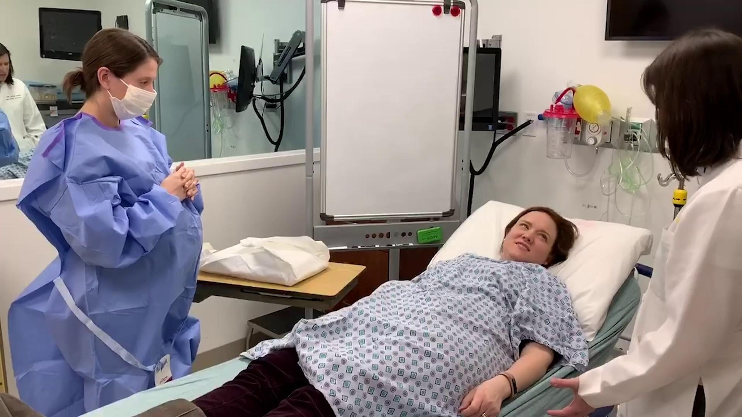
Video 1: Procedure/Formative
Notes:
ANNA & MINI CEX List (Activity #4)
Tables work independently through the assessment types. We give them 20 minutes to move through 4 types.
Review layout of Mini-CEX
Each table work through a different Learner Case (so no table will share the same case but maybe the same sample assessment sheets).

Slide 16
Sample Mini-CEX
Please comment on procedures that you did with the resident. (Please try to be as descriptive as possible.)
The resident broke sterility several times and can improve by understanding and applying sterile technique when performing procedures. The resident also needs to be sure to acquire informed consent prior to any procedure.
Notes:
ALL - Let’s plug the Mini-CEX - ask the learner to send you the mini-CEX asap so that you can complete it right after an observation. This is one example of how the comments from a mini-CEX can provide useful assessment. In just 2 sentences, the faculty describes a patient interaction that is uniquely specific. This is exactly what we are looking for – a quick comment detailing the student’s strengths.
Which form did you choose? Why? Behavioral anchors can be valuable in gathering more specific data, and especially for junior faculty. Sometimes the anchors can act as a frame of reference to detect where the learner is at the moment, although they do not help to identify specific tools for growth/change.
If you’re developing assessment tools know that there can be various ways to create a tool.

Slide 17
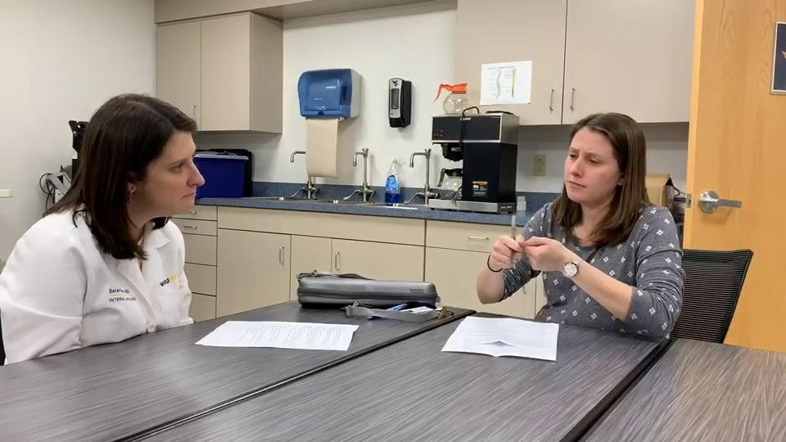
Video 2: Summative
Notes:
SUSIE (10 min)- VIDEO of RESIDENT/ATTENDING with SPIKES Model
This is indicative of most of the feedback you have with the learner
Tables work independently through the assessment types. We give them 5-7 minutes.

Slide 18
SUMMATIVE ASSESSMENT
Notes:
ALL: To align directly with Video + Milestones and feedback from video #1
OK to have an emotional reaction, and to have more than one answer. #BrainyQuote.com

Slide 19
What do you find useful when you read assessment comments?
Notes:
SUZIE (2 min) - LARGE GROUP WONDERING: What items do you place in your comments? Post It Easel pad and markers for note taking.
PollEverywhere

Slide 20
Notes:
Poll Title: What do you find useful when you https://www.polleverywhere.com/free_text_polls/ZAtOzcF2yApXV2wigw29P

Slide 21
Feedback to students
A few details on what you observed
+
How you judge those observations
Meaningful Narrative Comments
Justification on why you rated high or low
Check one’s own biases
Online Teaching Modules for Free CME:
https://medicine.fiu.edu/academics/continuing-medical-education/online-teaching-modules/index.html
Notes:
SUZIE: Let’s talk a little bit more about NARRATIVE COMMENTS. As we’ve already discussed, assessments are based on your direct observation; comments which include specific details that you observed and how you judge those observations are quite meaningful.
Meaningful comments provide feedback to the student and help us know why you rate a student as very high performing or very low performing – that is, your comments are necessary to justify these outliers. Why did you feel this student’s performance was oustanding? Why did you feel that student’s performance was not adequate?
Comments also allow you to check your biases. For example, if you’ve just worked with a challenging learner, you may be so relieved to work with the next learner who is not as challenging that you award high marks. Then, when you are writing comments, you realize the learner’s performance is average and you can appropriately adjust your marks. This is a way that your comments can help you to check your biases.
Shanu - add the BOSS method for narrative comments

Slide 22
THE BOSS-METHOD
Brief Observation
Significance
Suggestions
Notes:
SHANU - Directed and succinct way of transmitting feedback to learners- Piloted at the University of Iowa Division of Immunology - pubished on: https://www.im.org/resources/ume-gme-program-resources/faculty-development-resources
The BOSS Method consists of three interconnected components: Brief observation; Significance; Suggestions
The first component is to briefly state one’s observations. One-sentence summary of what has been observed on one or more occasions. Specificity is welcomed, but be aware that it may undercut the anonymity of comments “Often,” “Sometimes,” and “Frequently” may be useful when documenting multiple occasions. Observations should be as objective and neutral as possible. Avoid words like “is,” “appears,” “seems,” “looks like,” or “believes” – these are statements. Consider active verbs (e.g. does, says, exhibits, inspects, etc.). When possible, consider documenting the presence of certain behaviors. In other words, minimize statements emphasizing absence, like “Dr. ABC does not …”
Unless an observation has significance to the learner, it is unlikely to be received well. You may as well save your time and effort rather than write something insignificant. Significance is much more subjective and opinionated. Unless it is articulated well, the evaluator and learner may be on two different wavelengths.
Comments should be of convincing significance to learners. Significance should always be explained from the learner’s point of view
I.e. Why should she or he care about this comment?
Evaluators should be authentic in their statements. Avoid hyperbole or exaggerations.
There should be a clear link between the Brief observation and the significance. Consider this litmus test:
Prefix “That’s important because …” [If it is awkward or unconvincing, then it’s likely not significant]
Or use gestalt: is this something the learner should remember 1 month from now?
Observations must be paired with suggestions for self-improvement. Suggestions have to be realistic and somewhat measurable. Suggestions can be very flexible but must provide direction. This may include:
Access to resources
Encouragement of deliberative practice
Recommendations for alternative approaches
Suggestions must be respectful and culturally appropriate. As with Brief observations, they should not be judgmental. Suggestions are not mandates. Avoid “needs to” or “must”. Avoid threatening wording. Ideally, these should have been relayed to learners in person.

Slide 23
Learner Assessment Tool
Please comment on the strengths of this learner’s performance. (Please try to be as descriptive as possible.)
Please comment on areas of learner’s performance that need improvement.
Notes:
SHANU - INDIVIDUAL, TABLE, THEN LARGE GROUP DISCUSSION
Let’s use these prompts to write your own comments about the learner’s performance. Then, talk about your comments at each table.

Slide 24
ACTIVITY: THINK AND SHARE What are some takeaways from today you can use in your place of practice?
Notes:
ANNA - Written evaluations do not replace frequent feedback throughout the rotation
Recognize your barriers to giving quality assessment
Meaningful comments on assessment are specific and based on direct observation
Consider rubric language when completing evaluation

Slide 25
If you want help with faculty development, contact: Dr. Shanu Gupta
Notes:
If you would like a clinical faculty teaching consult, just contact
Thank you so much for asking me to give this presentation. What questions do you have?
Literature to link here:
Ramani, S., Post, S. E., Könings, K., Mann, K., Katz, J. T., & van der Vleuten, C. (2017). “It's just not the culture”: a qualitative study exploring residents' perceptions of the impact of institutional culture on feedback. Teaching and learning in medicine, 29(2), 153-161. Internal Medicine Residency Program at Brigham and Women’s Hospital (at Harvard). The authors identify types of feedback that are simply not supportive nor resonate with residents in receiving honest feedback: (1) lacking clear expectations and messages, (2) a culture of “being nice” (e.g., good job!), (3) singular direction feedback without room for question or wondering, (4) feedback should be consistent in delivery (e.g., at the end of each impatient rotation, continuity clinics) to deliver feedback for consistency and establish a feedback culture. [Based on constructivist grounded theory approach, more opinions through comments.]
Ramani, S., Könings, K. D., Mann, K. V., Pisarski, E. E., & van der Vleuten, Cees P.M. (2018). About politeness, face, and feedback: Exploring resident and faculty perceptions of how institutional feedback culture influences feedback practices. Academic Medicine, 93(9), 1348-1358.
Lye, P. S., Biernat, K. A., Bragg, D. S., & Simpson, D. E. (2001). A pleasure to work with—An analysis of written comments on student evaluations. Ambulatory Pediatrics, 1(3), 128-131.

Slide 26
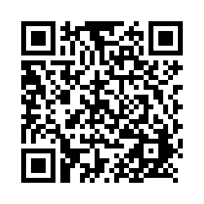
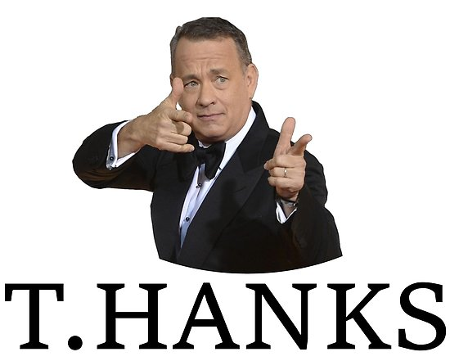
Please give us your feedback and take a moment to complete our survey (less than a minute)
https://bit.ly/CELSAssessmentofLearners

