Slide 1
Study Designs:
Choosing Wisely
Dr. Rahul Mhaskar
Director
Office of Research, Innovation and Scholarly Endeavors (RISE)
Associate Professor
Research Methodology and Biostatistics Core,
Office of Research
Department of Internal Medicine

Slide 2

Learning objectives
At the end of this session participants will be able to
Learn the importance of a specific research question in clinical research and decision making
Match the research question to a study design
Understand differences between analytical and observational study designs
Understand pros and cons of study designs
Design hypothetical studies to answer specific research question(s) (hands on activity)
Notes:
Appraising Evidence about Causation and Harm
Evidence Literacy Learning Unit
(c) Robert Hayward, Centre for Health Evidence
2
Welcome students.
Today we are going to learn about case report forms.
Upon completion of tis module: you will gain understanding in process of developing case report form and its various uses.
You will learn how to develop a case report form.

Slide 3
e-Learning Environment
e-Learning format
  Interactive (i.e. informal)
  Active participation from the participants is highly desired
Questioning/interruption
  Expected (there are no stupid questions)
Notes:
Appraising Evidence about Causation and Harm
Evidence Literacy Learning Unit
(c) Robert Hayward, Centre for Health Evidence
3
Welcome students.
Today we are going to learn about case report forms.
Upon completion of tis module: you will gain understanding in process of developing case report form and its various uses.
You will learn how to develop a case report form.

Slide 4
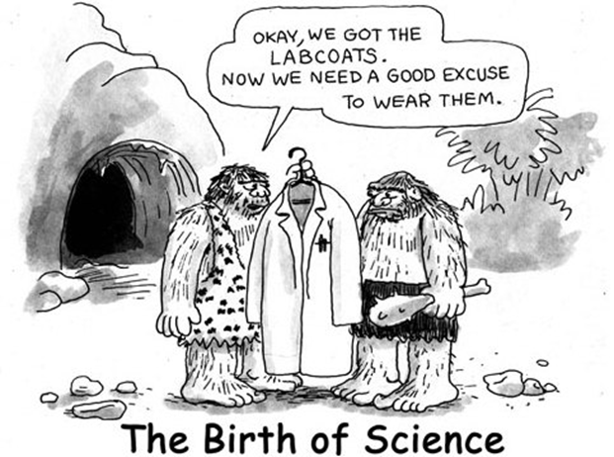
What makes a poor research question?
A question that matters to nobody, even you
Hoping one emerges from routine clinical records
  the records will be biased and confounded
  they’ll lack information you need to answer your question reliably, because they were collected for another reason
Fishing expedition/data dredging – gathering new data and hoping a question will emerge
A vague/unspecific question

Slide 5
What makes a good question?
Specificity / focus : PICOTS format
P - who are the patients or what’s the problem?
I - what is the intervention or exposure?
C – what is the comparison group?
O - what is the outcome or endpoint?
T- What is the type of the question?
S- what is an optimal study design to answer this question?

Slide 6
Key study designs
All Studies
What was the aim of the study?
Descriptive
Analytic
Experimental
Observational analytic
When were the outcomes determined?
Survey (cross-sectional)
Qualitative
Some time after the exposure or intervention
Cohort study
Randomized
(parallel group)
At the same time as the exposure or intervention
Cross-sectional
(Analytic)
Randomized
(Cross-over)
Before the exposure was determined
Case-control study
Exposure assigned
5 Cs
Controlled trial
Cohort (prospective) study (Inferior type: Chart review)
Case control study
Cross sectional study
Case series/Case report
Exposure not assigned

Slide 7
What constitutes BEST Evidence?
Depends on the type of question
The Higher up a methodology is ranked, the more robust and closer to objective truth it is assumed to be.
Systematic Reviews
& Meta-Analyses
RCTs
Cohort Studies
Cross Sectional studies
Case Control Studies
Case Studies
Ideas, Editorials, Opinions
Anecdotal

Slide 8
In many ways the design of a study is more important than the analysis.
A badly designed study can never be retrieved, whereas a poorly analyzed one can usually be re-analyzed.
Consideration of design is also important because the design of a study will govern how the data are to be analyzed.
Most medical studies consider an input, which may be a medical intervention or exposure to a potentially toxic compound, and an output, which is some measure of health that the intervention is supposed to affect.
The simplest way to categorize studies is with reference to the chronology of events in which the input and output are studied.

Slide 9
Randomized controlled trials
Past
Present
Future
Evaluate for outcome
Patient population
Exposure
Outcome
Appropriate patient spectrum
Experimental
No outcome
Randomize
No exposure
Outcome
Control
No outcome
The addition of bran to the diet has been reported to benefit patients with diverticulosis.
Several different bran preparations are available, and a clinician wants to test the efficacy of two of them on patients, since favorable claims have been made for each.
Among the consequences of administering bran that requires testing is the transit time through the alimentary canal.
Does it differ in the two groups of patients taking these two preparations?
Measurement: Multiple times possible

Slide 10
RCT with parallel design
Advantages:
  unbiased distribution of confounders;
  blinding more likely;
  randomization facilitates fair statistical analysis.
Disadvantages:
  expensive: time and money;
  volunteer bias;
  ethically problematic at times.

Slide 11
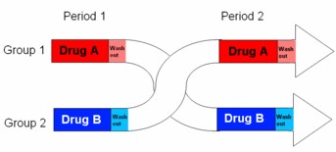
Cross-over RCT
Advantages:
all participants serve as own controls and error variance is reduced, thus reducing sample size needed
all participants receive treatment (at least some of the time)
statistical tests assuming randomisation can be used
blinding can be maintained
Disadvantages:
all participants receive placebo or alternative treatment at some point
washout period lengthy or unknown
cannot be used for treatments with permanent effects

Slide 12
Prospective Cohort study
Past
Present
Future
Evaluate for outcome
Patient population
Outcome
Exposed
Appropriate patient spectrum
No outcome
Outcome
Not exposed
No outcome
Measurement: Multiple times possible
A clinician is investigating impact of meditation on diabetes outcomes (e.g. HbA1C).

Slide 13
Cohort study
Advantages:
  ethically safe;
  subjects can be matched;
  can establish timing and directionality of events;
  eligibility criteria and outcome assessments can be standardized;
  administratively easier and cheaper than RCT.
Disadvantages:
  controls may be difficult to identify;
  exposure may be linked to a hidden confounder;
  blinding is difficult;
  randomization not present;
  for rare disease, large sample sizes or long follow-up necessary.

Slide 14
Case-control study
Past
Present
Future
Evaluate for exposure
Outcome
Patient population
Exposure
Case
No exposure
Appropriate patient spectrum
Exposure
Control
No exposure
A clinician is investigating relationship of spicy food consumption and peptic ulcer prevalence.

Slide 15
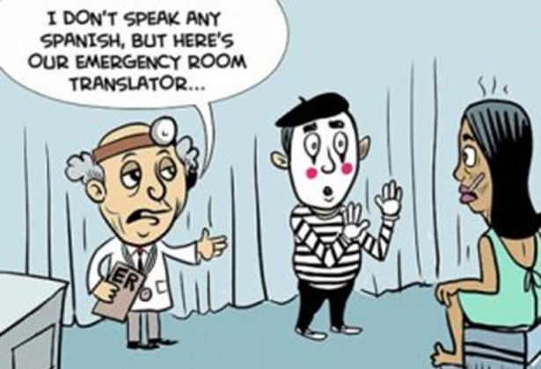
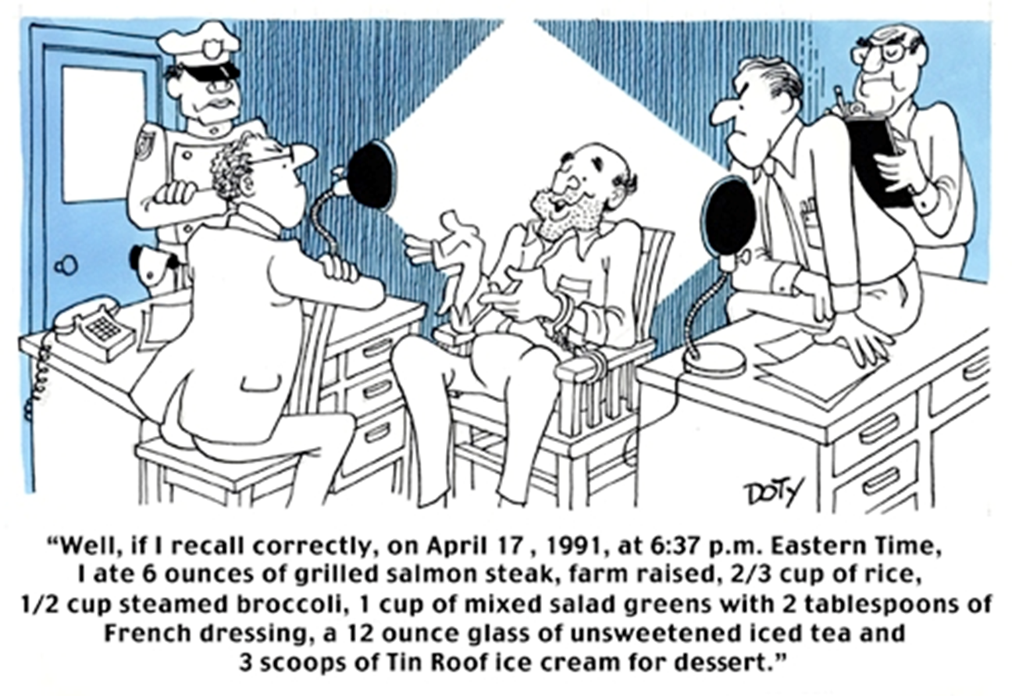
Interviewer Bias
Recall Bias

Slide 16

Case-control studies
Advantages:
  quick and cheap;
  only feasible method for very rare disorders or those with long lag between exposure and outcome
  fewer subjects needed than cross-sectional studies.
Disadvantages:
  reliance on recall or records to determine exposure status;
  confounders;
  selection of control groups is difficult;
  potential bias: recall, selection.

Slide 17
Sometimes confounding factors are knotty and wholly misleading.
In 1991, the authors of a commentary published in the New England Journal of Medicine suggested that left-handed people had a higher risk of mortality.
For their retrospective case-control study, researchers looked at death certificates from two counties in southern California and then asked family members of the deceased about their beloved ones' handedness.
They found that being left-handed is associated with dying younger. "The mean age at death in the right-handed sample was 75 years, as compared with a mean age at death of 66 years in the left-handers," they wrote.
After publication, the journal editor was inundated with angry letter-writers.
That's because the researchers failed to account for the cultural context: there was a time in the US when left-handed children were forced to become right-handed children.
The reason there were few older left-handers was not because the hand you write with spells an early end, but because the would-be elderly lefties had converted when they were young and appeared as right-handed people in the study.

Slide 18
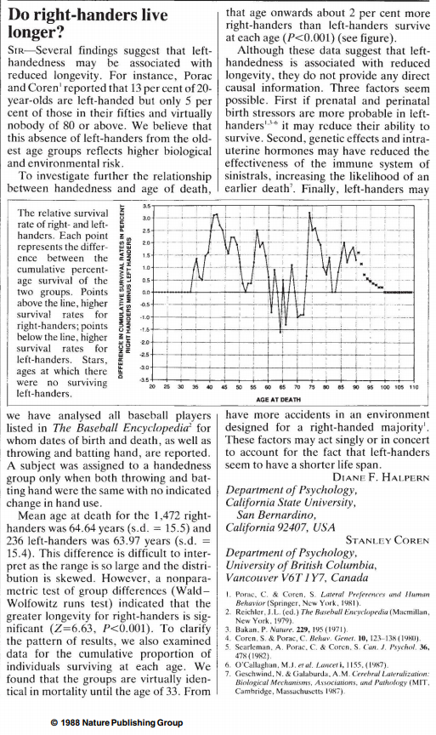
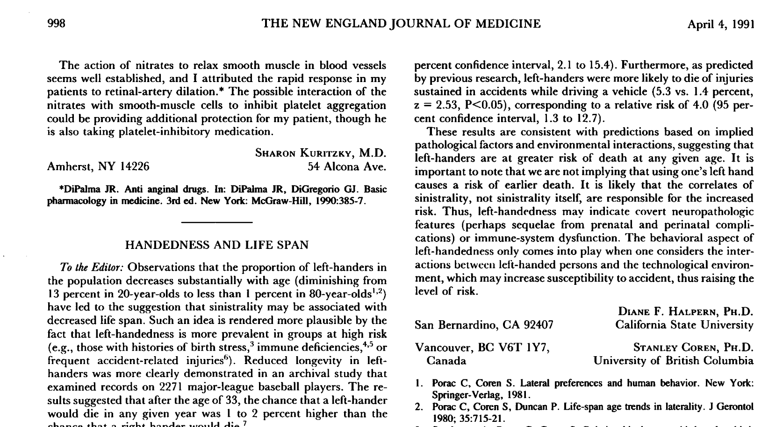
Sometimes confounding factors are knotty and wholly misleading.
After publication, the journal editor was inundated with angry letter-writers.
That's because the researchers failed to account for the cultural context: there was a time in the US when left-handed children were forced to become right-handed children.
The reason there were few older left-handers was not because the hand you write with spells an early end, but because the would-be elderly lefties had converted when they were young and appeared as right-handed people in the study.
Left handers are more prone to injury in the world designed by majority (right handers)!

Slide 19
Cross-sectional study
Past
Present
Future
Evaluate for outcome
Patient population
Exposure/ group 1
Outcome
Appropriate patient spectrum
No outcome
Exposure/
group 1
Exposure/ group 2
Exposure/ group 2
Outcome
No outcome
A pediatrician in a hospital is investigating the amount of lead in the urine of children from a county based on gender.
Measurement: One point in time

Slide 20
Cross-sectional study
Advantages:
  cheap and simple;
  ethically safe.
Disadvantages:
  establishes association at most, not causality;
  recall bias susceptibility (e.g. surveys);
  confounders may be unequally distributed;
  group sizes may be unequal.

Slide 21

  Coffee and Pancreatic Cancer
Pancreatic cancer is the eighth most common cause of death from cancer worldwide.
Although the diagnosis and treatment of pancreatic cancer has been evident improvement, the five-year survival rate for the disease is still no more than 5%.
Thus, it is very important to detect modifiable risk factors that may develop into the primary prevention for this cancer.
Coffee is one of the most popular beverages over the world.
We plan to study the association between coffee consumption and pancreatic cancer risk.

Slide 22
Randomized controlled trial
Past
Present
Future
Evaluate for outcome
Pancreatic Cancer
Exposure
Patient population
Coffee
Appropriate patient spectrum
No Pancreatic Cancer
Randomize
Pancreatic Cancer
No exposure
No Coffee
No Pancreatic Cancer

Slide 23
Cohort study
Past
Present
Future
Evaluate for outcome
Pancreatic Cancer
Patient population
Coffee
Appropriate patient spectrum
No Pancreatic Cancer
Pancreatic Cancer
No Coffee
No Pancreatic Cancer

Slide 24
Case-control study
Past
Present
Future
Evaluate for exposure
Outcome
Patient population
High coffee consumption
Pancreatic Cancer
Patients
Appropriate patient spectrum
Low coffee consumption
High coffee consumption
Patients without Pancreatic Cancer
Low coffee consumption

Slide 25
Cross-sectional study
Past
Present
Future
Evaluate for outcome
Pancreatic Cancer
Patient population
High Coffee
consumption
Appropriate patient spectrum
No Pancreatic Cancer
Coffee
consumption
Low Coffee
consumption
Pancreatic Cancer
No Pancreatic Cancer
Coffee consumption and Pancreatic Cancer prevalence assessed at the same time

Slide 26
Objective: To ascertain whether prone ventilation offers a survival advantage when compared with traditional
supine or semi recumbent ventilation in patients with severe acute respiratory failure requiring conventional invasive artificial ventilation.
In your search for an answer you would attempt to find a study employing which of the following study designs?
Case control
Cohort
Cross-sectional
Randomized controlled trial
Randomized controlled trial
Randomly assign patients with severe ARDS to undergo prone-positioning sessions of at least 16 hours or to be left in the supine position.
The primary outcome is the proportion of patients who die from any cause within 28 days after inclusion.

Slide 27
Objective: To investigate the relationship between egg consumption and heart disease.
In your search for an answer you would attempt to find a study employing which of the following study designs?
Case control
Cohort
Cross-sectional
Randomized controlled trial
Matched case control study
A group of patients admitted to hospital with myocardial infarction were questioned about their egg consumption.
A group of age and sex matched patients admitted to a fracture clinic were also questioned about their egg consumption using an identical protocol.

Slide 28
Objective: To investigate the relationship between certain solvents manufactured at an industry plant and cancer.
In your search for an answer you would attempt to find a study employing which of the following study designs?
Case control
Cohort
Cross-sectional
Randomized controlled trial
Cohort study
All employees at a factory were questioned about their exposure to an industrial solvent, and the amount and length of exposure measured.
These subjects were regularly monitored, and after 10 years a copy of the death certificate for all those who had died was obtained.

Slide 29
Objective: To investigate the difference between surgery and medical management and physical therapy for rotator cuff injury.
In your search for an answer you would attempt to find a study employing which of the following study designs?
Case control
Cohort
Quasi experimental design
Randomized controlled trial
Randomized controlled trial
Patients with rotator cuff injury were randomly allocated to either the surgery and medical management and physical therapy.
After 3 months they were questioned about their pain, range of joint motion and observed lifting a weight by independent monitors.

Slide 30
Objective: To assess career/job satisfaction of residents working at a hospital.
In your search for an answer you would attempt to find a study employing which of the following study designs?
Case control
Cohort
Cross-sectional
Randomized controlled trial
Cross-sectional study
A survey was conducted of all residents employed at a particular hospital.
Among other questions, the questionnaire asked about the year, specialty of the resident and whether he/she was satisfied with her career prospects.

Slide 31
A 38-year-old man presents to the emergency department for severe alcohol abuse with nausea and vomiting. He reports no other significant medical problems.
The patient is confused and slightly obtunded, and hepatomegaly is discovered on physical exam.
You establish that patient is cirrhotic and most cirrhotic patients develop esophageal varices, with a lifetime incidence as high as 80-90%.
You decide to send the patient for EGD which you know is not a very pleasing experience for the patient.
You remember that recently a colleague mentioned that why not use capsule endoscopy rather than the EGD.
Being a logical person you wonder how effective is capsule endoscopy in accurately identifying esophageal varices in cirrhotic patients?
In your search for an answer you would attempt to find a study employing which of the following study designs?
Case control
Cohort
Cross-sectional
Randomized controlled trial

Slide 32
You recall a conversation from your medical school days with one of your favorite anatomy professors.
The professor observed that most students from his class who were good in anatomy tend to become radiologists.
As believer in science you decided to explore if there is any truth to this observation.
Which study design is most suited to address the hypothesis that good anatomy students are most likely to become radiologists?
Case control
Cohort
Cross-sectional
Randomized controlled trial

Slide 33
Febrile neutropenia is a frequent adverse event experienced by people with cancer who are undergoing chemotherapy, and is a potentially life-threatening situation.
The current treatment is supportive care plus antibiotics.
Colony-stimulating factors (CSFs), such as granulocyte-CSF (G-CSF) are cytokines that stimulate and accelerate the production of one or more cell lines in the bone marrow.
CSFs have been demonstrated to be effective in reducing the incidence of febrile neutropenia when given immediately after chemotherapy.
Which study design is best suited to provide most unbiased answer to the question of whether the addition of a CSF to antibiotics could improve outcomes in individuals diagnosed with febrile neutropenia?
Case control
Cohort
Cross-sectional
Randomized controlled trial

Slide 34
All the best..
Contact me if you have further questions or need assistance
Email: rmhaksar@usf.edu
Cell Phone: 765 337 5899
Thank you.

