Slide 1
Designing a research question
and
Matching the study design to the research question
Dr. Rahul Mhaskar
Director
Office of Research, Innovation and Scholarly Endeavors (RISE)
Associate Professor
Department of Internal Medicine
Morsani College of Medicine
University of South Florida

Slide 2
Learning objectives
At the end of this session participants will be able to
Evaluate the importance of a specific research question in clinical research and clinical decision making
Describe the framework used to design research questions
Summarize how to match the research question to a study design
Explain the potential biases in key study designs
Notes:
Appraising Evidence about Causation and Harm
Evidence Literacy Learning Unit
(c) Robert Hayward, Centre for Health Evidence
2
Welcome students.
Today we are going to learn about case report forms.
Upon completion of tis module: you will gain understanding in process of developing case report form and its various uses.
You will learn how to develop a case report form.

Slide 3
Learning Environment
Learning format
Interactive (i.e. informal)
Active participation from the participants is highly desired
Questioning/interruption
Expected (there are no stupid questions)
Notes:
Appraising Evidence about Causation and Harm
Evidence Literacy Learning Unit
(c) Robert Hayward, Centre for Health Evidence
3
Welcome students.
Today we are going to learn about case report forms.
Upon completion of tis module: you will gain understanding in process of developing case report form and its various uses.
You will learn how to develop a case report form.

Slide 4
What is a research question?
The researcher asks a very specific question and tests a specific hypothesis.
Broad questions are usually broken into smaller, testable hypotheses or questions.
Often called an objective or aim, though calling it a question tends to help with focusing the hypothesis and thinking about how to find an answer
PICOTS format

Slide 5
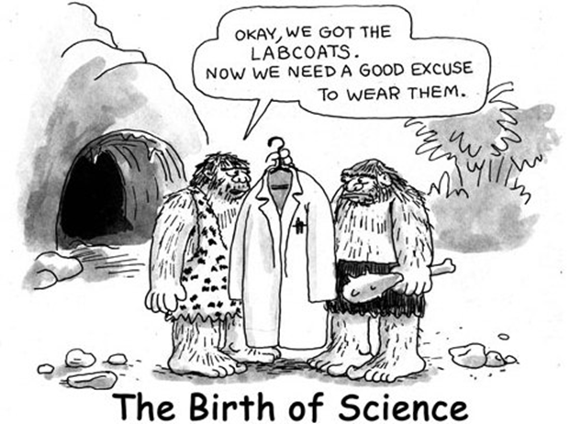
What makes a poor research question?
a question that matters to nobody, even you
hoping one emerges from routine clinical records
the records will be biased and confounded
they’ll lack information you need to answer your question reliably, because they were collected for another reason
fishing expedition/data dredging – gathering new data and hoping a question will emerge
A vague/unspecific question

Slide 6
What makes a good question?
Specificity / focus ! : PICOTS format
P - who are the patients or what’s the problem?
I - what is the intervention or exposure?
C – what is the comparison group?
O - what is the outcome or endpoint?
T- What is the type of the question?
S- what is an optimal study design to answer this question?

Slide 7
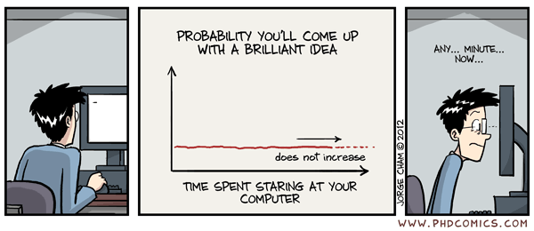
How to focus your question?
brief literature search for previous evidence (think about library services)
discuss with colleagues
narrow down the question – time, place, group
what answer do you expect to find?

Slide 8
From a research question to a proposal
who am I collecting information from?
what kinds of information do I need?
how much information will I need? *
how will I use the information?
how will I minimise chance/bias/confounding?
how will I collect the information ethically?
* sample size – ask a statistician for help

Slide 9
Key study designs
All Studies
What was the aim of the study?
Descriptive
Analytic
Experimental
Observational analytic
When were the outcomes determined?
Survey (cross-sectional)
Qualitative
Some time after the exposure or intervention
Cohort study
Randomized
(parallel group)
At the same time as the exposure or intervention
Cross-sectional
(Analytic)
Randomized
(Cross-over)
Before the exposure was determined
Case-control study
Exposure assigned
Exposure not assigned

Slide 10
What constitutes BEST Evidence? Depends on the type of question
The Higher up a methodology is ranked, the more robust and closer to objective truth it is assumed to be.
Systematic Reviews
& Meta-Analyses
RCTs
Cohort Studies
Cross Sectional studies
Case Control Studies
Case Studies
Ideas, Editorials, Opinions
Anecdotal

Slide 11
Randomized controlled trials
Past
Present
Future
Evaluate for outcome
Patient population
Exposure
Outcome
Appropriate patient spectrum
Experimental
No outcome
Randomize
No exposure
Outcome
Control
No outcome
Measurement: Multiple times possible

Slide 12
RCT with parallel design
Advantages:
unbiased distribution of confounders;
blinding more likely;
randomization facilitates fair statistical analysis.
Disadvantages:
expensive: time and money;
volunteer bias;
ethically problematic at times.

Slide 13
Cross-over RCT
Advantages:
all participants serve as own controls and error variance is reduced, thus reducing sample size needed
all participants receive treatment (at least some of the time)
statistical tests assuming randomisation can be used
blinding can be maintained
Disadvantages:
all participants receive placebo or alternative treatment at some point
washout period lengthy or unknown
cannot be used for treatments with permanent effects

Slide 14
Prospective Cohort study
Past
Present
Future
Evaluate for outcome
Patient population
Outcome
Exposed
Appropriate patient spectrum
No outcome
Outcome
Not exposed
No outcome
Measurement: Multiple times possible

Slide 15
Cohort study
Advantages:
ethically safe;
subjects can be matched;
can establish timing and directionality of events;
eligibility criteria and outcome assessments can be standardized;
administratively easier and cheaper than RCT.
Disadvantages:
controls may be difficult to identify;
exposure may be linked to a hidden confounder;
blinding is difficult;
randomization not present;
for rare disease, large sample sizes or long follow-up necessary.

Slide 16
Cross-sectional study
Past
Present
Future
Evaluate for outcome
Patient population
Exposure 1
Outcome
Appropriate patient spectrum
No outcome
Exposure 1
Exposure 2
Exposure 2
Outcome
No outcome
Measurement: One point in time

Slide 17
Cross-sectional study
Advantages:
cheap and simple;
ethically safe.
Disadvantages:
establishes association at most, not causality;
recall bias susceptibility (e.g. surveys);
confounders may be unequally distributed;
group sizes may be unequal.

Slide 18
Case-control study
Past
Present
Future
Evaluate for exposure
Outcome
Patient population
Exposure
Case
No exposure
Appropriate patient spectrum
Exposure
Control
No exposure
Measurement: not applicable

Slide 19
Case-control studies
Advantages:
quick and cheap;
only feasible method for very rare disorders or those with long lag between exposure and outcome
fewer subjects needed than cross-sectional studies.
Disadvantages:
reliance on recall or records to determine exposure status;
confounders;
selection of control groups is difficult;
potential bias: recall, selection.

Slide 20
Consume Vitamin D
Vitamin D is the key to good health
Be sure to eat Vitamin D fortified foods
Vitamin D–improves the good gut microbiome
Vitamin D–improves overall immune response
Vitamin D is wonderful

Slide 21
Hypothetical Research Question
Your belief(s):
Vitamin D consumption is the key to good health and not getting severe Covid 19 infection
People who consume lots of Vitamin D tend not to suffer from severe Covid 19 infection symptoms
Your hypothesis
Optimal vitamin D intake decreases the risk of severe Covid 19 illness

Slide 22
Randomized controlled trials
Past
Present
Future
Evaluate for outcome
Patient population
Exposure
Severe Covid19
Appropriate patient spectrum
Vit D
No Severe Covid19
Randomize
No exposure
Severe Covid19
No Vit D
No Severe Covid19

Slide 23
Prospective cohort study
Past
Present
Future
Evaluate for outcome
Patient population
Severe Covid19
Vit D supplement
No Severe Covid19
Appropriate patient spectrum
Severe Covid19
No Vit D supplements
No Severe Covid19

Slide 24
Cross-sectional study
Past
Present
Future
Evaluate for outcome
Patient population
Vit D yes
Severe Covid19
Appropriate patient spectrum
No Severe Covid19
Vit D supplements
Vit D No
Severe Covid19
No Severe Covid19
Vitamin D supplement consumption and Severe Covid 19illness prevalence assessed at the same time

Slide 25
Case-control study
Past
Present
Future
Evaluate for exposure
Outcome
Patient population
High Vit D
Severe Coid19 Patients
Low Vit D
Appropriate patient spectrum
High Vit D
Patients w/o severe Covid 19 illness
Low Vit D

Slide 26
On morning rounds in the Hem/Onc unit, a first year resident turns to you for consultation. She wants to discuss options for managing moderate nausea and vomiting that result following chemotherapy. She shares an experience a relative had taking ginger when prochlorperazine didn’t provide effective relief and asks for your input. What is your clinical question in PICO format? What type of clinical question is this? What is the best study design to answer this type of clinical question?
Case control
Cohort
Cross-sectional
Randomized controlled trial

Slide 27
Traditionally, clinicians have used a conservative approach for the diagnostic evaluation of head-injured infants, arguing that infants are at increased risk of intracranial injury (ICI) and that symptoms or signs of brain injury may not be reliably present in those with ICI. A number of previous studies have reported that a significant fraction of ICIs in infants occur in patients with a normal neurological status and with no signs or symptoms of brain injury. You want to see how well clinical features predict ICI in infants. What is your clinical question in PICO format? What type of clinical question is this? What is the best study design to answer this type of clinical question?
Case control
Cohort
Cross-sectional
Randomized controlled trial

Slide 28
You recall a conversation from your medical school days with one of your favorite anatomy professors. The professor observed that most students from his class who were good in anatomy tend to become radiologists. As believer in science you decided to explore if there is any truth to this observation. Which study design is most suited to address the hypothesis that good anatomy students are most likely to become radiologists?
Case control
Cohort
Cross-sectional
Randomized controlled trial

Slide 29
A 48-year-old man presents to the emergency department for severe alcohol abuse with nausea and vomiting. He reports no other significant medical problems. The patient is confused and hepatomegaly is discovered on physical exam. You establish that patient is cirrhotic and most cirrhotic patients develop esophageal varices, with a lifetime incidence as high as 80-90%. You decide to send the patient for Esophagogastroduodenoscopy (EGD) which you know is not a very pleasing experience for the patient. You remember that recently a colleague mentioned that why not use capsule endoscopy. You wonder how effective is capsule endoscopy in accurately identifying esophageal varices in cirrhotic patients? In your search for an answer you would attempt to find a study employing which of the following study designs?
Case control
Cohort
Cross-sectional
Randomized controlled trial

Slide 30
Following up on our cirrhotic patient the capsule endoscopy reveled acute variceal bleeding. You know that cirrhosis in Child–Pugh class C or those in class B who have persistent bleeding at endoscopy are at high risk for treatment failure and a poor prognosis. You decide to recommend treatment right away with a transjugular intrahepatic portosystemic shunt (TIPS). However a colleague of yours suggests to continue treatment with vasoactive-drug therapy, followed after 3 to 5 days by treatment with propranolol and long-term endoscopic band ligation (EBL), with insertion of a TIPS if needed as rescue therapy only. Which study design is best suited to provide most unbiased answer to the question of immediate versus rescue treatment with TIPS?
Case control
Cohort
Cross-sectional
Randomized controlled trial

Slide 31
All the best..
Contact me if you have further questions or need assistance
Email: rmhaksar@usf.edu
Or
Schedule an appointment to see us in the RISE office.
https://usfhealth.az1.qualtrics.com/jfe/form/SV_9LxCL6t2ST8SEvj
Thank you.

