Slide 1
Latent Labor
Where it all begins!

Slide 2
Session Outline
New parameters for latent labor
National recommendations related to latent labor phase
Shared decision-making
Patient education on expectations and coping strategies
Labor support
Hospital admission/Patient intake

Slide 3
Definitions
Labor: Uterine contractions resulting in cervical change (dilation and/or effacement)
Phases:
  Latent phase: from the onset of labor to the onset of the active phase
  Active phase: accelerated cervical dilation typically beginning at 6cm

Slide 4
Did you know?
6 is the new 4!
FIRST STAGE OF LABOR
Zhang 2002 found that 50% of women entered active labor at 4cm, 75% at 5cm and 100% at 6cm.
Cervical dilation of 6 cm should be considered the threshold for the active phase of most women in labor. Before 6 cm dilation, standards of active phase progress should not be applied.
Safe prevention of the primary cesarean delivery. Obstetric Care Consensus No. 1. American College of Obstetricians and Gynecologists. Obstet Gynecol 2014;123:693–711.

Slide 5
Diagnosing Active Labor
Too Soon
  Increased Risk of Cesarean Section and Pitocin use.
Too Late
  Missed opportunity for epidural anesthesia or time to adjust to birth environment.
  Neal JL, Lowe NK, Schorn MN, et al. Labor dystocia: A common approach to diagnosis. J Midwifery Womens Health. 2015;60(5):499-509. doi: 10.1111/jmwh.12360 [doi].

Slide 6
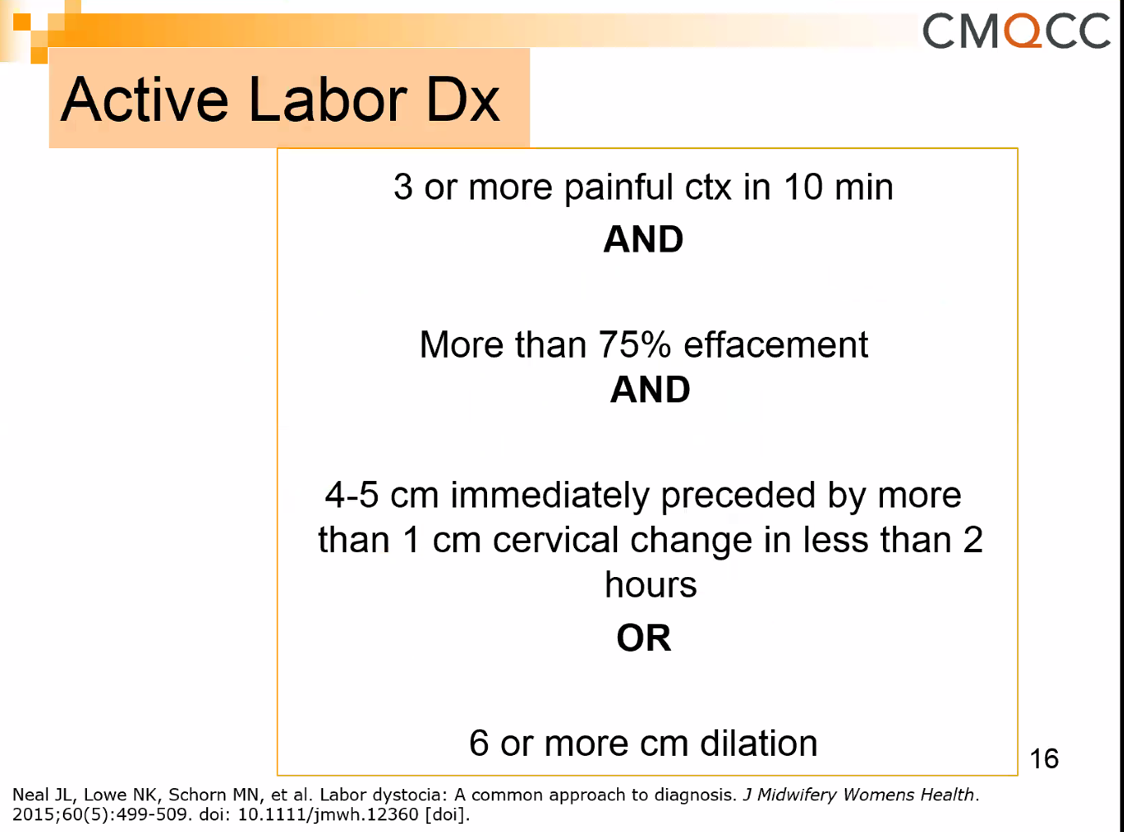
Active Labor Diagnosis
  Three or more painful , uterine contractions every 10 minutes in presence of cervical effacement ≥ 75% and
    4-5 cm cervical dilatation if preceeded by adequate cervical change over time (≥1cm in ≤ 2 hours) as determined by 2 or more sequential cervical exams preferably by the same examiner,
    OR
    6cm cervical dilatation regardless of rate of previous cervical change.
          Neal JL, Lowe NK, Schorn MN, et al. Labor dystocia: A common approach to diagnosis. J Midwifery Womens Health. 2015;60(5):499-509. doi: 10.1111/jmwh.12360 [doi].

Slide 7
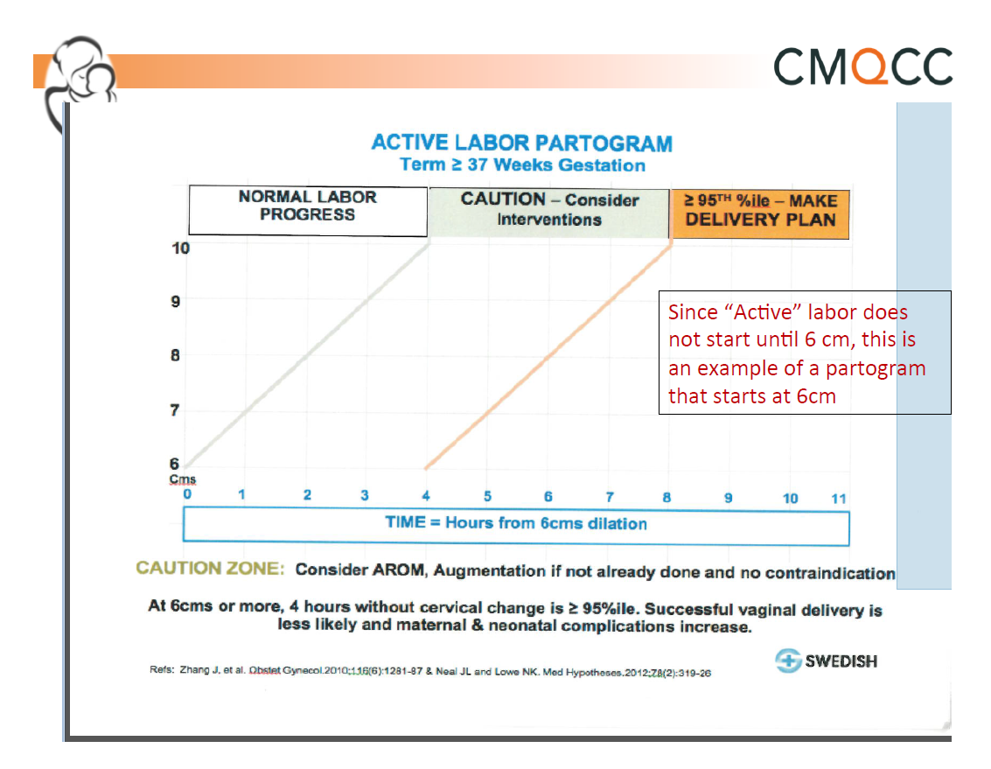
Did you know?
6 is the new 4!
FIRST STAGE OF LABOR
A prolonged latent phase (>20 hours in nulliparous women and >14 hours in multiparous women) should not be an indication for cesarean delivery.
Slow but progressive labor in the first stage should not be an indication for cesarean delivery.
Cervical dilation of 6 cm should be considered the threshold for the active phase of most women in labor. Thus, <6 cm dilation, standards of active phase progress should not be applied.
Safe prevention of the primary cesarean delivery. Obstetric Care Consensus No. 1. American College of Obstetricians and Gynecologists. Obstet Gynecol 2014;123:693–711.
Notes:
At 6 cm or more, 4 hours without cervical change it too long. At this phase intervention should be performed which can include position changes, AROM, Pitocin. We don’t apply this standard to women before 6 cm.

Slide 8

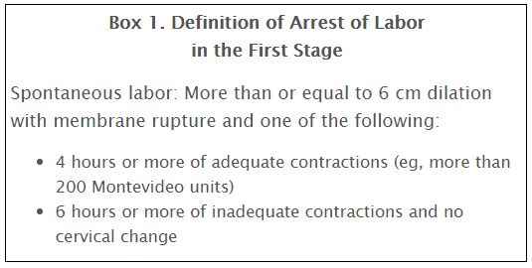
Safe prevention of the primary cesarean delivery. Obstetric Care Consensus No. 1. American College of Obstetricians and Gynecologists. Obstet Gynecol 2014;123:693–711.

Slide 10

Number 687, February 2017
Approaches to Limit Intervention During Labor and Birth
Obstetrician–gynecologists, in collaboration with midwives, nurses, patients, and those who support them in labor, can help women meet their goals for labor and birth by using techniques that are associated with minimal interventions and high rates of patient satisfaction. Many common obstetric practices are of limited or uncertain benefit for low-risk women in spontaneous labor.
For women who are in latent labor and are not admitted, a process of shared decision making is recommended.
Admission during the latent phase of labor may be necessary for a variety of reasons.
Admission to labor and delivery may be delayed for women in the latent phase of labor when their status and their fetuses’ status are reassuring. The women can be offered frequent contact and support, as well as non-pharmacologic pain management measures.
When women are observed or admitted for pain or fatigue in latent labor, techniques such as education and support, oral hydration, positions of comfort, and non-pharmacologic pain management techniques such as massage or water immersion may be beneficial.
Notes:
I think its important to note that these recommendations are coming from ACOG!

Slide 11
Decision Points
Discharge home
Re-evaluate
Admit

Slide 12
Shared Decision Making

Slide 14
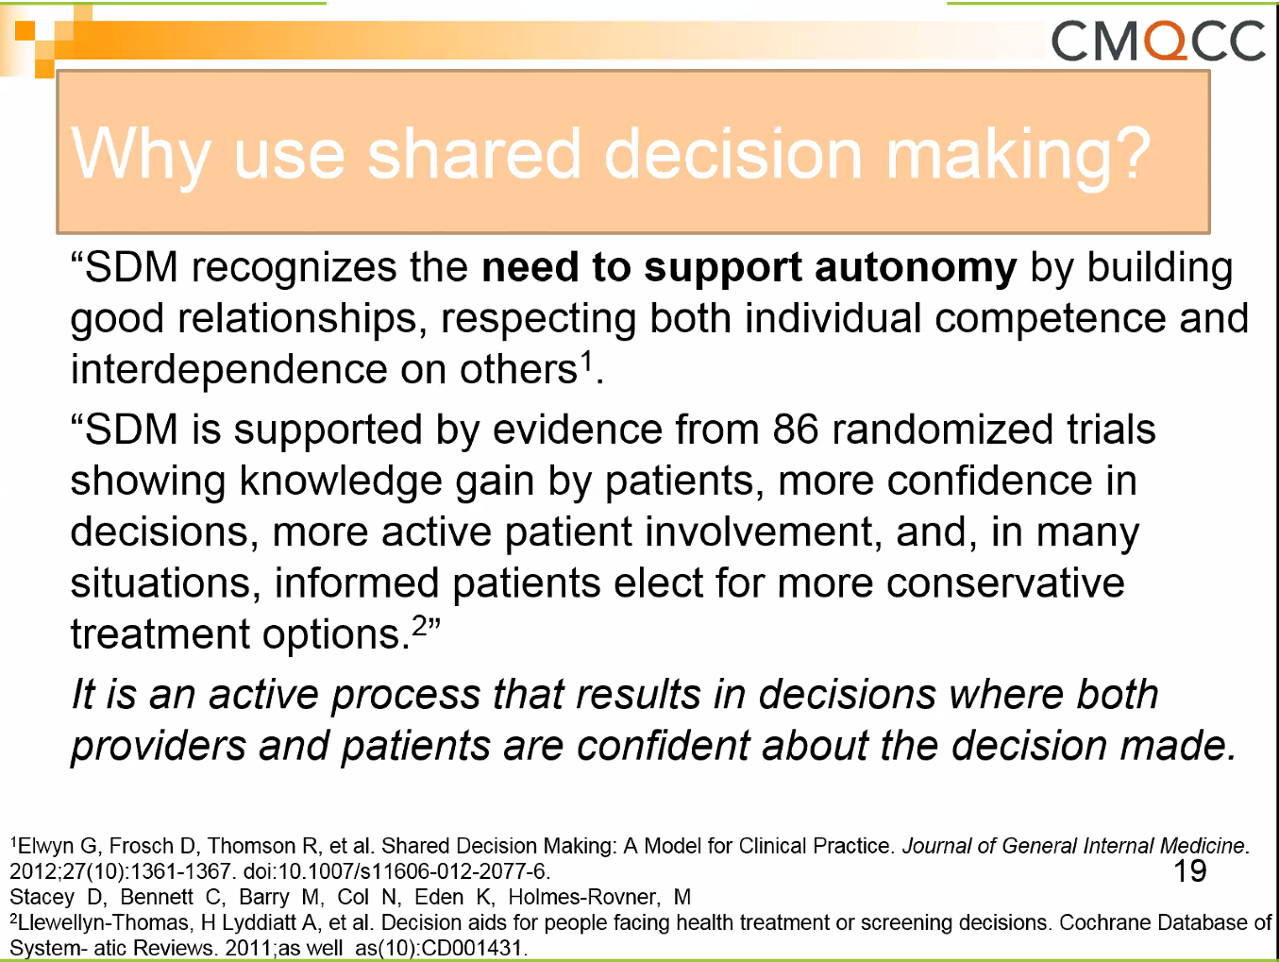

Slide 15
Benefits for Your Patients
Shared decision making can:
  Improve the patient’s experience of care
  Improve patient adherence to treatment recommendations - emerging evidence that it can help improve health outcomes
Notes:
SAY: Shared decision making has many benefits for the patient.
Shared decision making:
Improves the patient’s experience of care.
Improves patient adherence to treatment recommendations; there is also emerging evidence that it can improve health outcomes.

Slide 16
Benefits for Your Organization
Shared decision making can:
  Improve the quality of care delivered
  Increase patient satisfaction
Notes:
SAY: Shared decision making can benefit the provider organization by improving the quality of care delivered, and increasing patient satisfaction.
We will discuss more about the benefits to patients and providers in Module 4.

Slide 20
Step 1: Seek your patient’s participation
Communicate that a choice exists and invite the patient to participate in the decision-making process.
Many patients are not aware that they can and should participate in their health care decision making.
Many patients are not aware of the uncertainty in medicine, and that the outcomes of various treatments are variable.
Notes:
SAY: Let’s look at Step 1 on page 3 of the tool. Seek your patient's involvement.
Communicate that a choice of treatment exists and invite your patient to participate in the decision- making process.
Many patients are not aware that they can and should participate in their health care decision making.
In addition, many patients are not aware of the uncertainty in medicine, and that the outcomes of various treatments are variable.

Slide 21
Step 1: Seek your patient’s participation
Tips
Summarize the health problem and communicate there may be more than one treatment choice.
Ask your patient to participate with the health care team.
Assess the role your patient
wants to play.
Include family/caregivers in decisions.
Use cues to continually engage your patient. For example, “I'd like your input.”
Notes:
SAY: Each of the steps offer practical tips that you can use. I suggest you read through tool 2 when you get back to your office. Soon using one or more of the tips will become second nature to you during shared decision making.
Let’s go over some tips to help you invite your patient to participate.
Summarize the health problem clearly and communicate there may be more than one treatment choice.
Ask your patient to participate with the health care team in the decision-making process. Help the patient understand he or she is being invited to ask questions, get answers, and discuss options with you.
Assess the role your patient wants to play in the decision-making process.
Provide ongoing cues during the interaction about why their input is important. For example, say
“I would like your input.”
Ask your patient if he or she would like family and caregivers to participate.

Slide 22
Step 1: Seek your patient’s participation
Conversation Starters
“Now that we have identified the problem, it’s time to think about what to do next. I’d like us to make this decision together.”
“There is good information about how these treatments differ that I’d like to discuss with you before we decide on an approach that is best for you.”
“I’m happy to share my views and help you reach a good decision. Before I do, may I describe the options in more detail?”
Notes:
SAY: Here are some conversation starters to invite your patient's involvement:
“Now that we have identified the problem, it’s time to think about what to do next. I’d like us to make this decision together.”
“There is good information about how these treatments differ that I’d like to discuss with you before we decide on an approach that is best for you.”
“I’m happy to share my views and help you reach a good decision. Before I do, may I describe the options in more detail?”

Slide 23
Step 2: Help your patient explore and compare treatment options
Conversation Starters
“Here are some choices we can consider.”
“Let me tell you what the research says about the benefits and risks of the medicine/treatments that you are considering.”
“I have some booklets I want to give you that have information about your condition and the treatment options.”
“These tools have been designed to help you to understand your options in more detail.”
Notes:
SAY: Some conversation starters for helping your patient assess pros and cons of treatments options are on pages 5-8. Let’s go over some of them now.
“Here are some choices we can consider.”
“Let me tell you what the research says about the benefits and risks of the medicine/treatments that you are considering .”
When introducing decision aids, you can say:
“I have some booklets I want to give you that have information about your condition and the treatment options.”
“These tools have been designed to help you to understand your options in more detail.”

Slide 24
Benefits of using decision aids in shared decision making
Improves patient’s knowledge of options
Results in patient having more accurate expectations of possible benefits and risks
Leads to patient making decisions that are more consistent with his/her values
Increases patient’s participation in decision making
Notes:
SAY: The benefits of using decision aids include:
Improving patients’ knowledge of their options
Patients having more accurate expectations of possible benefits and risks
Patients making decisions that are more consistent with their values
Increasing patients’ participation in decision making

Slide 25
Step 3: Assess your patient’s values and preferences
An optimal decision is one
that takes into account patient preferences and values.
Communicate with your patient about the outcomes that are most important to
him or her.
What matters most to your patient?
Fears
Costs
Pain
Notes:
SAY: The third step in the SHARE model is to assess your patient’s values and preferences. See page 9 of Tool 2, the SHARE Approach. Essential Steps of Shared Decision Making: Expanded Reference Guide with Sample Conversation Starters.
Some health care providers may not be aware of the outcomes that matter most to patients. In fact, studies have shown that heath care professionals aren’t truly tuned in to the things that really matter to patients.
And other studies have shown that patient treatment decisions often change after patients become well informed about their available options and the associated risks.
The best decision for your patient is one that takes into consideration his/her preferences and values. Talk with your patient about what matters the most and what outcomes are the most important to him/her.

Slide 26
Step 3: Assess your patient’s values and preferences
Tips
Encourage your patient to talk about his or her values and preferences.
Use open-ended questions.
Listen actively to the patient and show empathy and interest.
Acknowledge what matters to your patient.
Agree on what is important to your patient.
Notes:
SAY: Some tips to accomplish Step 3 are:
Encourage your patient to talk about what is important to him or her regarding the options.
Use open-ended questions. Avoid questions with yes and no answers.
Listen actively to your patient. Show empathy and interest in the effect that a problem is having on your patient's life.
Acknowledge the values and preferences that matter to your patient.
Come to agreement on what your patient prefers and is important.

Slide 27
Step 3: Assess your patient’s values and preferences
Conversation Starters
“When you think about the possible risks, what matters most to you?”
“As you think about your options, what’s important to you?”
“Which of the options fits best with treatment goals we’ve discussed?”
“Is there anything that may get in the way of doing this?”
Notes:
SAY: Some things you can say to get the conversation going about your patient’s values and preferences are:
“When you think about the possible risks, what matters most to you?”
“As you think about your options, what’s important to you?”
“Which of the options fits best with the treatment goals we’ve discussed ?”
“Is there anything that may get in the way of doing this?”
Assessing preferences matter, especially when patients defer decisions to clinicians.
Find out what matters to the patient. This may greatly impact achieving satisfactory health outcomes and patient satisfaction.

Slide 28
Potential Barriers or Concerns
Distance to hospital
Lack of support at home
Fear of delivering outside of the hospital
Fear of not being able to get an epidural
Concern regarding fetal wellbeing

Slide 29
Step 4: Reach a decision with your patient
Decide together on the best option.
Arrange for follow-up steps to achieve the preferred treatment.
Conversation Starters
“It’s fine to take more time to think about the treatment choices. Would you like some more time, or are you ready to decide?”
“What additional questions do you have for me to help you make your decision?”
“Now that we had a chance to discuss your treatment options, which treatment do you think is right for you?”
Notes:
SAY: The fourth step in the SHARE model is to reach a decision with your patient about the treatment option that is best. Turn to page 10 of Tool 2, the SHARE Approach. Essential Steps of Shared Decision Making: Expanded Reference Guide with Sample Conversation Starters.
Making a decision may take time. Check to see if your patient needs more time to consider the options or discuss them with others.
After assessing the treatment options, including benefits and risks, and guiding your patient to express what matters the most to him or her in determining the best option, decide together on the best treatment option.
Your patient may choose to delegate the decision to someone else or decide not to make a decision. In that case, active surveillance may be the option.
Schedule follow-up appointments to carry out the preferred treatment or active surveillance.

Slide 30
Step 4: Reach a decision with your patient
Tips
Ask your patient if he/she is ready to make a decision.
Ask your patient if he/she needs more information.
Confirm the decision with your patient.
Notes:
SAY: Tips to help move your patient to come to a decision after jointly talking about the pros and cons of the treatment are:
Ask your patient if he or she is ready to make a decision or if they have any additional questions.
Ask if he or she would like additional information tools, such as decision aids to help make a decision.
If more time is needed, schedule another session.
Confirm the decision by asking your patient to describe the option she or he chose.
Have other staff schedule appointments to carry out the preferred option.

Slide 31
Step 5: Evaluate your patient’s decision
Support your patient so the decision has a positive impact on health outcomes.
Notes:
SAY: Once a decision has been made, it will be important to follow up with your patient on how he or she is doing. Evaluate your patient's decision. This is the last step in the SHARE Approach to shared decision making.
See page 11 of Tool 2, The SHARE Approach. Essential Steps of Shared Decision Making: Expanded Reference Guide with Sample Conversation Starters.
For patients facing life-threatening conditions, some of the decisions will be irreversible, so careful follow-up is needed during the treatment phase.
For decisions related to management of chronic disease, the decision should be revisited periodically.

Slide 32
Evidence-Based Practice during
Latent Labor
Decision Point 1: <3 cm dilated
  Offer coping skills and encourage discharge home.
  Evidenced-based coping strategies include:
    Ambulation and upright positions
    Hydrotherapy
    Continuous labor support
    Eating and drinking

Slide 33
Evidence to Avoid Admission in Latent Labor
Women admitted in latent labor are at greater risk of:
  Cesarean Section
  Pitocin augmentation
  Higher temperatures after amniotomy
  Longer labors
  Neal et al., 2012 …

Slide 34
Avoiding early labor admission
Evidence based strategies:

Slide 35
Implement Early Labor Supportive Care Policies and Active Labor Criteria for Admission
Translation: Early labor at home. Let labor start on its own!
Physiologic onset of labor is critical to the success in labor, and introduces moms and babies to protective hormonal pathways
Women admitted in early labor are more likely to have a cesarean, and more likely to have routine interventions e.g. oxytocin even if not clinically necessary

Slide 36
Early admission support
Recog/Prevent
Admission policy or checklist for spontaneous labor
Latent labor support and therapeutic rest policies
Patient education materials to explain rationale for delayed admission, reduce anxiety and provide guidance on when to return to the labor and delivery unit
Material with specific guidance for partners and family members as to how to best support the woman in early labor
36

Slide 37
Continuous Labor Support

Slide 38
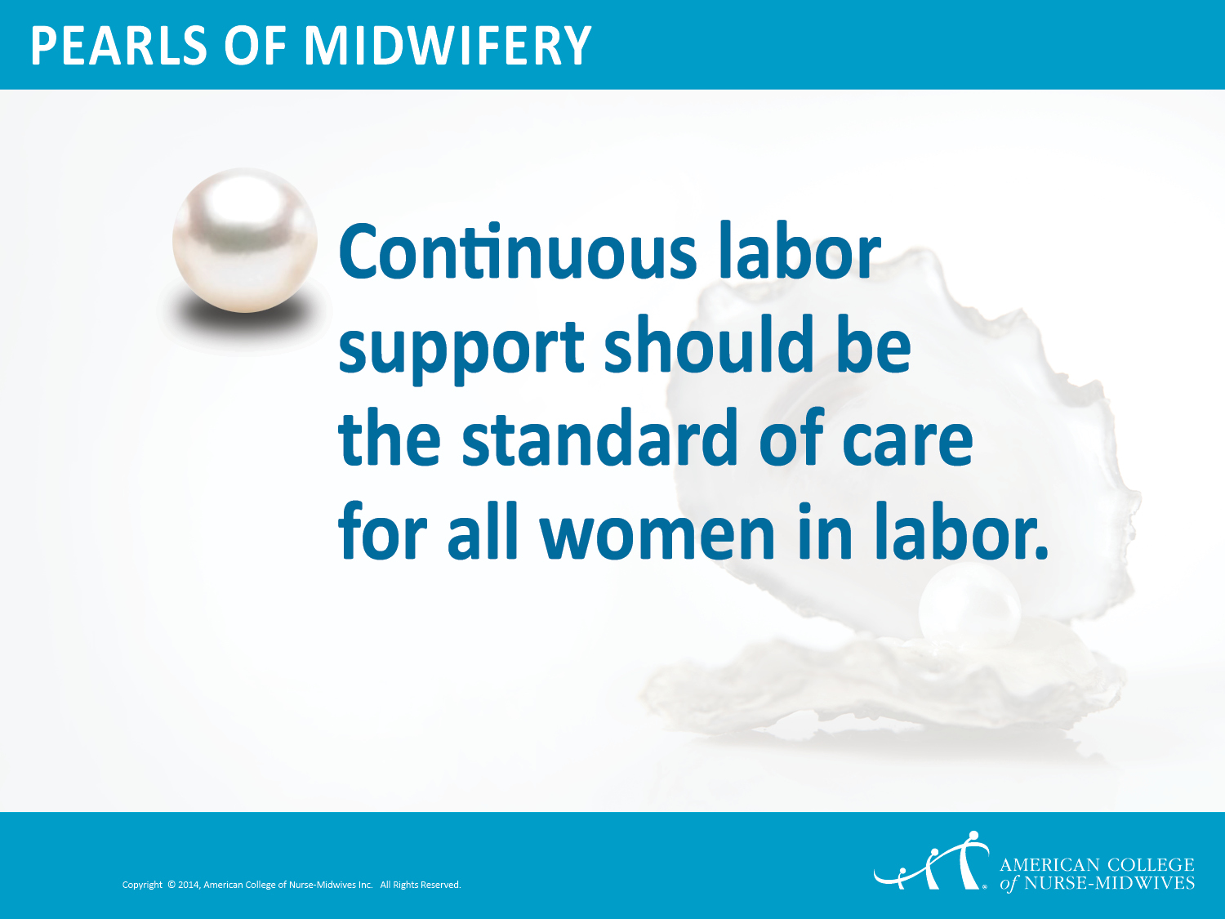
Notes:
Throughout history, women in labor have been attended by other women skilled in providing continuous, emotional and physical support. As birth moved to hospitals, this component of care was largely lost. Continuous support in labor has become the exception rather than the norm.

Slide 39
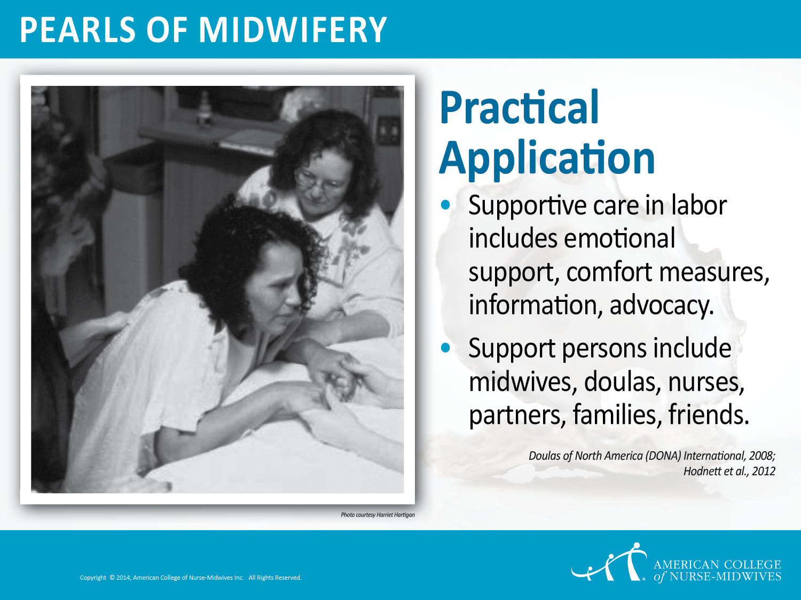
Notes:
Supportive care during labor involves providing emotional support, comfort measures, information about what’s going on, and advocacy for the woman’s rights and needs. Doulas are experts in providing labor support, and their presence should be encouraged. One-on-one nursing care is ideal for laboring women. Midwives guide labor and provide support. Families should be educated about the evidence regarding continuous labor support. Continuous labor support appears to be more effective when provided by caregivers who were not employed by the hospital as they have no obligation to anyone other than the woman in labor.

Slide 40
AWHONN Position Statement
"The Association of Women’s Health, Obstetric and Neonatal Nurses (AWHONN) asserts that continuous labor support from a registered nurse (RN) is critical to achieve improved birth outcomes."
"AWHONN recognizes that childbirth education and doula services contribute to the woman’s preparation for and support during childbirth..."
- Continuous Labor Support for Every Woman, JOGNN, January 2018, Volume 47, Issue 1, Pages 73–74
Notes:
This position statement was published just this month, January 2018. AWHONN identifies labor support as fundamental and intrinsic to the role of the labor and delivery nurse.

Slide 41
AWHONN Position Statement
"Additionally, the RN should help the woman to cope with labor (Roberts, Gulliver, Fisher, & Cloyes, 2010). Support during early labor builds the woman’s confidence and helps her establish realistic expectations."
- Continuous Labor Support for Every Woman, JOGNN, January 2018, Volume 47, Issue 1, Pages 73–74
Notes:
A position statement was just published this month, January 2018, which

Slide 42
Nurses' Role in Labor Support
Labor and delivery nurses report increased feelings of job satisfaction when able to provide support to laboring women, rather than solely tending to the technical aspects of a birth.

Slide 43
Number 687, February 2017
Approaches to Limit Intervention During Labor and Birth
Obstetrician–gynecologists, in collaboration with midwives, nurses, patients, and those who support them in labor, can help women meet their goals for labor and birth by using techniques that are associated with minimal interventions and high rates of patient satisfaction. Many common obstetric practices are of limited or uncertain benefit for low-risk women in spontaneous labor.
Evidence suggests that, in addition to regular nursing care, continuous one-to-one emotional support is associated with improved outcomes for women in labor.

Slide 44
Continuous Labor Support during Childbirth
(Cochrane Review updated 2017)
Improves outcomes for women and infants:
  Increased spontaneous vaginal birth
  Shorter duration of labor
  Decreased cesarean birth
  Decreased instrumental vaginal birth
  Decreased use of analgesia
  Decreased low 5-min Apgar score
  Increased feelings of satisfaction about childbirth experience

Slide 45
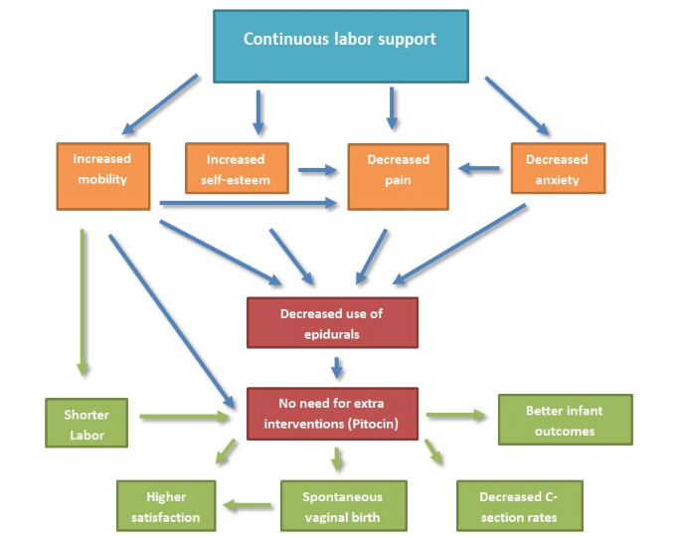
Conceptual Model for Continuous Labor Support
© 2012 by Rebecca L. Dekker, PhD, RN, APRN at evidencedbasedbirth.com

Slide 46
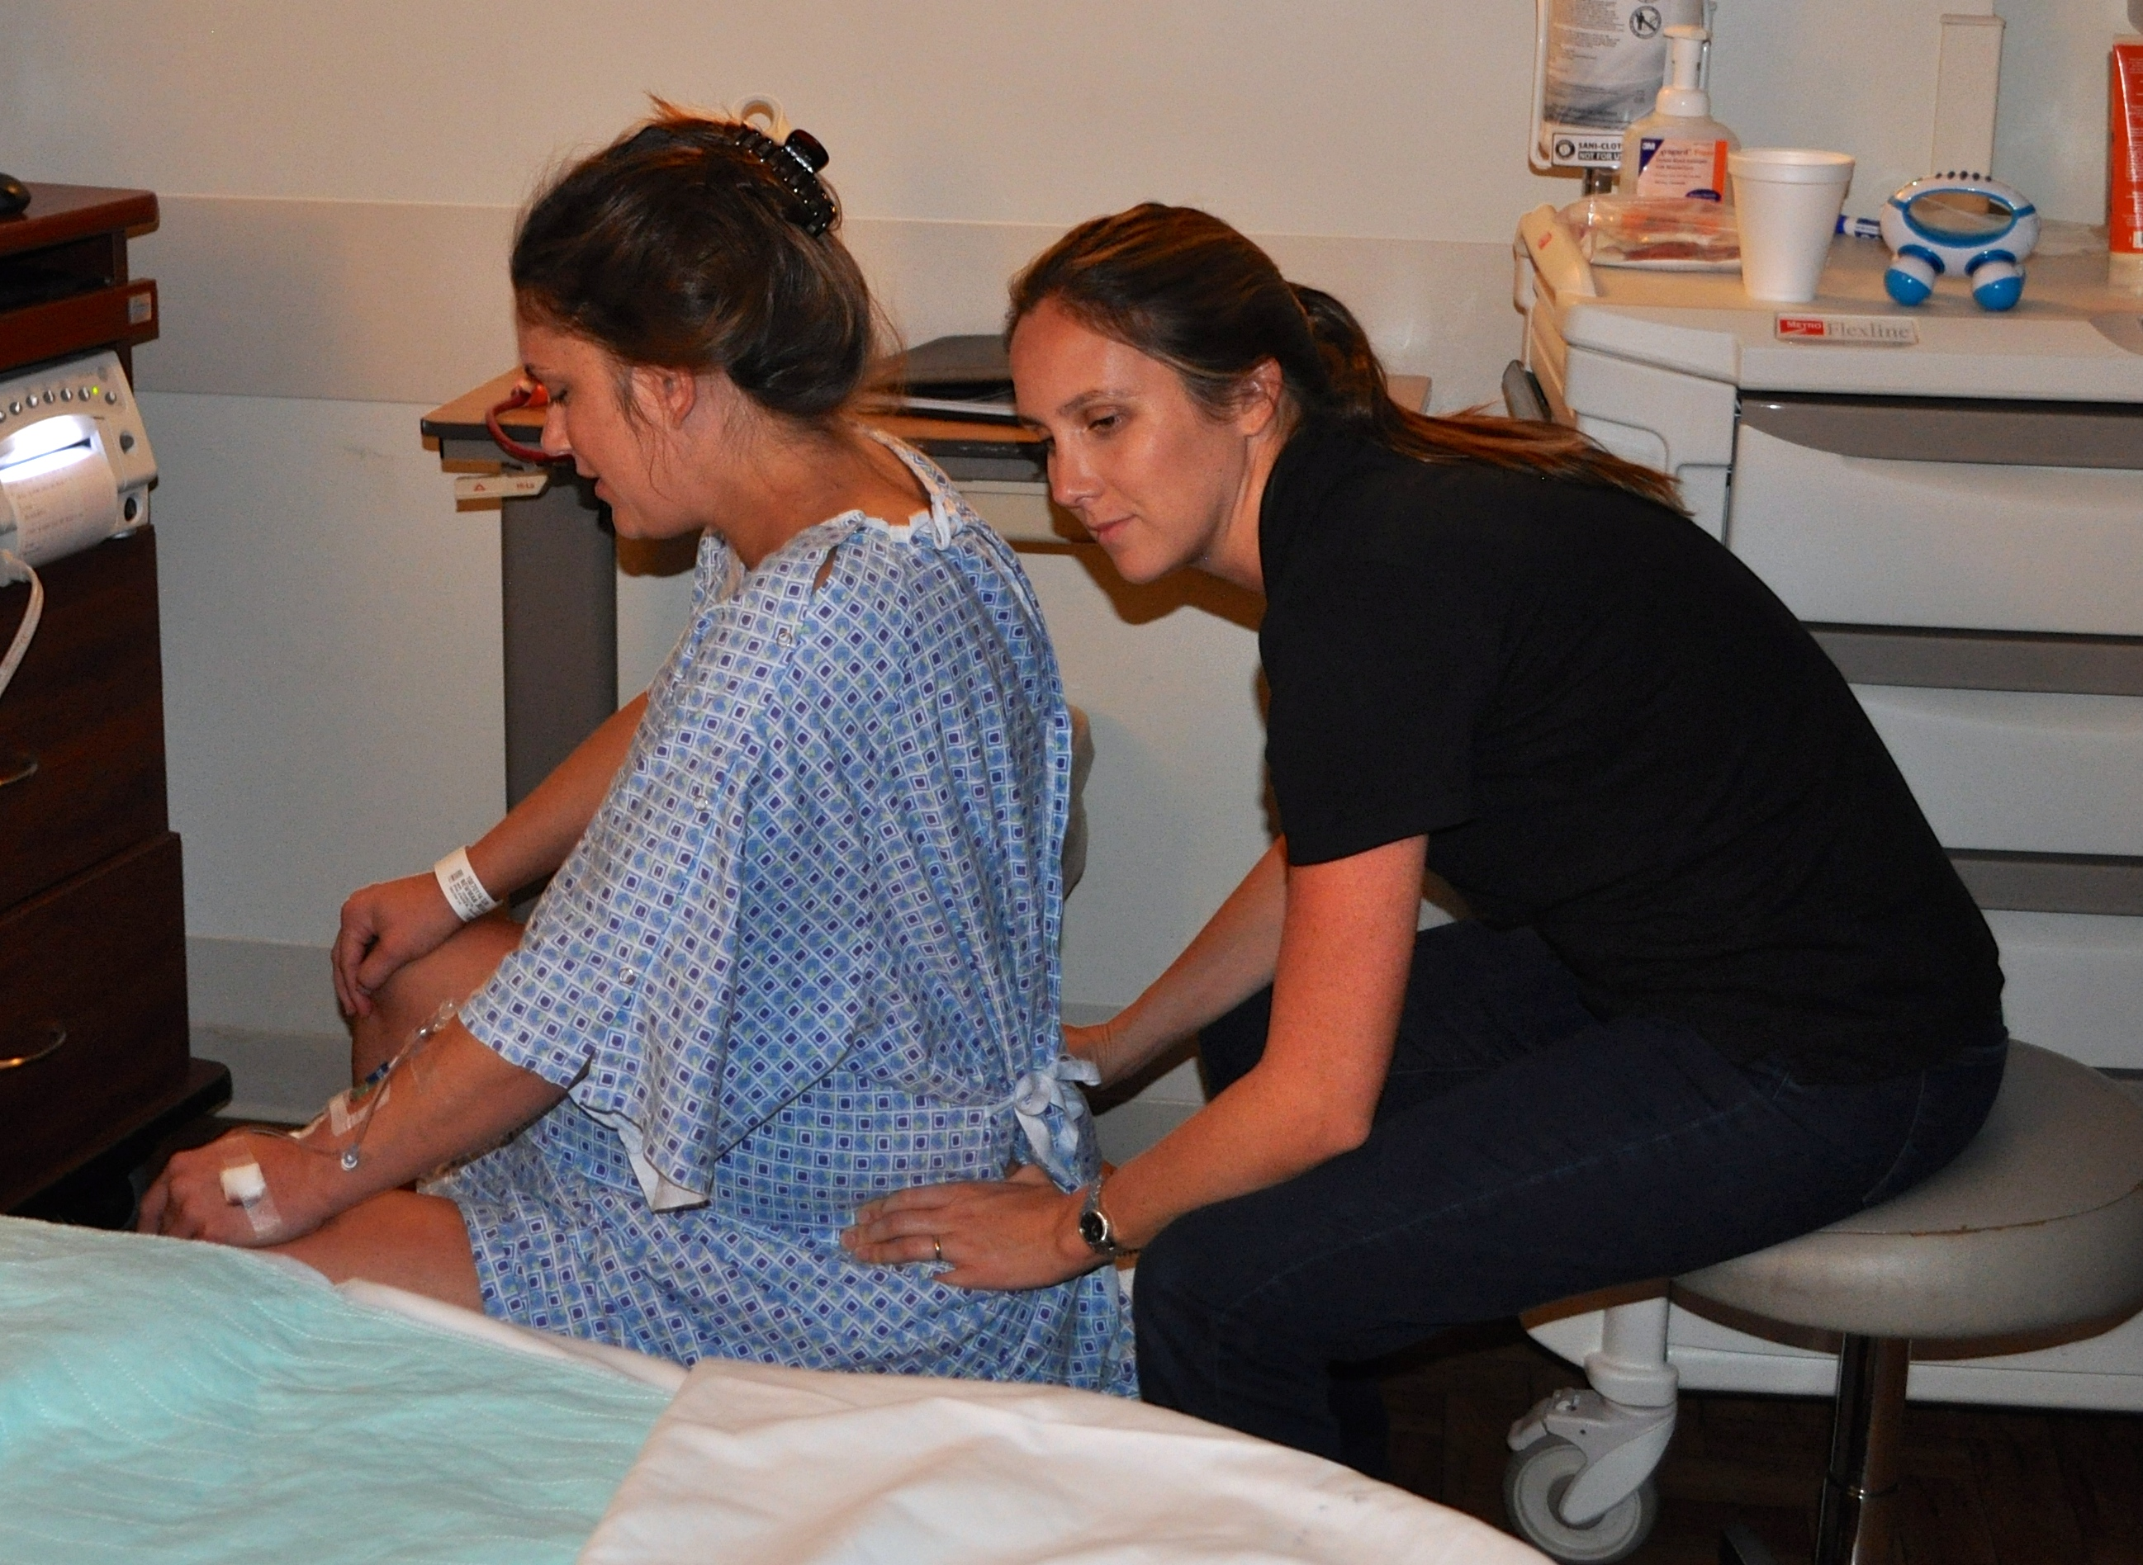
What Is a Doula?
A birth doula is a trained professional who continuously supports the physical, informational and emotional needs of the patient before, during and after labor.
Notes:
Have you worked with doulas before? What was your experience like?
Not all doulas are created equal. Doulas are trained and certified by doula training organizations and are expected to stay within their scope of practice. The best doulas work collaboratively with nurses and doctors with the overall goal of helping their clients have a safe, supported, positive birth experience. Doula are hired by women that have varying birth wishes including those who wish to have an unmedicated birth, those who are planning to have an epidural and even clients that are having a scheduled cesarean. Doulas can bring comfort and support to all of them.

Slide 47
Have you worked with doulas before? What was your experience like?
Good?
Bad?

Slide 48
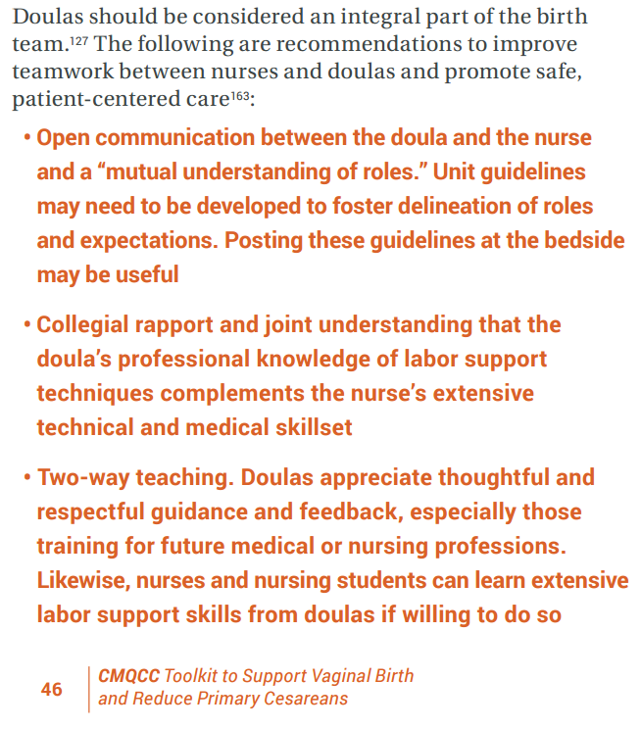
Patients with Doulas
When doulas are utilized in a way that allows them to function appropriately in their unique and integral role, they can simultaneously advocate for women and act as helpful allies to nurses and providers.
There are still many misconceptions about doula care and often there is a stigma surrounding the “type” of woman who has a doula.

Slide 49
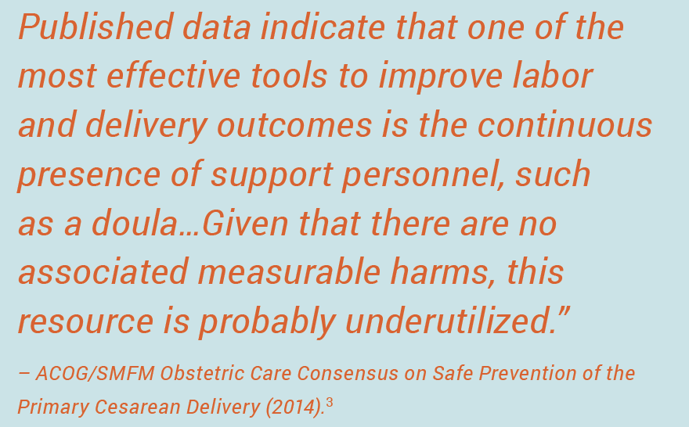
Doulas
Recognition
Notes:
It would a beautiful goal for every first time mom to have a doula to support her through labor and birth.
Women that do not have a partner can definitely benefit from having a doula. Doulas work in an unbiased fashion and do not bring any personal opinions or desires about the birth outcome into the picture. Some women might prefer this to having their own family, mother or mother in law as a support person as sometimes those people can bring more stress or anxiety. A doula can be a nonjudgement support person that fills that role for a woman.

Slide 50

Continuous Support Means:
Physical Support
Help moving into more comfortable positions, massage, hip squeeze, offering water, applying hot pack, getting in and out of shower/tub.
Informational Support
Support with shared decision making, translation of medical jargon, assistance in communication of birth preferences.
Emotional Support
Encouragement, relief of stress and reduction of fear, creating a calm environment.

Slide 51
Patients with Doulas

Slide 52
Doula Role in Latent Labor
Over the phone availability to answer questions
Assistance with determining it is latent labor (regular contractions, getting stronger, closer together)
In person physical support and comfort measures
Providing information on latent vs active labor indicators
Assistance with determining when to go to the hospital
Fostering a calm and relaxed environment for mother and partner to promote labor progress
Referring to care provider for questions and assistance as needed
Notes:
Doulas can join clients in early labor and make a difference in their comfort and ability to continue laboring without heading to the hospital too soon.
The doula can also be a great resource for nurses that might be uncomfortable sending patient home in latent labor.

Slide 53
Coping Strategies for Latent Labor

Slide 54
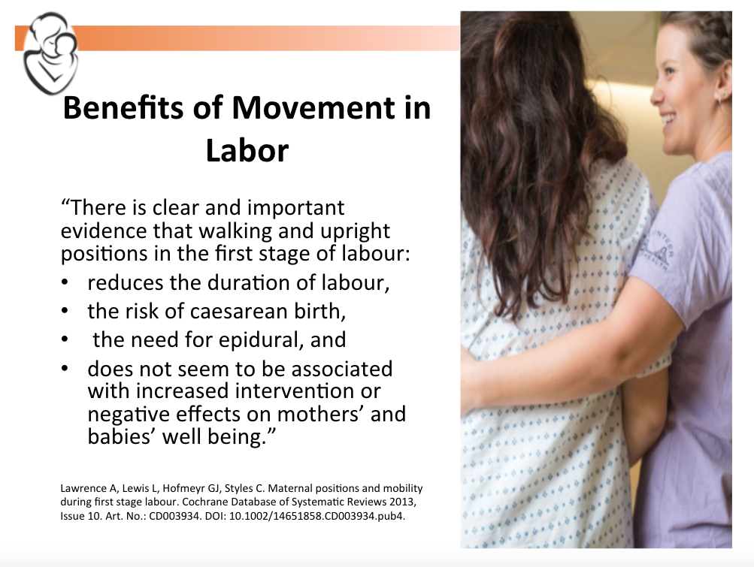
Neal JL, Lowe NK, Schorn MN, et al. Labor dystocia: A common approach to diagnosis. J Midwifery Womens Health. 2015;60(5):499-509. doi: 10.1111/jmwh.12360 [doi].

Slide 55
Hydrotherapy
Immersion in water during the first stage of labor significantly reduces the:
  length of labor
  need for epidural anesthesia.
Practical tips
  Relax in the tub or shower.
  Use of a birth tub, baby pool, etc.
  Use props to keep comfortable such as a pool noodle, plastic cushion, etc.
Cluett E, Burns E. Immersion in water in labour and birth. Cochrane Database Syst Rev. 2009;2:CD000111.

Slide 56
Oral Nutrition in Labor Is Safe
“The uterus is mostly made of muscle tissue. Muscles use fuel as they work and require enough nutrition to meet these energy needs. Very little research has been done specific to the nutrition needs of women in labor, but research in sports nutrition has found that taking in carbohydrates during exercise improves performances and protects against fatigue and ketosis.”
Dekker, R. (2017) Evidence on eating and drinking in labor. www.evidencebasedbirth.com.
Rodriguez et al. (2009) American College of Sports Medicine position stand. Nutrition and athletic performance. Med Sci Exerc, 41(3), 709-731.
Notes:
Another great reason for women to stay home in early labor is that they can eat and drink as much as they please, and depending on hospital policy this may be an issue.

Slide 57
Latent Labor Coping Strategies
Distraction (cooking, organizing, mani/pedi, movie, games)
Ignoring the contractions until you can't any longer
Continuous support (partner, doula, mother)
Breathing and relaxation
Massage
Movement and position changes
Heat and cold therapy
Eating and drinking
Hydrotherapy
Notes:
What can she do when she goes home....

Slide 58
Patient Education
Resources and tips

Slide 59
Patient Education
What are signs of concern?
How long can latent labor last?
What can she do to stay comfortable at home?
Strategies to support delayed admission until active labor
When should she come back?
  What does active labor feel like?
  What does active labor look like?

Slide 60

Empower Women to Use Their B.R.A.I.N.
B
Benefits: What are the benefits of this procedure? How will this positively impact my labor, myself, or my baby?
Risks: What are the risks of this procedure? How might this negatively affect my labor, myself or my baby?
Alternatives: Are there alternatives to this procedure? Other options that may have the same results?
Intuition: What is my gut telling me about this?
Nothing/Need time: Can this procedure be delayed? Can I take some time to think about it? What will happen if I choose to watch and wait for now?
R
A
I
N

Slide 61
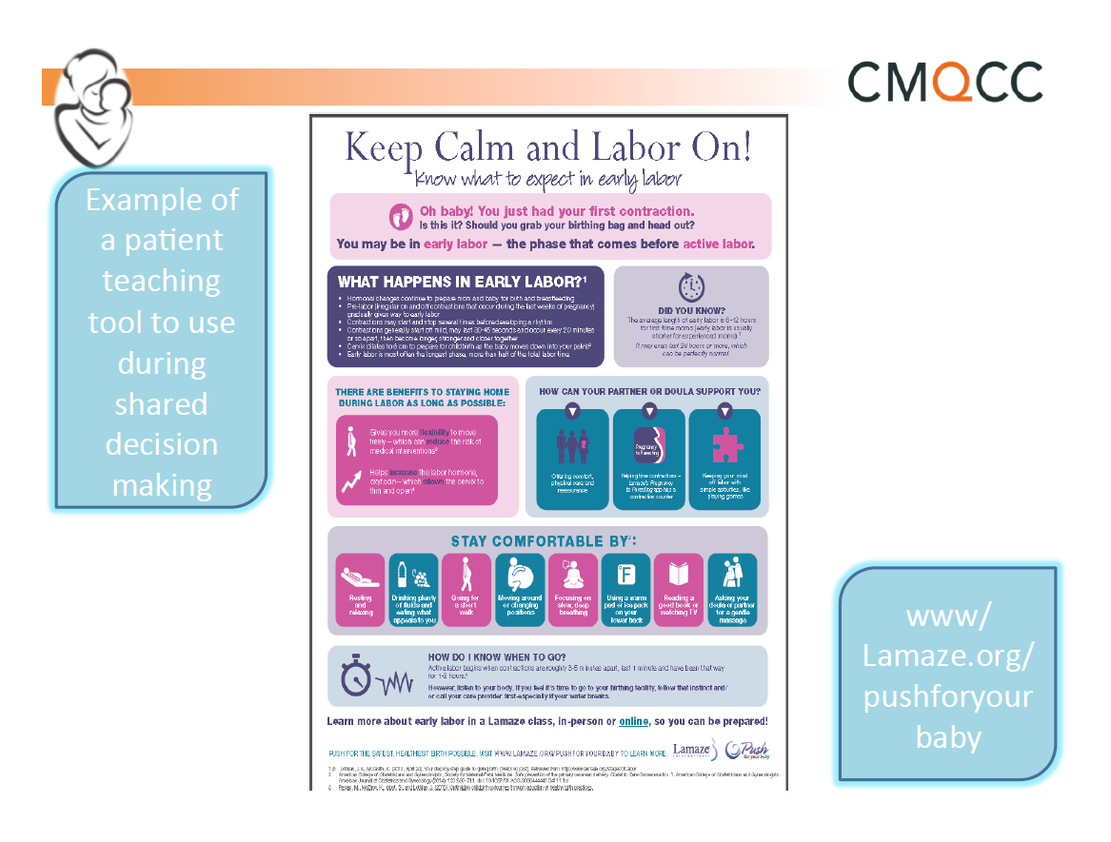
Notes:
Available online in the FPQC toolbox

Slide 62
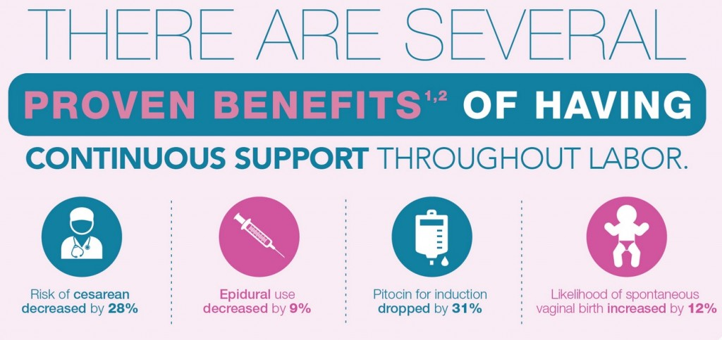

Slide 63
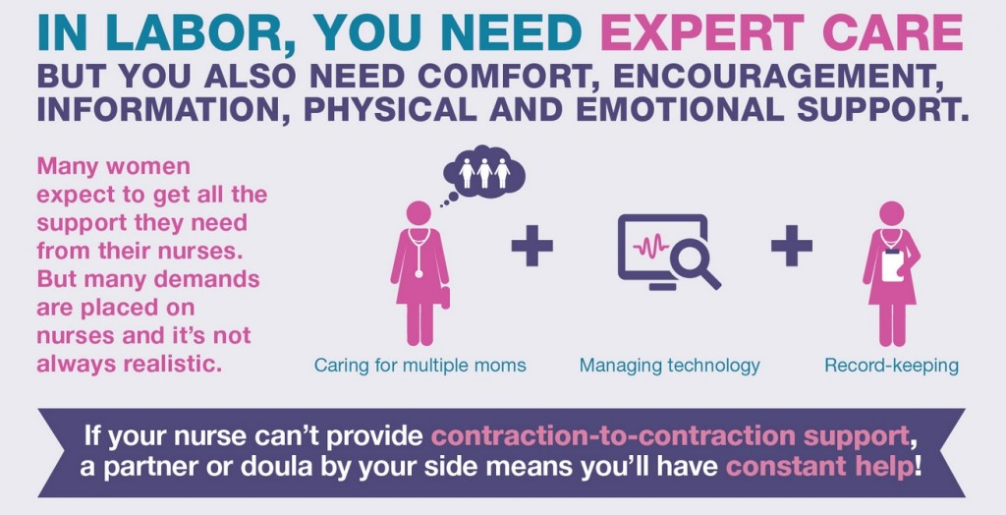

Slide 64
Communication with the care team

Slide 65
SBAR
A technique for communicating critical information that requires immediate attention and action concerning a patient’s condition.
Situation: What is going on with the patient?
  “ I am calling about Ms. Johnson in Triage 5. She presents with complaints of contractions every 5-7 minutes x 5 hours.”
Background: What is the clinical background or context?
  “She is a 32 year old G1P0 at 39 weeks 5 days. She has not complications this pregnancy. She denies any leakage of fluid or vaginal bleeding and reports normal fetal movement.
Assessment:
  “Her cervical exam was 3/thick/-2. Her fetal heart tracing is reactive. She seems to be in early labor and is coping well.”
Recommendation or Request: What would I do for this patient?
  “I have reviewed comfort measures with her and her partner and they prefer to go home and come back in active labor.”

Slide 66
Practice Latent Labor Scenarios

Slide 67
Scenario
Stephanie is a 21y.o. G1P0, at 40.5 weeks GA, no health problems and a normal prenatal course, who has arrived, alone, in L&D triage anxious and nervous about her contractions. She has had contractions at home on and off for 2 days but lately they have been stronger. She was told to come to the triage unit when she called her doctor. She does not think she has ruptured her membranes. Vital signs WNL.
Notes:
What additional information do you need to collect from Stephanie?
What physical assessment(s) do you need to perform?
Are there any elements of Shared decision making to use at this time?

Slide 68
continued
Stephanie states that she has been contracting all day and is ‘so tired.' She describes the contractions as ‘really strong.' On PE you determine VE to be 3cm/-2/thick, and change from the day before when she was 1cm/high/thick. Stephanie wonders if this is ‘normal,' and wonders if she should call her partner and ask him to come to the hospital.
Notes:
What does this tell us about Stephanie’s labor? How does it relate to hospital admission and anticipated length of labor?
What would you tell Stephanie about her labor progress?
What element(s) of shared decision making would you use at this point to assist Stephanie?

Slide 69
continued
After your discussion, you realize that Stephanie clearly expects to be admitted to the hospital. She is also clearly wants to do what’s best for her baby, and seems open to exploring options. However, when you suggest that it might be best for her to go home and await active labor, she becomes quite hesitant. Stephanie expresses fear about the baby being alright, how to cope at home, and knowing when she should come back to the hospital.
Notes:
What element of Shared Decision Making is appropriate now? What would that sounds like with Stephanie?
How would you address Stephanie’s/Kate’s concerns?
What options would you give her for coping at home?
tub, shower, ability to rest, walk inside or out; food and water
support, home safety, transportation
What would you tell Stephanie about how admission to hospital may her affect movement, and access to nutrition and hydration.
How would you explain to Stephanie the potential for increased interventions while she is in the hospital?
What parameters would you give for return to the hospital?

Slide 70
continued
After your discussion about possible comfort measures, and guidelines for when to return to the hospital, Stephanie seems more relaxed. She expressed an interest in being able to use her Jacuzzi tub at home, it would be more comfortable than the bed she was sitting in. She also remembered that her neighbor had offered to come sit with her during labor. You assess that it would be appropriate to move to the final phase of shared decision making.
Notes:
What is the final phase of Shared Decision making? How would you approach this phase with Stephanie?
Assuming Stephanie agrees to return home to await active labor, how would you go about sharing this information with Stephanie’s care provider?
Shared mental model, closed loop communication, and SBAR
What discharge teaching would you provide Stephanie?

Slide 71
TAKE HOME POINTS
A standardized approach to evaluation of active labor is a helpful tool to decrease early admission in labor. When utilized it can significantly increase the chance of vaginal birth.
The Shared Decision Making model is ideal for helping patient make informed decisions.
Inter-professional communication is a key elemental in promoting vaginal birth.

