Slide 1
Induction of labor and Techniques for Preparing the Cervix for Labor
David C. Lagrew, Jr.,M.D.
Regional Executive Medical Director Women’s Services SJHH
Clinical Professor UC Irvine, Dept Ob-Gyn

Slide 2
Reflection
The pessimist complains about the wind,
the optimist expects it to change;
the realist adjusts the sails.
William Arthur Ward

Slide 3
Outline
Induction of labor
Cervical preparation choices
Inpatient versus outpatient
Conclusions

Slide 4
Induction of labor:
The stimulation of labor
for the purpose of accomplishing vaginal delivery

Slide 5

What virtually every mother wants:
A safe, easy, short delivery.
One of the biggest reasons the cesarean section rate increased. The desire lead people to forego a trial of labor which has only slight increased risks in current pregnancy (especially if scheduled cesarean) but an exponentially increasing risk of complications such as hemorrhage, infection, long term surgical complications and even death.

Slide 6

One of the greatest gifts to pregnant women, families, obstetricians, labor nurses and others involved is spontaneous labor at term. Those deliveries have a much lower cesarean section rate, shorter/easier labors and less long term risks to the mother. Advice: Don’t give up that gift lightly!
But there are good indicated reasons for inducing labor at times to improve the outcomes and experiences for mothers and babies. Therefore, when needed trying to have the shortest, easiest and most successful induction is the goal.

Slide 7
Keys for Induction Success
Who you choose
(parity and cervical ripeness)
How you perform the induction
Follow your success rates!

Slide 8
NEW ACOG STANDARD LABOR DEFINITIONS (2014)
LABOR | Uterine contractions resulting in cervical change (dilation and/or effacement) Phases: Latent phase – from the onset of labor to the onset of the active phase Active phase – accelerated cervical dilation typically beginning at 6 cm
AUGMENTATION OF LABOR | The stimulation of uterine contractions using pharmacologic methods or artificial rupture of membranes to increase their frequency and/or strength following the onset of spontaneous labor or contractions following spontaneous rupture of membranes. If labor has been started using any method of induction described below (including cervical ripening agents), then the term, Augmentation of Labor, should not be used.
INDUCTION OF LABOR | The use of pharmacological and/or mechanical methods to initiate labor (Examples of methods include but are not limited to: artificial rupture of membranes, balloons, oxytocin, prostaglandin, Laminaria, or other cervical ripening agents) Still applies even if any of the following are performed: Unsuccessful attempts at initiating labor Initiation of labor following spontaneous ruptured membranes without contractions
Menard MK, Main EK, Currigan SM. Executive Summary of the reVITALize Initiative: Standardizing Obstetric Data Definitions. Obstet Gynecol 2014 July; 124:150-3.

Slide 9


Slide 11
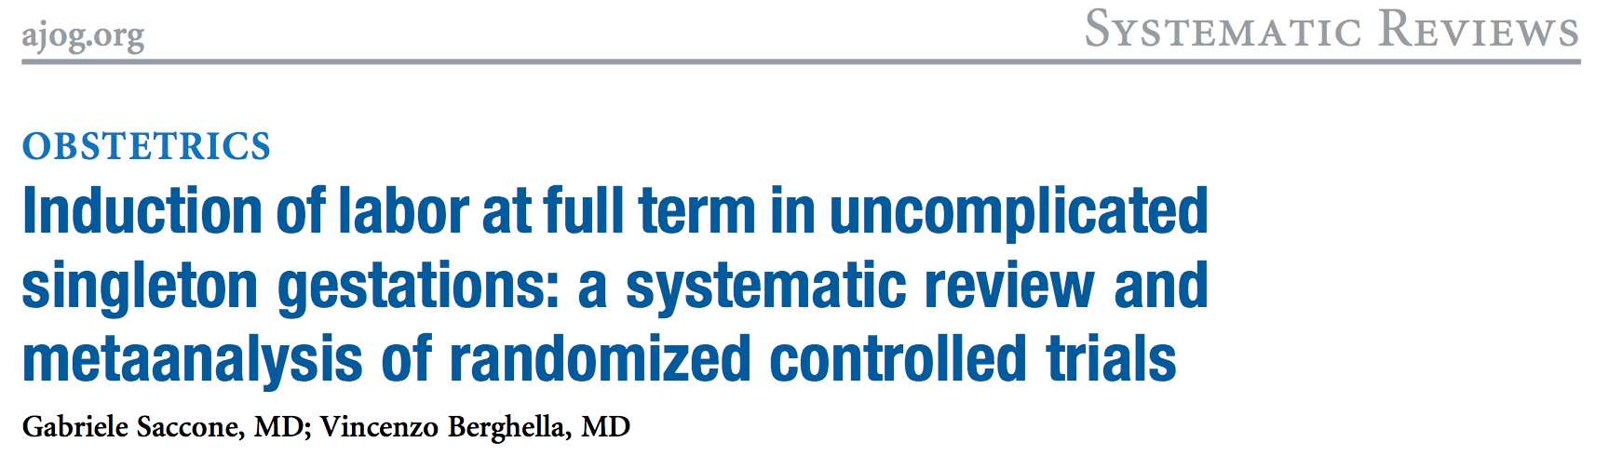
November 2015
Meta-analysis of 5 medium RCTs: 39-41wks
Similar rates of CS: 9.7% v. 7.5% (Ind v Spon)
Similar rates of Chorio: 9.6%v. 8.0%
2 RCT did sub-analyses of Nullips (100 each arm)
Rates of CS: 25.5% v. 15.3% (Ind v Spon)
RR: 1.67 (0.94-2.95)

Slide 12
NEJM: Randomized Trial of Labor Induction in Women ≥35 Years of Age
UK Academic Centers, all nulliparous,
35-39 years of age
304/314 women in each group
No difference in CS rate: 32% v 33%
No difference in maternal or infant outcomes (not powered enough for stillbirth detection)
(Walker KF etal. N Eng J Med 2016; 374:813-22)

Slide 13

CSR Elephants in the room
Medical Legal: Have we changed?
Payment Reform: When will it transition?
Provider: Willingness to change?
Elective Induction of labor?

Slide 14
What to do when there is conflicting data?
Retrospective studies vs. RCTs with selected populations
How can you pick from the literature?
  Is my setting and patient population the same?
  Does my hospital have strict induction protocols like the ones used in the RCTs?
  Are my results similar?
Where are ACOG guidelines?

Slide 15
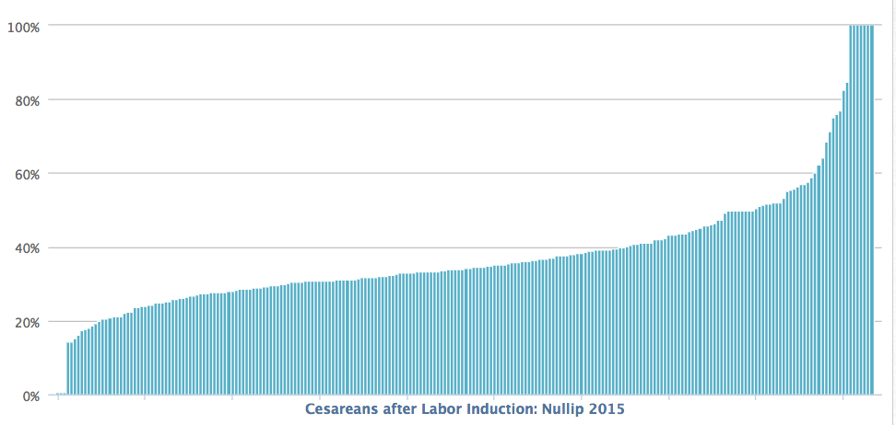
Cesarean Rate for Nullip Inductions
244 California Hospitals-- 2015
(CMQCC Maternal Data Center)
Striking Variation in the rates of Cesarean after Nullip Induction!

Slide 16
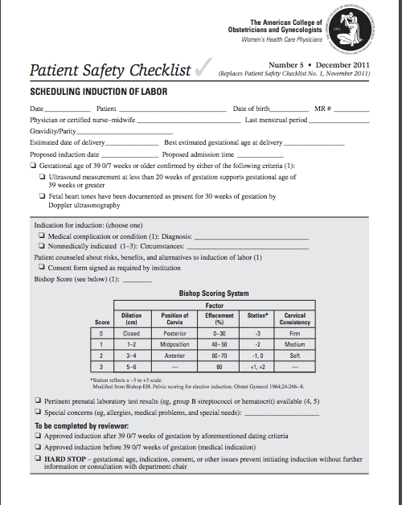
Scheduling
Checklist

Slide 17
“Elective” Inductions 39-41wks
“First do no harm”: are the risks minimal? What’s my rate?
First births + need for cervical ripening = Trouble
Should elective inductions be limited to Bishop scores > 6 or 8?
Should elective inductions not have cervical ripening?
A nullip with a long hard cervix at 40wks has no easy choices…
CAVEAT: Induced labor has a different shaped labor curve and longer stages

Slide 18
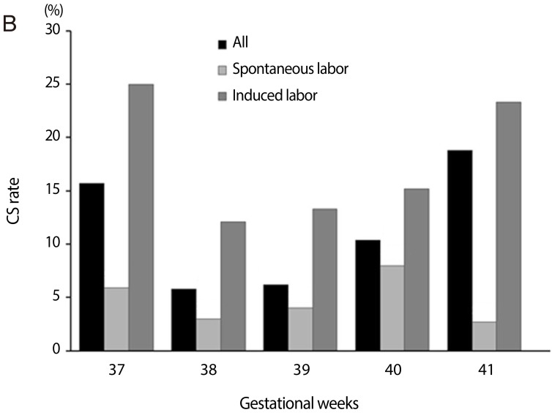
Retrospective Studies
Lee, et al. Obstet Gynecol Sci. 2015 Sep;58(5):346-52.
Notes:
In most retrospective studies you can see that spontaneous labor patients have much lower cesarean section rates. Critics counter that this ignores the increasing cesarean section rate associated with gestational age, therefore the comparison should be spontaneous rate and “cumulative” cesarean risk

Slide 19
Risks vs. Expectant Management
The risk of developing any hypertension in expectantly managed women was 4.1% after 37 weeks, 3.5% after 38 weeks, 3.2% after 39 weeks, and 2.6% after 40 weeks.
Compared with eIOL, women with hypertensive disorders had significantly higher rates of cesarean delivery and maternal morbidities (intensive care unit admission or death, third- or fourth-degree lacerations, maternal infections, and bleeding complications) at each week of gestation and the composite neonatal morbidity at 38 and 39 weeks of gestation.
Gibson et al. Am J Obstet Gynecol. 2016 Mar;214(3):389.e1-389.e12.

Slide 20
Who is right about elective inductions?
Clearly, spontaneous labor with usually favorable cervical exams and favorable fetal positioning is going to have lower chances for cesarean section.
However, because expectant management has risk of developing complications which can increase cesarean
In settings where clinicians not following a strict protocols for induction probably would lead to higher cesarean rates
More research is indicated

Slide 21
Careful protocols for scheduling inductions
Ensuring a safe gestational age;
Clarifying that the patient has an appropriate indication;
Making sure that appropriate cervical status and fetal positioning is present
Validating the scheduling provider has documented appropriate patient counselling on the risk and benefits and techniques of the process
Notes:
Before scheduling induction several elements need to be considered to estimate the success of induction and minimize the risk or CS.
Every women should ideally have an ultrasound preferably in the first trimester to confirm gestational age.
The indication for induction must be convincing, consented to and documented.
The pre induction assessment should include assessment of cervical status in order to 1) select the appropriate method of induction and 2) to estimate the likelihood of successful vaginal delivery. Of the Bishop score criteria for predicting successful induction, the most important is cervical dilation followed by effacement, station, position and consistency.
A discussion between the care provider and the women is needed in order to obtain clear consent. The discussion should include reason for induction, method of induction, including failure to achieve labor

Slide 22
Checklist-based Protocol for
Oxytocin Administration
Mean time of infusion to delivery was 8.5 +/- 5.3 hours versus 8.2 +/- 4.5 hours (NS)
Newborn index of adverse outcome were significantly fewer in the post protocol group (31 vs 18, P = .049).
System wide decline in the rate of primary cesarean delivery from 23.6% in 2005 to 21.0% in 2006.
Clark S, Belfort M, Saade G, Hankins G, Miller D, Frye D, Meyers J. Implementation
of a conservative checklist-based protocol for oxytocin administration: maternal
and newborn outcomes. Am J Obstet Gynecol. 2007 Nov;197(5):480.e1-5.

Slide 23
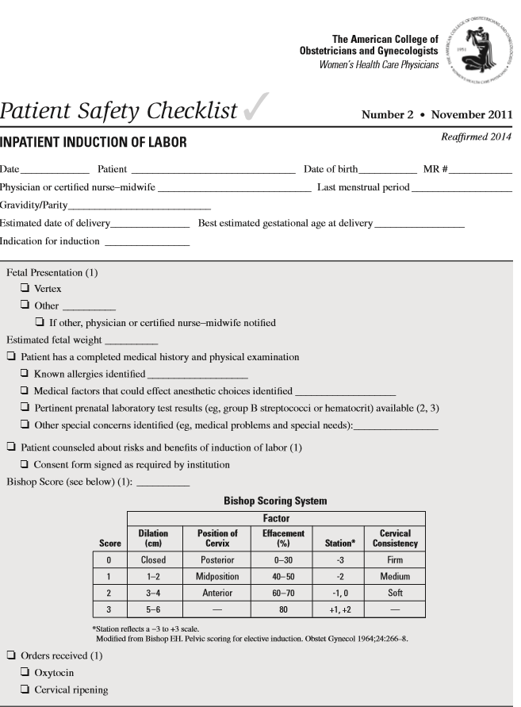
Every Woman with a Labor Induction Should have a Patient Safety Checklist

Slide 24
Preparing the Cervix with Cervical Ripening Techniques

Slide 25
Cervical Ripening
Dissociation of the cervix
Increase in glycosamnioglycans
Increase in fibroblast activity
Reduction of the stretch modulus

Slide 26
Term Cervical Ripening Techniques
Hormonal
  Estradiol
  Relaxin
  Prostaglandin E2 (Prepadil, Cervidil)*
  Misoprostil*-vaginal vs. oral
Mechanical
  Lamnicel/Laminaria
  Stripping membranes
  Catheters*-Single vs. Double Balloon
Other Techniques
  Extra-amniotic saline
  Nitric Oxide*

Slide 27
Choice of Ripening Agent Meta-Analysis
MAIN RESULTS:
A total of 96 RCTs (17,387 women) were included in the meta-analysis. Vaginal misoprostol was the most effective cervical ripening method to achieve vaginal delivery within 24 hours, but had the highest incidence of uterine hyperstimulation with FHR changes.
The use of a Foley catheter to induce labor was associated with the lowest rate of uterine hyperstimulation accompanied by FHR changes.
The caesarean section rate was lowest using oral misoprostol for the induction of labor.
AUTHOR'S CONCLUSIONS:
No method of labor induction demonstrated overall superiority when considering all three clinical outcomes. Decisions regarding the choice of induction method will depend upon the relative preference for effecting vaginal delivery within 24 hours, minimizing the incidence of uterine hyperstimulation with adverse FHR changes and avoiding caesarean section.
TWEETABLE ABSTRACT:
Oral misoprostol for the induction of labor is safer than vaginal misoprostol and has the lowest rate of caesarean section.
Chen et al. BJOG. 2016 Feb;123(3):346-54.

Slide 28
Misoprostol
Misoprostol is a prostaglandin E1 analog, which has been successful in prevention of NSAID induced gastric ulcers
An abortion rate of 11% to 15% has been noted when the drug is used during the first trimester.
Dosage ranges 25-50 mg per vagina recommended, oral administration possible
Major side effect: Uterine Tachysystole

Slide 29
Mechanical Cervical Ripening Techniques

Slide 30
Outpatient Balloon Cervical Ripening

Slide 31
Cochrane Review: Mechanical methods for induction of labor
Mechanical methods results in similar cesarean section rates as prostaglandins, with a lower risk of hyper-stimulation.
Mechanical methods do not increase the overall number of women not delivered within 24 hours, (exception-multiparous women had lower rates of vaginal delivery within 24 hours when compared with vaginal PGE2.
Compared with oxytocin, mechanical methods reduce the risk of cesarean section.
Jozwiak et al Cochrane Database Syst Rev. 2012 Mar 14;(3):CD001233.

Slide 32
Timing of Adverse Events with Foley Catheter for Cervical Ripening
What is the risk for adverse events between Foley insertion and 6AM the following day in a low risk population (no prior CS, HTN, DM, or PPROM)?
1,905 women observed as inpatients
Zero rates of: CS for non-reassuring fetal tracing, vaginal bleeding, placental abruption, or intrapartum stillbirth; 2 patients needed CS for having NRFHR on initial presentation
This large cohort supports the outpatient use of Foley cervical ripening
Sciscione AC etal. Am J Perinatol. 2014; 31:781.

Slide 33
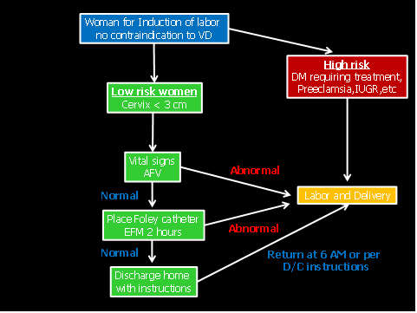
Protocol based on results
Courtesy of Anthony Sciscione MD, ChristianaCare

Slide 34
Rationale of Outpatient Balloon
Mechanical methods as effective with respect to achieving ripeness and cesarean delivery rates in controlled studies
Balloon ripening can be used outpatient since tachysystole is not associated
Better experience comes from patients having less cramping and not spending the night in the hospital
Less cost since monitoring and nursing care not used for 8-12 hours while awaiting ripening of the cervix

Slide 35
Outpatient Foley catheter versus inpatient prostaglandin E2 gel for induction of labor: RCT
METHODS: RCT of term IOL (N=101)--outpatient care using Foley catheter (OP, n=50) or inpatient care using vaginal PGE2 (IP, n=51). OP group had Foley catheter inserted and were discharged home. IP group received 2 mg/1 mg vaginal PGE2 if nulliparous or 1 mg/1 mg if multiparous.
RESULTS: OP group had shorter hospital stay prior to birth (21.3 vs. 32.4 hrs, p< .001), IP were more likely to achieve vaginal birth within 12 hours of presenting to Birthing Unit (53% vs. 28%, p= .01). Vaginal birth rates (66% OP Vs. 71% IP), total induction to delivery time (33.5 hrs vs. 31.3 hrs) were similar. OP group felt less pain (significant discomfort 26% Vs 58%, p=.003), and had more sleep (5.8 Vs 3.4 hours, p< .001), during cervical preparation, but were more likely to require oxytocin IOL (88 Vs 59%, p=.001).
Henry A et al BMC Pregnancy Childbirth. 2013 Jan 29;13:25.

Slide 36
Outpatient as Effective as Inpatient
Foley Catheter for Cervical Ripening
Sixty-one women were randomized into the outpatient group, and 50 women into the inpatient group.
The median Bishop score at entry was 3.0 for each group. The mean change in Bishop scores after catheter placement was not different between the inpatient and outpatient groups (3.0 versus 3.0).
The maximum dose of oxytocin, time of oxytocin, epidural rate, induction time, 1-minute and 5-minute Apgar scores, and cord pH were not significantly different. The outpatient group on average avoided 9.6 hours of hospitalization.
There were no adverse events or maternal morbidity in either group.
Sciscione AC et al Obstet Gynecol. 2001 Nov;98(5 Pt 1):751-6.

Slide 37
Mechanical and Pharmacologic Methods of
Labor Induction
This randomized trial compared four induction methods: misoprostol alone, Foley alone, misoprostol–cervical Foley concurrently, and Foley–oxytocin concurrently. Women undergoing labor induction with full-term (37 weeks of gestation or greater)
Singleton, vertex-presenting gestations, with no contraindication to vaginal delivery, intact membranes, Bishop score 6 or less, and cervical dilation 2 cm or less were included
Results: Median time to delivery: misoprostol–Foley: 13.1 hours, Foley–oxytocin: 14.5 hours, misoprostol: 17.6 hours, Foley: 17.7 hours, (p=.001)
Conclusion: After censoring for cesarean delivery and adjusting for parity, misoprostol–cervical Foley resulted in twice the chance of delivering before either single-agent method.
Levine et al Obstet Gynecol 2016;128:1357–64

Slide 38
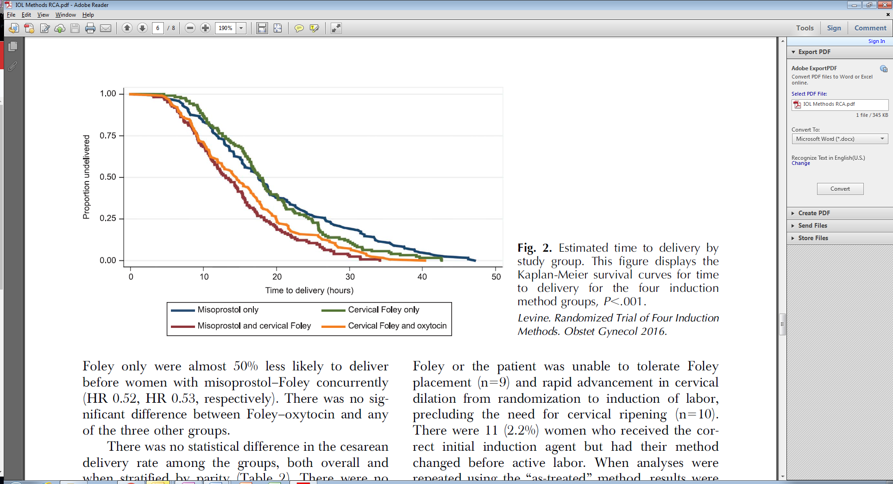
What if outpatient?
Outpatient only=>

Slide 39
Our Technique Summary
Patient seen in labor and delivery where navigator reviews documentation, labs and orders, explains induction procedure in detail (saving time in morning of induction); pre-induction checklist done
Patient goes to office/ clinic afternoon prior to scheduled induction and balloon placed
Patient arrives 0600 or 0700 of the morning of induction IV started and infusion after hospital checklist completed

Slide 40
Foley Catheter Placement
The catheter is inserted just inside the internal cervical os. The balloon rests on the internal os and puts pressure down. The patient usually feel minimal cramping since the balloon elevates the amniotic sac and vertex.
External Cervical Os
Vagina

Slide 41
Office Equipment List
Graves speculum (large)
Betadine swabs
Ring forceps
16 French Foley catheter with 30 cc balloon (60 cc)
30 cc syringe and 19 G needle
30 cc vial Normal Saline
Scissors
Umbilical tape
Sterile gloves
OR Marker pen

Slide 42
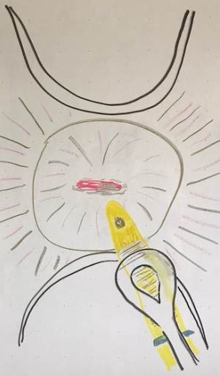
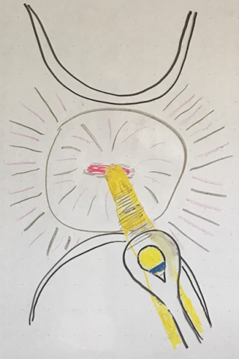
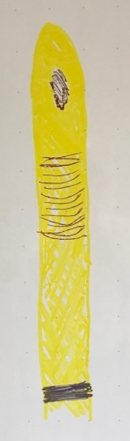
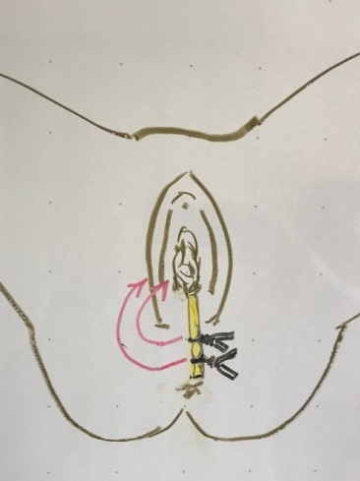
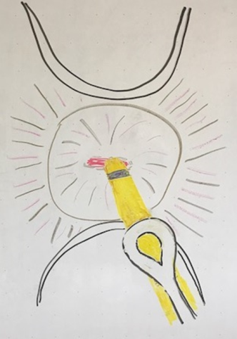
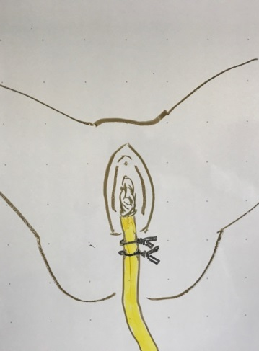
Mark
Place thru cervical canal
Cut off Foley Tail
Tuck into vagina
Inflate balloon
Tie off catheter at vaginal entrance

Slide 43
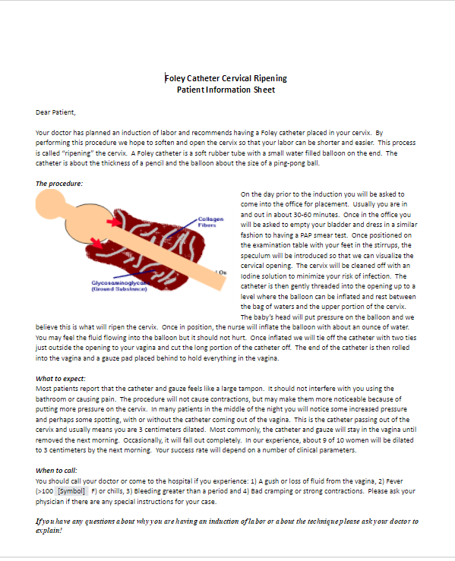
Patient Information

Slide 44
Shifted Burden…
Obvious that this adds some burden to the office/ clinic in terms of time and costs.
Consider a hospital supplied package (catheter, syringe, needle, saline, ties, marker)
One reason for using Foley balloon is much lower cost than Cook catheter and no strong evidence double balloon is more effective (more studies needed to determine which patients would benefit from this device)

Slide 45
Lessons Learned From Experience
Majority of patients can have balloon placed/ stenosis rare
Proper placement above internal os has very good success
No fetal monitoring needed since no tachysystole risk, monitoring only for other indications
If inpatient for monitoring you can use misoprostol or oxytocin and Foley balloon concurrently
Only about 5% come in labor before morning
Balloon usually sitting in vagina in the morning, can have induction started if balloon not expelled
Patients much happier with the process and less tired since slept at home
Relieves significant burden on L&D Staff and Physicians

Slide 46
Keys for Safe Successful Inductions
Follow ACOG guidelines—avoid elective inductions in nullips with an unfavorable cx
Follow your hospital’s and your personal success rates for induction—Aim for 20%’s in nulliparous patients
Remember, how you perform the induction is critical (standard guidelines, lots of patience!)
Strongly consider outpatient approach to cervical ripening

Slide 47
Foley Catheter Placement
The catheter is inserted just inside the internal cervical os. The balloon rests on the internal os and puts pressure down. The patient usually fell minimal cramping since the balloon elevates the amniotic sac and vertex.

Slide 48
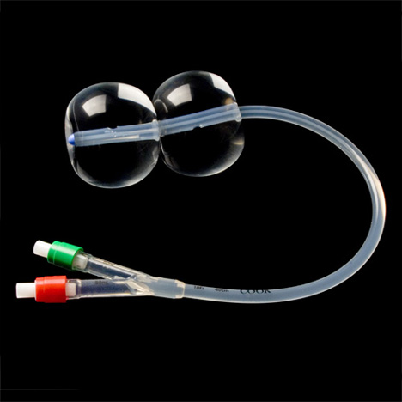
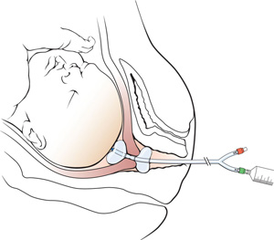
Double Balloon Catheter

Slide 49
Mechanical methods for induction of labor
AUTHORS' CONCLUSIONS:
Induction of labour using mechanical methods results in similar caesarean section rates as prostaglandins, for a lower risk of hyperstimulation.
Mechanical methods do not increase the overall number of women not delivered within 24 hours, however the proportion of multiparous women who did not achieve vaginal delivery within 24 hours was higher when compared with vaginal PGE2.
Compared with oxytocin, mechanical methods reduce the risk of caesarean section.
Jozwiak et al Cochrane Database Syst Rev. 2012 Mar 14;(3):CD001233.

Slide 50
Transcervical Foley Catheter: Infection
TABULATION, INTEGRATION, AND RESULTS:
We identified 26 randomized trials including 5,563 women. Compared with prostaglandin preparations alone, patients who underwent cervical ripening with a Foley catheter had similar rates of chorioamnionitis (56/782 [7.2%] with Foley compared with 54/754 [7.2%] with prostaglandins; relative risk [RR] 0.96; 95% confidence interval [CI] 0.66-1.38), endometritis (40/1,042 [3.8%] compared with 35/991 [3.5%]; RR 1.03, 95% CI 0.66-1.6), pooled maternal infection (237/2,699 [8.8%] compared with 257/2,864 [9%]; RR 0.95, 95% CI 0.81-1.12), and neonatal infection (34/1,061 [3.2%] compared with 39/1,074 [3.6%]; RR 0.9, 95% CI 0.58-1.39). With subgroup analysis, excluding studies using preinsertion cervical cleansing or prophylactic antibiotics in the Foley arm, results were similar.
CONCLUSION:
Use of transcervical Foley catheters for cervical ripening and induction of labor is not associated with an increased risk of infectious morbidity.
McMaster et al, Obstet Gynecol. 2015 Sep;126(3):539-51.

Slide 51
Single versus double-balloon catheter nulliparous postdate pregnancies
RESULTS:
Spontaneous expulsion of the Foley catheter was encountered more frequently than the Cook (89.2% vs 78.4%; P = 0.03).
However, the median Bishop score was significantly higher when using the Cook compared with the Foley catheter after balloon removal (6 vs 5; P = 0.03).
The duration from balloon insertion to expulsion and from insertion to delivery was significantly shorter in the Foley group compared with the Cook balloon group (6:19 ± 2:1 vs 7:26 ± 2:25 h; P = 0.03 and 13:50 ± 4:00 vs 15:16 ± 4:30 h; P = 0.03, respectively).
There were no significant differences in other outcomes, such as the amount of oxytocin units used, mode of delivery, pain encountered during or after insertion and overall patient satisfaction.
CONCLUSIONS:
Use of the Cook cervical ripening catheter results in greater cervical ripening compared with the Foley catheter. However, the duration from balloon insertion to expulsion and then delivery were significantly shorter when using the Foley catheter; therefore, we recommend its use, particularly in low resource settings.
Sayed Ahmed et al J Obstet Gynaecol Res. 2016 Nov;42(11):1489-1494.

Slide 52
30 mL Single- versus 80 mL double-balloon catheter
RESULTS:
A total of 98 women were included in the analysis (50 in the 80 mL double and 48 in the 30 mL single-balloon catheter groups).
Among nulliparous women, a greater proportion of those randomized to the 80 mL double achieved a Bishop score ≥6 at time of catheter removal (88.0% versus 28.0%; p ≤ 0.001) and delivered vaginally (60.0% versus 32.0%; p = 0.047) compared to those with the 30 mL single-balloon catheter.
We found no difference by catheter type in achieving a Bishop score ≥6 or vaginal delivery among multiparous women.
Hoppe KK J Matern Fetal Neonatal Med. 2016;29(12):1919-25.

Slide 53
30 mL Single- versus 80 mL double-balloon catheter with EASI
RESULTS:
One hundred and eighty-six women completed the study. Ripening success was comparable between the double and single balloon arms (96.4% versus 92.7%, p = 0.55, respectively).
Balloon insertion to delivery interval was significantly shorter, and cesarean section rate was significantly lower in the double balloon arm compared with the single balloon arm (14.3 versus 15.8 h, p = 0.04 and 8.3% versus 20%, p = 0.05, respectively).
There were no significant differences in maternal characteristics, satisfaction or adverse outcomes
Mei-Dan E J Matern Fetal Neonatal Med. 2014 Nov;27(17):1765-70.

Slide 54
Labor induction 30 mL compared with 60 mL RCT
METHODS: Women with term, vertex, singleton pregnancies (n=192) and a Bishop score less than 5 were assigned randomly to receive a transcervical Foley balloon inflated to either 30 mL or 60 mL.
RESULTS: A higher proportion of women randomly assigned to the 60-mL Foley balloon achieved delivery within 12 hours of placement compared with the 30-mL Foley balloon group (26% compared with 14%, P=.04). This difference was more pronounced among nulliparous women. There was no difference in median time interval to delivery or proportion of women who achieved delivery within 24 hours. Median cervical dilation after Foley balloon expulsion was higher in the 60-mL Foley balloon group (4 cm compared with 3 cm, P<.01). There were no differences in the frequencies of cesarean delivery, maternal morbidity, or neonatal outcomes.
CONCLUSION: Labor induction using Foley balloons inflated to 60 mL was more likely to achieve delivery within 12 hours compared with 30-mL inflation. There were no differences in delivery within 24 hours, cesarean delivery, labor complications, or neonatal outcomes.
Delaney et al Obstet Gynecol. 2010 Jun;115(6):1239-45

Slide 55
Inpatient versus Outpatient

Slide 56
Outpatient versus Inpatient Meta-Analysis
MAIN RESULTS:
We included four trials, with a combined total of 1439 women in the review; each trial examined a different method of induction and we were unable to pool the results from trials.
1.Vaginal PGE2 (two studies including 1028 women). There were no differences between women managed as outpatients versus inpatients for most review outcomes. There was no evidence of a difference between the likelihood of women requiring instrumental delivery in either setting (risk ratio (RR) 1.29; 95% confidence interval (CI) 0.79 to 2.13). The overall length of hospital stay was similar in the two groups.
2. Controlled release PGE2 10 mg (one study including 300 women). There was no evidence of differences between groups for most review outcomes, including success of induction. During the induction period itself, women in the outpatient group were more likely to report high levels of satisfaction with their care (satisfaction rated seven or more on a nine-point scale, RR 1.42; 95% CI 1.11 to 1.81), but satisfaction scores measured postnatally were similar in the two groups.
3. Foley catheter (one study including 111 women). There was no evidence of differences between groups for caesarean section rates, total induction time and the numbers of babies admitted to neonatal intensive care.
AUTHORS' CONCLUSIONS:
The data available to evaluate the efficacy or potential hazards of outpatient induction are limited. It is, therefore, not yet possible to determine whether induction of labor is effective and safe in outpatient settings
Kelly AJ et al Cochrane Database Syst Rev. 2013 Nov 12;(11):CD007372.

Slide 57
Outpatient versus Inpatient Foley Catheter
RESULTS:
Sixty-one women were randomized into the outpatient group, and 50 women into the inpatient group.
The median Bishop score at entry was 3.0 for each group (P =.97). The mean change in Bishop scores after catheter placement was not different between the inpatient and outpatient groups (3.0 versus 3.0; P =.74).
The maximum dose of oxytocin, time of oxytocin, epidural rate, induction time, 1-minute and 5-minute Apgar scores, and cord pH were not significantly different. The outpatient group on average avoided 9.6 hours of hospitalization.
There were no adverse events or maternal morbidity in either group.
CONCLUSIONS:
The Foley bulb is as effective in the outpatient as the inpatient setting for preinduction cervical ripening.
Sciscione AC et al Obstet Gynecol. 2001 Nov;98(5 Pt 1):751-6.

Slide 58
Cervical Ripening: Outpatient versus Inpatient Meta-Analysis
RESULTS:
Most included studies were underpowered to detect differences in safety outcomes, as the majority are powered for time to delivery or cesarean delivery.
Meta-analysis of these studies does not allow assessment of the safety profile of Foley catheter compared to misoprostol (any dose, any administration route) with sufficient power. For the safety outcomes of the total group of Foley catheter versus misoprostol (any dose, any administration route) (17 studies, 4,234 women) we found that Foley catheter results in less hyperstimulation compared to misoprostol (2% versus 4%; risk ratio [RR], 0.54; 95% confidence interval [CI], 0.37-0.79) and fewer cesarean deliveries for nonreassuring fetal heart rate, 5% vs 7%; RR, 0.72; 95% CI, 0.55-0.95; while there were no statistically significant differences in neonatal outcomes.
The total number of cesarean deliveries was 26% versus 22% (RR, 1.16; 95% CI, 1.00-1.34). There were fewer vaginal instrumental deliveries with a Foley catheter compared to misoprostol (10% vs 14%; RR, 0.74; 95% CI, 0.60-0.91).
Foley catheter with misoprostol compared to misoprostol alone (any dose, any administration route) (7 studies, 1,073 women) resulted in less hyperstimulation than misoprostol alone (17% vs 23%; RR, 0.71; 95% CI, 0.52-0.97). Cesarean deliveries for nonreassuring fetal heart rate were comparable (7% vs 9%; RR, 0.79; 95% CI, 0.51-1.22).
Neonatal outcomes were infrequently reported. The total number of cesarean deliveries was 34% versus 34% (RR, 1.01; 95% CI, 0.86-1.19).
CONCLUSION:
In women with an unripe cervix at term, Foley catheter seems to have a better safety profile than misoprostol (any dose, any administration route) for induction of labor. Larger studies are needed to investigate the safety profile of a Foley catheter compared to separate dosing and administration regimens of misoprostol.
Eikelder ML et al Obstet Gynecol Surv. 2016 Oct;71(10):620-630.

Slide 59
Is Fetal Monitoring Needed?
While the balloon doesn't itself seem to cause abnormalities to FHR this can be a high risk population so that monitoring with an NST prior and assessing AFI may be indicated if the patient has disorder which may cause (postdates, hypertension, diabetes, oligohydramnios, etc.)
Therefore prior to placing you should obtain appropriate antepartum testing and should the patient begin having regular contractions spontaneously after catheter placement come to labor evaluation area for monitoring.

Slide 60
Conclusions
Prostaglandins are widely utilized medications for inducing cervical ripening but generate high costs due to the drug costs or surveillance required for their application
Misoprostol is also widely utilized but like PG has increase rates of tachysystole requiring careful observation
Oral misoprostol may be safer than vaginal misoprostol
Foley catheters have been shown to be equally effective, have less side effects and can be performed as an outpatient .
There is some evidence that double balloon catheters may be more effective but definitive evidence is lacking; Similarly using 60 cc balloon may be more effective in achieving greater initial dilation and shorter labors.

Slide 61
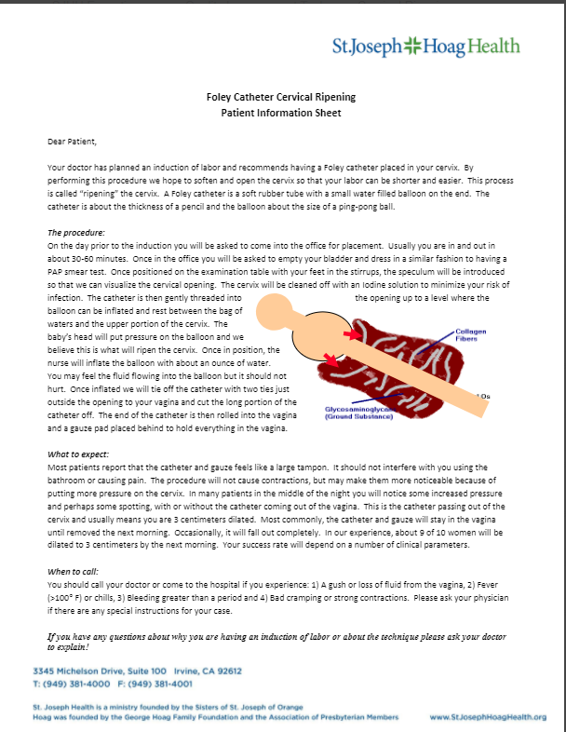
Patient Information Sheet

Slide 62
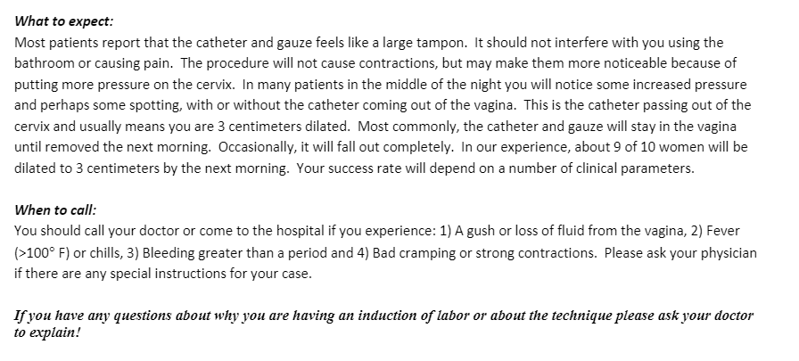
Patient Information

Slide 63
Technique for Outpatient Insertion

Slide 64
In Office Balloon Placement
Patient arrives: Questionnaire/Hx/VS Reviewed
High Risk?*
Patient sent to hospital for possible admission and/or monitoring**
Cx > 3cm Bishop >7?
Patient sent home for admission in AM**
Balloon Placed per Protocol
Induction per protocol
*Positive questionnaire, abnormal vital signs or history (Preeclampsia, Premature Rupture of Membranes,
Equivocal AP Testing, Oligohydramnios, etc.)
** Patients admitted into hospital, if no prior uterine surgery or other complication consider combination cervical ripening
with misoprostol and foley catheter balloon

Slide 65
Patient Questionnaire
Has you felt good fetal movement over the last 24 hours?
Have you been having any contractions or strong back ache in the last 24 hours?
Have you had any evidence of increased cervical discharge or spotting?
Have you had any bleeding during the pregnancy or been told your placenta was near your cervix (placenta previa)?
Have you been told you have low or borderline low amniotic fluid levels?

Slide 66
Equipment List
Graves speculum
Betadine swabs
Ring forceps
16 French Foley catheter with 30 cc balloon
30 cc syringe and 19 G needle
30 cc vial Normal Saline
Scissors
Umbilical tape
Sterile gloves
OR Marker pen

Slide 67
Preparation for insertion:
The procedure is performed on an exam table with the patient in dorsal lithotomy position. The patient should have a baseline vaginal examination to determine cervical status and length. The estimated cervical length can be used to mark the Foley catheter by making a mark the appropriate distance from the proximal end of the balloon. The nurse or assistant should draw up the 30 ccs of saline and test the balloon to assure intactness. (note some newer protocols have utilized a 60 cc balloon)

Slide 68

Marked Foley
Use a sterile marker to mark the distance from the lower edge of the deflated balloon (as shown) using the estimate of the cervical length you determined from examining the cervix. This will show you how far to insert the catheter. This will position the inserted catheter with the lower end of the balloon at the level of the internal os.
<Catheter tip
<Balloon
Estimated Cervical>
Length
<Marked distance

Slide 69
Insertion of the catheter
A vaginal speculum is introduced in normal fashion (using a large Graves speculum will straighten the cervix when properly positioned). The cervix is visualized and cleaned off with Betadine solution. At this point, a 16 French Foley catheter is inserted. The balloon is inflated with 30 ccs of sterile saline by the nurse or assistant in a slow fashion testing the resistance. Confirm proper placement with no evidence of bleeding or discharge of fluid. The patient should feel pressure but if there is significant pain that is suggestive of the balloon not being above the internal os.

Slide 70
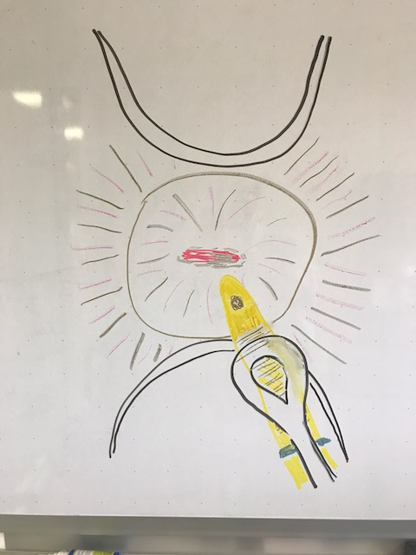
Getting oriented
Anterior speculum blade
In anterior fornix
Cervical Os
Ring forceps holding
catheter tip
Posterior speculum blade
In posterior fornix

Slide 71
Catheter Insertion
Insert the large Graves speculum into the vagina attempting to center the cervix with the os centered so the cervix is straightened out by the blades extending anteriorly and posteriorly into the anterior and posterior fornix (this will straighten out the endocervical canal and make insertion easier). Using the ring to hold the catheter about 1-2 cm from the tip, insert the tip in the external cervical os.

Slide 72
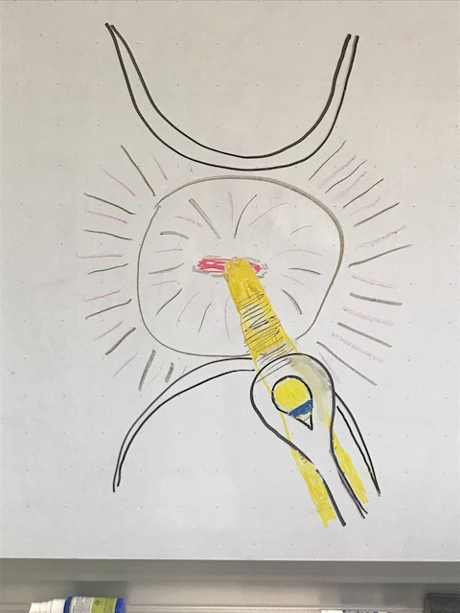
Continue to feed the catheter up the canal by progressing the catheter with the ring forceps at 1-2 cms per time. The catheter should not meet significant resistance if the cervical canal is straightened and not stenotic (the latter is rare). Continue feeding the catheter up the canal following progress by watching the balloon area and marker line going up the canal. The patient should feel minimal discomfort during this process as the catheter is not being forced but merely gliding up the endocervical canal.

Slide 73
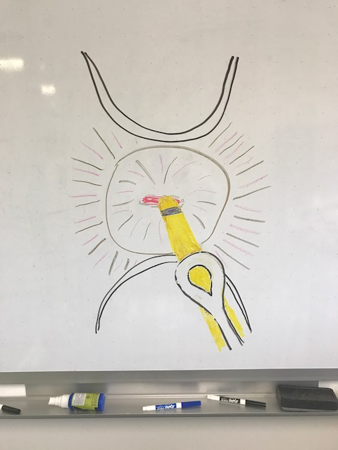
Once the marker line reaches the external os, the balloon should be a the level of the internal cervical os. While holding the catheter (gently so as to not occlude) have your assistant begin to instill the saline into the balloon. The patient may feel the fluid going through but there should not be any discomfort (if the patient feels pain with inflation, the balloon is likely still at the level of the canal and should be inserted higher. Once all of the fluid has been instilled, give the catheter a slight pull to position the balloon on the internal cervical os. Once in place release the catheter and remove the speculum.

Slide 74
Completion of the procedure
The speculum can be removed once the proper catheter placement is confirmed. Next, the catheter is tied off with two ties of umbilical tape at the level of the introitus and the distal portion removed with the scissors. The tied off end of the catheter is rolled up and placed in the vagina (inform the patient that if it unrolls and sticks out this will not dislodge the placement). The patient is then sent home with instructions and informed she is likely to notice mild cramping and spotting when the catheter passes through the cervix when catheter dilation is complete in about 6-8 hours.

