Slide 1
Shared Decision Making in Maternity Care: Improving Care for Moms and Babies Together
September 21, 2018
PROVIDE
Mid-Project Meeting
Notes:
We have relied heavily on tools from AHRQ (Agency for Healthcare Research and Quality), The Council on Patient Safety and Women’s Health and AIM to develop this slide set focused on Shared Decision Making in Maternity Care. Together we can improve care for moms and babies.

Slide 2
Session Objectives
  Define shared decision making.
  List critical elements required in effective shared decision making.
  Explain key steps for conducting shared decision making.
  To better understand shared decision making and the evidence-based resources available to do it.
  The clinical applications of shared decision-making principles to maternity care.

Slide 3
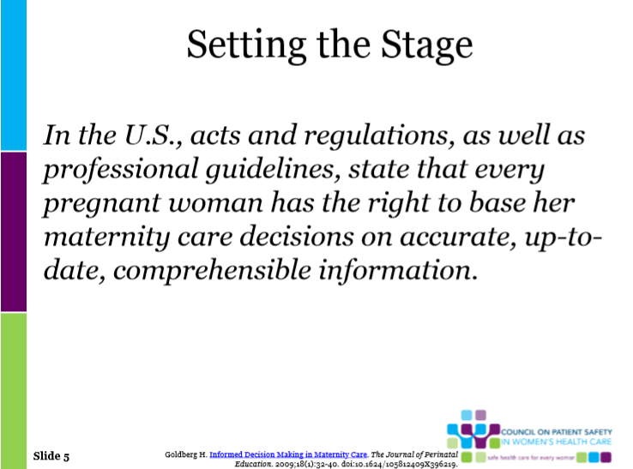
Setting the Stage
Patients involved in shared decision making feel an increased sense of responsibility for health of baby and self baby (Harrison, et al., 2003), and experience shorter recovery periods (Green & Baston, 2003)
Patients involved in childbirth decisions have lower levels of fear (Green & Baston, 2003; Green et al., 1990) and experience less depressive and posttraumatic stress symptoms after birth (Green & Baston, 2003; Green et al., 1990)
Women who had a cesarean were more likely to indicate feeling pressure from a health-care practitioner to have an intervention that women who had a vaginal birth (Green & Baston, 2003; Green et al., 1990)
Goldberg H. Informed Decision Making in Maternity Care. The Journal of Perinatal Education.2009;18(1):32-40. doi:10.1624/105812409X396219.

Slide 4
FPQC Recommended Key Practices
Improve access to and promote quality childbirth education, informed consent, and shared decision making
Implement institutional policies that uphold best practices in obstetrics, safely reduce routine interventions in low-risk women, and consistently support vaginal birth
Educate nurses and providers on intermittent auscultation/EFM and implement intermittent monitoring for low-risk women
Educate nurses on labor support skills that promote labor progress, labor support, pain management
Notes:
FPQC has identified shared decision making as one of our key recommendations for promoting primary vaginal deliveries.

Slide 5
Definitions of Shared Decision Making (SDM)
A communication skill, focused on patient’s values and preferences as they apply to facilitate high-quality patient care in the context of medical decision making.
An attitude and philosophy; an approach to thinking about effective patient care.
Acknowledges the collaborative nature of good medical care and the dual expertise involved in all decision making–that of patient and doctor.
Cathleen E. Morrow, M.D.
Department of Community and Family Medicine
Geisel School of Medicine at Dartmouth
July 26, 2016 Webinar Sponsored by:
Agency for Healthcare Research and Quality (AHRQ

Slide 6

Shared decision making is a collaborative process that enables people to make the health care decisions that are right for them, in the context of their own lives. It draws on the expertise and knowledge of both the patient and provider. The care provider shares her medical expertise and provides evidence-based information about care options, and the patient shares her values, preferences, and concerns. Together they make a decision and carry it out The best health care decisions are made when patients and providers work together. – Rebekah Gee, Maureen Corry
Patient Engagement and Shared Decision Making in Maternity Care
Obstetrics & Gynecology: November 2012 - Volume 120 - Issue 5 - p 995–99
Notes:
In a 2001 report, Crossing the Quality Chasm, the Institute of Medicine recommended redesigning health care processes according to 10 rules, many of which emphasize shared decision making. One rule, for instance, underlines the importance of the patient as the source of control, envisioning a health care system that encourages shared decision making and accommodates patients' preferences.
Unfortunately, this ideal is inconsistently realized today. The care patients receive doesn't always align with their preferences. For example, in a study of more than 1000 office visits in which more than 3500 medical decisions were made, less than 10% of decisions met the minimum standards for informed decision making.¹ Similarly, a study showed that only 41% of Medicare patients believed that their treatment reflected their preference for palliative care over more aggressive interventions. ⁽Covinsky KE, Fuller JD, Yaffe K, et al. Communication and decision-making in seriously ill patients: findings of the SUPPORT project: the Study to Understand Prognoses and Preferences for Outcomes and Risks of Treatments. J Am Geriatr Soc 2000;48:Suppl:S187-S193 )
Patient Engagement and Shared Decision Making in Maternity Care
Gee, Rebekah E. MD, MPH; Corry, Maureen P. MPH
Obstetrics & Gynecology: November 2012 - Volume 120 - Issue 5 - p 995–997
doi: http://10.1097/AOG.0b013e31827046ac
Health Policy in Practice
Obstetrics & Gynecology
Issue: Volume 120(5), November 2012, p 995–997
Copyright: © 2012 by The American College of Obstetricians and Gynecologists. Published by Wolters Kluwer Health, Inc. All rights reserved.
Publication Type: [Health Policy in Practice]
DOI: http://10.1097/AOG.0b013e31827046ac
ISSN: 0029-7844
Accession: 00006250-201211000-00003
Hide Cover
[Health Policy in Practice] « Previous Article Table of Contents Next Article »
Patient Engagement and Shared Decision Making in Maternity Care
Gee, Rebekah E. MD, MPH; Corry, Maureen P. MPH
Author Information
Louisiana State University Departments of Health Policy and Management and Obstetrics and Gynecology, Schools of Public Health and Medicine, New Orleans, Louisiana; and Childbirth Connection, New York, New York.
Corresponding author: Rebekah E. Gee, MD, MPH, 2020 Gravier Street, New Orleans, LA 70112; e-mail: rgee@lsuhsc.edu.
The authors thank Amy Romano, CNM, MSN and Carol Sakala, PhD, MSPH from Childbirth Connection for providing editorial assistance and comments on the manuscript.
Financial Disclosure Ms. Corry discloses a partnership between Childbirth Connection and the Informed Medical Decisions Foundation (IMDF) to develop shared decision-making resources. The partnership includes a grant from the IMDF to Childbirth Connection. No grant funds were used in preparation of this manuscript. The other author did not report any potential conflicts of interest.
The 2001 Institute of Medicine report Crossing the Quality Chasm outlined six key aims for national health care quality improvement. One central aim was that care be patient-centered, meaning that the care provided to patients be “respectful of and responsive to individual patient preferences, needs, and values, and ensuring that patient values guide all clinical decisions.”1 With patient-centered treatment, the care-delivery system incorporates the decisions and preferences of patients into the clinical calculus. Despite the importance of patient preferences, several studies have shown that these often are not taken into account by physicians in medical decision making.2
The maternity care that many women in the United States receive is becoming increasingly procedure-intensive. For example, the cesarean delivery rate rose by 53% from 1996 to 2007.3 The interventionist nature of our obstetric culture can lead to overuse of procedures and interventions for which harms may outweigh benefit and underuse of beneficial practices such as waiting for spontaneous labor in healthy women before 41 weeks.4 In addition to these challenges, there is broad practice variation in cesarean delivery and assisted vaginal delivery rates across geographic areas, facilities, and health care providers.5 The issue of overuse of tests and procedures is not unique to the field of obstetrics and gynecology. This year, nine U.S. specialty societies, including the American Academy of Family Physicians, the American College of Cardiology, the American College of Radiology, and the American College of Physicians developed lists of “Five Things Physicians and Patients Should Question,” recognizing the importance of patient and physician communication to improve care, with the goal of eliminating unnecessary tests and procedures.6
Despite the importance of involving women in decision making, multiple studies demonstrate that many women have inadequate knowledge to make informed choices about their pregnancies and maternity care. A 2009 study of 650 recently postpartum women revealed that 24% considered a fetus of 34–36 weeks of gestation to be full term, 50.8% believed full term was at 37–38 weeks, and only 25.2% considered 39–40 weeks full term.7 A national survey of postpartum women found that most new mothers thought it was necessary to know most or all complications of cesarean deliveries or inductions before making decisions about them, yet most were unable to answer basic questions on risks of both interventions correctly, whether or not they had undergone them.8 In the same study, more than half of survey respondents interested in vaginal birth after cesarean were denied the option owing to caregiver unwillingness or hospital refusal. Too often, women are not full partners with providers in decision making. Institutional and caregiver policies and practices can take precedence over patients’ informed choice, even when patient preference is supported by best available evidence.9
Patient education is a major focus of efforts to assist childbearing women and their families in making informed decisions about their care and navigating the complex health care system. Women receive information from a variety of sources, including physicians, but many receive their information from television and print media, and many cite mass media or “reality” TV programming as a source of information about childbirth.10 These often sensationalized programs can be lacking in accuracy and can foster misperceptions about what interventions are necessary to achieve healthy birth outcomes.11
Several national organizations have taken leadership roles in balancing popular culture media with accurate and science-based pregnancy education. The March of Dimes for almost a decade has been running a large-scale patient and family education campaign around issues relating to prematurity prevention. Childbirth Connection, a national organization focusing on providing women and health professionals with evidence-based information on safe and effective maternity care, is now expanding its focus to promote maternity care shared decision making. The American College of Obstetricians and Gynecologists also makes significant contributions to patient education through widely distributed patient educational materials and recently has taken a leadership role in promoting shared decision making in its 2011 Committee Opinion titled “Effective Patient–Physician Communication,” which states that patient engagement, satisfaction, and treatment adherence can be improved through shared decision making as well as risks reduced and outcomes improved.12
Shared decision making is a collaborative process between patients and their providers to make health care decisions together, taking into account the best available scientific evidence on possible benefits and harms of all treatment options, along with the patient’s values and preferences. Strategies to implement shared decision making are receiving growing attention from health-policy makers as a way to integrate patient-centered concepts into health care. The Affordable Care Act authorized several key provisions related to shared decision making for patients. The Center for Medicare & Medicaid Innovation received funding to test innovative delivery models to improve the quality and costs of health care, including the shared decision-making model. States also are engaged in various activities to incorporate shared decision making into the health care system: Vermont and Washington have enacted shared decision-making legislation, and additional states are in the process of doing so, including Connecticut, Massachusetts, Minnesota, New Hampshire, Oklahoma, and Oregon.13 This growing health-policy focus is supported by policy research that indicates that shared decision making may reduce overuse of tests and procedures, thereby reducing costs.14 One cost analysis estimates that implementing shared decision making for 11 common procedures would save more than $9 billion in health spending over 10 years.15
Given the dearth of information women have about their medical choices, more investment is needed in patient education and tools for shared decision making in clinical settings. A recent Cochrane review of shared decision-making tools demonstrates multiple benefits for patients, including more informed values-based choices, enhanced communication with providers, increased involvement of patients in medical decisions, improved knowledge and realistic perceptions of outcomes, reduced patient choice of elective surgery, and no apparent adverse effects on health outcomes or satisfaction.16 A systematic review of the evidence for shared decision making in maternity care showed promising results: improved knowledge, reduced decisional conflict and anxiety, increased perception of having made an informed choice, and improved patient satisfaction.17
To address current barriers to shared decision making and consumer choice, Childbirth Connection and the Informed Medical Decisions Foundation partnered to establish The First National Maternity Care Shared Decision Making Initiative. The partners are currently producing a suite of evidence-based, publicly available decision aids for a broad range of treatment options in maternity care. Tools being developed are web-based and interactive and will allow the woman to understand her condition and the context of her decision, explore her options in depth, clarify her preferences and values, and engage with her obstetric provider in decision making. Decision support tools and related content will be available on a multimedia web site, with the goal of integration with innovative technologies such as mobile applications and electronic and personal health records. The collaboration will also break new ground by producing and evaluating maternity decision support resources for women with low literacy and numeracy.18
The 2003 National Assessment of Health Literacy found that 60% of Medicaid beneficiaries had basic or below basic health literacy in comparison with 24% of those with employer-provided coverage.19 Women with low literacy skills are less likely to have a high school education compared with those with adequate literacy skills, be they women with low income or racial or ethnic minorities, and are at risk for poorer health outcomes.20,21 Literacy-appropriate decision aids have the potential to empower and engage those with low health literacy in a shared decision-making process. Physicians must be diligent in efforts to identify accurately patients with low literacy skills, and a few widely respected tools are available for this purpose, including the Rapid Estimate of Adult Literacy in Medicine and the Test of Functional Literacy in Adults.22,23
The decisions that childbearing women and their obstetric providers make have considerable implications for the health of women and newborns. However, implementing shared decision making in an office setting is not simple and requires enhanced engagement of patients in the care process. Obstetrician–gynecologists face tremendous demands on time during office practice, including clinical productivity and documentation requirements.24Although efforts to increase patient engagement increase demands on physician and staff time in the short term, in the long run shared decision making has the potential to increase efficiency through improved patient adherence and understanding of the care plan, leading to the need for fewer follow up calls and visits. This shared decision-making framework also has the potential to decrease litigation through improved patient satisfaction.25 Suggestions for better integration of these concepts include payment models that allow for consideration of the time shared decision making takes and practice algorithms using e-mail or physician extenders or both, whether office staff or interactive web-based before and after appointments.26 Initial results of shared decision making applied to maternity care are promising, and further research is needed to evaluate the use of decision aids in routine clinical practice.
Back to Top
REFERENCES
1. Institute of Medicine. Crossing the quality chasm: a new health system for the 21st century. Washington, DC: The National Academies Press; 2001. [Context Link]
2. Coppola KM, Ditto PH, Danks JH, Smucker WD. Accuracy of primary care and hospital-based physicians’ predictions of elderly outpatients’ treatment preferences with and without advance directives. Arch Int Med 2001;161:431–40. Ovid Full Text Bibliographic Links [Context Link]
3. Menacker F, Hamilton BE. Recent trends in cesarean delivery in the United States. NCHS data brief, no 35. Available at: http://www.cdc.gov/nchs/data/databriefs/db35.htm. Retrieved July 18, 2012. [Context Link]
4. Sanchez-Ramos L, Bernstein S, Kaunitz AM. Expectant management versus labor induction for suspected fetal macrosomia: a systematic review. Obstet Gynecol 2002;100:997–1002. Ovid Full Text Bibliographic Links [Context Link]
5. Hanley GE, Janssen PA, Greyson D. Regional variation in the cesarean delivery and assisted vaginal delivery rates. Obstet Gynecol 2010;115:1201–8. Ovid Full Text Bibliographic Links [Context Link]
6. American Board of Internal Medicine Foundation. Choosing wisely. Lists. Available at: http://choosingwisely.org/?page_id=13. Retrieved July 18, 2012. [Context Link]
7. Goldenberg RL, McClure EM, Bhattacharya A, Groat TD, Stahl PJ. Women’s perceptions regarding the safety of births at various gestational ages. Obstet Gynecol 2009;114:1254–8. Ovid Full Text Bibliographic Links [Context Link]
8. Declercq ER, Sakala C, Corry MP, Applebaum S. Listening to mothers II: report of the second national U.S. survey of women’s childbearing experiences. Available at: http://www.childbirthconnection.org/pdfs/LTMII_report.pdf. Retrieved August 18, 2012. [Context Link]
9. Sakala C, Corry MP. Evidence-based maternity care: What it is and what it can achieve. Available at: http://www.milbank.org/uploads/documents/0809MaternityCare/0809MaternityCare.pdf. Retrieved August 17, 2012. [Context Link]
10. Declercq ER, Sakala C, Corry MP, Applebaum S. Listening to mothers II: results of the second national U.S. survey of women’s childbearing experiences. Available at: http://www.ncbi.nlm.nih.gov/pmc/articles/PMC2174380/. Retrieved August 17, 2012. [Context Link]
11. Morris T, McInerney K. Media representations of pregnancy and childbirth: an analysis of reality television programs in the United States. Birth 2010;37:134–40. Bibliographic Links [Context Link]
12. Effective patient-physician communication. Committee Opinion No. 492. American College of Obstetricians and Gynecologists. Obstet Gynecol 2011;117:1254–7. [Context Link]
13. Shafir A, Rosenthal J. Shared decision making: advancing patient-centered care through state and federal implementation. Available at: http://www.nashp.org/sites/default/files/shared.decision.making.report.pdf. Retrieved July 15, 2012. [Context Link]
14. Rosenthal J, Hanlon C. State partnerships to improve quality: models and practices from leading states. Available at: http://nashp.org/publication/state-partnerships-improve-quality-models-and-practices-leading-states-report. Retrieved July 17, 2012. [Context Link]
15. The Lewin Group. Bending the curve: technical documentation. Available at: http://www.lewin.com/publications/Publication/325. Retrieved July 17, 2012. [Context Link]
16. Stacey D, Bennett CL, Barry MJ, Col NF, Eden KB, Holmes-Rovner M. Decision aids for people facing health treatment or screening decisions. The Cochrane Database of Systematic Reviews 2011, Issue 10. Art. No.: CD001431. DOI: 10.1002/14651858.CD001431.pub3 [Context Link]
17. Say R, Robson S, Thomson R. Helping pregnant women make better decisions: a systematic review of the benefits of patient decision aids in obstetrics. BMJ Open 2011;1:e000261. [Context Link]
18. Romano A. The first national maternity care shared decision making initiative. Available at: http://informedmedicaldecisions.org/wp-content/uploads/2012/05/First_Natl_Maternity_SDM.pdf. Retrieved August 20, 2012. [Context Link]
19. Kutner M, Greenberg E, Jin Y, Paulsen C, White S. The health literacy of america’s adults: results from the 2003 National Assessment of Adult Literacy. Washington, DC: National Center for Health Statistics, Institute of Education Sciences; 2006. [Context Link]
20. Berkman ND, Sheridan SL, Donahue KE, Halpern DJ, Crotty K. Low health literacy and health outcomes: an updated systematic review. Ann Intern Med 2011;155:97–107. Ovid Full Text Bibliographic Links [Context Link]
21. King JS, Eckman MH, Moulton BW. The potential of shared decision making to reduce health disparities. J Law Med Ethics 2011;39:30–3. Bibliographic Links [Context Link]
22. Health literacy measurement tools. Available at http://www.ahrq.gov/populations/sahlsatool.htm. Retrieved August 13, 2012. [Context Link]
23. Nurss J, Parker R, Williams M, Baker J (1995). TOFHLA: test of functional health literacy in adults. Snow Camp (NC): Peppercorn Books & Press. [Context Link]
24. Mechanic D, McAlpine DD, Rosenthal M. Are patients’ office visits with physicians getting shorter? N Engl J Med 2001;344:198–204. [Context Link]
25. Barry MJ, Wescott PH, Reifer EJ, Chang Y, Moulton BW. Reactions of potential jurors to a hypothetical malpractice suit: alleging failure to perform a prostate-specific antigen test. J Law Med Ethics 2008;36:396–402. Bibliographic Links [Context Link]
26. Ye J, Rust G, Fry-Johnson Y, Strothers H. E-mail in patient-provider communication: a systematic review. Patient Educ Couns 2010;80:266–73. Bibliographic Links [Context Link]
ah

Slide 7
What studies are showing
Studies suggest that many health providers believe patients are not interested in participating in health care decision making.
Evidence suggests that most patient want more information than given, and many would like to be more involved in their health decisions.
AHRQ online resources: https://www.ahrq.gov/professionals/education/curriculum-tools/shareddecisionmaking/index.htm
Notes:
These slides are from AHRQ webinars that can be found on their site.
Studies suggest that many health care professionals believe that patients are not interested in participating in their health care decision making.
However, evidence suggests that most patients want more information than they are routinely given by their provider, and many would like to be involved in making their own health care decisions.

Slide 8
Benefits to Health care Professionals:
Improved quality of care delivered
Increased patient satisfaction
Benefits to Patients:
Improved patient experience of care
Improved patient adherence to treatment recommendations Using the SHARE Approach builds a trusting and lasting relationship between health care professionals and patients.
Notes:
Benefits to Health care Professionals:
Improved quality of care delivered
Increased patient satisfaction
Benefits to Patients:
Improved patient experience of care
Improved patient adherence to treatment recommendations Using the SHARE Approach builds a trusting and lasting relationship between health care professionals and patients.
AHRQ website https://www.ahrq.gov/professionals/education/curriculum-tools/shareddecisionmaking/tools/sharefactsheet/index.html
Why organizational change is needed to implement effective shared decisionmaking
Implementing the SHARE Approach is a team effort that involves everyone in the organization, from senior leadership to front desk staff. Helping team members understand how using shared decisionmaking can support the organization or practice's mission and how each individual plays a role, builds camaraderie, trust, and a motivation to change current practice.

Slide 9
When to engage in shared decision making?
Engage when your patient has a health problem that needs a treatment decision.
  Not every patient encounter requires shared decision making.
Some patients may not want to or be ready to participate in shared decision making.
  A patient choosing not to participate in the decision-making process is still making
  a decision.
Notes:
The shared decision-making process begins when your patient has a health problem that needs a treatment decision. Remember, not every patient encounter requires shared decision making.
Some patients may not want to or be ready to participate. The patient choosing not to participate in the decision making process is still a decision.

Slide 10
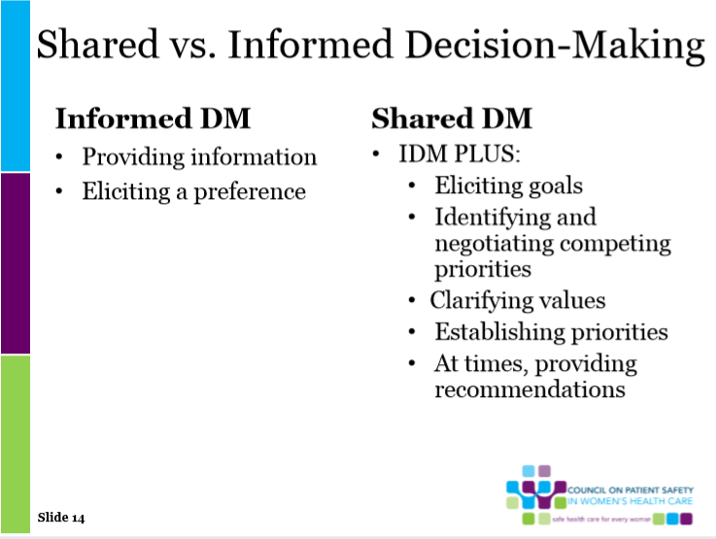

Slide 11
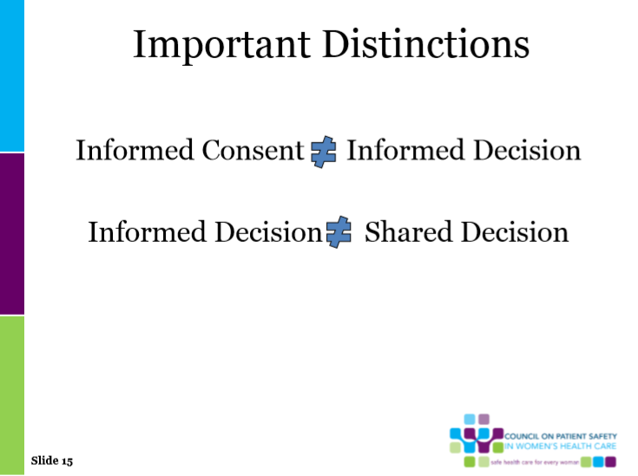

Slide 12
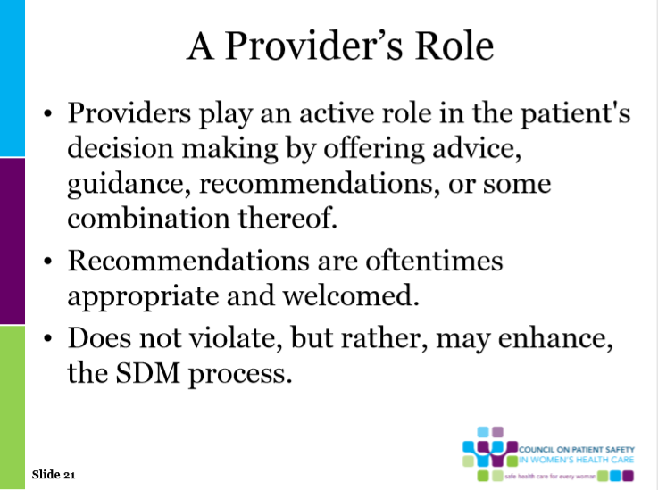


Slide 13
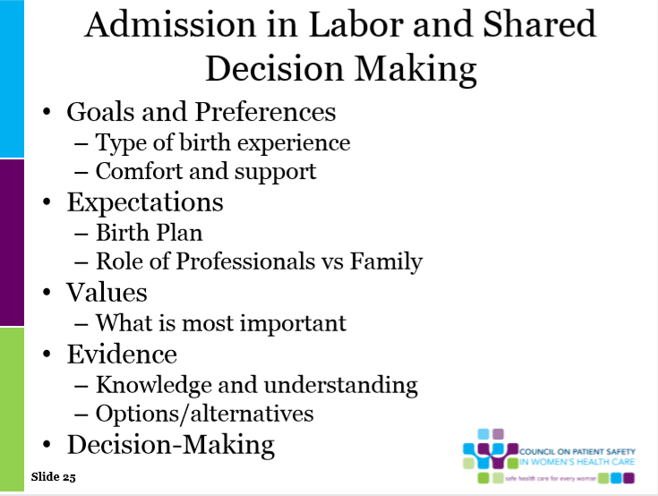

Slide 14
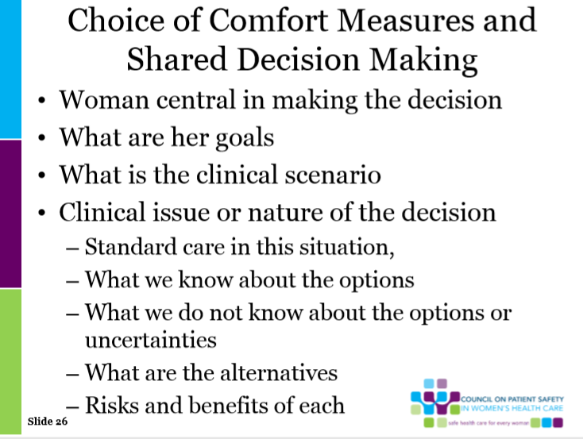

Slide 15
Patient Decision Aids augment the process of Shared Decision Making.
The Ottawa Hospital Research Institute website below includes a searchable A to Z inventory of decision aids on particular health topics, as well as a general decision guide that can be used for any health or social decision. It also includes guides for practitioners to incorporate patient decision aids into clinical practice and for researchers interested in developing new patient decision aids.
http://decisionaid.ohri.ca/index.html
Notes:
These decision aids for patients provide facts, options, and evidence to help them talk with their doctor when making a treatment decision. These tools are meant to serve as a complement to counseling from a health practitioner rather than as a replacement for it.
The Web site includes a searchable A to Z inventory of decision aids on particular health topics, as well as a general decision guide that can be used for any health or social decision. It also includes guides for practitioners to incorporate patient decision aids into clinical practice and for researchers interested in developing new patient decision aids.
http://decisionaid.ohri.ca/index.html
Childbirth
Birth Choices: What is best for you... Vaginal or Caesarean Birth? Yale University School of Nursing
Making choices: options for a pregnant woman with a breech baby. University of Sydney
Pain Relief for Labour: For women having their first baby. University of Sydney
Pregnancy: Should I Have an Epidural During Childbirth? Healthwise
Pregnancy: Should I Try Vaginal Birth After a Past C-Section (VBAC)? Healthwise
Vaginal birth after C-section (VBAC) guide Mayo Clinic
Prenatal Testing
Amniocentesis test: yes or no? Option Grid Collaborative
Down syndrome screening test: yes or no? Option Grid Collaborative
Pregnancy: Should I Have Amniocentesis? Healthwise
Pregnancy: Should I have an early fetal ultrasound? Healthwise
Pregnancy: Should I Have CVS (Chorionic Villus Sampling)? Healthwise
Pregnancy: Should I Have Screening Tests for Birth Defects? Healthwise
What are my options regarding prenatal screening tests? ; Quelles sont mes options concernant le test de dépistage prénatal? Laval University

Slide 16
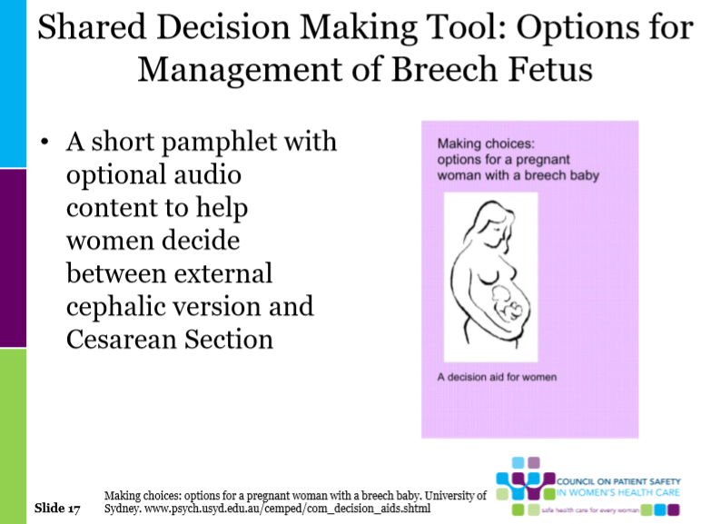
Notes:
This is one of the aids listed in the Ottawa Hospital Research Institute website.

Slide 17
AHRQ online resources: https://www.ahrq.gov/professionals/education/curriculum-tools/shareddecisionmaking/index.htm
Notes:
The SHARE Approach Essential Steps of Shared Decision Making from AHRQ is one of the tools that is widely used in Shared Decision Making.
The SHARE Approach is a five-step process for shared decision making that includes exploring and comparing the benefits, harms, and risks of each health care option through meaningful dialogue about what matters most to the patient.
—From AHRQ toolkit https://www.ahrq.gov/professionals/education/curriculum-tools/shareddecisionmaking/index.html
Five steps for you and your patients to work together to make the best possible health care decisions.
Step 1: Seek your patient's participation
Communicate that a choice exists and invite your patient to be involved in decisions.
Step 2: Help your patient explore and compare treatment options
Discuss the benefits and harms of each option.
Step 3: Assess your patient's values and preferences
Take into account what matters most to your patient.
Step 4: Reach a decision with your patient
Decide together on the best option and arrange for a followup appointment.
Step 5: Evaluate your patient's decision
Plan to revisit decision and monitor its implementation.

Slide 18
Essential behaviors
Define/explain problem
Present options
Discuss pros/cons (benefits/risks/costs)
Discuss patient values/preferences
Discuss patient ability/self-efficacy
Present doctor knowledge/recommendations
Check/clarify understanding
Make or explicitly defer decision
Arrange follow-up
Makoul & Clayman
Notes:
There are 9 Essential behaviors developed by Makoul and Clayman that make Shared Decision Making successful.
•Define/explain problem
•Present options
•Discuss pros/cons (benefits/risks/costs)
•Discuss patient values/preferences
•Discuss patient ability/self-efficacy
•Present doctor knowledge/recommendations
•Check/clarify understanding
•Make or explicitly defer decision
•Arrange followup

Slide 19
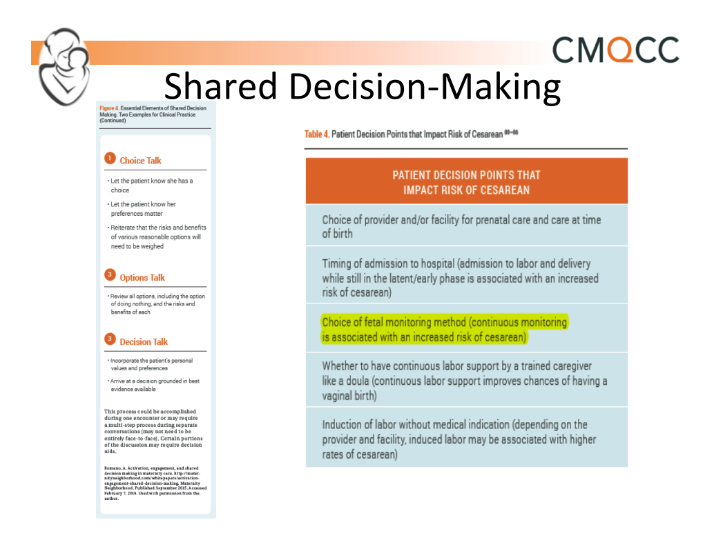
Notes:
This slide is from the CMQCC tool kit and reinforces some of the steps specific to risk of Cesarean--Take her birth plan into consideration as you focus on decision points

Slide 20
Patient decision aids are needed:
Improve decision quality with…
  13% higher knowledge
  82% more accurate risk perception
  51% better match between values & choices
  6% reduced decisional conflict
  Helps undecided to decide (41%)
  Patients 34% less passive in decisions
  Improved patient-practitioner communication (7/7 trials)
Stacey D, Légaré F, Col NF, et al. Decision aids for people facing health treatment or screening decisions. Cochrane Database Syst Rev. 2014 Jan 28;1:CD001431. PMID: 2447007
Notes:
Patient decision aids are needed—these tools help patients to better undersand options and facilitate decisions:
Improve decision quality with…
✓ 13% higher knowledge
✓ 82% more accurate risk perception
✓ 51% better match between values & choices
✓6% reduced decisional conflict ✓Helps undecided to decide (41%)
✓Patients 34% less passive in decisions
✓ Improved patient-practitioner communication (7/7 trials
Stacey, et al., 2014
Stacey D, Légaré F, Col NF, et al. Decision aids for people facing health treatment or screening decisions. Cochrane Database Syst Rev. 2014 Jan 28;1:CD001431. PMID: 2447007
 Facilitators to shared decision making: ▪ Patient decision aids ▪ Decision coaching ▪ Public awareness campaigns ▪ Training of health professionals ▪ Targeting patients and providers is needed

Slide 21
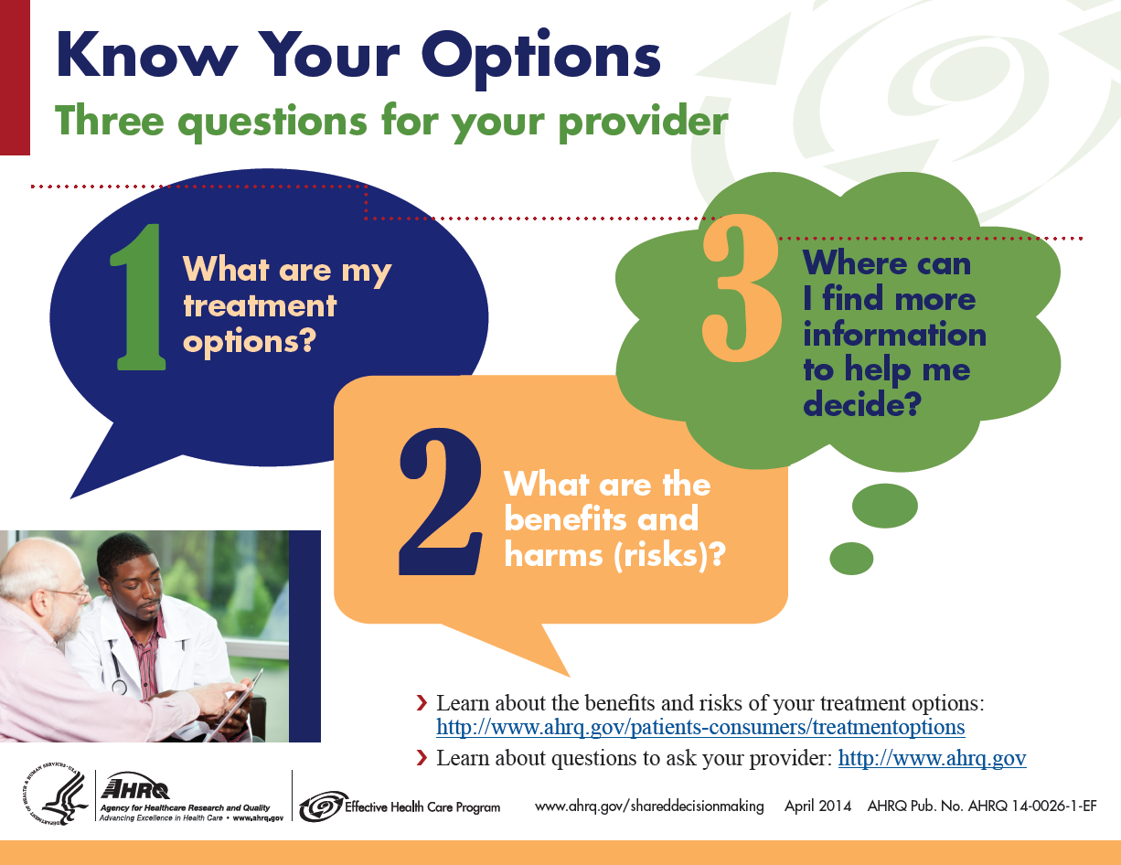
Patient Poster
Notes:
One of the tools available in the AHRQ Participant Guide workbook is the Know Your Options patient poster to be placed in the clinic.

Slide 22
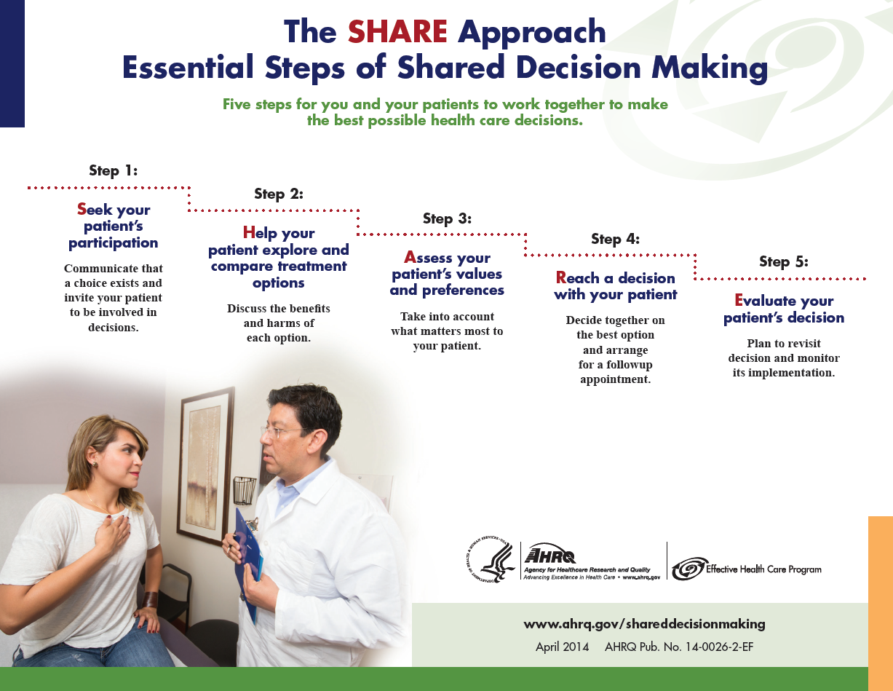
Notes:
The SHARE Approach to shared decision making involves five steps. This slide shows the poster from AHRQ workshop materials, and it can be posted in your clinic. You may want to post it in your office or cubical, in the break room or above the photocopy machine. The poster can help serve as a prompt for you and your team to use this five-step approach with your patients.

Slide 23
Presenting SHARE steps. . .
The mnemonic “SHARE” is a learning device to help you readily recall the steps in the SHARE Approach Model.
You may find that you do not present them in “linear order” during encounters.
The important takeaway is to address all five steps.
AHRQ online resources: https://www.ahrq.gov/professionals/education/curriculum-tools/shareddecisionmaking/index.html
Notes:
This is a detailed approach from AHRQ for learning to use the SHARE approach:
The mnemonic, SHARE, is a learning tool to help you readily remember the five steps.
You may find that you do not present them in “linear order” during your interactions with patients. For example, steps 1, 2, and 3 could all be going on simultaneously.
The important takeaway is to address all five steps.

Slide 24

Step 1: Seek your patient’s participation
Communicate that a choice exists and invite the patient to participate in the decision-making process.
Many patients are not aware that they can and should participate in their health care decision making.
Many patients are not aware of the uncertainty in medicine, and that the outcomes of various treatments are variable.
Refer to page 3, Tool 2.
AHRQ online resources: https://www.ahrq.gov/professionals/education/curriculum-tools/shareddecisionmaking/index.html
Notes:
Let’s look at Step 1 Seek your patient's involvement.
Communicate that a choice of treatment exists and invite your patient to participate in the decision- making process.
Many patients are not aware that they can and should participate in their health care decision making.
In addition, many patients are not aware of the uncertainty in medicine, and that the outcomes of various treatments are variable.

Slide 25
Step 1: Seek your patient’s participation
Tips
Summarize the health problem and communicate there may be more than one treatment choice.
Ask your patient to participate with the health care team.
Assess the role your patient
wants to play.
Include family/caregivers in decisions.
Use cues to continually engage your patient. For example, “I’d like your input”
Refer to page 3, Tool 2.
AHRQ online resources: https://www.ahrq.gov/professionals/education/curriculum-tools/shareddecisionmaking/index.html
Notes:
Each of the steps offer practical tips that you can use. Soon using one or more of the tips will become second nature to you during shared decision making.
Let’s go over some tips to help you invite your patient to participate.
Summarize the health problem clearly and communicate there may be more than one treatment choice.
Ask your patient to participate with the health care team in the decision-making process. Help the patient understand he or she is being invited to ask questions, get answers, and discuss options with you.
Assess the role your patient wants to play in the decision-making process.
Provide ongoing cues during the interaction about why their input is important. For example, say
“I would like your input.”
Ask your patient if he or she would like family and caregivers to participate.

Slide 26
Step 2: Help your patient explore and compare treatment options
Discuss the benefits and risks of each treatment option.
Use evidence-based decision-making resources to compare treatment options.
Read more about decision-support resources in Module 2.
Refer to page 4, Tool 2.
AHRQ online resources: https://www.ahrq.gov/professionals/education/curriculum-tools/shareddecisionmaking/index.html
Notes:
Let's look at Step 2, which is to help your patient explore and compare treatment options.
This step involves discussing the benefits and risks of the treatment options, so the provider’s knowledge about risks and benefits of a treatment and the use of evidence-based decision aids are very important to this step.
This is the step where evidence-based decision aids and other resources are very important.
In Module 2, you will learn more about using decision support resources to help you do so.

Slide 27
Step 2: Help your patient explore and compare treatment options
Tips
Check for patient knowledge of the options.
Clearly communicate risks and benefits of each option.
Explain the limitations of what is known about the options.
Use simple visual aids and evidence-based decision aids when possible.
Summarize by listing the options.
AHRQ online resources: https://www.ahrq.gov/professionals/education/curriculum-tools/shareddecisionmaking/index.htm
Notes:
Tips to help your patient explore and compare treatment options include:
Assess what your patient already knows about the options. Some patients gather their own information. Explore with your patient what he/she may already know about his/her treatment options.
List the treatment options, and describe them in plain language. Clearly communicate risks and benefits of each option.
Explain the limitations of what is known and unknown about the options and what would happen with no treatment. Offer evidence-based decision aid tools whenever possible.
Summarize by listing the options again.

Slide 28
Step 2: Help your patient explore and compare treatment options
Conversation Starters
“Here are some choices we can consider.”
“Let me tell you what the research says about the benefits and risks of the medicine/treatments that you are considering.”
“I have some booklets I want to give you that have information about your condition and the treatment options.”
“These tools have been designed to help you to understand your options in more detail.”
Refer to pages 5-8, Tool 2.
AHRQ online resources: https://www.ahrq.gov/professionals/education/curriculum-tools/shareddecisionmaking/index.htm
Notes:
Some conversation starters for helping your patient assess pros and cons of treatments options:
“Here are some choices we can consider.”
“Let me tell you what the research says about the benefits and risks of the medicine/treatments that you are considering .”
When introducing decision aids, you can say:
“I have some booklets I want to give you that have information about your condition and the treatment options.”
“These tools have been designed to help you to understand your options in more detail.”

Slide 29
Step 3: Assess your patient’s values and preferences
An optimal decision is one
that takes into account patient preferences and values.
Communicate with your patient about the outcomes that are most important to
him or her.
What matters most to your patient?
Recovery time
Out-of-pocket costs
Being pain free
Having a specific level of functionality
Refer to page 9, Tool 2.
AHRQ online resources: https://www.ahrq.gov/professionals/education/curriculum-tools/shareddecisionmaking/index.htm
Notes:
The third step in the SHARE model is to assess your patient’s values and preferences.
Some health care providers may not be aware of the outcomes that matter most to patients. In fact, studies have shown that heath care professionals aren’t truly tuned in to the things that really matter to patients.
And other studies have shown that patient treatment decisions often change after patients become well informed about their available options and the associated risks.
The best decision for your patient is one that takes into consideration his/her preferences and values. Talk with your patient about what matters the most and what outcomes are the most important to him/her.

Slide 30
Step 3: Assess your patient’s values and preferences
Tips
Encourage your patient to talk about his or her values and preferences.
Use open-ended questions.
Listen actively to the patient and show empathy and interest.
Acknowledge what matters to your patient.
Agree on what is important to your patient.
AHRQ online resources: https://www.ahrq.gov/professionals/education/curriculum-tools/shareddecisionmaking/index.htm
Notes:
Some tips to accomplish Step 3 are:
Encourage your patient to talk about what is important to him or her regarding the options.
Use open-ended questions. Avoid questions with yes and no answers.
Listen actively to your patient. Show empathy and interest in the effect that a problem is having on your patient's life.
Acknowledge the values and preferences that matter to your patient.
Come to agreement on what your patient prefers and is important.

Slide 31
Step 3: Assess your patient’s values and preferences
Conversation Starters
“When you think about the possible risks, what matters most to you?”
“As you think about your options, what’s important to you?”
“Which of the options fits best with treatment goals we’ve discussed?”
“Is there anything that may get in the way of doing this?”
Refer to page 9, Tool 2.
AHRQ online resources: https://www.ahrq.gov/professionals/education/curriculum-tools/shareddecisionmaking/index.htm
Notes:
Some things you can say to get the conversation going about your patient’s values and preferences are:
“When you think about the possible risks, what matters most to you?”
“As you think about your options, what’s important to you?”
“Which of the options fits best with the treatment goals we’ve discussed ?”
“Is there anything that may get in the way of doing this?”
Assessing preferences matter, especially when patients defer decisions to clinicians.
Find out what matters to the patient. This may greatly impact achieving satisfactory health outcomes and patient satisfaction.

Slide 32
Step 4: Reach a decision with your patient
Decide together on the best option.
Arrange for follow-up steps to achieve the preferred treatment.
Refer to page 10, Tool 2.
AHRQ online resources: https://www.ahrq.gov/professionals/education/curriculum-tools/shareddecisionmaking/index.htm
Notes:
The fourth step in the SHARE model is to reach a decision with your patient about the treatment option that is best.
Making a decision may take time. Check to see if your patient needs more time to consider the options or discuss them with others.
After assessing the treatment options, including benefits and risks, and guiding your patient to express what matters the most to him or her in determining the best option, decide together on the best treatment option.
Your patient may choose to delegate the decision to someone else or decide not to make a decision. In that case, active surveillance may be the option.
Schedule follow-up appointments to carry out the preferred treatment or active surveillance.

Slide 33
Step 4: Reach a decision with your patient
Tips
Ask your patient if he/she is ready to make a decision.
Ask your patient if he/she needs more information.
Schedule another session if your patient needs more time to consider the decision.
Confirm the decision with your patient.
Schedule follow-up appointments to carry out preferred options.
AHRQ online resources: https://www.ahrq.gov/professionals/education/curriculum-tools/shareddecisionmaking/index.htm
Notes:
Tips to help move your patient to come to a decision after jointly talking about the pros and cons of the treatment are:
Ask your patient if he or she is ready to make a decision or if they have any additional questions.
Ask if he or she would like additional information tools, such as decision aids to help make a decision.
If more time is needed, schedule another session.
Confirm the decision by asking your patient to describe the option she or he chose.
Have other staff schedule appointments to carry out the preferred option.

Slide 34
Step 4 dialogue: Reach a decision with your patient
Conversation Starters
“It’s fine to take more time to think about the treatment choices. Would you like some more time, or are you ready to decide?”
“What additional questions do you have for me to help you make your decision?”
“Now that we had a chance to discuss your treatment options, which treatment do you think is right for you?”
Refer to page 10, Tool 2.
AHRQ online resources: https://www.ahrq.gov/professionals/education/curriculum-tools/shareddecisionmaking/index.htm
Notes:
Some actual dialogue to help move your patient to a decision includes:
“It’s fine to take more time to think about the treatment choices. Would you like some more time, or are you ready to decide?”
“What additional questions do you have for me to help you make your decision?”
“So now that we had a chance to discuss your treatment options, do you have a preference for which treatment you would prefer? Which treatment do you think is right for you?”

Slide 35
Step 5: Evaluate your patient’s decision
Support your patient so the treatment decision has a positive impact on health outcomes.
For management of chronic illness, revisit decision after a trial period.
Refer to page 11, Tool 2.
AHRQ online resources: https://www.ahrq.gov/professionals/education/curriculum-tools/shareddecisionmaking/index.htm
Notes:
Once a decision has been made, it will be important to follow up with your patient on how he or she is doing. Evaluate your patient's decision. This is the last step in the SHARE Approach to shared decision making.
For patients facing life-threatening conditions, some of the decisions will be irreversible, so careful follow-up is needed during the treatment phase.
For decisions related to management of chronic disease, the decision should be revisited periodically.

Slide 36
Step 5: Evaluate your patient’s decision
Tips
Make plans to review the decision in the future.
Monitor implementation of treatment decision.
Assist your patient with managing barriers to implementation.
Revisit the decision if the option does not produce the desired health outcomes.
AHRQ online resources: https://www.ahrq.gov/professionals/education/curriculum-tools/shareddecisionmaking/index.htm
Notes:
Some tips to aid in evaluating your patient’s decision are:
Make plans to review the decision in the future. Decisions may be reviewed and changed if they are not working well.
Monitor the extent to which the treatment decision is implemented.
Help with managing barriers to implementing a decision. Provide access to self-management support programs or other resources.
Reconsider other options if the preferred option is not working.

Slide 37
Step 5: Evaluate your patient’s decision
Conversation Starters
“Let’s plan on reviewing this decision at our next appointment.”
“If you don’t feel things are improving, please schedule a follow-up visit so we can plan a different approach.”
Refer to page 11, Tool 2.
AHRQ online resources: https://www.ahrq.gov/professionals/education/curriculum-tools/shareddecisionmaking/index.htm
Notes:
To let your patient know that you will continue to evaluate the decision that was made, keep the communication avenues open by saying something, like:
“Let’s plan on reviewing this decision at our next appointment.”
“If you don’t feel things are improving, please schedule a follow-up visit so we can plan a different approach.”

Slide 38
Putting Shared Decision Making Into Action
Role Play Activity
AHRQ online resources: https://www.ahrq.gov/professionals/education/curriculum-tools/shareddecisionmaking/index.htm
Notes:
Optional activity: After learning about the SHARE Approach to shared decision making, we’d like to take the next half hour to have you practice shared decision making.
.
Ask participants to break into groups of 4-6 people based on the size of your group and the amount of space in your room.
.

Slide 39
Instructions
Break into your assigned group.
Choose roles: Provider, patient, reporter, observers.
Refer to the Conversation Starters handout and the SHARE Approach model as you role play.
Refer to your consumer and clinician summaries during this activity.
Role play:
  Reporter asks for volunteers for provider and patient.
  Role play a shared decision-making encounter.
  Observers provide feedback.
Notes:
Your handout outlines the instructions for this role-play exercise. They are also listed on this slide. After you have broken into your groups:
Choose roles: health care provider, patient, reporter, and observers.
Some groups will be working with case study 1. Others will be working with case study 2.
Refer to the consumer and clinician summaries as needed as you conduct the role plays.
The provider will role play a shared decision-making encounter with the patient.
For each step of the SHARE Approach, use one of the conversation starter phrases. Use one of the samples provided, or come up with your own.
The provider will go through all five steps of shared decision making with the patient.
At the end of the role play, observers provide feedback.
Be prepared to report your experiences with shared decision making at the end of the 25-minute role-play period. The reporter from each role play will report the experiences from the role play.

Slide 40
Debrief
Summarize your group’s role play.
Could you fit all steps in?
What was most challenging?
What worked best?
How long did it take?
How difficult would this be to implement in real life?
Notes:
After 25 minutes are up, ask the participants to get ready to debrief.
Now it’s time to debrief. Let’s start with Table/Group 1 to report your role-play experiences.
Please summarize your group’s role play, and address the following points in your report.
Could you fit all steps in?
What was most challenging?
What worked best?
How long did it take?
How difficult would this be to implement in real life?
Call up the reporter from each table to report out, starting with Table/Group 1. Continue until all tables/groups have reported out.
Great job with role playing. You are really getting the hang of using shared decision making in practice.
As time goes on, you will find that incorporating the SHARE Approach will come much more easily to you. Posting the poster and putting the screen saver on your computer can help remind you of the model.

Slide 41
Key takeaways
Shared decision making is a two-way street
  Occurs when a health care provider and a patient work together to make a health care decision that is best for the patient.
  The optimal decision takes into account evidence-based information about available options, the provider’s knowledge and experience, and the patient’s values and preferences.
AHRQ online resources: https://www.ahrq.gov/professionals/education/curriculum-tools/shareddecisionmaking/index.htm
Notes:
Let’s briefly review key takeaway information for today.
Shared decision making is a two-way street.
It occurs when a health care provider and a patient work together to make a health care decision that is best for the patient.
The optimal decision takes into account evidence-based information about available options, the provider’s knowledge and experience, and the patient’s values and preferences.

Slide 42
Key takeaways
The SHARE Approach is a five-step process for shared decision making that includes exploring and comparing the benefits, harms, and risks of each health care option through meaningful dialogue about what matters most to the patient.
AHRQ online resources: https://www.ahrq.gov/professionals/education/curriculum-tools/shareddecisionmaking/index.htm
Notes:
The SHARE Approach is a five-step process for shared decision making that includes exploring and comparing the benefits, harms, and risks of each health care option through meaningful dialogue about what matters most to the patient.

Slide 43
Key takeaways
Conversation starters can help you engage patients as you present each of the SHARE Approach Model’s five steps.
AHRQ online resources: https://www.ahrq.gov/professionals/education/curriculum-tools/shareddecisionmaking/index.htm
Notes:
Conversation starters can help you engage patients as you present each of the SHARE Approach Model’s five steps.

Slide 44
Key takeaways
Using evidence-based decision aids in shared decision making can:
  Improve patient’s knowledge of options
  Result in patient having more accurate expectations of possible benefits and risks
  Lead to patient making decisions that are more consistent with their values
  Increase patient’s participation in decision making
AHRQ online resources: https://www.ahrq.gov/professionals/education/curriculum-tools/shareddecisionmaking/index.htm
Notes:
Using evidence-based decision aids in shared decision making can:
Improve patients knowledge of their options
Result in patients having more accurate expectations of possible benefits and risks
Lead to patients making decisions that are more consistent with their values
Increase patients’ participation in decision making

Slide 45
Citations AHRQ online resources: https://www.ahrq.gov/professionals/education/curriculum-tools/shareddecisionmaking/index.htm
Makoul G, Clayman ML; An integrative model of shared decision making in medical encounters. Patient Educ Couns. 2006;60(3):301-12.
Wilson SR, Strub P, Buist AS, Knowles SB, Lavori PW, Lapidus J, Vollmer WM; Better Outcomes of Asthma Treatment (BOAT) Study Group. Shared treatment decision making improves adherence and outcomes in poorly controlled asthma. Am J Respir Crit Care Med. 2010 Mar 15;181(6):566-77. PubMed PMID: 20019345.
Clever SL, Ford DE, Rubenstein LV, Rost KM, Meredith LS, Sherbourne CD, Wang NY, Arbelaez JJ, Cooper LA. Primary care patients’ involvement in decision-making is associated with improvement in depression. Med Care. 2006 May;44(5):398-405. PubMed PMID: 16641657.
Da Silva, D. Evidence: Helping people share decisions. A review of evidence considering whether shared decision making is worthwhile. 2012 June. London, England: Health Foundation. http://www.health.org.uk/public/cms/75/76/313/3448/HelpingPeopleShareDecisionMaking. pdf?realName=rFVU5h.pdf
Notes:
These citations are from the AHRQ Module 1 training on Shared Decision Making.

Slide 46
Citations
Swanson KA, Bastani R, Rubenstein LV, Meredith LS, Ford DE. Effect of mental health care and shared decision making on patient satisfaction in a community sample of patients with depression. Med Care Res Rev. 2007 Aug; 64(4):416-30. PubMed PMID: 17684110.
Thompson L., McCabe R. The effect of clinician-patient alliance and communication on treatment adherence in mental health care: a systematic review. BMC Psychiatry 2012 Jul 24;12:87. PMID:22828119.
Duncan E., Best C., Hagen S. Shared decision making interventions for people with mental health conditions. Cochrane Database Syst Rev 2010 Jan 20;(1):CD007297. PMID: 20091628.
Stacey D, Légaré F, Col NF, et. al. Decision aids for people facing health treatment or screening decisions. Cochrane Database Syst Rev. 2014 Jan 28; 1:CD001431. PubMed PMID: 24470076 (2014 Systematic Review; 113 studies; 34,444 participants).

Slide 47
Citations
Little P., Everitt H., Williamson I., et al. Preferences of patients for patient centred approach to consultation in primary care: observational study. BMJ 2001. 322(7284):468-72. PMID: 11222423.
Coulter A., Parsons S., Askham A. Where are the patients in decision-making about their own care? Health Systems and Policy Analysis 2008: p. 1-26.
Levinson W., Kao A., Kuby A., et al. Not all patients want to participate in decision making. A national study of public preferences. J Gen Intern Med 2005 Jun;20(6):531-5. PMID: 15987329.
Légaré F., Ratté S., Gravel K., et al. Barriers and facilitators to implementing shared decision-making in clinical practice: update of a systematic review of health professionals’ perceptions. Patient Educ Couns 2008. Dec;73(3):526-35. PMID: 18752915.
Guadagnoli E., Ward P. Patient participation in decision-making. Soc Sci Med 1998 Aug;47(3):329-39. PMID: 9681902.
Murray E., Charles C., Gafni A. Shared decision-making in primary care: tailoring the Charles et al. model to fit the context of general practice. Patient Educ Couns 2006 Aug;62(2):205-11. PMID:16139467.

Slide 48
Q & A

Slide 49
THANK YOU!

