Slide 1
CITI TRAINING FOR THOSE INVOLVED IN CLINICAL RESEARCH

Slide 2
CITI Training
IRB requires that all people participating in human subjects research complete a human subjects research course
The course you need to take is “Biomedical Investigators and Key Personnel”
There are 16 modules in the course
I have outlined all steps on the subsequent slides

Slide 3
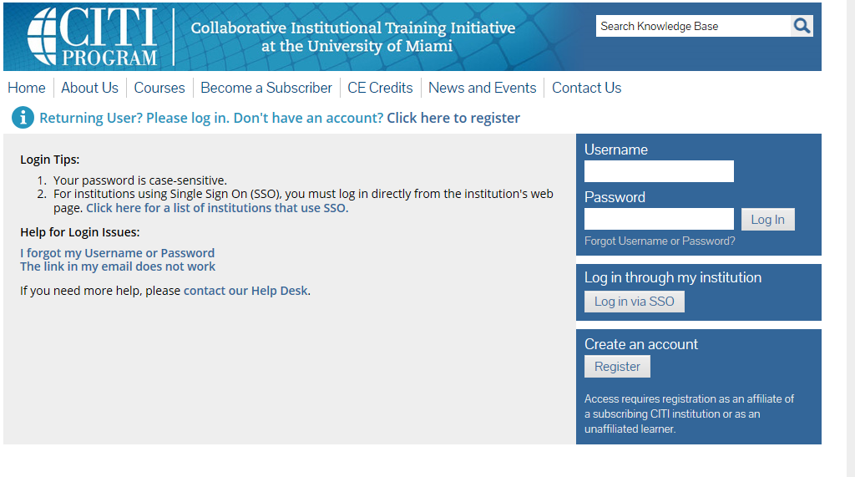
REGISTER FIRST

Slide 4
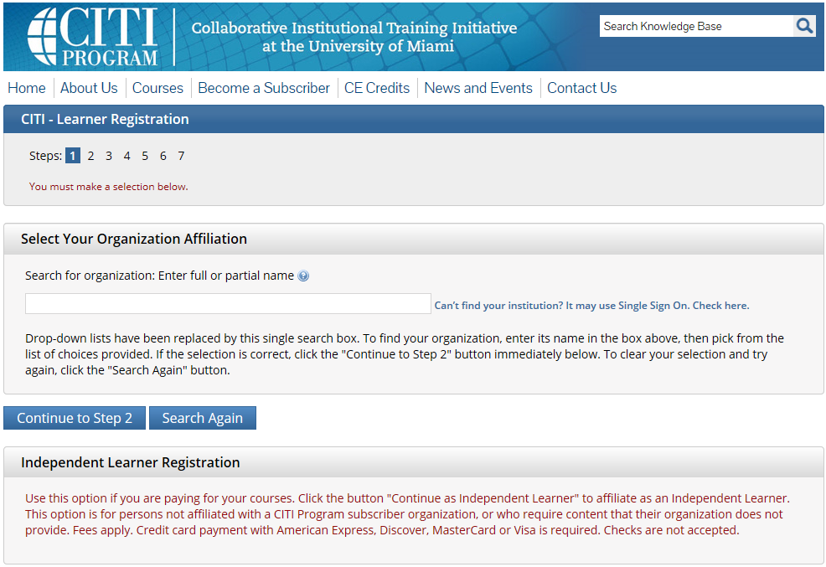
TYPE IN “UNIVERSITY OF SOUTH FLORIDA”

Slide 5
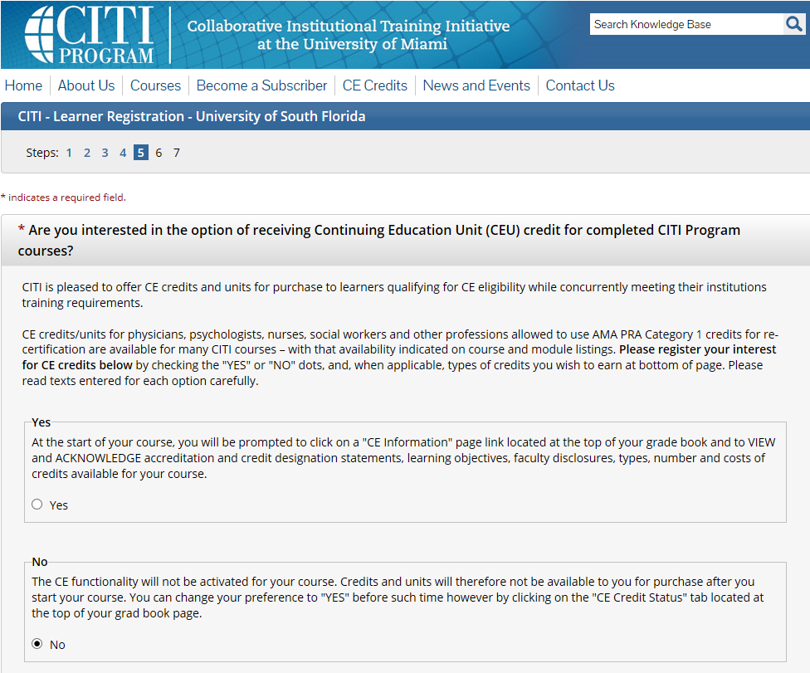

Slide 6
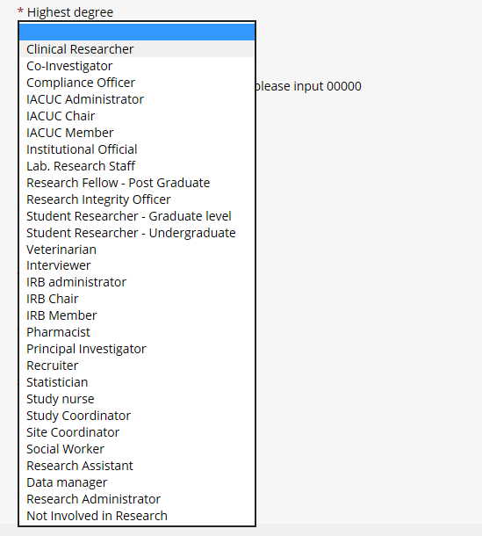
Select your role
For the Attendings,
Select Principal Investigator to obtain your own studies at a later date.
Residents select study coordinator and medical students selected student

Slide 7
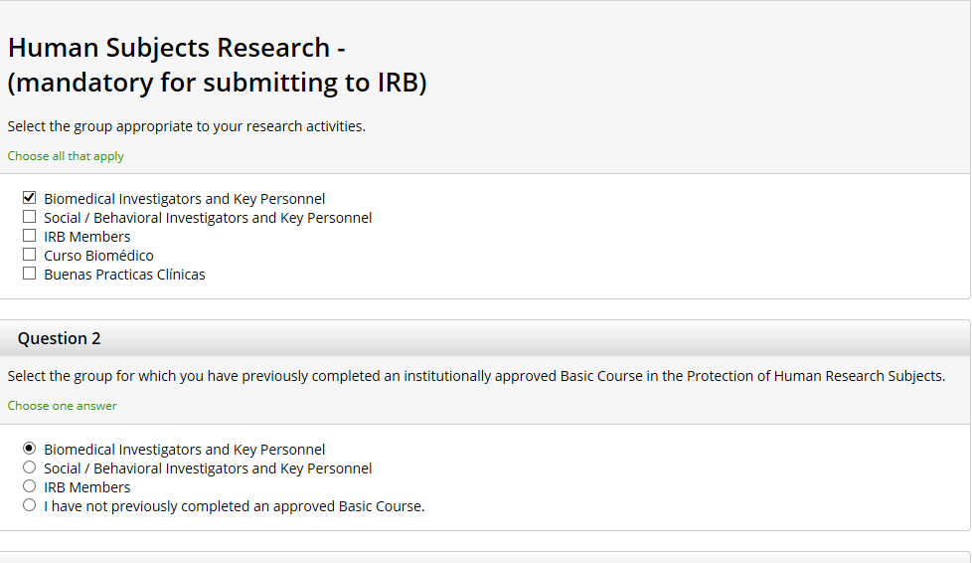

Slide 8
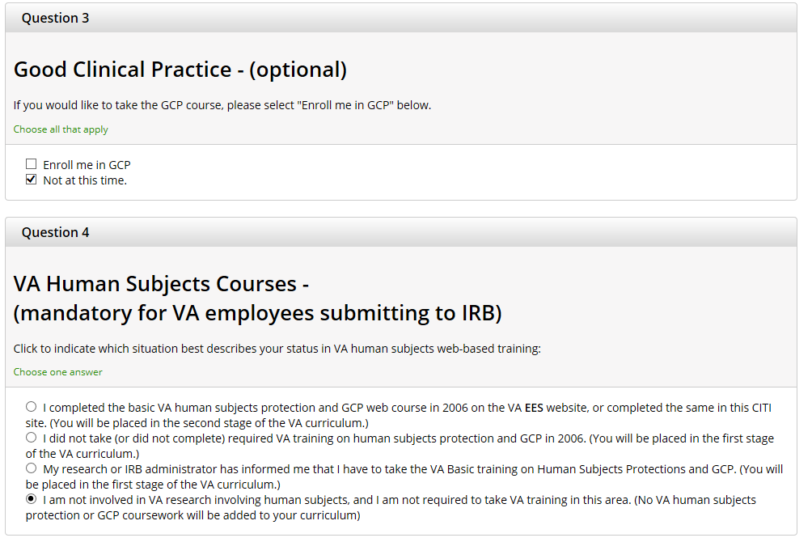

Slide 9
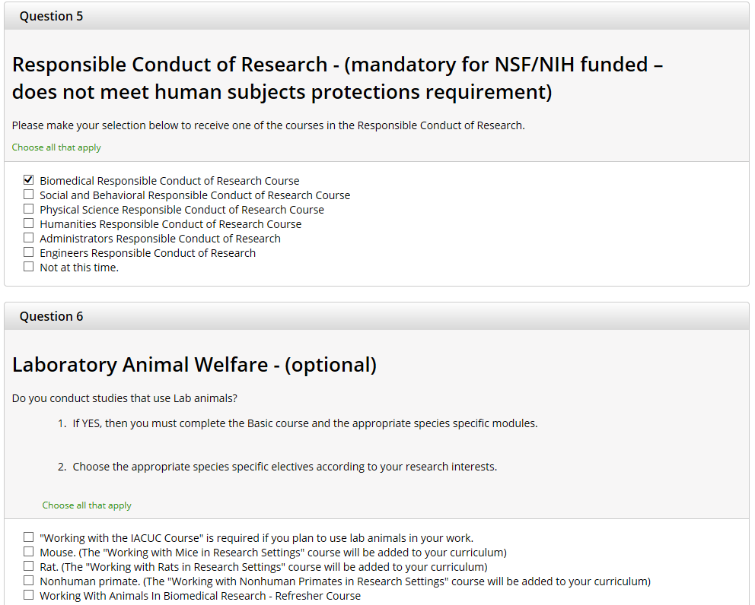

Slide 10
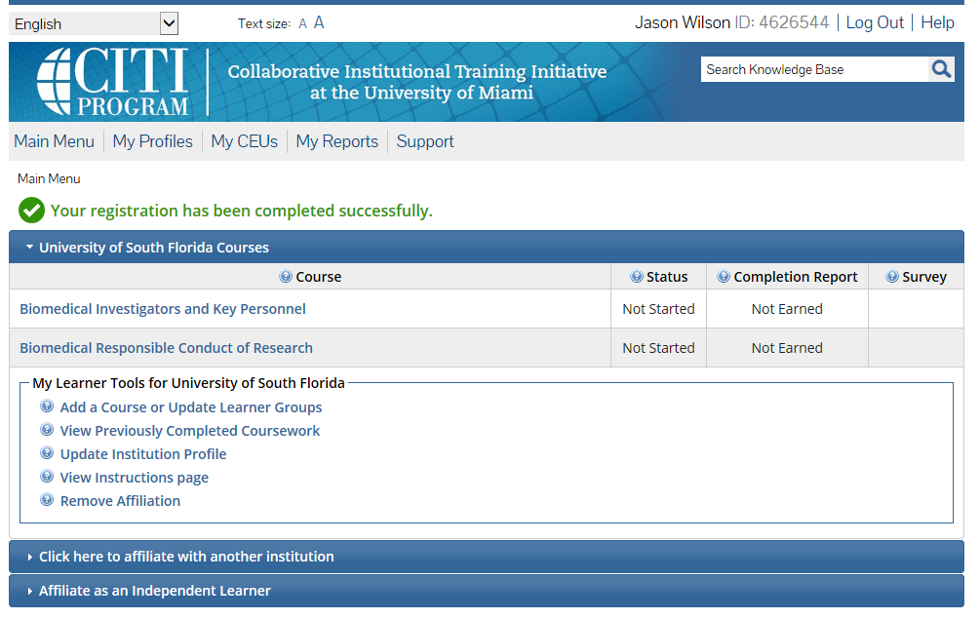

Slide 11
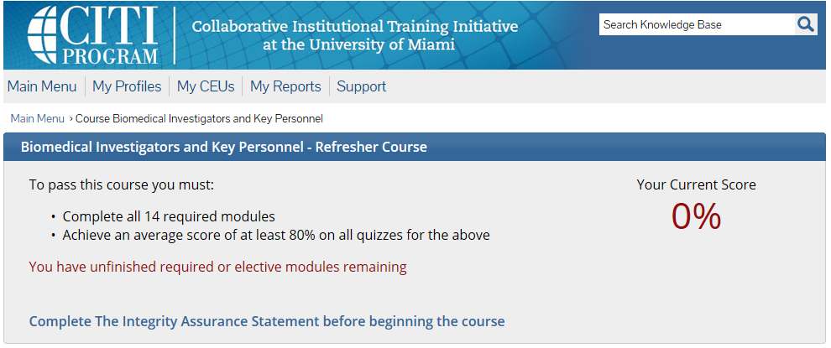
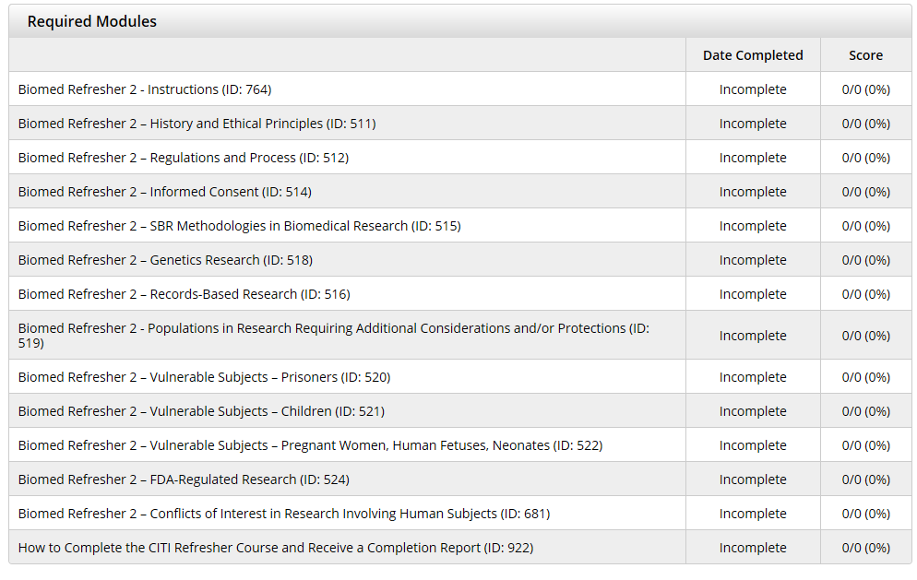

Slide 12
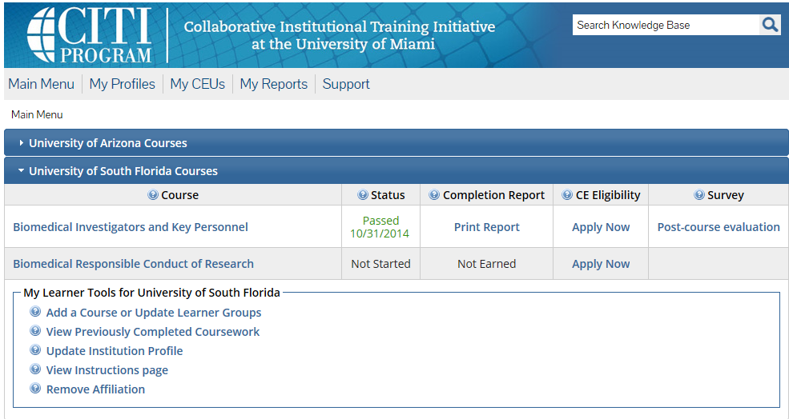

Slide 13
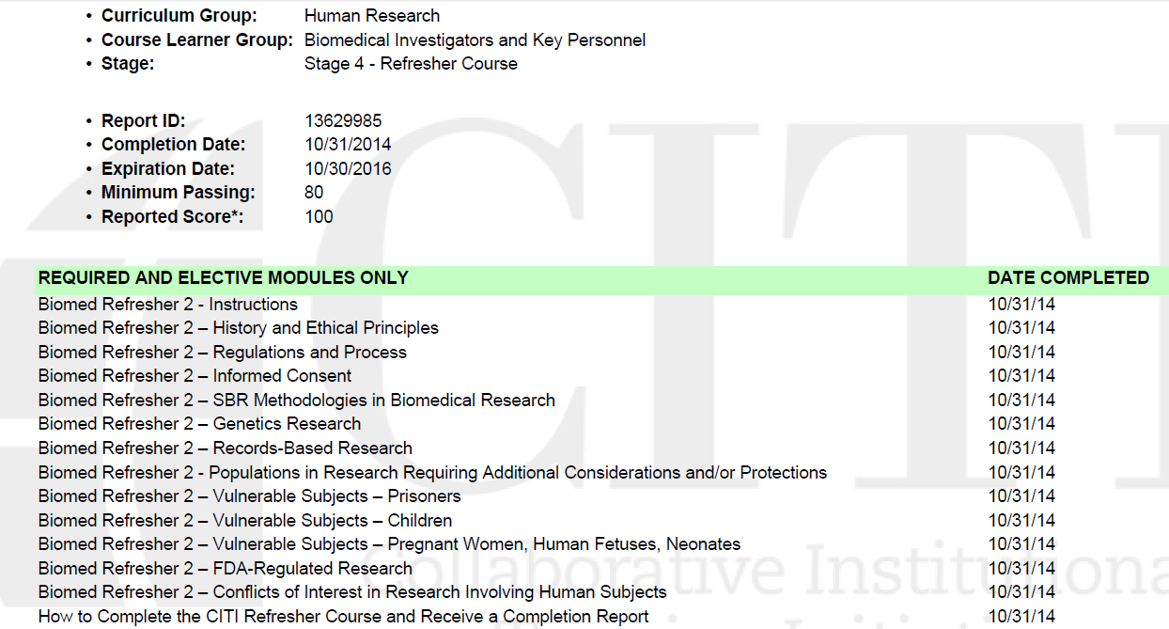
Mine says refresher because I have done this numerous times – but these should be the same courses you have on your transcript

