Slide 1
Labor of Compassion: Trauma Informed Approaches to Maternal Care
Understanding causes of birth trauma and how to help your patient come out on the other side.
Lacy Chavis, PsyD, PMH-C, Amanda Holbrook, MSN, RN, RNC-OB, C-EFM and Raquel Isaza Quasius, MSHI, BSN, RN-BE

Slide 2
Learning Objectives
Identify the implications of ANS dysregulation
2. Describe the 6 Principles of Trauma Informed Care (TIC)
3. Identify TIC practices that can be applied to improve patient outcomes
4. Harness your Power

Slide 3
Polyvagal Theory

Slide 4
Trauma is an Experience, Not an Event
“Psychical trauma-or more precisely the memory of the trauma-acts like a foreign body which long after its entry must continue to be regarded as the agent that still is at work”
Breur &Freud, 1985

Slide 5
Lopez et al, 2021
Notes:
In the perinatal phase, the fetal brain may be exposed to maternal cortisol levels resulting from prenatal stress, usually associated with dampening of the infant’s HPA axis postnatally, often lasting into infancy and early childhood. Exposures to ELA/stress then manifest as hyperactive responses to acute stress, which, if prolonged or repetitive, can lead to chronically dysregulated diurnal rhythms and HPA-axis exhaustion.

Slide 6
Why does L&D potentially lead to traumatic stress?
Challenges sense of safety
Senes of life threat or perceived life threat
Feelings of helplessness
Feeling of pain or observed pain
Decision making during times of distress
Personal or cultural past experiences with medicine and OB/GYN
Notes:
One of the most vulnerable experiences.
What is trauma informed care?
The belief that multiple dimensions of trauma can have lasting adverse effects on well-being and function.
This includes physical/bodily and psychological injuries and is unquie to each individual and their experience.

Slide 7
Core Principles of Trauma Informed Care
CDC, 2018
Notes:
SAMHSA’S (Substance Abuse and Mental Health Services Administration) six principles that guide a trauma-informed approach, including: Adopting a trauma-informed approach is not accomplished through any single particular technique or checklist... It IS HOW YOU SHOW UP. It requires constant attention, caring awareness, sensitivity, and possibly a cultural change at an organizational level. On-going internal organizational assessment and quali-ty improvement, as well as engagement with community stakeholders, will help to imbed this approach which can be augmented with organi-zational development and practice improvement.

Slide 8
Safety
Provide privacy
Maintain confidentiality
Trustworthiness and Transparency
Communicate frequent and regularly
Encourage involvement in rounds and during shift change
Peer Support
Offer peer support during admission
Consider various platforms for peer support
Demonstrate mutual respect
Validate patients’ experience
Respect patients’ concerns and questions
Make medical record accessible
Notes:
Safety: mutual respect-once you label me you negate me. “ The placenta previa in room.. The 23 weeker…The IUFD...)
Trustworthiness: Just because the words are coming out of your mouth communication is not necessarily happening. Make and maintain eye contact, position yourself on the same level or below pt.
Peer support: Isolation and loneliness kills human beings.

Slide 9
Collaboration and Mutuality
Partner with patient and family
Empower, Voice and Choice for patients and staff
Foster resilience
Cultural, Historical and Gender Issues
Treat all patients equally
Mentor and coach patient and family
Involve in care
Perform shared decision making
Create a nurse –physician collaboration
Encourage presence on rounds
Support staff with appropriate assignments, mentoring and self scheduling
Welcome support systems
Provide culturally effective care
Notes:
Recognize that you are viewed in a position of power. Awareness and response are not mutually exclusive. Balance out the science and the soul.

Slide 10
Patient Story
Raquel is a current leader at Tampa General Hospital in the Inpatient Informatics department. She has been at TGH for 12 years, starting as a nurse tech, ICU nurse, nurse analyst and now leader in IT.
She delivered both her son (3yo) and daughter (1yo) with very different experiences in labor and delivery. One experience being chaotic and the other experience being peaceful – both ending with a post-partum hemorrhage.
Raquel Isaza Quasius, MSHI, BSN, RN-BC
Manager – inpatient informatics

Slide 11
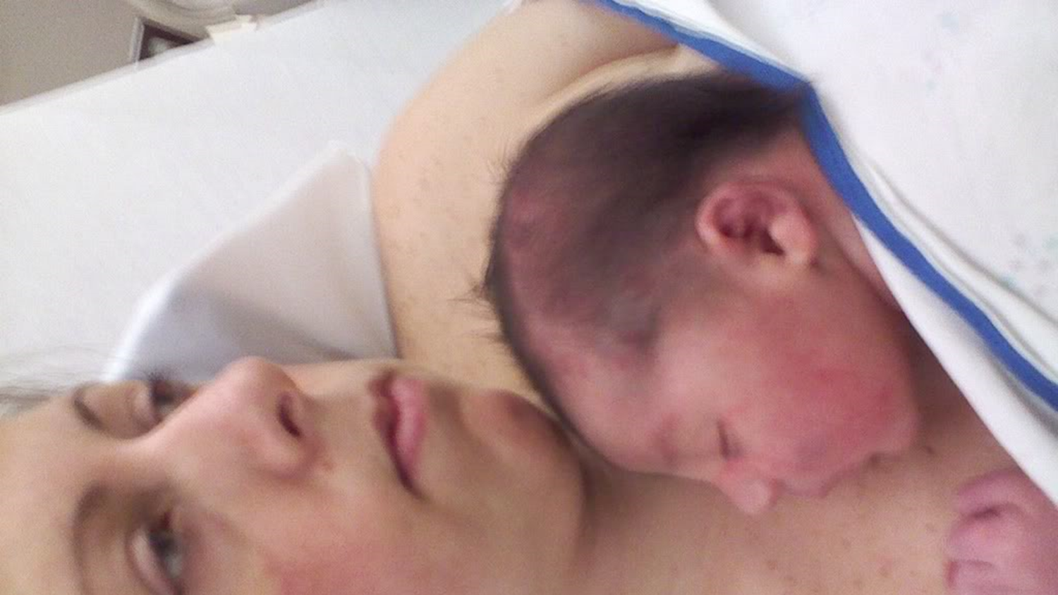

Slide 12
Birth trauma. What is it?
The Birth Trauma Association report that women who suffer from a traumatic birth experience report:
Flashbacks
Depressive Feelings
Feelings of inadequacies
Reoccurring negative thoughts about their experience

Slide 13
Can we predict who is at risk for a traumatic experience?
Previous mental health disorders
Have suffered from sexual trauma
Undergo an obstetric emergency
Have neonatal complications
Have poor quality of provider interactions
“Women who’ve had straightforward deliveries can also be affected, if they felt as though they had control snatched away from them.”
~ Birth Trauma Association

Slide 14
Survival Strategies
•Dissociate
•Repress our feelings
•Deny, ignore, reject, and minimize what happened to us
•Suppress our rage and despair by numbing our physical sensations
•Become aggressive and easily irritated
•Experience somatic symptoms (headaches, migraines, anxiety)
•Disconnect from others

Slide 15
You’ve had a traumatic birth; now what else may happen to you?
Sexual dysfunction and intimacy issues
Difficulty forming positive attachment with their infant
Disruption to family life
SUICIDAL IDEATION
Another major theme was that women reported a fear of childbirth (tocophobia) or secondary tocophobia, which was associated with women making a conscious decision to not have any further pregnancies elect to have a caesarean section for future births
PTSD

Slide 16
PTSD
OCCURS IN 1.7-9% OF WOMEN WHO BIRTH.
RISK FACTORS FOR PTSD AFTER CHILDBIRTH INCLUDE:
Pre-existing maternal psychological disorders, including prior diagnosis of PTSD symptoms
The quality of interactions with medical staff and perceived social support

Slide 17
How can you help a patient at risk?

Slide 18
Present a calm front
Your single, best tool

Slide 19
If your patient has a known history of PTSD: Staff should receive training on perinatal psychology to ensure that women identified as being at risk received supportive, emotionally intelligent care during their labor and birth. Allow them to discuss their experience and validate their feelings.
If your patient is having an obstetric emergency: Present a CALM demeanor. Provide as much education as possible during the emergency. Debrief with the patient and family after stabilization. Provide any missing information after stabilization.
If there are fetal/infant complications: Present a CALM demeanor. Assess your environment, are there 10 people in the room when there only needs to be 1-2? Debrief with the patient and family after.
Your patient has reported (or you have witnessed) poor health team member interactions: Provide honest communication to your team member regarding what you observed or what the patient communicated to you. Offer the patient the opportunity to discuss what happened. Apologize for what happened. Provide education on the plan of care.

Slide 20
Case Study:
29 wk G3 P2 for PPROM brought in by ambulance with cord prolapse (not handed off in report by Paramedic. Pt told OB Triage RN after approximately 10 minutes after arrival. Team quickly responded. Emergency C/S performed with skin incision being done 9 minutes of this report. Live birth of BG with apgars of 1, 4, 7 with infant now in NICU.
What factors place this pt at risk for birth trauma?
What can you do during and after the emergency to possibly prevent birth trauma?

Slide 21
The R’s
Realize
Recognize
Respond
Resist Re-traumatization
Notes:
All the answers are inside, they already lay within you: What makes you feel seen, heard, respected and loved?
Realize the impact that trauma has on people, and that reactions to past trauma, may inform the person’s response to a potentially traumatic situation
Recognize the signs and symptoms of trauma in people (patients) and the staff caring for them
Respond by providing support and resources
Resist retraumatization, to prevent a situation that represents a tolerable stress from evolving into a toxic stress

Slide 22
GRACE Joan Halifax, Ph.D.
Gather attention
Recall intention
Attune to self/other
Consider what will serve
Engage and end

Slide 23
A Way Through…When Less is More
Less Distracted, More Intention
Less Disconnection, More Presence
Less Attachment, More Curiosity
Less Depletion, More Stamina
Lipsky, 2018
Notes:
A moment in time into a timeless moment!

Slide 24
“Compassion is not a relationship between the healer and the wounded. It’s a relationship between equals. Only when we know our own darkness well, can we be present with the darkness of others.”
Pema Chodron

Slide 25
References
C.T. Beck, Birth trauma in the eye of the beholder. Nurs Res, 53 (1) (2004), pp. 28–35.
J. Fenwick, J. Gamble, D. Creedy, L. Barclay, A. Buist, E.L. Ryding. Women's perceptions of emotional support following childbirth: a qualitative investigationMidwifery, 29 (3) (2013), pp. 217–224
R. Grekin, M.W. O’Hara. Prevalence and risk factors of postpartum posttraumatic stress disorder: a meta-analysis. Clin Psychol Rev, 34 (5) (2014), pp. 389–401.
M. Simpson, C. Catling. Understanding psychological traumatic birth experiences: A literature review. Women & Birth. (2015). doi:10.1016/j.wombi.2015.10.009

Slide 26
THANK YOU

