Slide 1
PACC Update: Successes & Challenges Estefania Rubio, MD, MPH

Slide 2
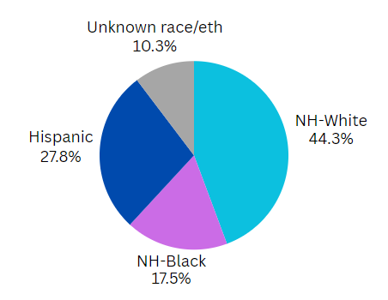
PATIENT CHARACTERISTICS
11,100 PP women
10% Spanish speaking
3% Creole speaking
5% III trimester PNC entry
2% No PNC
44% Medicaid
34% Cesarean
48% PP high risk
Notes:
Engagement? Data submission # hospitals and # babies received vs what we should have
% hospitals attending coaching calls

Slide 3
AIM
QI Outcome Measures
By 6/2024, FPQC participating hospitals will:
1. Increase % of patients with a 2-week PP visit scheduled prior to discharge by 20%
2. Increase patient PP education by 20%
Includes benefits of early PP visits, warning signs, and family planning

Slide 4
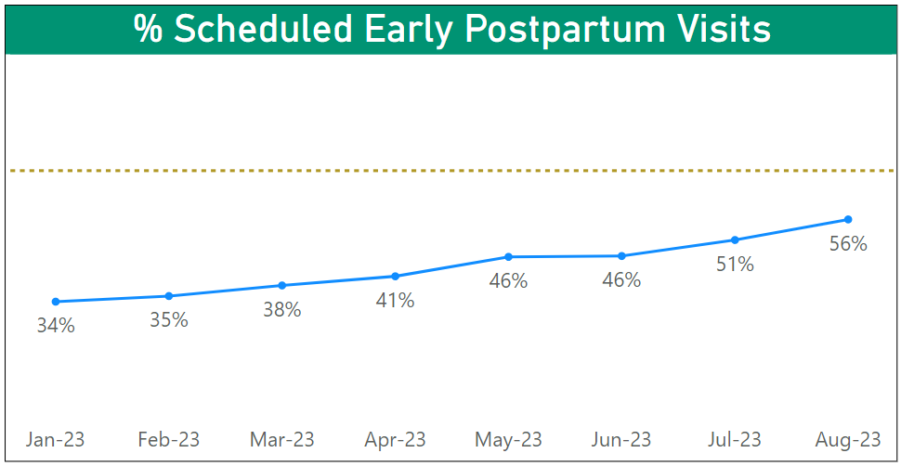
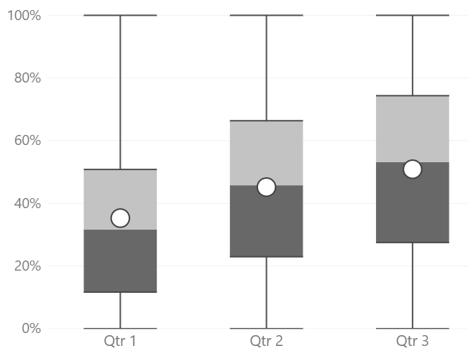
Early Postpartum Visits Scheduled Prior to Discharge
Goal: 70%
Scheduled Early PP Visits by PACC Hospitals

Slide 5
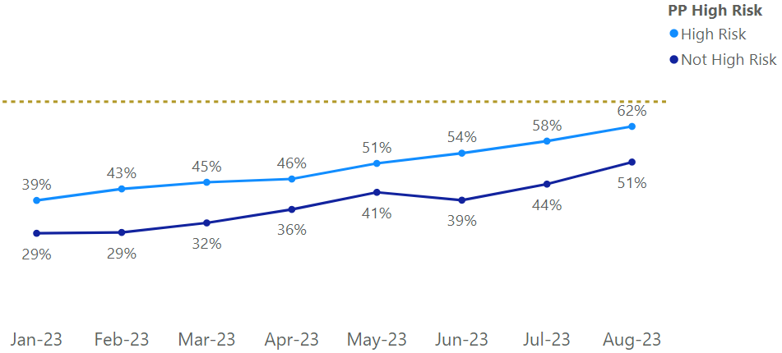
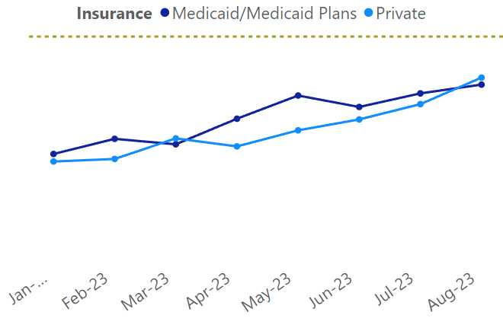
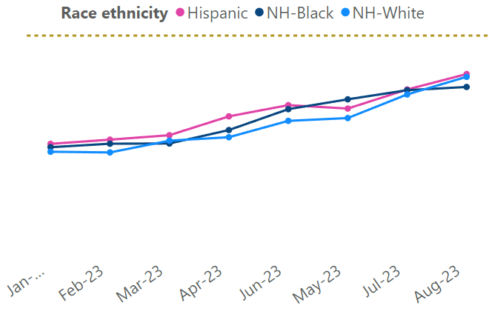
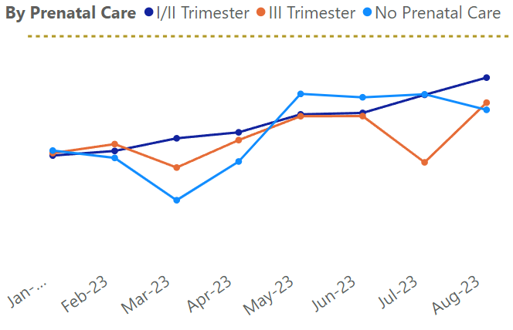
Early Postpartum Visits Scheduled Prior to Discharge

Slide 6
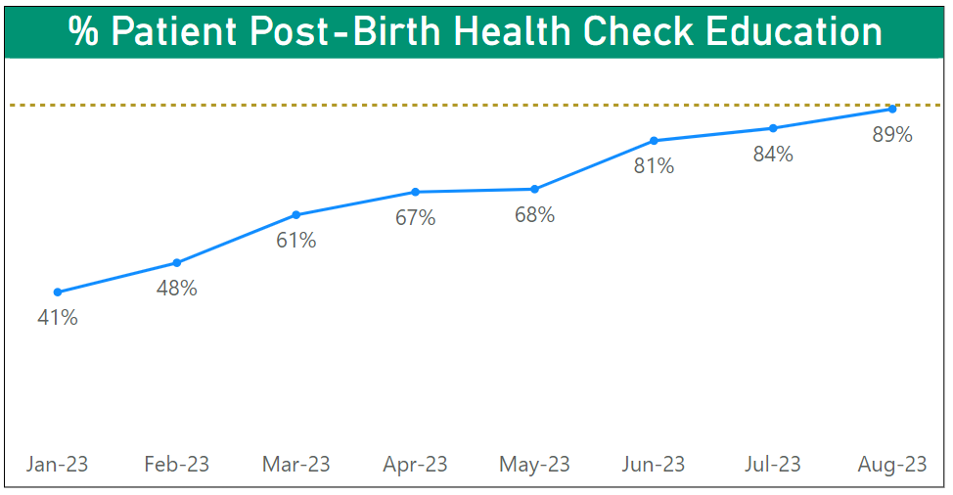
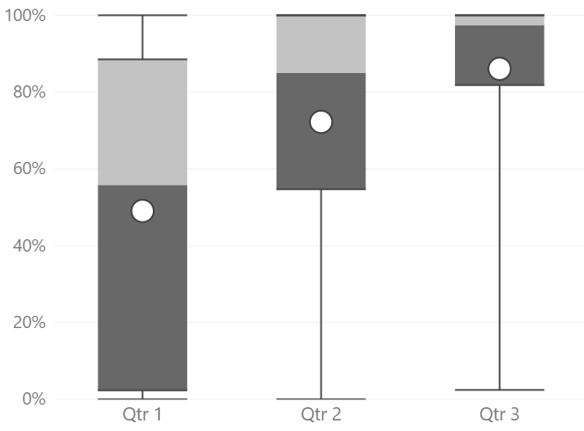
Patient Education on Importance of Early Postpartum Visit
Goal: 90%
Patient PBHE education by PACC Hospitals
Standardized care for all

Slide 7
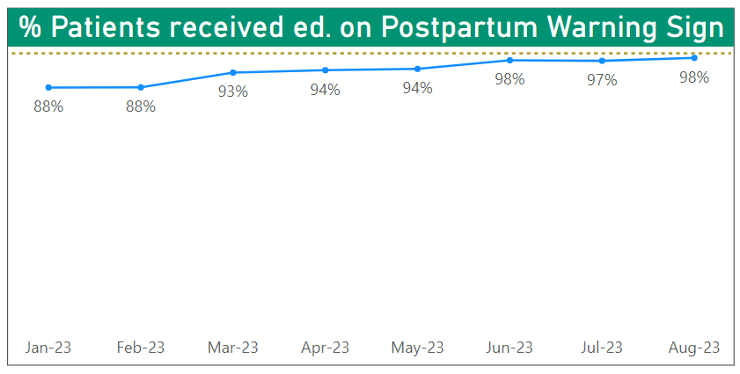
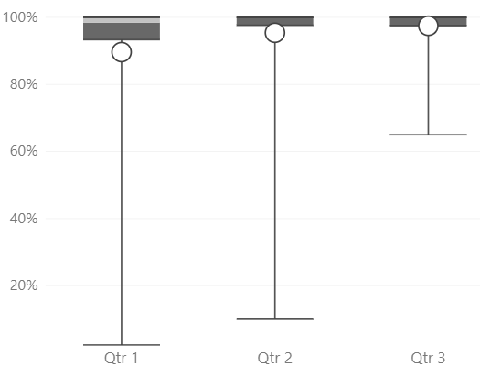
Postpartum Warning Signs
Goal: 100%
PP warning signs ed by PACC Hospitals
Standardized care for all

Slide 8
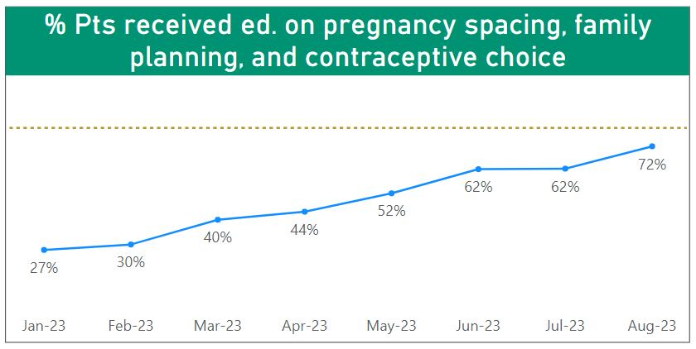
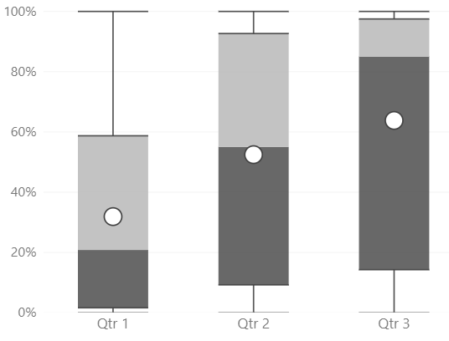
Education on pregnancy spacing, family planning, and contraceptive choice
Goal: 80%
Ed. on pregnancy spacing… by PACC Hospitals

Slide 9
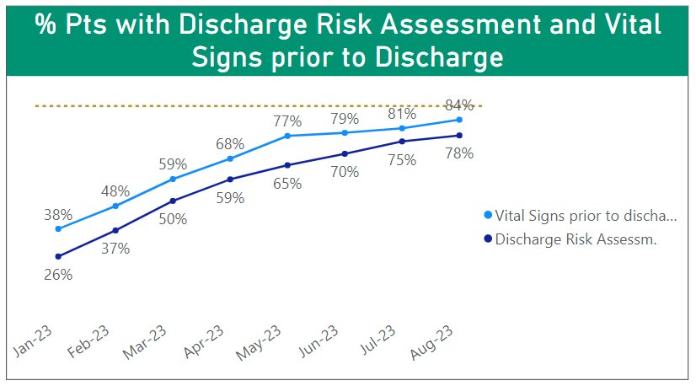
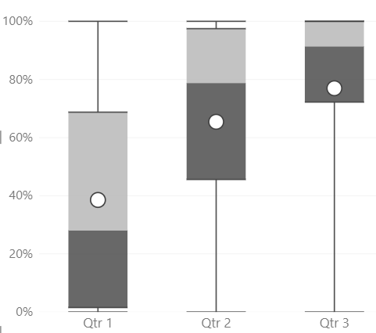
Maternal and Postpartum Discharge Assessment
Goal: 90%
Risk Assess. & VS by PACC Hospitals

Slide 10
HIGH RISK PATIENTS
 | % patients
Cesarean/3-4 degree vaginal laceration | 30.5%
Hypertension and cardiac issues | 16.3%
Other | 6.2%
Substance Abuse Disorder | 2.6%
Community services | 2.2%
Depression | 2%
Intimate partner violence | 0.5%
Venous Thromboembolism/Anticoagul | 0.5%
68% appropriately referred

Slide 11
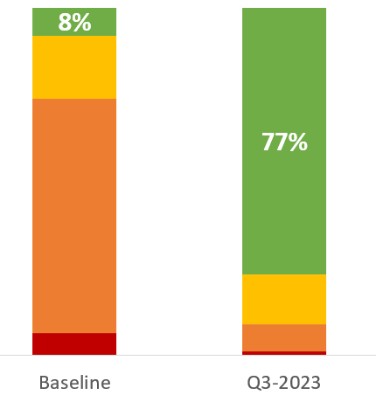
Aligned policies, guidelines, and/or procedures to support risk-appropriate PP visits/encounters prior to discharge

Slide 12
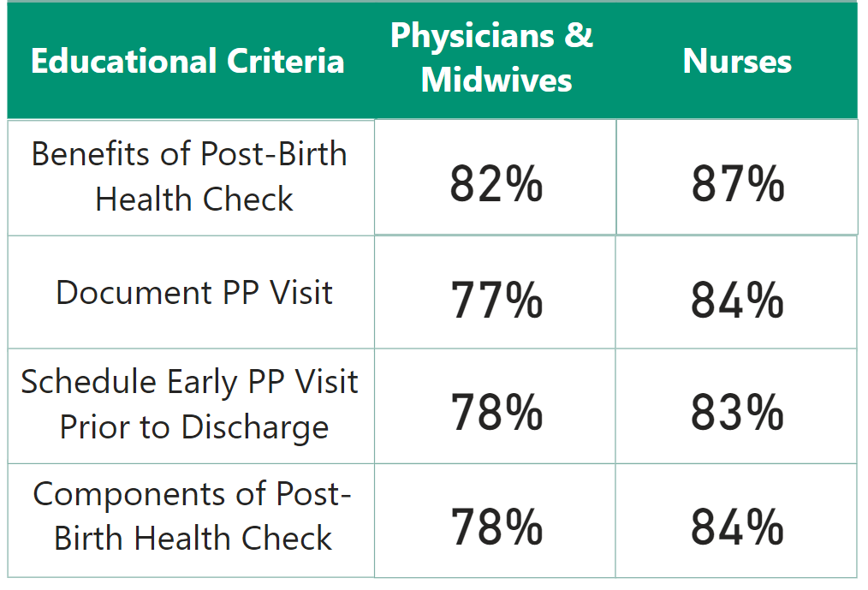
Staff and Provider PACC education

Slide 13
Education and engagement
67 hospitals developed a strategy to engage and educate inpatient providers and staff using initiative promotional and educational materials
56 hospitals developed a strategy to engage outpatient providers using initiative promotional materials and educate them on billing and coding for early PP visits
54 hospitals have implemented a strategy to educate new hires

Slide 14
Aim
Primary Key Drivers
By 6/2024, FPQC participating hospitals will:
Increase the % of patients with a 2-week PP visit scheduled prior to discharge by 20%*
Increase patient PP education by 20%*
Process for Maternal Discharge Risk Screening & Arranging Early Postpartum Visits
**Early PP visits scheduled for low-risk vaginal deliveries**
Comprehensive Postpartum Patient Discharge Education
**Education on pregnancy spacing, family planning, and contraceptive choice**
Clinician Postpartum Engagement and Education
**ER provider engagement and verbal screening**
Respectful care is a universal component of every driver & activity

Slide 15
QI MONTHLY CYCLE
Coaching Call
Submit Data
Review Data Report
Discuss and Disseminate Data Report
Identify opportunities *PDSA*
Coaching Call
QI REPORTS
Aim
Run Charts
Tracks Process, Structural and Outcome Measures
Add your PDSAs
Identify issues
PDSA
Submit Data
Disseminate and Discuss Data Report
Review Data Report

Slide 16
Questions?
erubio1@usf.edu
fpqc@usf.edu
www.fpqc.org
“To improve the health and health care of all Florida mothers & babies”

