Slide 1
Global AIM: Improve maternal health through hospital-facilitated continuum of postpartum care by coordinating and providing respectful, timely, and risk-appropriate coordinated care and services.
Primary Key Driver
Secondary Drivers
Develop a strategy to engage and educate inpatient and outpatient providers and staff using initiative promotional and education materials
Clinician Postpartum Engagement and Education
Plan in place to continue to engage and educate new hires
Develop a strategy to engage and educate ER physicians & staff about pregnancy/PP care including PP screening & care practices
Respectful care is a universal component of every driver & activity

Slide 2
Postpartum Discharge Pregnancy-Related Deaths with a Stand-Alone Postpartum ER Visit, Florida, 2015 to 2019
Days After Birth
Source: FL Maternal Mortality Review data

Slide 3
Postpartum ER Care—Mortality Prevention
ER care can prevent some postpartum deaths based on
Florida Maternal Mortality Review Findings
1.
2.
3.
Ask women ages 15-45 years if they have been pregnant in the past year?
If yes, add postpartum complications to your differential
Check for early postpartum warning signs and their medical problem list
3. Clinician PP Engagement & Education
4.
5.
6.
If needed, review postpartum checklist & management guidelines
If unsure, seek OB consultation early
If discharged, arrange referral and educate when to return

Slide 4
Postpartum ER Care—Mortality Prevention
Provider Educational Presentation
3. Clinician PP Engagement & Education

Slide 5
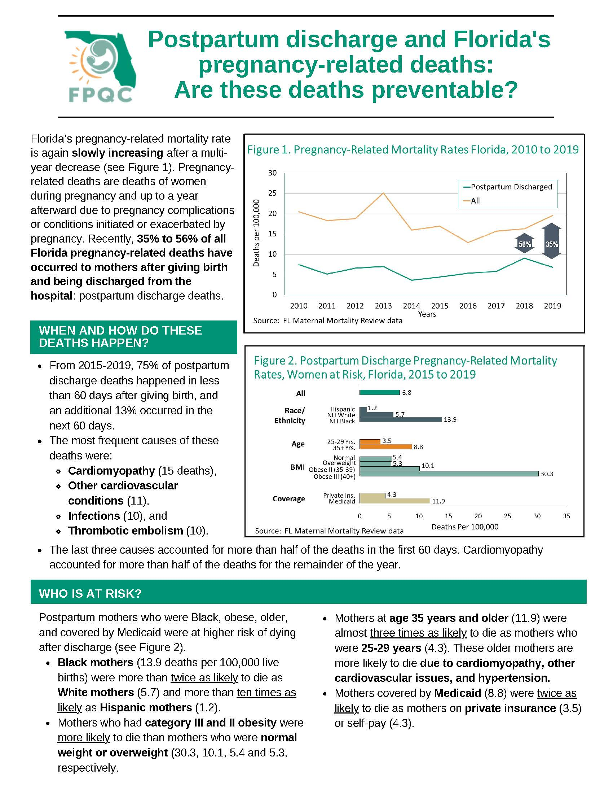
Postpartum Mortality Brief (For Providers)
3. Clinician PP Engagement & Education

Slide 6
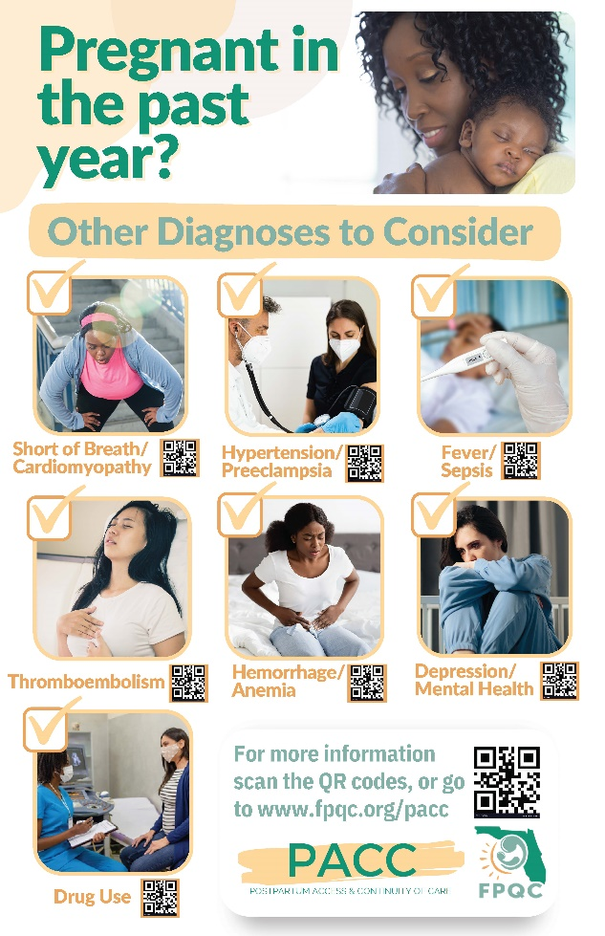
Postpartum ER Care—Mortality Prevention
Provider Educational Poster/Flyer:
Postpartum Checklist & Management Guidelines
3. Clinician PP Engagement & Education

Slide 7
Hypertension / Preeclampsia
Key Points
Stabilize and transfer if necessary.
Consider OB consultation.
Antihypertensive treatment should be started quickly for persistent acute-onset severe hypertension (SBP >160 mm Hg or DBP >110 mm Hg) that is confirmed as persistent (>15 mins.). Research suggests that treatment should be administered within 30–60 minutes.
Abnormal blood pressure range—140-159 systolic or >90 diastolic should require oral treatment.
Eclampsia is usually self-limiting. Magnesium sulfate is started to prevent recurring seizures.
Synopsis
Hypertensive disorders are a leading cause of maternal mortality and morbidity.
Includes Gestational Hypertension, Preeclampsia, Eclampsia, and Chronic Hypertension with Preeclampsia.
Distinguishing feature: proteinuria is a protein/creatinine ratio of 0.3 or more, a 24-hour urine protein of 300 mg/dl or more, or a urinalysis protein value of 1+ or more.
Preeclampsia with severe features includes one or more: unrelenting headache, visual disturbances, right upper quadrant pain, thrombocytopenia, elevated transaminases, elevated creatinine and pulmonary edema.

Slide 8
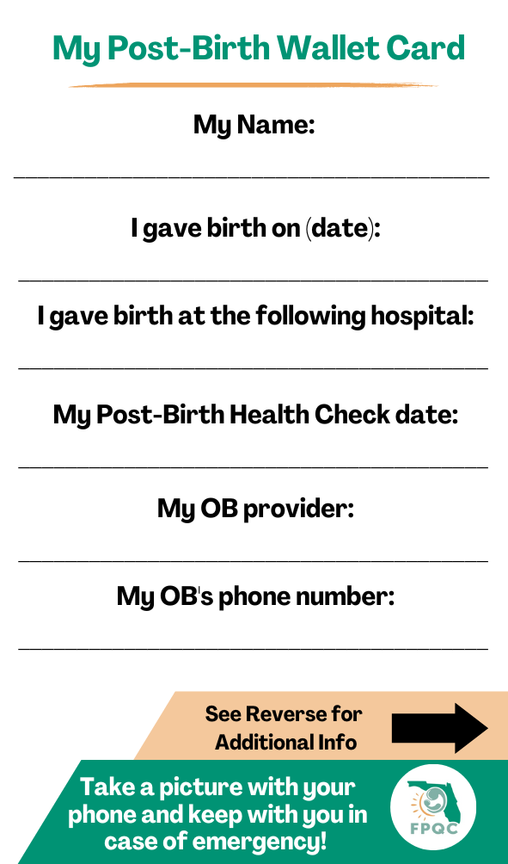
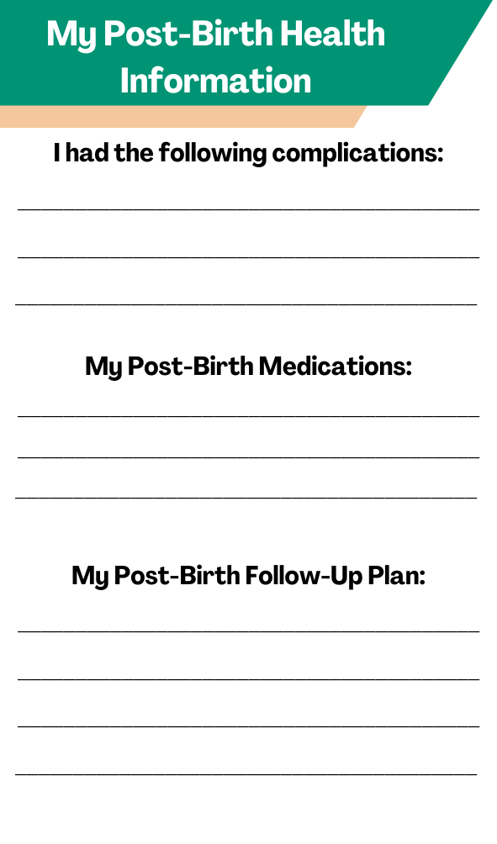
Postpartum ER Care—Mortality Prevention
Front
Back
Maternal Wallet Card
3. Clinician PP Engagement & Education

Slide 9
Questions?
wsappenf@usf.edu
fpqc@usf.edu
www.fpqc.org
“To improve the health and health care of all Florida mothers & babies”
Florida Perinatal Quality Collaborative
Florida Perinatal Quality Collaborative
@TheFPQC

