Slide 1
Nurse Driven Protocol for 2-week Post-Birth Health Check
Dr. Kimberly Fryer September 28, 2023

Slide 2
Post-Birth Health Check: Provider Offices
3. Clinician PP Engagement & Education

Slide 3
Post-Birth Health Check:
Scheduling 2 week Postpartum Visit
Did/does the patient have:
3rd or 4th degree vaginal laceration
C-section
Was seen in High Risk Generalists (schedule in HRG clinic) or Fellows clinic (route to MFM nursing for scheduling)
3. Clinician PP Engagement & Education
Nurses Schedule
No
Yes
Provider Visit
In-person visit with BP check
Yes
Did/does the patient have:
Preeclampsia or CHTN
Telehealth
No
Billing for nursing visit 99211 if in person or video-audio telehealth

Slide 4
Post-Birth Health Check:
Billing and Coding:
Nursing visit: 99211
3. Clinician PP Engagement & Education
Billing for nursing visit 99211 if in person or video-audio telehealth

Slide 5
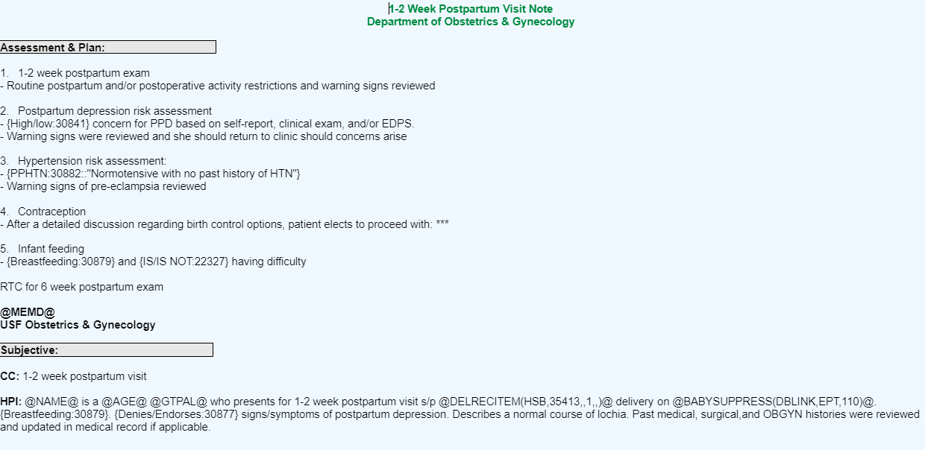
2 week post-birth check

Slide 6
Tips and Tricks from my nurses
Have protocol for high depression score (EPDS >10)
Safety measures for suicidal ideation
Referral to psych, OB visit, counseling
Can send depression scale ahead of time with MyChart or online portal
Electronically sent resource list for depression, breastfeeding, and birth spacing/contraception
Have point provider if any issues during visit

Slide 7
Questions?
fpqc@usf.edu
www.fpqc.org
“To improve the health and health care of all Florida mothers & babies”
Florida Perinatal Quality Collaborative
Florida Perinatal Quality Collaborative
@TheFPQC

