Slide 1
Postpartum Birth Check: Billing Strategies
Julie DeCesare, MD

Slide 2
The way to get started is to quit talking and begin doing.
Walt Disney

Slide 3
New billing and coding strategies are necessary to receive additional reimbursement for the early postpartum visit outside of the global obstetrical reimbursement

Slide 4
Objectives
Review overall importance of the post birth health check
Review Medicaid billing strategies
Review options for private pay patients

Slide 5
Why Early Postpartum Care?
50% of postpartum strokes occur within 10 days of discharge (Too G, et al, 2018)
20% of women discontinue breastfeeding before the first 6-weeks (Stuebe, et al, 2014)
Up to 40% of women do not attend the 6-week postpartum visit (ACOG CO #736 2018)
As many as 1 in 5 women experience a postpartum mental health disorder
Notes:
Suzanne to add citations
Stuebe AM, et. al. Prevalence and risk factors for early, undesired weaning attributed to lactation dysfunction. J Womens Health (Larchmt) 2014;23:404–12.
Martin A, et. al. Views of women and clinicians on postpartum preparation and recovery. Matern Child Health J 2014;18:707–13. 5.
Tully KP, et. al. The fourth trimester: a critical transition period with unmet maternal health needs. Am J Obstet Gynecol 2017;217:37–41.
Optimizing postpartum care. ACOG Committee Opinion No. 736. American College of Obstetricians and Gynecologists. Obstet Gynecol 2018;131:e140–50.
. Illinois Maternal Morbidity and Mortality Report. Illinois Department of Public Health. (October 2018)
Too G , Went T , Boehme AK , Miller EC , Leffert LR , Attenello FJ , et al. Timing and Risk Factors of Postpartum Stroke . Obstet Gynecol 2018

Slide 6
Around the world..
In Denmark, a midwife will call the day after discharge, and then an at-home health visitor will come to the house within 4 to 5 days.
In the Netherlands and Belgium, new mothers will have a kraamverzorgster, a maternity nurse who comes to the home to provide a minimum of 24 hours of care within the first 8 days after discharge
For Swedish mothers, breastfeeding counseling is covered by insurance and midwives conduct as many home visits as needed within the first 4 days after delivery
France offers in-home postpartum care and all birthing parents automatically receive a referral for pelvic floor therapy

Slide 7
Illinois Data to support Postpartum Birth Check…
~In Illinois, 24% of pregnancy-associated deaths occurred 0-42 days postpartum -the period before the traditional 6-week postpartum visit
~50% of postpartum strokes occur within 10 days of discharge
~20% of women discontinued breastfeeding before the first six weeks
~Up to 40% of women do not attend the 6-week postpartum visit
~As many as 1 in 5 women experience a postpartum mental health disorder

Slide 8
The Florida Context…

Slide 9
Florida Maternal Mortality Review Data from 2015 - 2019
~67% of postpartum pregnancy-related deaths are moderately or substantially preventable
~75% of postpartum deaths occur within 60 days of discharge
~One-third of postpartum deaths occur to women with a visit to the ER before their demise

Slide 10
Medicaid
Florida Medicaid is mostly fee-for-service and most Florida Medicaid Health Plans are fee-for-service only: billing for an additional postpartum visit(s) should not be an issue
Aetna and Molina are predominantly global reimbursement with some exceptions. Humana does some global obstetrical reimbursement, but does more fee-for-service

Slide 11
Global Reimbursement Options
Bill outside the global obstetrical package
End the global package early
Schedule the 6-week postpartum visit after the global period
Trade an antepartum visit for a postpartum visit

Slide 12
Bill outside the global obstetrical package
An early postpartum visit can be billed without a pregnancy diagnosis using CPT Evaluation and Management (E/M) codes 99211-99215.
Append modifier 24 to the E/M code indicating care is provided outside of the global obstetrical reimbursement package and link the E/M code to an appropriate ICD-10 code for the visit diagnosis
O86.01 Infection of obstetric surgical wound, superficial incisional site
O14.05 Mild to moderate pre-eclampsia
Patient may incur a co-pay

Slide 13
End the global package early
Bill the early postpartum visit (Post-Birth Health Check) serve as the comprehensive postpartum visit using E/M code 0503F.
Schedule the second postpartum visit as a well-women/annual exam using CPT Evaluation and Management (E/M) codes 99393-99397
Reimbursement will depend on whether the global ends based on this visit type or a specified timeframe after delivery

Slide 14
Schedule the 6-week postpartum visit after the global period
Have the early postpartum visit (Post-Birth Health Check) serve as the comprehensive postpartum visit using E/M code 0503F
Schedule the second postpartum visit as a well-women/annual exam using CPT Evaluation and Management (E/M) codes 99393-99397 after the global ends (e.g., 7 weeks)
The timeframe for the global period is different for different health plans or may be different for vaginal versus cesarean deliveries

Slide 15
Trade an antepartum visit for a postpartum
Reduce the number of antepartum visits by one allowing for an even swap with a new 2-week postpartum visit for low medical and social risk patients
The 2-week postpartum visit can be billed as a 99024 (post-op visit/no charge) and the 6-week visit as comprehensive postpartum visit using E/M code 0503F
All visits would be included in the global obstetrical reimbursement package. This does not increase the number of visits and provides equal reimbursement

Slide 16
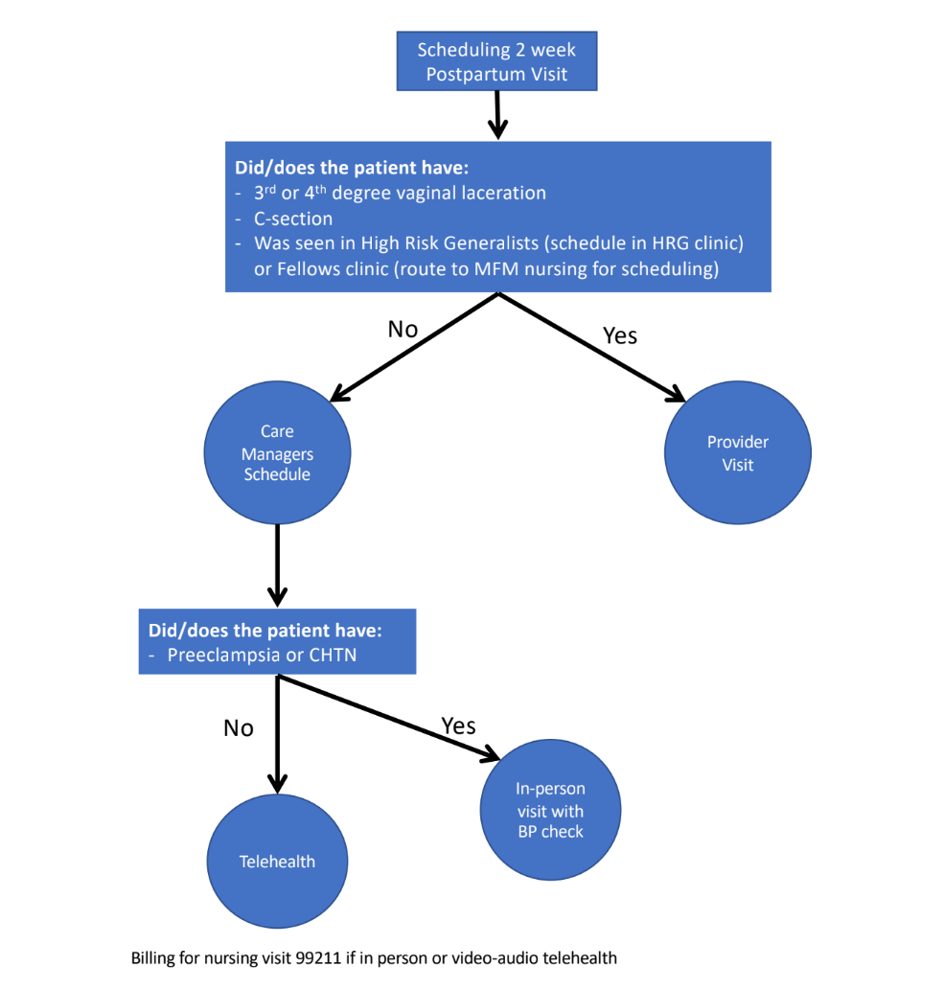
Consider alternates to traditional PP Visits

Slide 17
Questions?

