Slide 1
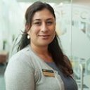
Maintaining milk supply
Mother’s Own Milk in the NICU Initiative
Ivonne Hernandez PhD, RN, IBCLC
Florida Perinatal Quality Collaborative Nurse Consultant

Slide 2
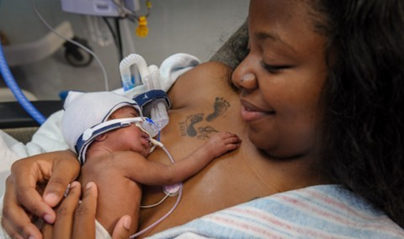
The Start…Initiation & Establishing Milk Supply
Prenatal education
First Pumping session ≤ 6 hours of delivery of infant
Hospital grade pumps at discharge
Follow up of 24 hour expressed milk volume (≥ 500 ml)
7, 14, & 28 DOL
Personal maximum milk making capacity ☺
Skin to skin by DOL 10
Daily skin to skin
Plan sessions (60 mins)
Celebrate Kangaroo awareness month this May!

Slide 3
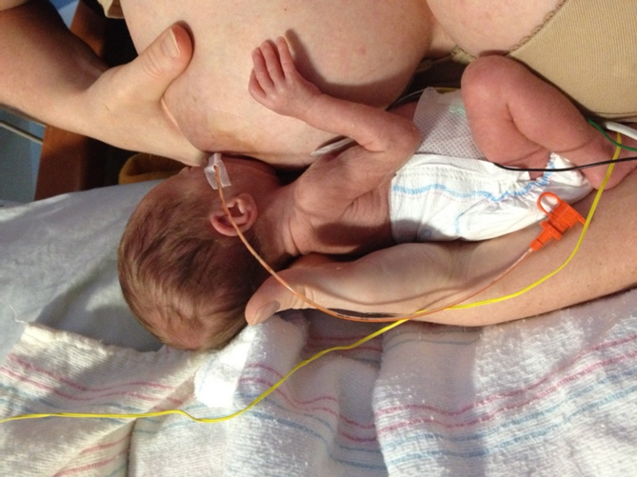
Supporting Milk Supply dol 28 & Beyond
Encourage and facilitate bedside visitation
Incorporate family into daily care of infant
Non-nutritive suckling at the breast (Practice breastfeeding)
Licking or suckling at the breast are wins!
Observe as suckling patterns mature
First oral feeding at the breast
Plan feedings with parents
Reserve the first three oral feeding at the breast
Use of test weights (pre/post feeding)
Weight gain patterns
Infant progress to advance feedings

Slide 4
Lifestyle and maintaining milk supply
Storage of expressed MOM
Containers for storage & transport
Pumping & LIFE
Plan pumping sessions to meet or exceed 500 ml per 24 hours
Extra pump kits for night sessions
Consume additional water after evening pumping sessions
Hands free pumping https://kellymom.com/bf/pumpingmoms/pumping/hands-free-pumping/

Slide 5
Lifestyle and maintaining milk supply
Back to work
Medical necessity letter
WomensHealth.gov LINK

Slide 6
Lifestyle and maintaining milk supply
Support Groups
Use existing classes
Craft making activities
Peer support
Invite WIC & Healthy Start Programs staff to facilitate groups
Trouble shooting
Competing demands
Pumping is hard work and time intensive!

Slide 7
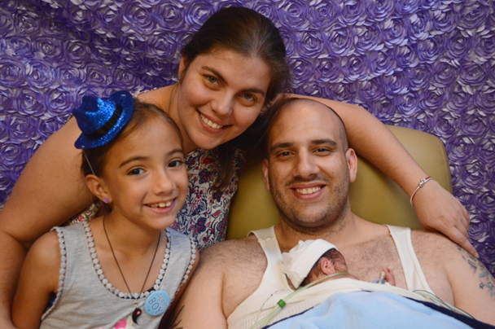
Parents Resources
http://health.usf.edu/publichealth/chiles/fpqc/momresources

Slide 8
Keep up the great work!
Contact info: ihernand@health.usf.edu

