Slide 1
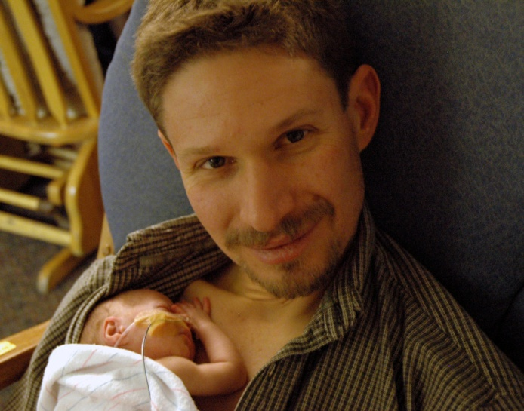
PAIRED Coaching Calls
Samarth Shukla, MD
PAIRED Clinical Co-Lead

Slide 2
What are coaching calls?
Brainstorming sessions
Great place to discuss barriers and challenges
Share successes with other units
Briefly review statewide data from all the units
Sharing updates
Experts/Family representative consultations
Experiences from pilot initiative

Slide 3
Coaching call logistics
Includes: Representatives from all participating centers, FPQC project leads, FPQC data and QI analysts and PAIRED family representatives
Schedule for coaching calls
1-hour sessions, once a month
Three groups due to the large number of participating centers
Agenda for the session/topics of discussion will be sent out
All centers are expected to attend and participate

