Slide 1
Health Care Disparities:
The What … Why… and How
USF GME Program Director Workshop
January 25-26, 2018
Cathy D. Meade, PhD, RN, FAAN
Moffitt Cancer Center
Population Science, Health Outcomes & Behavior
Tampa, FL
Shirley Smith, MA
Director, Student Diversity and Enrichment
USF Health, College of Medicine
Tampa, FL

Slide 2
Objectives
Highlight the value of addressing health disparities in the clinical learning environment (CLE).
Identify opportunities within the CLE for improving health care quality by reducing health disparities.
Generate listing of learning needs about health disparities to enhance GME.

Slide 3
Story from the field. A senior ER resident in a large hospital

Slide 4
What’s the Context for Today?
ACGME established CLER (Clinical Learning Environment Review Program) to provide feedback for GME leaders and executive leadership of CLEs on areas of focus: patient safety, health care quality, care transitions, supervision, duty hours/fatigue management and mitigation, and professionalism.
Health Disparities is a key aspect of these foci.
National 2016 Report of Findings (297 site visits).
Local 2017 CLER site visit.

Slide 5
Some key highlights
Only 30% of CLEs had some type of training in cultural competency that was tailored to the population they serve (mostly generic).
A median of 60% of the residents and fellows interviewed reported knowing their CLE’s priorities in the area of health care disparities.
Uncommon to collect, analyze, and disseminate data and information that would help residents/fellows/faculty members understand the degree of health care disparity experienced by populations served by the CLE.
(2016 National Report of Findings)

Slide 6
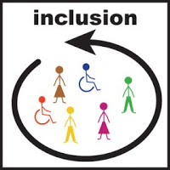
U.S. Healthcare System Maze
Language/linguistics
Transportation
Employment/
Loss Wages
Problems with Scheduling
Location of Facility
Fear
Literacy
Race/
ethnicity
Perceptions & Beliefs
Disability
Insurance
Child/Adult Care
Communications
With providers
Comorbidities
Geography

Slide 7
Why? Our Changing Landscape: Language, Literacy, and Culture
Rapidly changing demographics.
Culture – Blending of many backgrounds.
Health care system demands are steep
Scientific advancements
Reducing health disparities advances health equity and moves us toward a social justice framework
Sources: IOM reports; PEW Hispanic Report; US Census; Kleinman, 1978)
Notes:
Poor communication can lead to reduced access to needed services and poorer outcomes Communication difficulties
With physicians
Describing their symptoms
Understanding instructions/recommendations
Reading prescriptions
Navigating the health system

Slide 8
What is Health Equity?
Health equity is the “attainment of the highest level of health for all people. Achieving health equity requires valuing everyone equally with focused and ongoing societal efforts to address avoidable inequalities, historical and contemporary injustices, and the elimination of health and health care disparities.”
(Healthy People 2020)

Slide 9
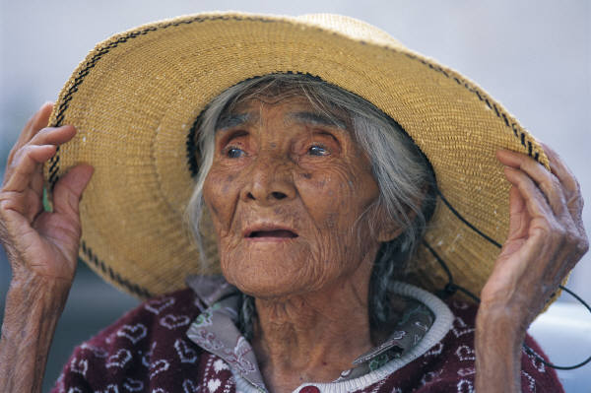
What are Health Disparities?
Although the term disparities is often interpreted to mean racial or ethnic disparities, many dimensions of disparities exist, particularly in the health care arena. If a health outcome is seen to a greater or lesser extent between populations, there is disparity.

Slide 10
For example . . .
Geography = Rural Appalachian, diagnosed later stages = cervical cancer.
Low SES / Medically Underserved - reduced access, limited literacy, transportation factors.
African American, AIAN, Hispanic/Latino = higher cancer rates, higher mortality.
Disparities by cancer type (Asian Americans - more cancers of infectious origin, e.g., hepatitis B virus-induced liver cancer, and stomach cancer.
Disparities by sexual orientation (HIV-infected MSM have higher rates anal cancer).

Slide 11
Patients’ Explanatory Models - Worldview
Kleinman describes the health care system as one that is both social and cultural. It consists of external & internal factors
Worldview
The Explanatory Model:
What do you call the problem?
What do you think caused it?
What do you fear the most?
Culture, illness and care: Clinical lessons from Anthropological and Cross Cultural Research (Kleinman, 1978)

Slide 12
Health Disparities
No single cause
. . . No single solution
Many factors contribute to positive health outcomes, quality, & good use of health care systems.

Slide 13
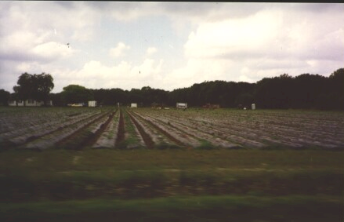
Many Factors Influence Health
Social determinants (SD) are conditions in which people are born, grow, live, work and age. These circumstances are shaped by the distribution of money, power and resources at global, national and local levels.
SD are mostly responsible for health inequities - the unfair and avoidable differences in health status seen within and between countries.
http://www.who.int/social_determinants/sdh_definition/en/

Slide 14
INTERSECTIONALITY
“Intersectionality is a way of understanding and analyzing the complexity in the world, in people, and in human experiences.
When it comes to social inequality, people’s lives and the organization of power in a given society are better understood as being shaped not only by a single axis of social division, be it race or gender or class, but by many axes that work synergistically together and influence each other.
(Collins, P. H., and S. Blige. 2016. Intersectionality. Malden, MA: Polity Press)

Slide 15
For example…
Race/ethnicity, gender, sexual identity, age, disability, socioeconomic status, geographic location ‘place’, and literacy.
Other powerful, complex relationships also exist between health and biology, genetics, and individual behavior, as well as between health and health services, the physical environment (clean air/non-polluted water,
Affordable, reliable transportation, high quality education, decent and safe housing, discrimination, racism, and legislative policies.
Intersectionality

Slide 16
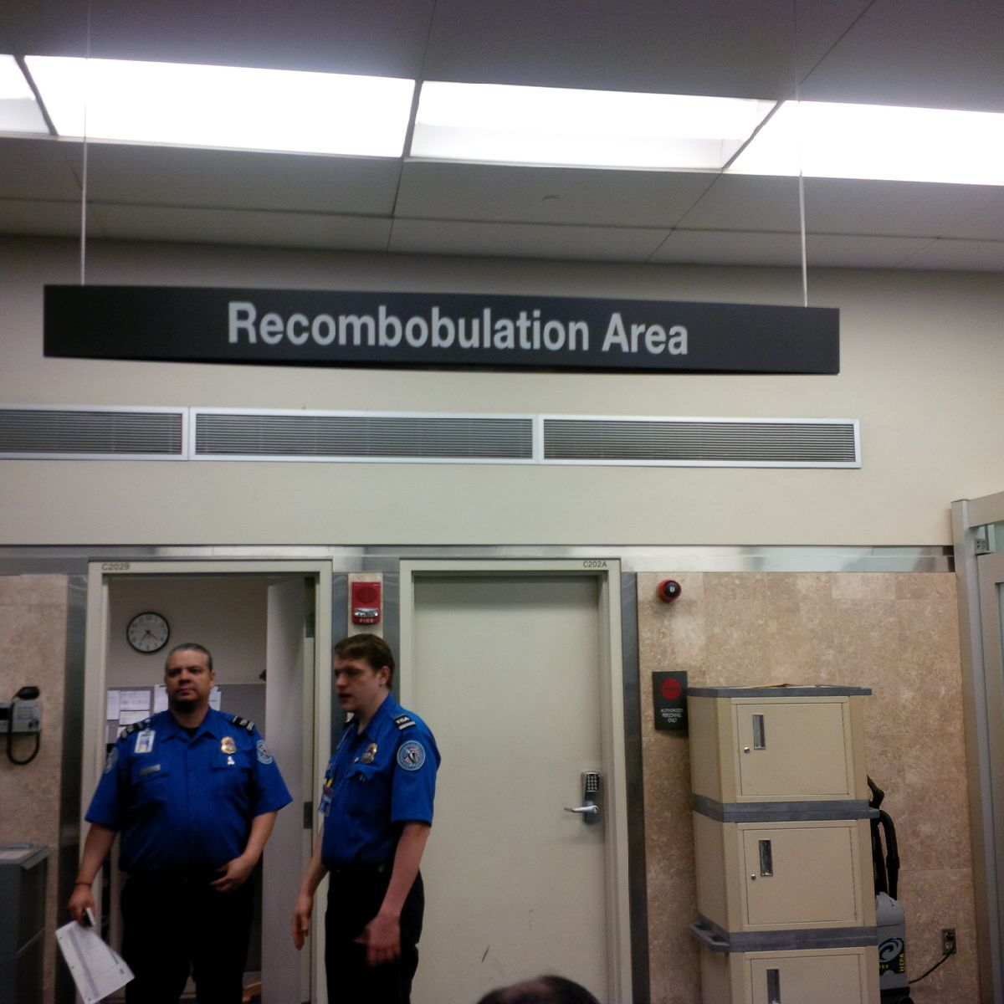
Literacy
Literacy: the degree to which an individual has the capacity to obtain, communicate, process, understand basic health information and services to make decisions (CDC).

Slide 17
Who is at risk for
low health literacy?
Anyone who enters the culture of healthcare and research!

Slide 18
Levels of Health Literacy
Critical
Cognitive & social skills to critically analyze everyday information.
More advanced cognitive and interactive skills to extract information.
Transmission of basic health facts.
Interactive
Basic/functional
Sources: Mogford et al., 2010; Chinn 2011; Nutbeam 2000, Sorensen et al., 2012, Inoue et all, 2013

Slide 19
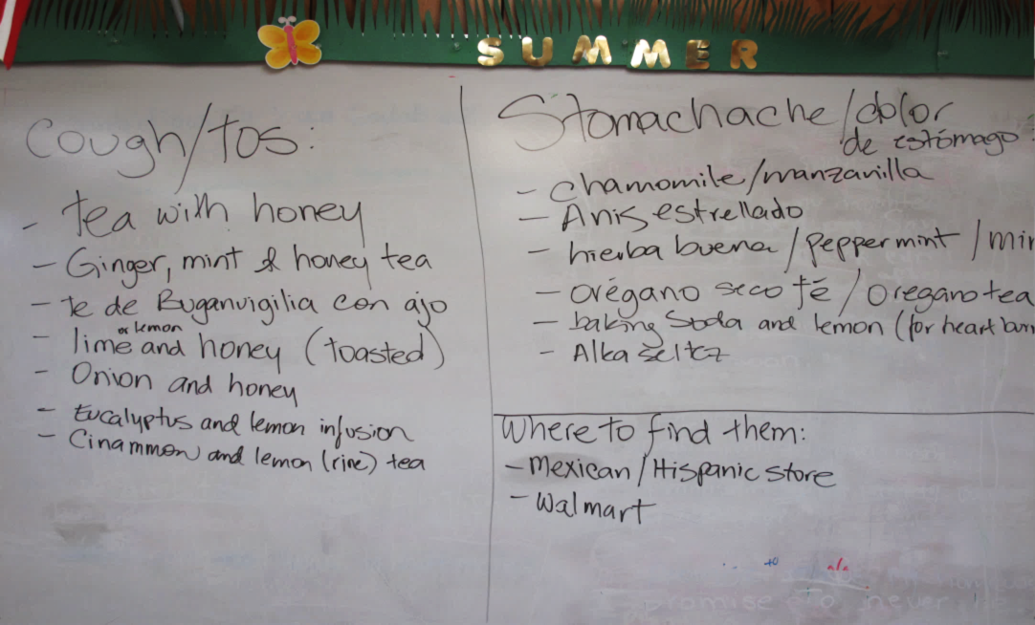
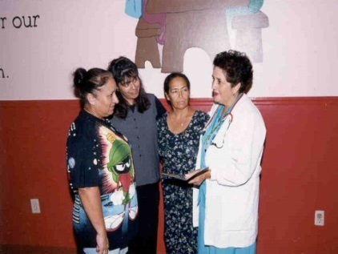
Clinical Cultural Competency
Being aware of social and cultural factors that impact health beliefs and behaviors.
Assessing how to address factors that affect patients and families.
Having tools and skills to empower patients and families.
Negotiating patients’ ethno-cultural beliefs and practices and those of the culture of biomedicine.
(Betancourt, Green and Carillo et al 2002)

Slide 20
Dr. Harold Freeman . . .
“The existence of health disparities is not just a scientific and medical issue but a moral and ethical issue.”
The concept of patient navigation was founded and pioneered by Harold P. Freeman in 1990 for the purpose of eliminating barriers to timely cancer screening, diagnosis, treatment, and supportive care.

Slide 21
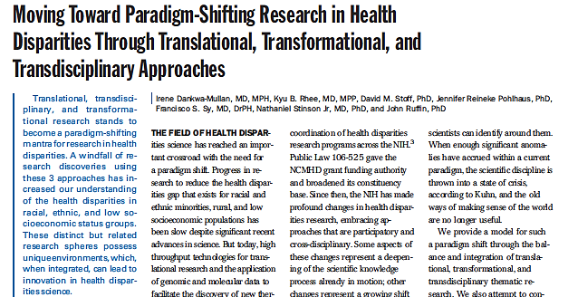
Dawarka-Mullan et al., 2010 America Journal of Public Health

Slide 22
But how?
What are the clinical site’s priorities with regard to addressing HD?
How is GME integrated into an organization’s strategic planning and focus relating to HD?
How accessible and available are cultural competency training and resources?
What opportunities exist for residents/fellows to become engaged in health care quality, patient safety, and other systems-based initiatives.
How can they be supported? (time)

Slide 23
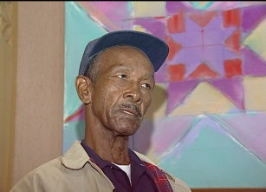
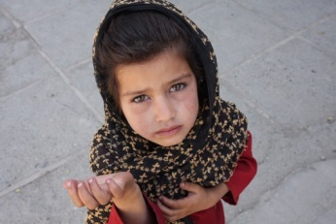
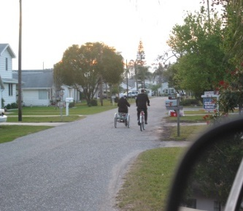
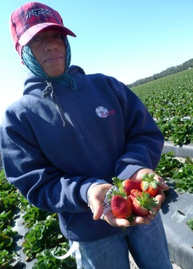
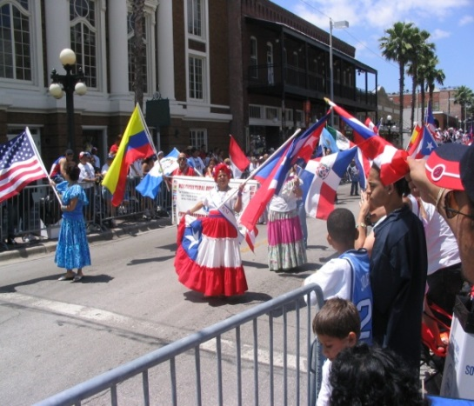
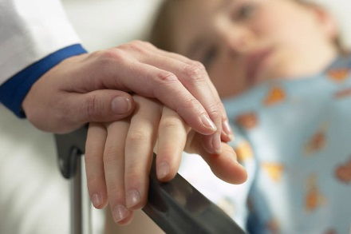
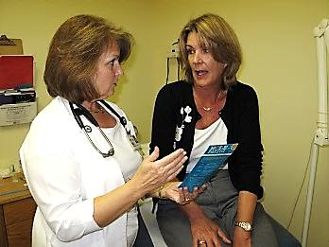
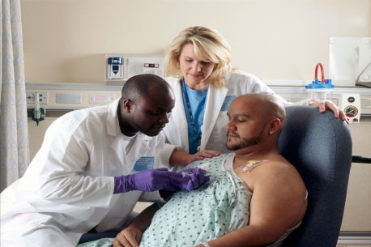
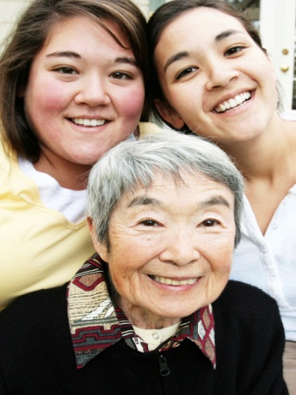
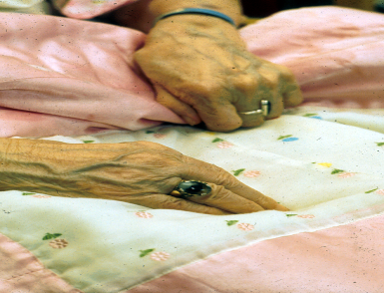
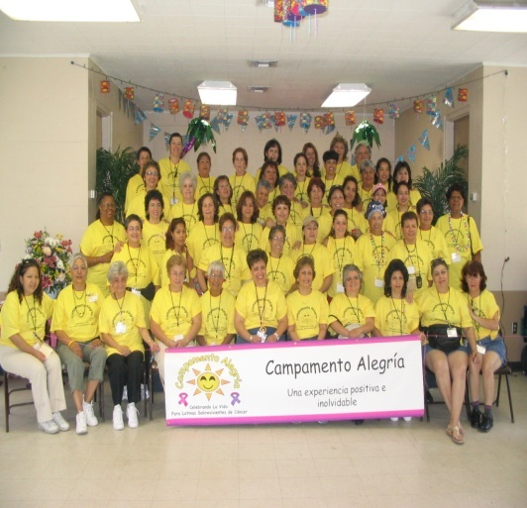
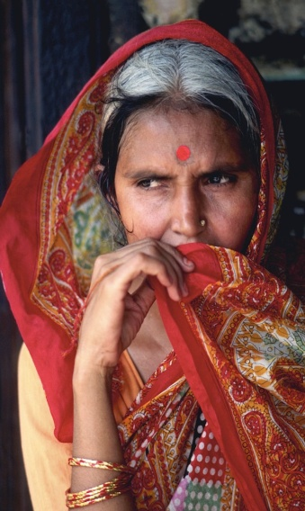
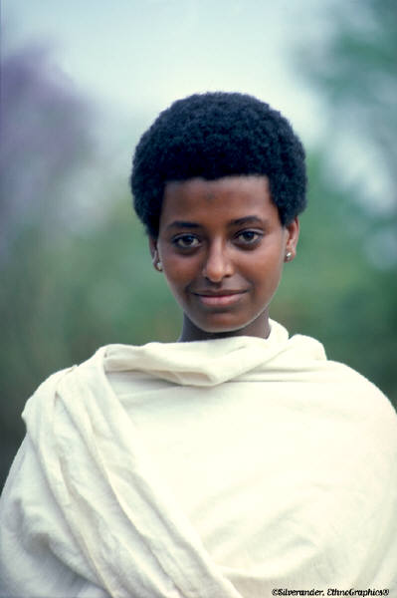
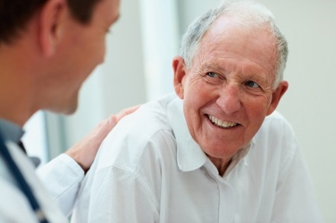
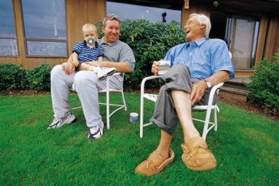
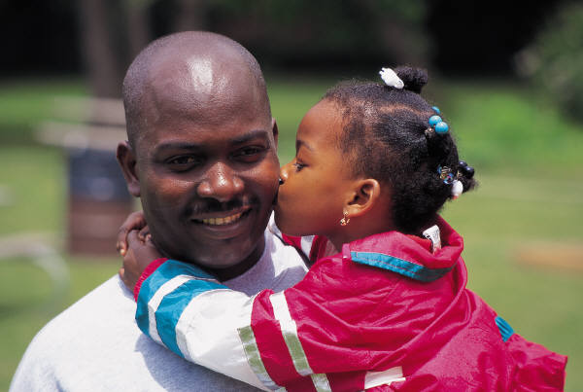
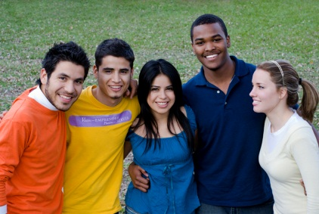
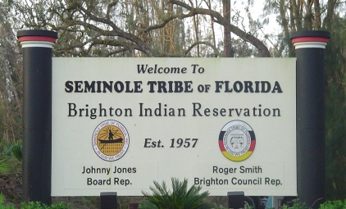
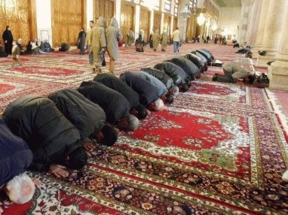
Who seeks care at your CLE’s?
Notes:
23

Slide 24
Tampa
Race: White (Non-Hispanic/Latino) – 64%; African American 26%; Asian 4%; American Indians: 0.8% Mixed/other race 6%;Hawaiians 0.8%.
Ethnicity: Hispanic/Latino origin 23%;
About 18% speak Spanish.

Slide 25
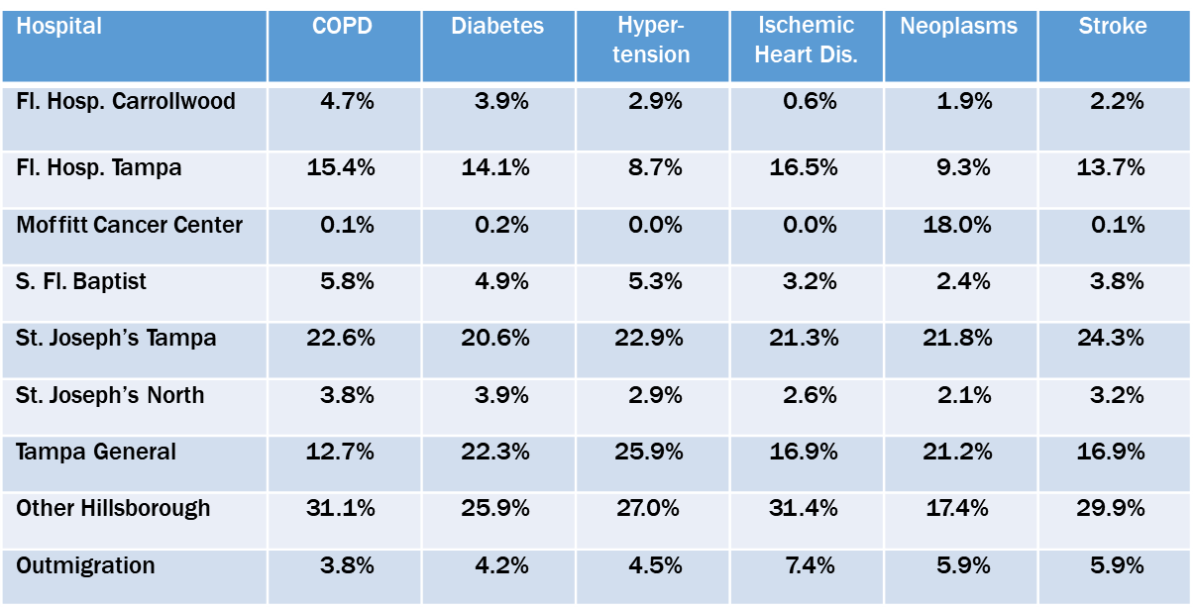
CLE - TGH
TGH is the hospital of choice for individuals suffering from hypertension and a top choice for patients with neoplasms and diabetes.
Source: Florida Agency for Health Care Administration Inpatient Discharge Database and Legacy Consulting Group

Slide 26
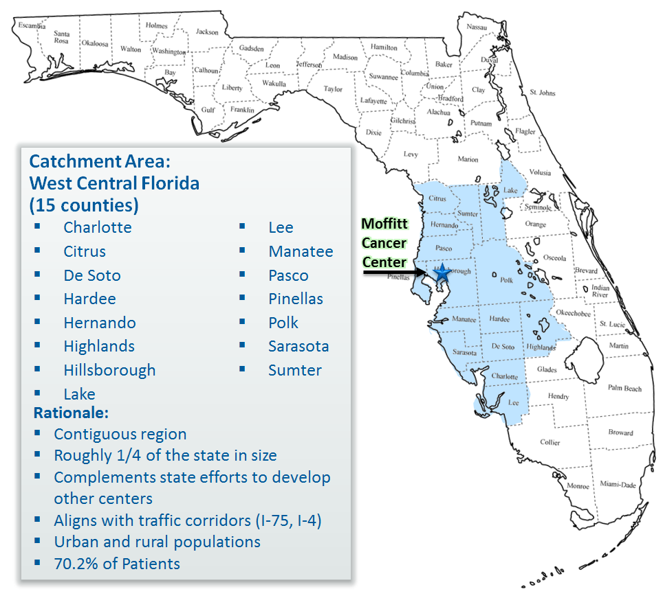
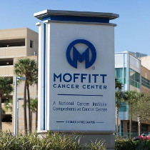
CLE - Moffitt

Slide 27
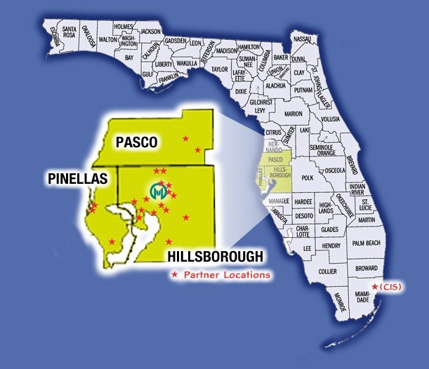
Tampa Bay Community
Cancer Network
What is TBCCN?
A network of 28 community partner organizations that works collaboratively to reduce the cancer burden among medically underserved populations in a tri-county area:
Education/Outreach
Training in CBPR
Research
U01 CA114627
2005-2017 (Meade-PI)
U54 CA153509
2010-present (Meade/Gwede MPI)
Notes:
27
The H. Lee Moffitt Cancer Center & Research Institute at the University of South Florida, in collaboration with local community-based heath centers, social service agencies, faith based groups, adult education and literacy groups, and local media, has formed the Tampa Bay Community Cancer Network.

Slide 28
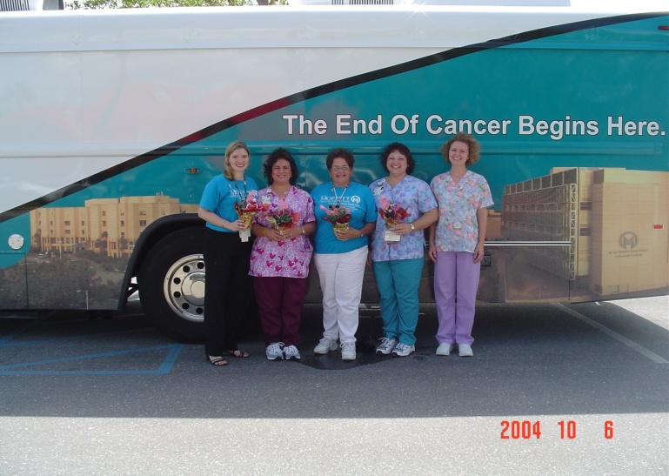
In the beginning . . .
Suncoast
FQHC
Rural &
Hispanic
Farmworkers
Moffitt
AVON

Slide 29
Now . . .
LUNA
Multicultural
Resource
Center
ACS
Morton
Plant
Mease
Leukemia &
Lymphoma
Society
HOPE
CDC
Sistahs
Surviving
Breast Cancer
AHEC
USF
Saint Leo
College
Tampa
Family
Health
Center
Pasco County Health Dept.
NCI
Haitian
Association
Foundation
Pinellas County Health Dept.
Medically
Underserved
MOFFITT
Star
Foundation
Faces of
Courage
Workforce Institute
Farmworkers
Self-Help
Premier
Health
Center
University
Area
CDC
Komen
Catholic
Charities
Hillsborough
County
Health
Dept.
Sanderlin
Family
Center
Tampa Bay
Healthcare
Collaborative
JWest
Prostate
Foundation
Community Foundation of Tampa Bay
Front
Porch
Community
. . . and growing

Slide 30
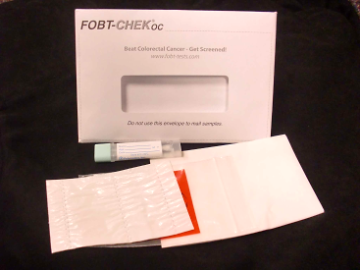
Colorectal Cancer (CRC)
What was the community concern?
‘Hard to obtain colon tests’ – colonoscopies are expensive.
CRC is one of the leading cause of cancer death in the US
CRCS tests are underutilized among patients in FQHCs.
What did we do?
CARES PROJECT: Colorectal Awareness,
Research, Education and Screening Project
Introduced IFOBT to clinics and patients.

Slide 31
What was the Result?
RCT Completed
(N=416 evaluable)
B
A
S
E
L
I
N
E
R
A
N
D
O
M
I
Z
E
CARES Intervention (photonovella DVD/booklet) + mailed reminders (N=210)
Standard CDC brochure + mailed reminders (N=210)
On Study
12 Months
Free Fecal Immunochemical Test (FIT); and Assessments
Hypothesis: CARES intervention > SI in screening efficacy (uptake and adherence of FIT and overall screening

Slide 32
Gwede . . . Meade, 2017

Slide 33
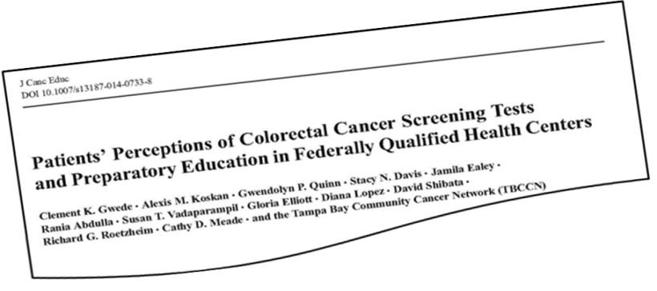
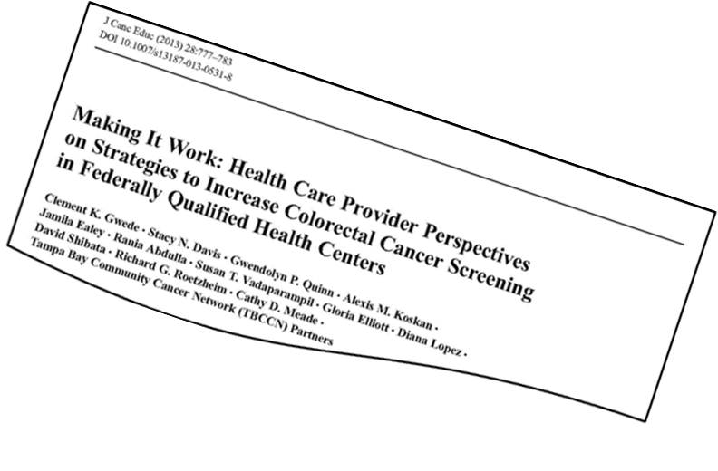
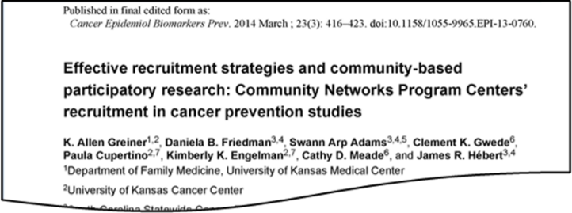
What did this lead to?
Other Studies
Latinos Cares -
Prevention Research Center –
Community Cares - Multi-level-dual language RCT
focused on ‘repeat’
screening. (Bankhead Coley)
Publications
Community Clinical Benefit
Introduced FIT screening to clinics
Clinic adoption of FIT
UDS and HEDIS/QA benchmarks

Slide 34
IOM – Unequal Treatment Confronting Racial and Ethnic Disparities in Health Care
Notes:
Congress, in 1999, requested an IOM study to assess the extent of disparities in the types and quality of health services received by U.S. racial and ethnic minorities and non-minorities; explore factors that may contribute to inequities in care; and recommend policies and practices to eliminate these inequities.
The report from that study, Unequal Treatment: Confronting Racial and Ethnic Disparities in Health Care, found that a consistent body of research demonstrates significant variation in the rates of medical procedures by race, even when insurance status, income, age, and severity of conditions are comparable. This research indicates that U.S. racial and ethnic minorities are less likely to receive even routine medical procedures and experience a lower quality of health services.

Slide 35
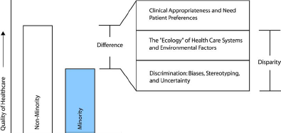
IOM– Unequal Treatment Confronting Racial and Ethnic Disparities in Health Care
Differences, Disparities, and Discrimination: Populations with Equal Access to Healthcare. SOURCE: Gomes and McGuire, 2001

Slide 36
Blindspot – Hidden Biases of Good People

Slide 37
Health Care Quality – HP Pathways
Notes:
HQ 5 – education on reducing health care disparities – shared mental model with regards to health care quality – to achieve a true patient centered approach
HQ 6 -

Slide 38
HQ Pathway 5: Resident/fellow and faculty member education on reducing health care disparities
Formal educational activities that create a shared mental model with regard to health care quality-related goals, tools, and techniques are necessary for health care professionals to consistently work in a well-coordinated manner to achieve a true patient-centered approach that considers the variety of circumstances and needs of individual patients
Notes:
The focus will be on the extent to which individuals receive education on the clinical site’s priorities and goals for addressing health care disparities in its patient population.
The focus will be on the extent to which individuals receive training in cultural competency relevant to the patient population served by the clinical site
The focus will be on the proportion of individuals able to describe the site-specific priorities for addressing health care disparities, and the proportion that are aware of the clinical site’s progress in meeting its goals to address the priorities.
.

Slide 39
Properties include:
Residents/fellows and faculty members receive education on identifying and reducing health care disparities relevant to the patient population served by the clinical site.
Residents/fellows and faculty members receive training in cultural competency relevant to the patient population served by the clinical site.
Residents/fellows and faculty members know the clinical site’s priorities for addressing health care disparities.

Slide 40
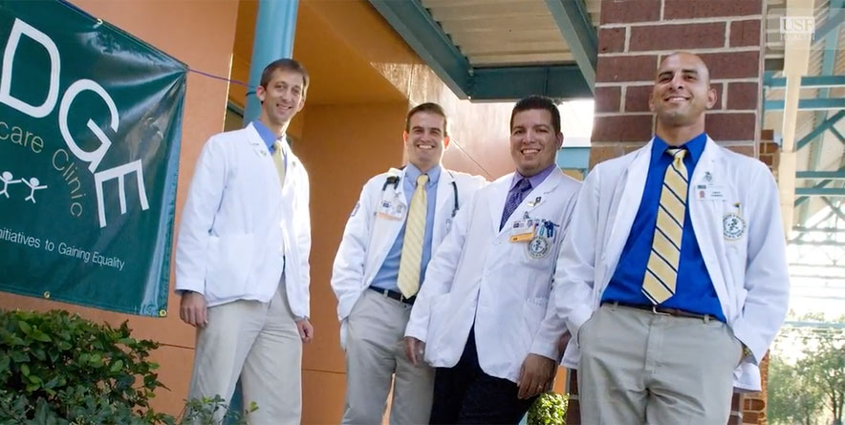
HQ Pathway 6: Resident/fellow engagement in clinical site initiatives to address health care disparities
Experiential learning is essential to developing the ability to identify and institute sustainable systems-based changes to address health care disparities.
Notes:
The focus will be on the proportion of programs that involve residents/ fellows in QI projects to reduce health care disparities, as well as on assessing whether there is some resident/fellow engagement in clinical site initiatives to address health care disparities, and resident/fellow engagement with the clinical site in defining priorities and strategies to address health care disparities specific to the site’s patient population.

Slide 41
Properties include:
Residents/fellows are engaged in QI activities addressing health care disparities for the vulnerable populations served by the clinical site.

Slide 42
SWOT ANALYSIS WITH SUMMARY
SWOT: Assessing for opportunities within the CLE for improving health care quality by reducing health disparities. GME Program ______________ Number of Residents/Fellows: _____________
INTERNAL FACTORS
STRENGTHS (+) | WEAKNESSES (-)
Criteria examples Capabilities; Expertise; Reputation Competitive advantages; Resources, Assets, People Experience, knowledge, data; Financial reserves, likely returns; Innovative aspects; Accreditations, qualifications, certifications Processes, systems, IT, communications | Criteria examples Gaps in capabilities; resource constraints; Lack of competitive strength; Reputation, presence and reach; Financials; Own known vulnerabilities; Timescales, deadlines and pressures; Effects on core activities, distraction Reliability of data, plan predictability; Morale, commitment, leadership Accreditations etc.
EXTERNAL FACTORS
OPPORTUNITIES (+) | THREATS (-)
Criteria examples Competitors' vulnerabilities; Industry or lifestyle trends; Technology development and innovation; Global influences; Information and research Partnerships, agencies, Business and product development | Criteria examples resource constraints; Political effects; Legislative effects; Environmental effects IT developments; Competitor intentions – various; New technologies, services, ideas; Obstacles faced; Insurmountable weaknesses; Vital contracts and partners
ANALYSIS SUMMARY
Notes:
71 % participated in QI of their own design – most lacked knowledge of QI Cycles

Slide 43
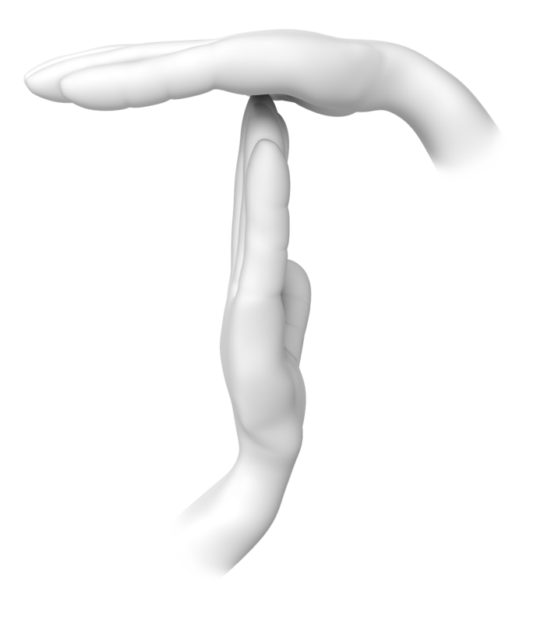

Slide 44
Discussion:
SWOT
Notes:
44

Slide 45
Expanding Cultural and Linguistic Competency
Medical Mission Trip: USF Health Nicaragua, Haiti, Dominican Republic
BRIDGE Clinic, Red Crescent Clinic, Tampa Bay Street Medicine, Mission - Dover
USF Health Service Corps https://www.brownbearsw.com/cal/servicecorps
Poverty Simulation

Slide 46
Expanding Cultural and Linguistic Competency
Safe Zone Training
Unconscious Bias Training
Canopy Medical Spanish course
MedEd Portal – QI Curriculum
USF Health Learn Portal
TBCCN/community linkages
AMA Toolkit: Working Together to End Racial and Ethnic Disparities
USF MCOM Student Council on Diversity and Inclusion ** (Sarah Iqbal, MSII and Will Amyeo, MSII)

Slide 47
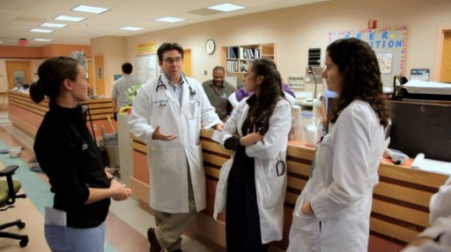
The GME Imperative
As front-line caregivers, residents/fellows are a valuable resource for formulating strategies to address groups that have differences in access or outcomes based on multiple factors.
Varied strategies are needed to recognize health care disparities and strive for optimal outcomes for all patients.

Slide 48
Look forward and dream big!!
What is the vision for GME?

Slide 49
Resources
https://www.ama-assn.org/delivering-care/reducing-disparities-health-care
https://www.acgme.org/Portals/0/PDFs/CLER/CLER_Brochure.pdf
Institute of Medicine. 2003. Unequal Treatment: Confronting Racial and Ethnic Disparities in Health Care. Washington, DC: The National Academies Press. https://doi.org/10.17226/10260.

Slide 50
Thank you

