Slide 1


It’s time for an Age-Friendly Health System
Terry Fulmer, PhD, RN, FAAN
January 31, 2018
Notes:
I want to start by thanking Grantmakers in Aging for the opportunity to speak to you today. And the JAHF and its President Dr. Terry Fulmer and Amy Berman for the vision they have had of transforming our national care system for older adults into one that is truly age-friendly.
More than a year ago now, Terry and Amy came to Institute where I work with an idea. For 30 years, the JAHF had spent over half a billion dollars on research to develop better practice models of care for older adults:
NICHE, PACE, GRACE, HELP. You name it, Hartford had funded it. And the fruits were many….marvelous advances in the care of our nation’s seniors.
But Terry and Amy were troubled by the fact that these best practice models were not reaching everyone they needed to reach.
And from that conversation was born the concept of a system of care that would meet every older person in this country, wherever they were with age-friendly best practice. As terry likes to say from the bedside to the kitchen table…an integrated concept of care we have come to describe as the Age-Friendly Health System.
But, before I get too far in this story, let me share with you a story about what brings me to this work…

Slide 2
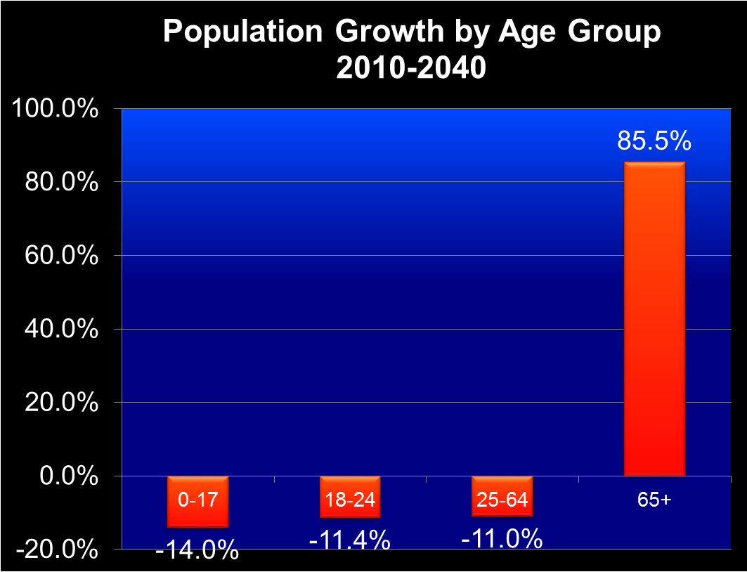

The problem simplified: the triple threat
Demography – more older adults
Utilization – more care
Disutility of care – more harm, defect, injury
From: Trinity Health SE Michigan

Slide 3

Know-do Gap
We have lots of evidence-based geriatric-care models of care that have proven very effective
Yet, most reach only a portion of those who could benefit
  Difficult to disseminate and scale
  Difficult to reproduce in settings with less resources
  Most don’t translate across care settings
4m
46m
Notes:
In the end, if we are generous, we reach <10% of the total need in our country with the best available evidence-based models of care.

Slide 4

IHI Overview
What We Do
Mission
Improve health and
health care worldwide
Vision
Everyone has the best
care and health possible
Strategic Approach
IHI develops and applies practical improvement methods to improve and sustain performance in health and health systems across the world. We generate optimism, spark and harvest fresh ideas, and strengthen local capabilities.
  Safe &
  High Quality
  Care
Health Equity
Joy in Work
Value
Health of Populations
Science of Improvement
How We Work
Convene
Innovate
Partner for Results
Notes:
To help address these issues and questions, IHI along with our partners and community are focusing on five core areas of work:

Slide 5
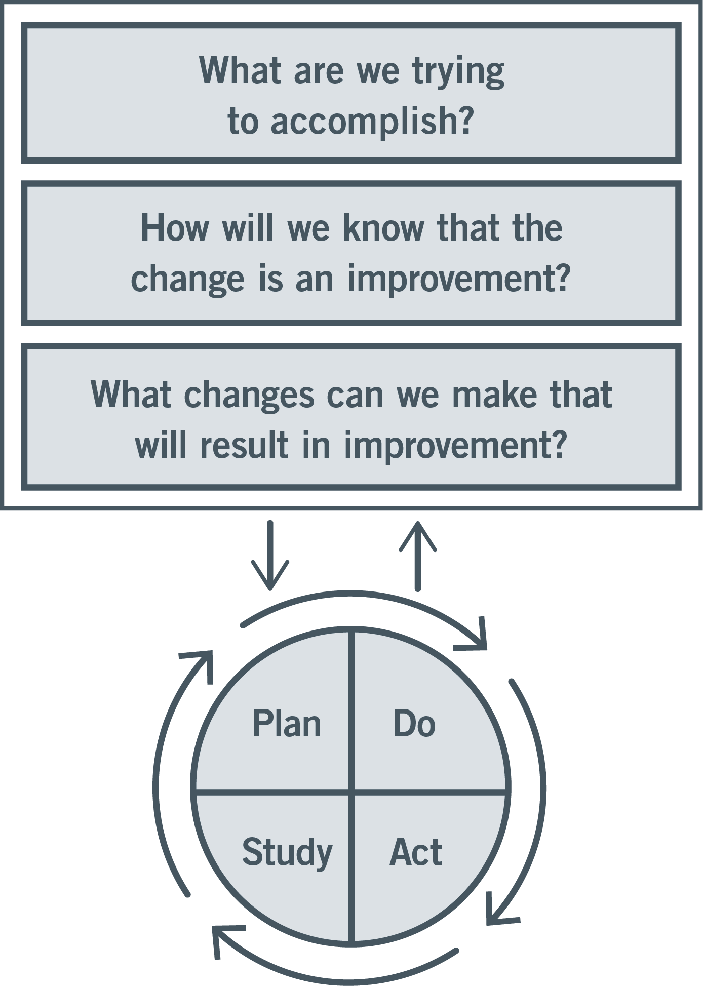
The Model for Improvement
Aim
Measure
Change
Notes:
The engine for iterative testing and learning = MFI.

Slide 6
Aim: What is an Age-Friendly Health System?
Create health care systems where every day, every older adult 65+:
Gets the best care possible;
Experiences no healthcare-related harms;
Is satisfied with the health care; and
Realizes optimal value.
Specific Aim:
The John A. Hartford Foundation and IHI have adopted the bold and important aim of establishing Age-Friendly Care in 20 percent of US hospitals and health systems by 2020

Slide 7
Measurement: Essential guidance
Hospital dashboard measures are age-stratified
If the hospital has an ACE or specialized unit, performance of that unit and regular care units are compared and studied to drive improvement.

Slide 8
Specific Measures: Outcome Improvements
Harm: Delirium & fall rates
Cost: Readmissions
Experience: Patient satisfaction (CAPHS)

Slide 9
Change: Deriving the Evidence-based interventions
Reviewed 17 evidence-based models and programs serving older adults:
  What population is served?
  What outcomes were achieved?
  What are the core features of the model?
Notes:
To develop the concept of an Age-Friendly system, we had to go to school at IHI.
150 articles 17 care models
What pop, what outcomes, and what core features…what were the active ingredients of the model
That improved care for older adults.

Slide 10
July – August 2016
90 discrete core features identified by model experts in pre-work
Redundant/similar concepts removed and 13 core features synthesized by IHI team
Expert Meeting led to the selection of the “vital few”: the 4Ms
Notes:
90 discrete features
13 distinct ones
Expert meeting…vital few, you can only have 5

Slide 11
Changes: The Four M’s
What Matters: Knowing and acting on each patient’s specific health goals and care preferences
Medication: Optimizing medication use to reduce harm and burden, focused on medications affecting mobility, mentation, and what matters
Mentation: Identifying and managing depression, dementia and delirium across care settings
Mobility: Maintaining mobility and function and preventing complications of immobility
Notes:
These are the 4 main interventions of an age-friendly system.
Common to all 17 care models.
Like the 6 intervention of the 100K lives campaign, if we do these 4 things for every older adult, across care settings, we will save lives and avoid harm.

Slide 12
Evidence-base
What Matters:
  Asking what matters and developing an integrated systems to address it lowers inpatient utilization (54% dec), ICU stays (80% dec), while increasing hospice use (47.2%) and pt satisfaction (AHRQ 2013)
Medications:
  Older adults suffering an adverse drug event have higher rates of morbidity, hospital admission and costs (Field 2005)
  1500 hospitals in HEN 2.0 reduced 15,611 adverse drug events saving $78m across 34 states (HRET 2017)
Mentation:
  Depression in ambulatory care doubles cost of care across the board (Unutzer 2009)
  16:1 ROI on delirium detection and treatment programs (Rubin 2013)
Mobility:
  Older adults who sustain a serious fall-related injury required an additional $13,316 in hospital operating cost and had an increased LOS of 6.3 days compared to controls (Wong 2011)
  30+% reduction in direct, indirect, and total hospital costs among patients who receive care to improve mobility (Klein 2015)
References at end of slides
Notes:
The evidence for these is extremely strong. Performed together the 4Ms improve outcomes, reduce the risk of harm, lead to better care experience and save money. They achieve all of the cardinal aims of the modern health care system.

Slide 13
4Ms, high level interventions and implementation actions
 | High-level Interventions |  | Implementation Actions
What Matters | 1 | Know what matters: health outcome goals and care preferences for current and future care, including end of life | Developed with the health systems teams. Teams can select from our ideas or identify their own ideas for reliable implementation. We will learn from one another and share generously.
 | 2 | Act on what matters for current and future care, including end of life
Mobility | 3 | Implement an individualized mobility plan
 | 4 | Create an environment that enables mobility
Medications | 5 | Implement standard process for age-friendly medication reconciliation
 | 6 | De-prescribe and adjust doses to be age-friendly
Mentation | 7 | Ensure adequate nutrition & hydration, sleep and comfort
 | 8 | Engage and orient to maximize independence and dignity
 | 9 | Identify, treat, and manage dementia, delirium, and depression
Notes:
But it wasn’t enough just to say what the 4M’s are.
These elements are well known to the geriatric care community.
We needed to define them further.
What would be the specific interventions across settings within each of the 4M’s
HOW exactly would we ensure reliable, systematic implementation every time for every person in every care setting.
For this we needed a method to learn and a group of partners to learn with.

Slide 14



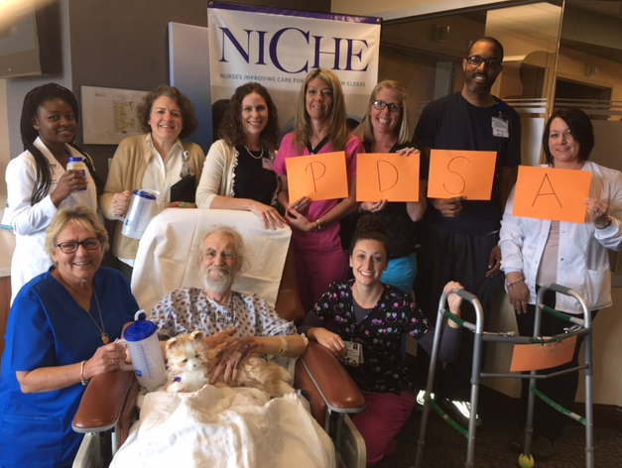

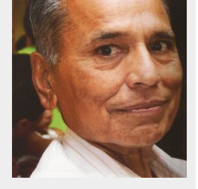


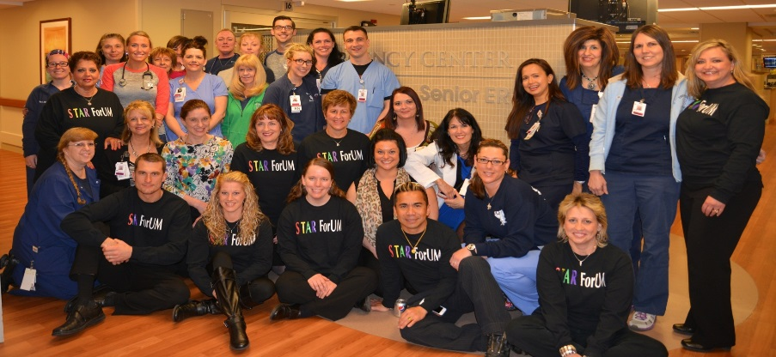


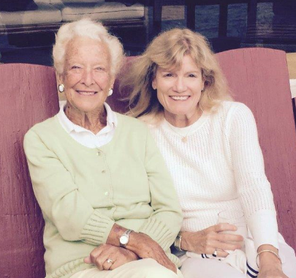
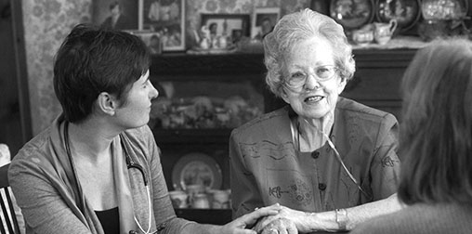


Notes:
Needed a group of organizations to learn with and spread with.
5 systems put up their hands to work with us.
Today, we are working across 26 clinical care sites (primary care, PACE, outpt hospice, SNF, inpatient acute, rehab, CCRC, senior ED) within these 5 systems.
And there are over 60 active tests of change, ideas for reliable implementation that are being tested.

Slide 15
Sequence to Scale-Up
2019
Activity: Campaign spreads to 1000+ care sites
Output: 1000+ Age Friendly Health Systems with evidence of improved outcomes for older adults
Stage 2 Scale-Up
2017 - 2018
Activity: Testing AFHS with 5 systems & scaling within those 5
Output: Age Friendly Model & Scale-up Guidance
Stage 1: Testing the Prototype
Activity: Literature review & Expert meeting
Output: Age Friendly Prototype
Stage 0: Develop the Prototype

Slide 16
Where are we now?

Slide 17
By the numbers…
5 systems actively testing across 26 sites (primary care, PACE, outpt hospice, SNF, inpatient acute, rehab, CCRC, senior ED) in 8 states
17 Advisory Group members (chaired by Mary Tinetti & Ann Hendrich)
9 expert geriatric faculty – the leaders of the field
60+ active tests executing now of age-friendly
214 members of AFHS list-servs (US and abroad)
“Thousands” of lives improved…our most recent estimate was over 3500 in early testing
Notes:
Moving target

Slide 18

A sample of tests being run by our health system teams
Glacier Hills: Moving to single document, work flow, documentation of What Matters conversation
Glacier Hills: Education of providers about asking What Matters questions using Being Mortal film
St. Alphonsus: What Matters Most to You flyer
St. Alphonsus: Testing Serious Illness Conversation Guide questions
St. Alphonsus: Asking What Matters questions in Assessment Bundle
St. Alphonsus: Moving advance care planning documents/ advanced directives to the next level/site of care or provider at discharge
St. Mary Mercy: Integrate What Matters questions into geriatrics assessment
Providence: Testing Scotland What Matters questions
KP: Knowing older adults through “My Care My Life” binder
Ascension: Assessing caregiver burden with caregivers and patients
Ascension: Information on website about services and to enable self-referral
Ascension: Streamlined patient access Referral and intact process
St. Alphonsus: Bring home med containers to AWV for better med rec
St. Alphonsus: Checking home meds with provider profile in EMR with every admit
St. Alphonsus: Obtaining med list from pharmacy to review for deprescribing
St. Alphonsus: Education guide based on Med Rec Guide
St. Mary Mercy: Medication review for pill burden and sending deprescribing recommendations to pharmacy
Providence: PharmD reviews med list for high risk meds and recommends de-prescribing to PCP
PACE: Pharmacovigilance review with ER/hospital utilization review
Anne Arundel: Established an Age-Friendly prescribing “culture”; Looking for opportunities to scale-up to other units
KP: Patients encouraged to bring personal items to hospital to create a “Just like home” environment
KP: Coaching for staff to develop personal relationship with pts
KP: Educate providers re medication issues for deprescribing and treatment of delirium
KP: Self-care plan for high-risk patients, case manager creates plan to include hydration and nutrition
Glacier Hills: Screening (bCAM), standard intervention for delirium
St. Alphonsus: Assessment with mini-cog and PHQ2
St. Mary Mercy: Communication re 3D delirium assessment
St. Mary Mercy: Assessment with family member involvement
Anne Arundel: Hydration- geriatric cups
Glacier Hills: Assessment tool with what matters most about mobility
Glacier Hills: Workflow, PT referral to wellness center, education
St. Alphonsus: Timed Get Up and Go assessment
St. Mary Mercy: Matter of balance, check your risk for falling (CDC) plus meds
St. Mary Mercy: Story book, shorts, What Matters document, thank you letters, MOVE (mobility optimizes virtually everything)
Providence: STEADI results at annual wellness visit, patient who has fallen or with specific STEADI score has follow up visit with RN to address risk factors
Providence: Measure mobility with STEADI scores at AWV year-over-year
Providence: Patient who has fallen or with specific STEADI score participate in a shared medical appointment; PharmD reviews med list for high risk meds and recommends deprescribing to PCP
KP: Patient-initiated patient mobilization, MD's provide 1-page prompt with exercises (includes exercises for patients in bed and wheelchair)
Anne Arundel: Mobility/quality tech
Anne Arundel: 6-clicks, refer to PT
Notes:
You can’t read this, I don’t intend for you to.
But each line on this slide and the dozens more represent a team of 5 to 7 health care workers somewhere in the country voluntarily testing some practical strategy to deliver on one or more of the 4M’s.
Implementation guidance will be VERY practical.

Slide 19
Knowing & Acting on What Matters
Reduced falls by 18%
Notes:
Dept of Aging in MD. 14 Assisted living, spreading to 89 more. 753 residents.
Susan Shelton Director.
Inspired by one of our partners organizations.
Reduce falls by knowing about their

Slide 20
Mobility: Empowering older adults
Reduce Length of Stay;
Go home not rehab
Notes:
Laminated card…pts can start rehabbing themselves in bed. While they wait
KP is now integrating this with their electronic health record and order entry system to make it
Possible for clinicians to “prescribe mobilty” going forward.

Slide 21

Developing the Age-Friendly Change Package
What Matters Medication Mentation Mobility
Act appropriately in accordance with individuals’ priorities and needs
Engage and support older adults to stay well
Know older adults with individual priorities and needs (A)

Slide 22
Example: Community-based
Activate older adults, their families, and care givers to keep themselves well In order for community-based care settings to be age-friendly, we must activate older adults, their families, and care givers to keep themselves well.
Change ideas Activating older adults, their families, and care givers around all of theses components is key to prevention and staying well. | Change idea | Example of how a health system can put this into action
 | a) Reflect on and know What Matters | Provide older adults with questions that help them to identify what brings them joy in their life, what their health concerns are, and their end of life wishes Create a patient portal where patients can share What Matters information with providers
 | b) Identify a care giver and a health care agent | Send state-specific health care agent materials to patients after their annual wellness visit Create access to state-specific health care agent materials on health system website
 | c) Have an accurate list of medications and doses | Include medication list printout as part of standard check-out steps Set up access to medication list on the patient portal
 | d) Know and talk with their physicians about high-risk medications | Schedule medication review appointments with pharmacist or provider other than physician Offer an age-friendly medication educational session in collaboration with a community-based organization Share high-risk medication pamphlets with patients – the risk, alternatives, and how to talk with they doctor
 | e) Ensure sufficient hydration and sleep | Hand out water bottles with age-friendly reminders of how much to drink each day Share nonpharmacological sleep strategies Include hydration and sleep recommendations with medication lists
 | g) Evaluate their home settings to ensure they are safe for mobilization | Identify a community-based organization able to offer home reviews and distribute their material to patients Share a home safety checklist for patients
 | h) Move in accordance with their abilities and goals | Identify a community-based organization that provides tai chi in your conference room “Prescribe” simple exercises that can be done at home in bed, sitting, or standing with family assistance or on their own
Learning | There is much of this that can occur outside the MD/patient visit Health systems don’t have to provide all the resources
Resources | The Conversation Project Preference Based Living

Slide 23
Becoming an Age-Friendly Health System
Becoming an Age-Friendly Health System
Clinical Changes
Physical Infrastructure
Data stratification
Strategic Priorities
Business case
Community Partnership

Slide 24
FY 18 Priority Strategic Aims – These are the priorities!
FY18 APPROVED System Level Performance Measures / Metrics
Goal Area/Weight | Measures | Level* | Threshold |  | Target | Maximum |  | Comments
1. Community Health & Well Being (CHWB) / 20% | 75% of the 20% weight (i.e., 15%): §Clinical Services: Tobacco and BMI Screening and Referral Improvement (2 points available) §Clinical Transformation Portfolio (8 points available) | System Level | 4+ points |  | 7+ points | 9+ points |  | Clinical Services: Each ministry has an individual baseline and individual targets. Points earned based on improvement. Clinical Transformation Portfolio: Five policy, system and environmental change strategy initiatives
 | 25% of the 20% weight (i.e., 5%) §Growth | System Level | TBD |  | TBD | TBD |  | New dimension for FY18 to be developed
2. Clinical Care / 20% | §Reduction of unplanned 30 day readmissions to acute inpatient Trinity Health facilities (50% of the 20% weight) | System Level | 40% of ministries at Target or better |  | 50% of ministries at Target or better | 60% of ministries at Target or better |  | For reference, FY17 = 30/40/50 % of ministries at threshold or better
 | §Reduction of Hospital Acquired Infections (50% of the 20% weight) | System Level | 40% of ministries at Target or better |  | 50% of ministries at Target or better | 60% of ministries at Target or better |  | For reference, FY17 = 30/40/50 % of ministries at threshold or better
3. Patient Experience / 20% | Willingness to Recommend: §Acute Care (34% of 20% weight) §Emergency Care (33% of 20% weight) §Owned physician practice groups CG -CAHPs (33% of 20% weight) | System Level | 30% of ministries at Threshold or better |  | 40% of ministries at Threshold or better | 50% of ministries at Threshold or better |  | For reference, FY17 = 30/40/50 % of ministries at threshold or better
4. Colleague Engagement / 20% | §Colleague Engagement Score | System Level | 4.06 |  | 4.08 | 4.09 |  | For reference, FY17 = system level score of 4.03/4.05/4.09
5. Financial Stewardship / 20% | §Operating Margin (OM) (50% of the 20% weight) §Cost Per Case Mix-Adjusted Equivalent Discharge (CMAED) (50% of the 20% weight)** | System Level System Level | OM: 1.5% Cost Per CMAED: $7,806 |  | OM: 2.1% Cost Per CMAED: $7,729 | OM: 2.6% Cost Per CMAED: $7,652 |  | For reference, FY17: 1.2/2.2/3.0 % OM For reference, FY17: $7,720/$7,645/$7,570 Cost Per CMAED
 | **Reflects our overall cost position and actions to improve this cost position to move on glide path to be profitable under Medicare. This Cost per CMAED is based on Regional Health Ministries (RHMs) only. For National Health Ministries and Mission Health Ministries, cost per unit metrics will be: §Trinity Health Senior Communities (THSC): Cost per Day §Trinity Health at Home (THAH): Cost per Admission §Trinity Health PACE: Cost per Member per Month §Pittsburgh Mercy Health Services: Cost per Outpatient Unit §All other Mission Health Ministries: No cost metric; Operating Margin used as the sole measure of financial stewardship Note: The same spread applies to National Health Ministries and Mission Health Ministries
*For RHM executives, weight on objectives is split between an RHM (70%) and System (30%) Components
↑ mob, ↓ hi risk meds & know what matters → ↓ ADEs, right-siting care, ↑ functional status → ↓ unplanned admissions
↑ mob & know what matters →
↑ functional status, ↑ d/c to home, ↑ HCAPHS→
↑ willingness to recommend
Mechanism varies by discounted FFS, Per case (DRG), APM (provider at risk)
Notes:
Readmissions
Willingness to recommend
Operating Margin

Slide 25
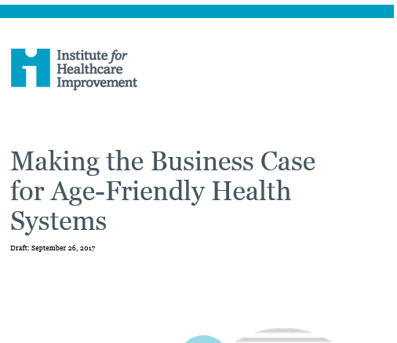
The business case
Make a sustainable business case for age-friendly care
Reduce costs associated with poor quality care
Increase utilization of cost-effective services
Enhance revenue and market share
Reduce over-utilization of unnecessary care
Reduce risk of malpractice claims
Increase consistent use of underused, evidence-based services and practices
Reduce harm that results in use of higher level of care settings, longer inpatient LOS, ED visits, readmissions to inpatient settings
Optimize site of care (shift care to lower cost care settings)
Increase staff productivity and decrease turnover
Increase bed capacity
Improve reputation as an AFHS to attract patients
Improve care transitions, discharge planning, and care coordination
Notes:
Stop overuse which leads to waste
Reduce the cost of poor quality
Capitalize better experience
And just as we did after the 100K lives campaign with patient safety, we will take this argument, together with the achievements of health systems across the country to CMS and commercial payers and ask for payment changes that will reward doing the right thing that reward the pursuit of age-friendly care.

Slide 26
Our ask of you
Take action! And teach us what you are learning
Tell this story, spread the word on Age-Friendly Health Systems
All Teach, All Learn. Join the “Friends of Age-Friendly” quarterly call series (email Kim at kmitchell@ihi.org)
Notes:
Be part of the learning community

Slide 27
Thank you
The John A. Hartford Foundation Staff
Kedar S. Mate, MD
Chief Innovation & Education Officer
Institute for Healthcare Improvement
Cambridge, MA

Slide 28
Citations
AHRQ Health Care innovations Exchange. System-integrated program coordinates care for people with advanced illness, leading to greater use of hospice services, lower utilization and costs and high satisfaction. 2013. Available from: https://innovations.ahrq.gov/profiles/system-integrated-program-coordinates-care-people-advanced-illness-leading-greater-use
Riley GF, Lubitz JD. Long-Term Trends in Medicare Payments in the Last Year of Life. Health Services Research. 2010; 45(2):565-576
Field, Terry S., et al. "The costs associated with adverse drug events among older adults in the ambulatory setting." Medical care 43.12 (2005): 1171-1176.
Health Research & Educational Trust (February 2017). Adverse Drug Events Change Package: 2017 Update. Chicago, IL: Health Research & Educational Trust. Accessed at www.hret-hiin.org
Unutzer J et al. Healthcare costs associated with depression in medically ill fee-for-service Medicare participants. Journal of the American Geriatrics Society. 2009 Mar;57(3):506-10
Rubin FH et al. Sustainability and scalability of the Hospital Elder Life Program (HELP) at a community hospital. Journal of the American Geriatric Society. 2013 Mar; 59(2): 359-365
Wong et al. The cost of serious fall-related injuries at three midwestern hospitals. Joint Commission Journal on Quality and Patient Safety. 2011 Feb; 37(2): 81-87.
Klein K, Bena JF, Albert NM. Impact Of Early Mobilization On Mechanical Ventilation And Cost In Neurological ICU. 2015 American Thoracic Society International Conference Abstracts.

