Slide 1
Hearing Loss in the Geriatric Population
Strategies for working with older adults with hearing loss in medical settings
Michelle Arnold, AuD, CCC-A February 23, 2018

Slide 2
Overview
Hearing loss in the geriatric population
Brief review of the anatomy and physiology of the hearing and balance systems
Signs and symptoms of hearing loss and balance disorders
Bedside strategies
Referrals
Questions?

Slide 3
Hearing Loss in the Geriatric Population
Hearing loss is highly prevalent in the US
  Adults: 16%+ (Agrawal, Platz, & Niparko, 2008)
    Adults 70 years and older: 65% (Lin, Thorpe, Gordon-Salant, & Ferrucci, 2011)
Untreated hearing loss is a significant public health concern
  Significant associations with other chronic conditions
  Dementia (Lin, 2011; Lin et al., 2013)
  Falls (Lin & Ferrucci, 2012)
  Social isolation, depression (Kramer, Kapteyn, Kuik, & Deeg, 2002)
Vulnerable populations are at an elevated risk for untreated hearing loss
  Known disparities in hearing healthcare use (Nieman, Marrone, Szanton, Thorpe, & Lin, 2016)
  And thus, at an increased risk for comorbid conditions

Slide 4
Hearing Loss in the Geriatric Population
Presbycusis – age-related hearing loss
  Primarily affects adults age 50+
Manifests as a high-frequency, sensory loss
  Permanent, damages to the cochlear structures
  Sometimes neural involvement (“sensorineural”)
Results from:
  Noise exposure
  Age-related changes in the auditory system
    Vascular
  Genetic predisposition

Slide 5
Hearing Loss in the Geriatric Population
Lin et al., 2011

Slide 6
Hearing Loss in the Geriatric Population
Lin et al., 2011

Slide 7
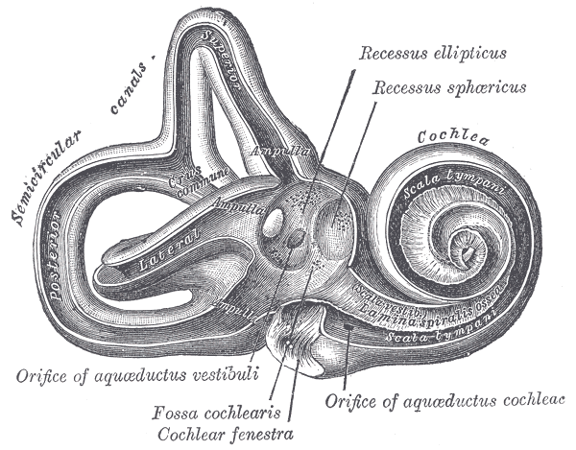
The Inner Ear: Auditory & Vestibular Systems

Slide 8
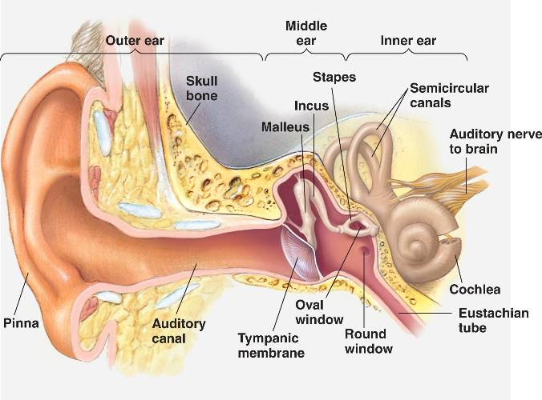
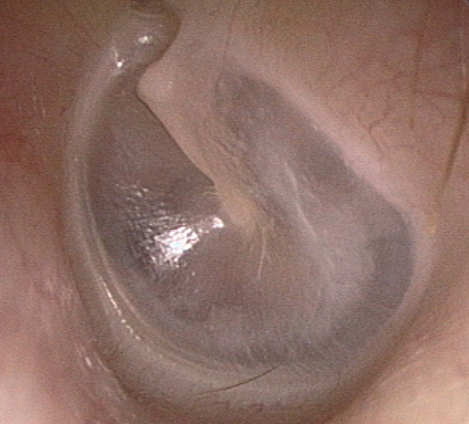
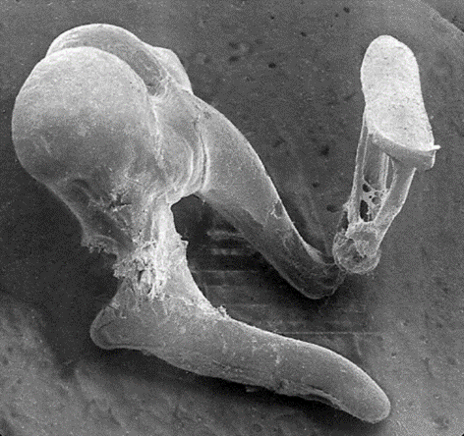
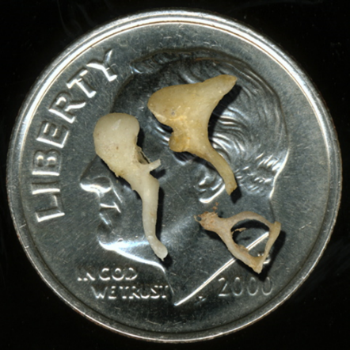
The Auditory System
Hearing process video

Slide 9
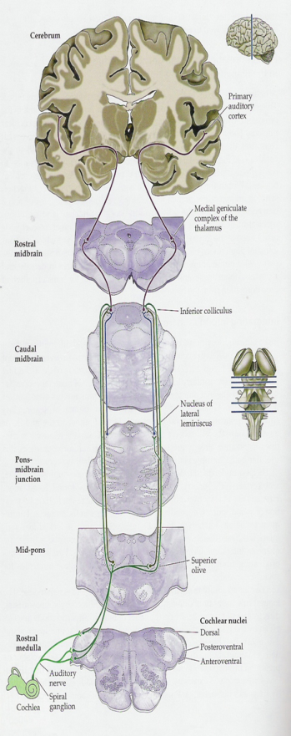
Peripheral to Central…
Peripheral auditory system
Central auditory pathways
…sound coding to meaning
…how the ear has “solved” the problem of transducing mechanical energy into neural impulses.

Slide 10
The Auditory System
Peripheral to Central…
…sound coding to meaning
Central auditory pathways
…how the ear has “solved” the problem of transducing mechanical energy into neural impulses.

Slide 11
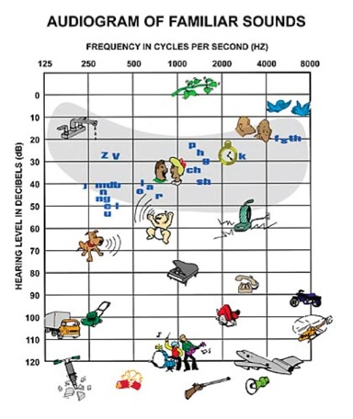
The Auditory System
The audiogram

Slide 12
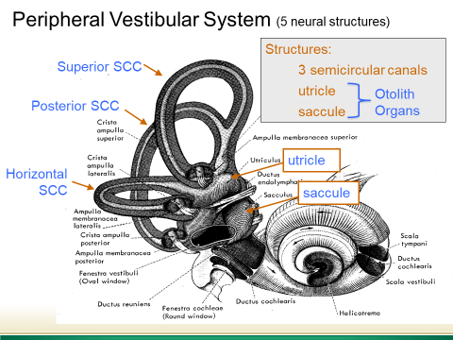
The Vestibular System
One of the oldest CNS system reflex pathways
In humans, has evolved to provide
  Orientation
  Equilibrium
Responsible for sensing head motion
  Maintain postural control
  Stabilize images on the fovea of the retina
Transmits information to the central vestibular pathways
  Control reflexes and perceptions
Vestibular system video

Slide 13
Hearing Loss Symptoms
Reduced attention to sound
Reports of ringing in the ears
“Missing” information, despite reporting no problems with hearing
Difficulty hearing in diverse settings
  Noise (restaurants, family gatherings, noisy hospital rooms)
Lack of interest in social activities, increased isolation

Slide 14
Vestibular Dysfunction Symptoms
Reports of positional dizziness
Reports of dizziness that is rapid onset, lasts up to 90 seconds, is recurrent
Reports of falls
Additional potential symptoms:
  Migraine
  Nausea
  Lightheadedness

Slide 15
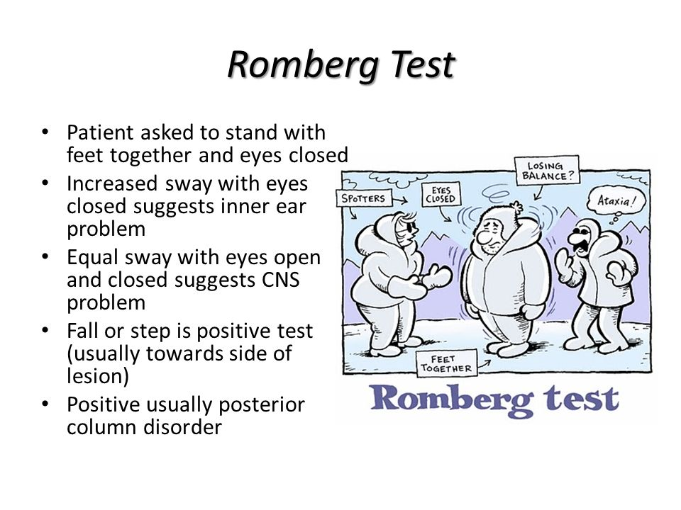
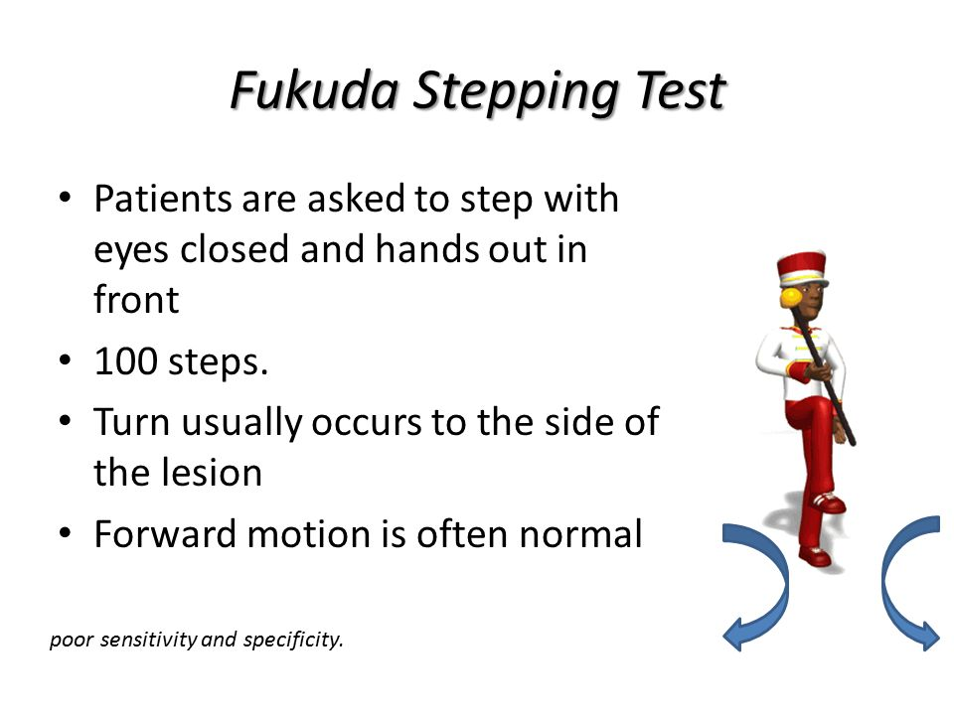
Bedside Strategies – Vestibular Dysfunction
Ask pertinent questions
Most common balance disorder among older adults is BPPV
  Benign positional paroxysmal vertigo
  Screening – Dix Hallpike Test
Other screeners
Mike Valdez, PA-C (2016)

Slide 16
Bedside Strategies – Hearing Loss
Screen patients 65 years and older for hearing loss
Use good communication strategies
Ensure patients are using corrective devices (hearing aids; cochlear implants)
Use assistive devices

Slide 17
Hearing Screening
Objective vs. Subjective
Objective bedside tests
  Otoscopy
  Tuning fork tests
  Whisper test (objective??)
  Screening audiometry and distortion product otoacoustic emmissions (at TGH, need to place audiology referral)

Slide 18
Hearing Screening
Objective vs. subjective
Subjective
  “Do you think you have a hearing problem?”
    Yes or no
    Single item screener found to be accurate in most older adults (Kamil, Genther, & Lin, 2015; Torre, Moyer, & Haro, 2006)
  Hearing handicap screening for the elderly (HHIE-S) (Ventry & Weinstein, 1983)
    Brief, 10-item screening tool that assess self-perceived hearing handicap
    Score of 10 or greater warrants referral for full audiologic exam

Slide 19
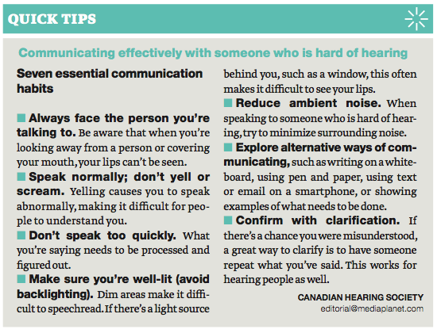
Communication Strategies

Slide 20
Ensure Patients are Using Their Hearing Devices
For patients who report they have hearing loss, ask if they wear hearing aids or cochlear implant(s)
  If “yes”, be sure they are wearing them (correctly) before you continue to speak to them!
  If they do not have their devices, have an amplifier on hand for conversation
  If they have their devices, ensure the battery is new
  If battery is dead, replace from patient supply – or contact audiology for replacement battery

Slide 21
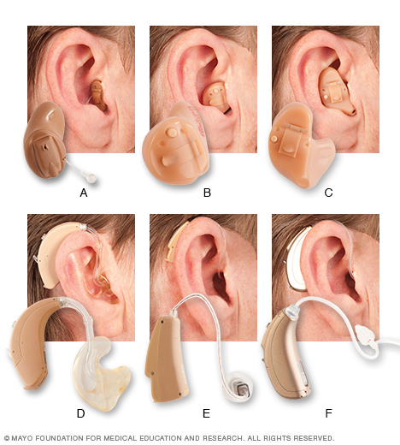
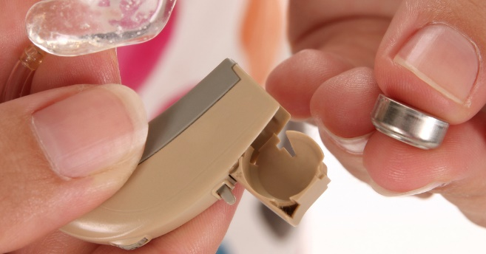
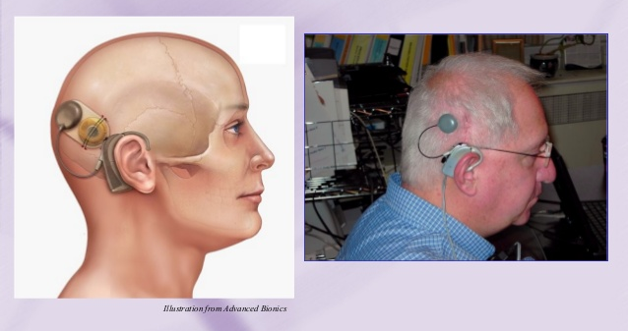
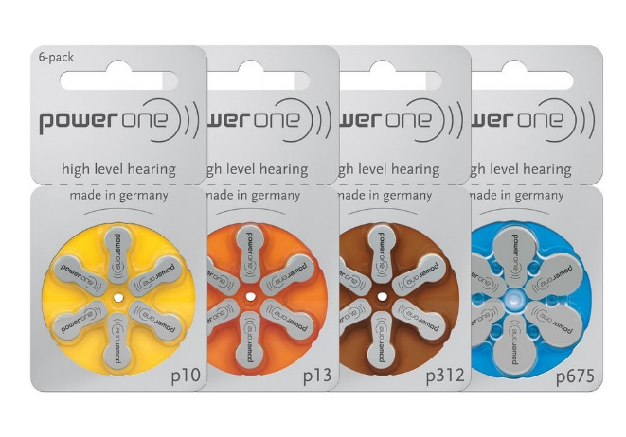
Ensure Patients are Using Their Hearing Devices
Hearing Aids
Cochlear Implant

Slide 22
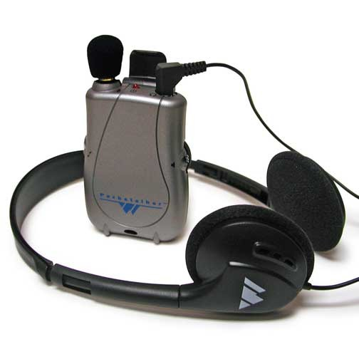
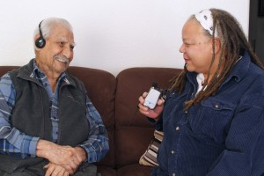
Use Assistive Devices
If you are working in a geriatric unit, ask the nurses for a pocket amplifier
  If the unit doesn’t have at least 3 pocket amplifiers for use, request them

Slide 23
Referrals
Utmost importance to refer older adults for vestibular assessment if they have history of falls or symptoms of dizziness
  American Institute of Balance
    8200 Bryan Dairy Rd Suite 340, Largo, FL 33777
    Office 727-398-5728
    Office 800-245-6442
    Fax 727-398-4914
  University of South Florida Hearing Clinic
    4202 E Fowler Ave PCD 1017
    Office 813-974-8804

Slide 24
Referrals
For patients with hearing loss a variety of options exist
  Refer to PCP
  Refer to TGH Audiology as outpatient (located in outpatient rehab center)
  Refer to TGH Audiology as inpatient
    Dr. Rebecca Marcadis – contact TGH outpatient rehab center
  Refer to USF Hearing Clinic (contact information on opposite page)

Slide 25
Questions?
???
My email: mlarnold@usf.edu
Thank you!

Slide 26
References
Kamil, R. J., Genther, D. J., & Lin, F. R. (2015). Factors associated with the accuracy of subjective assessments of hearing impairment. Ear and Hearing, 36(1), 164-167. doi:10.1097/aud.0000000000000075
Lin, F. R., Thorpe, R., Gordon-Salant, S., & Ferrucci, L. (2011). Hearing loss prevalence and risk factors among older adults in the United States. Journals of Gerontology. Series A: Biological Sciences and Medical Sciences, 66A(5), 582-590. doi:10.1093/gerona/glr002
Nieman, C. L., Marrone, N., Szanton, S. L., Thorpe, R., & Lin, F. R. (2016). Racial/ethnic and socioeconomic disparities in hearing health care among older Americans. Journal of Aging and Health, 28(1), 68-94. doi:10.1177/0898264315585505
Torre, P. T., Moyer, C. J., & Haro, N. R. (2006). The accuracy of self-reported hearing loss in older Latino-American adults. International Journal of Audiology, 45, 559-562. doi:10.1080/14992020600860935

