Slide 1

Field Experience Information Session
(PHC 6945)
September, 2016
Somer Burke Jesse Casanova
Experiential Learning Field Experience Administrator
College of Public Health International Programs
University of South Florida USF College of Public Health
Fehelp@health.usf.edu
Notes:
This session being virtually recorded – tell them to mute mics and save questions until end.
Trudy set up virtual recording

Slide 2

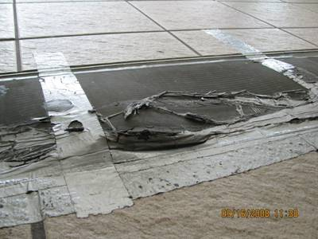
What is Field Experience (FE)?
A carefully supervised work or service experience that allows a student to address a public health issue or concern.
  Bridge theory to practice, gain work experience
An organized and carefully planned partnership
  Between the student, preceptor, and faculty advisor
One of the curriculum culminating events and a graduation requirement for College of Public Health
  Students who are earning an MPH, MHA, or an MSPH in Industrial Hygiene

Slide 3
Objectives of Field Experience
  Identify learning goals
  Design and implement activities to reach goals
  Provide practical experience in a public health setting
  Link academic training and theory with core functions of public health and practice
  Reflect on what was learned during the FE
  Explore career interests
Notes:
Think about what you are interested in and what you want to learn when planning your field experience.

Slide 4
Benefits of Field Experience
Professional Preparation
  Provide community service
  Integrate theory with practice
  Opportunity to identify areas for research
  Analyze community/public health problems
Career Development
  Gain work experience
  Explore career options
  Develop contacts for networking
  Define career objectives
Notes:
Treat this as a job interview, be professional, positive and open to learning at all times!

Slide 5
Preliminary Work…Finding a Site
Start early (2 semesters in advance recommended)
  Affiliation Agreements, Preliminary Requirements
Attend the FE Information Session
Students must follow instructions and meet the FE requirements.
  The FE team will provide guidance to assist students in meeting requirements.
  International students must make sure to meet with the ISSS office for any FE requirements
Be creative with your search.
  Reach out to organizations/agencies that interest you. Inquire about opportunities that are available or can be created.
  It is recommended to pursue various opportunities since some can be more competitive than others.
  Advance Planning and effort will help you find the best fit
Notes:
Think about your interests and connections.
What do you want to do? Who do you know?
What do you want to learn? Do you need to gain skills or experience in a certain area?
What have other students done that fits with what you want to do?
Reach out to inquire about opportunities in advance

Slide 6
Preliminary Work…Finding a Site
Consult with your faculty advisor
  Required course work
  Required amount of FE credit (1 FE credit = 45 contact hours)
  Goals/Aspirations
Consult with FE Office/Visit FE website: http://health.usf.edu/publichealth/academicaffairs/fe/dfe/index.htm
  Review opportunities emailed from the FE Office
  Check Canvas for interest forms, potential internships, and professional development help, self-enroll here: https://usflearn.instructure.com/enroll/7P47D6
  Contact us for suggestions
    We have robust lists of past placements, preceptors and local, national and international internships
Resume/Career preparation
  Make sure your resume is in great shape and you are prepared for a professional interview!
  Gianna Nicholas (gianna4@usf.edu) is our COPH career consultant
Notes:
Meet with faculty advisor once per term, discuss when to do FE
Concentration courses often required – important to have a theoretical foundation
Credit hours vary by department – ask your faculty advisor how many credit hours you need
Work with them on goals and aspirations
Have a resume ready to submit for possible placements

Slide 7
Preliminary Work…cont.
You solidified a field experience site…what next?
Create your FE Plan
  Includes goals, public health competencies, methods of evaluation, specific strategies, and activities for accomplishing those goals related to your department concentration.
  This plan should be created and agreed upon by the student, Preceptor, and faculty advisor.
Complete the FE Application
  Submit by the registration deadline to fehelp@health.usf.edu
Register for the credit(s) in OASIS
  Input the correct amount of FE credits
FE Plan and Application here: http://health.usf.edu/publichealth/academicaffairs/fe/forms.htm
Notes:
Plan: academic component - blueprint for FE
Deadline is the same as the registration deadline (Jan 6th for traditional students, Nov 20th for reduced rate)
Permits are needed for contract courses, change the credit hours to match your FE credits – (1 – 12 credits)

Slide 8
Preliminary Work…cont.
You solidified a field experience site…what next?
Ask the Preceptor or HR about any processes, documents and/or agreements required to start the field experience
  Affiliation Agreement/MOU
    (legal contract; can be a lengthy process)
  Background checks
  Immunizations
  Drug Screening
It is your responsibility to meet preliminary requirements
  We will provide a link to a company that provide these at your expense, if necessary
Notes:
Every site is different in terms of what is needed
Big sites require AA’s, can take time if we don’t already have one
It is your responsibility to meet preliminary requirements

Slide 9
Preliminary Work…cont.
You solidified a field experience site…what next?
IF you are doing your FE with any Department of Public Health, they will require a background check. Please use the following site!
https://portal.castlebranch.com/UP83
Shawn Afflick M.Ed.
Student Academic Compliance Officer
University of South Florida
College of Nursing
12901 Bruce B. Downs Blvd. MDC 22
Tampa, FL 33612
Notes:
Every site is different in terms of what is needed
Big sites require AA’s, can take time if we don’t already have one
It is your responsibility to meet preliminary requirements

Slide 10
Field Experience is a course-PHC 6945
The FE course is a collaborative effort between
the student, faculty advisor, preceptor and FE office
Field Experience is in Canvas!!!!
What’s due:
FE Plan
Final report
Evaluation- student
Evaluation- preceptor
Notes:
Upload FE plan
Write final report
Take evaluation in qualtrics
We will upload student and preceptor evaluation

Slide 11
Key Points
  Students enrolled in the college can not serve as a preceptor
  Your direct faculty advisor cannot serve as a preceptor
  FE can be done at your current employer with the following exceptions:
    Your preceptor is not your current job supervisor
    The FE should must be a new experience; it should not be your daily work responsibilities.
Notes:
Special project is separate, sometimes it is related to FE, but needs to be approved by your advisor
Special project is a research study
Meaningful experience – start early to plan this

Slide 12
Key Points
Follow specific departmental and concentration requirements
Field Experience and Special Project are separate entities
Register for the correct number of FE credit hours
FE is not clerical or administrative in nature
  Everyone has to do grunt work
Working schedules are created between the preceptor and student
FE’s may or may not be paid
Notes:
Special project is separate, sometimes it is related to FE, but needs to be approved by your advisor
Special project is a research study
Meaningful experience – start early to plan this

Slide 13
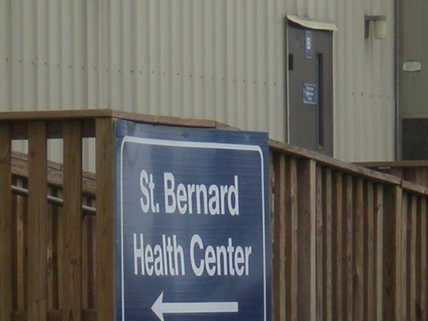



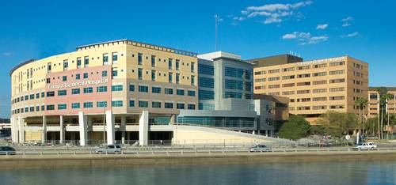
Expectations of FE Site
Offers programming, research or services relevant to public health
Provides opportunities to work with public health professionals
Preceptor qualified to evaluate public health competencies
Notes:
Don’t have to have a MA in PH, varied backgrounds ok – Master’s degree or many years experience necessary
Plan out how you will interact with preceptor – make sure they will be available to you

Slide 14
Expectations of Student
Professional
  Dress and behavior - put your phone away!
Organized
  Timely/meet deadlines
University and college ambassador
  Respect authority, organizational policies
  Be present, positive, and open to learning
Comply with the conditions of FE
Capture images and testimonies of your field work
Seize the day!
Notes:
Treat it like a job interview, this could turn into a job
Dress professionally, put your phone away
Be present, positive, and open to learning
Respect authority

Slide 15
Q & A from recent and previous sessions:
Can I do two FE’s?
Yes, you can. You can opt to do two during the same or different semesters. This will have to be approved by your advisor. You will have to judge if this is manageable for you as a student.
I’m a dual concentration student- which one of my faculty advisors will be my advisor for FE?
Choose one advisor as your FE advisor and put that person on the application. Usually, dual students will choose one of the faculty advisors to serve as the primary advisor for FE and the other will be the primary for special project.
My attempts to contact my advisor have been unsuccessful-what should I do now?
Get in contact with the department receptionist or Administrator. S/he should be able to assist you.
Notes:
35 minutes,
12 in person
19 online

Slide 16
Key Resources
Field Experience site: http://health.usf.edu/publichealth/academicaffairs/fe/index.htm
Somer Burke
Experiential Learning
(813) 974-6066
Jesse Casanova
Field Experience and International Programs Administrator
(813) 974-4247
Fehelp@health.usf.edu

Slide 17
Intermission

Slide 18

Going Global

Slide 19

What is an IFE?
A practicum
Purpose: integrate theory and practice
Structured and significant educational experience
Usually takes place in a developing country
Involves a preceptor and faculty advisor
YOU MUST BEGIN PROCESS 1 YEAR IN ADVANCED

Slide 20


The IFE is open to all students
An academic requirement for:
Global Health Practice Students
ACADEMIC REQUIREMENTS
Complete College Core Courses:
PHC 6000, 6050, 6102, 6357, 6410
Meet with Faculty Advisor to discuss other courses selection
Other helpful courses:
  PHC 6106, 6112,6115, 6442

Slide 21

International Students
International students, make sure to contact the ISSS Office for any travel restrictions or requirements that you may have

Slide 22

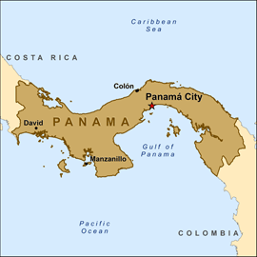

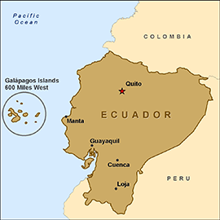

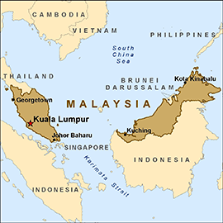

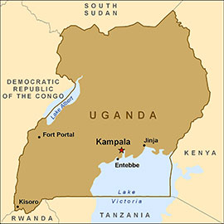

Where to go?
USF COPH
International Hubs
Panama
Ecuador
Malaysia
Uganda

Slide 23
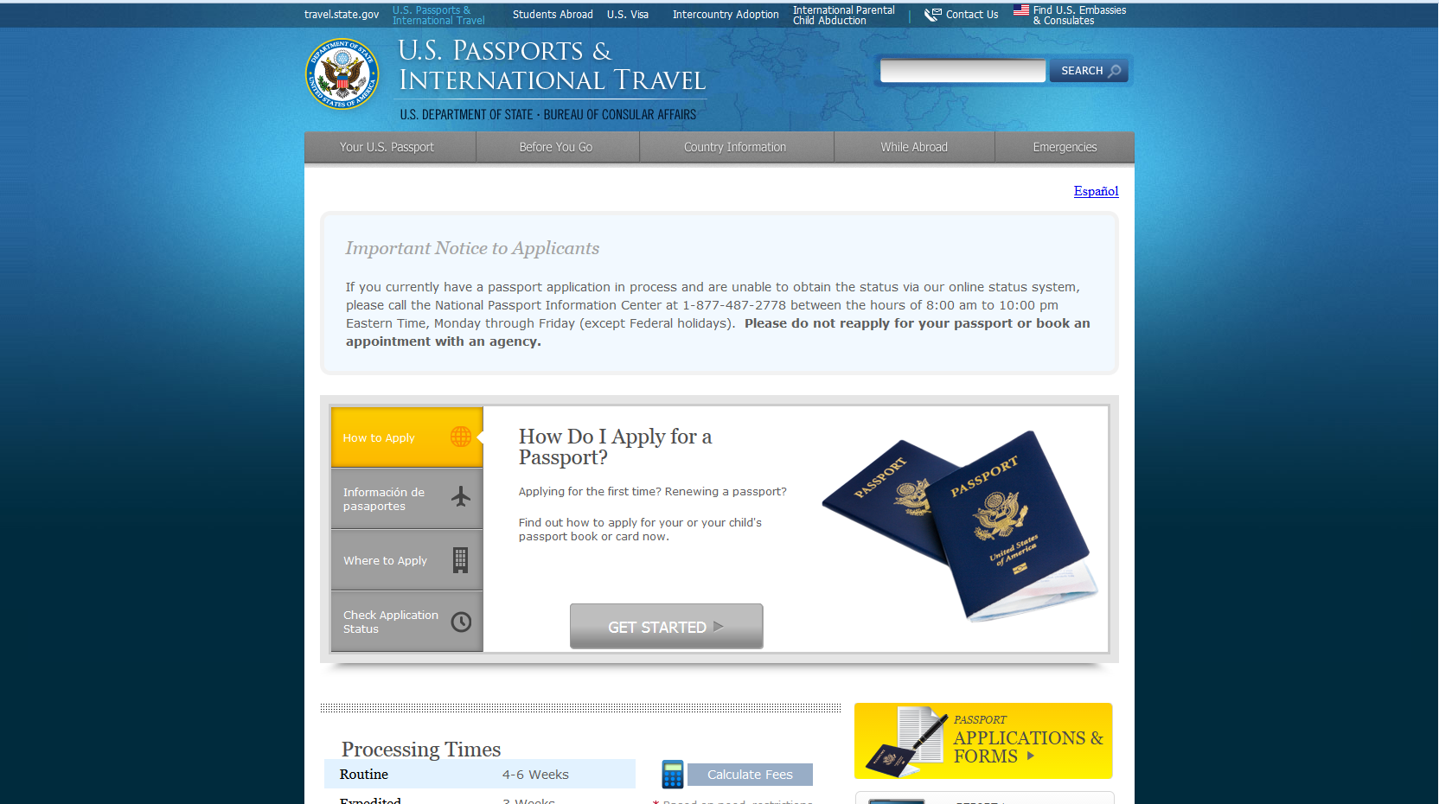
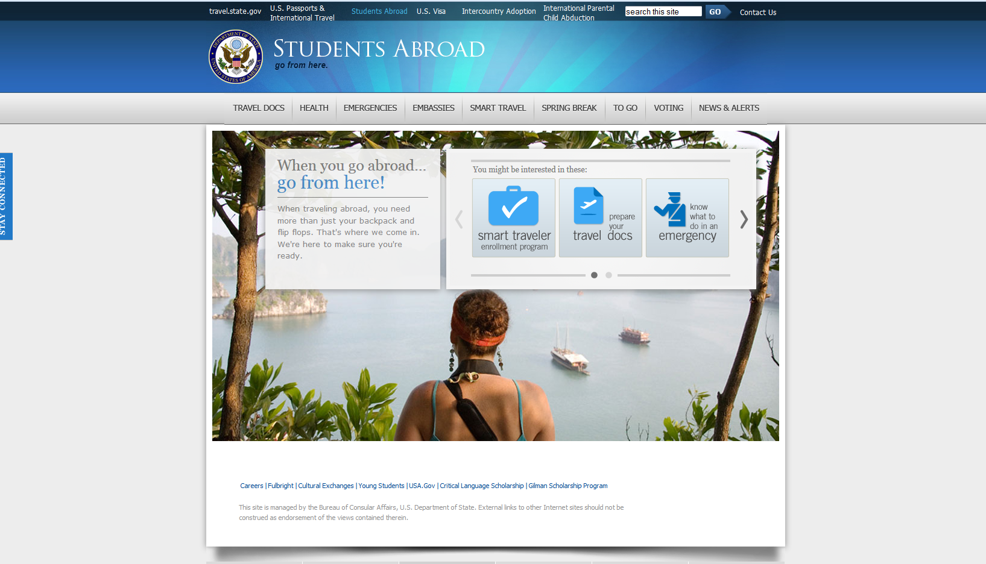

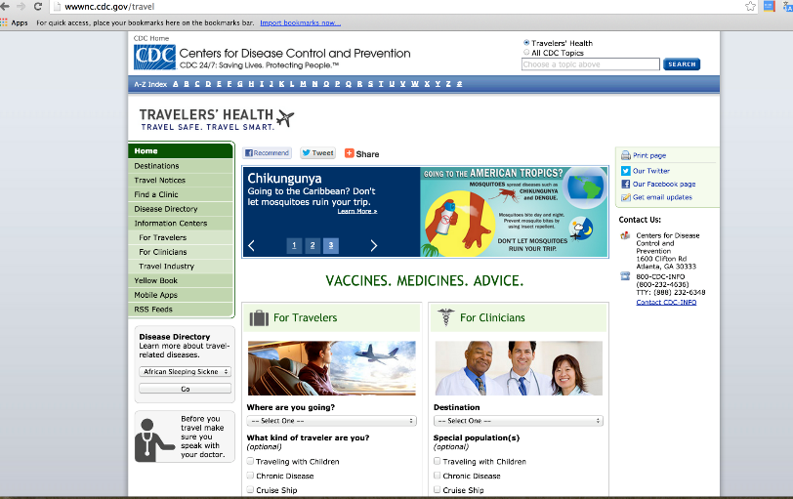
Passport, Visa, Immunizations and Entry Requirements
Please consider your country of citizenship

Slide 24
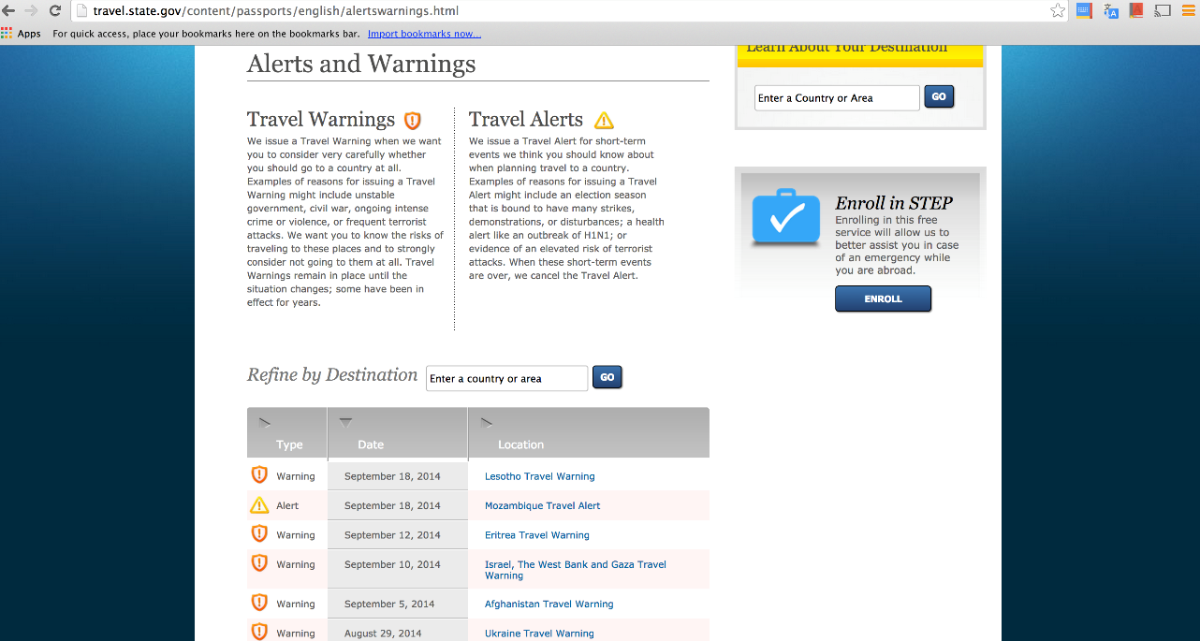

Where you may NOT go!
Look Simba everywhere this site has an alert/warning for, you must never go there!
Unless, you fill out a High Risk Application… and even then you may not get permission!
www.travel.state.gov

Slide 25

Official University Travel VS Personal Travel
If you are traveling overseas for any reason connected to the university either for credit or non-credit-bearing reasons, then you will need to make sure to follow the travel process for international travel approval.
If you are traveling for personal reasons, then you cannot engage in official travel activities such as “finding a site”, nor will you be able to begin an IFE while you are still abroad.

Slide 26

Going Global
Prepare http://www.state.gov/travel
Passport: http://travel.state.gov/passport
Visas: http://travel.state.gov/content/passports/english/country.html

Slide 27

Preliminary Steps
Email Jesse in the FE office at jcasanov@health.usf.edu
  Travel Approval Form
  IFE Site locations descriptions
  IFE Scholarship Application (if eligible)
  Online Application Link
2. Make appointment: Faculty Advisor
  Go over interested site locations
Make appointment: International Programs Office:
  USF Student Link: http://usfweb.usf.edu/escheduler/student.aspx
  Receive contact info for potential placement
  Discuss Academic Contract/IFE Scholarship or any other document
  Start Online Application
    Pre-departure orientation
    UHCG Insurance Purchase

Slide 28

Contact Potential Preceptor/site
  Contact potential preceptor
  Discuss possible IFE plans
Once Preceptor agrees
  Fill out academic contracts (PHC 6945)
  Review/Sign Travel Approval Form
  Meet with Faculty Mentor get all forms signed
  Make sure to finish the online travel application.
  Finalize your Mandatory Pre-Departure Orientation on Canvas

Slide 29

Once all documentation has been signed and submitted
  Email your contract and travel approval form to request a permit to: jcasanov@health.usf.edu
  Once ISSUED, you will receive an email from registration saying that you can register. M
    Make sure to change credits on Canvas from 1 to variable
  After you have registered and modified the credits
    Email International Programs Office and make them aware of registration/course credit change in order for scholarship to be processed.
    Please remember to also discuss your scholarship with financial aid to avoid any issues.
    REMEMBER DEADLINES
Once registered, student will be added to the Canvas course online
  All work should be submitted to the Canvas Course on time
  If there are problems with access, discuss difficulties with Faculty Advisor and we can come up with a solution.

Slide 30

Scholarship
Below you will find the ceiling limit per region of the world. The IFE scholarship
Regional Table Ceiling Limit for the IFE Scholarship
Latin America and the Caribbean | $700
South America | $1,500
Africa and Asia | $2,000
Regional Table Ceiling Limit for the IFE Scholarship
Latin America and the Caribbean | $500
South America | $1,000
Africa and Asia | $1,500
There is a deadline! This MUST be submitted by the course registration deadline of the semester that you are applying to.

Slide 31
Institution | Location | Contact
MALAYSIA
UNIMAS | Kuching | Dr. Razitasham
WABA | Penang | Jay Sharma
University of Malaya Department of Social & Preventive Medicine | Kuala Lumpur | Abqariyah Yahya
Stepping Stone Work Centre | Penang | Khor Ai-Na
Penang Family Health Development Association | Penang | Ng Lai Kin
Ampang Hospital | Kuala Lumpur | Jameela Sathar
Penang Medical College | Penang | Abdul Rashid Khan
UGANDA
Ministry of Health Uganda | Kampala | Mugagga Malimbo
Hope for Humans Organization | Gulu | Angwech Collines
Papoli Village | Tororo District | Emanuel Ofundi
Rakai Health Sciences Program Clinical | Entebbe | Steven Reynolds
ECUADOR
Universidad Central del Ecuador | Quito | Manuel Calvopiña
Universidad San Francisco de Quito | Quito | Maurico Espinel
PANAMA
The Gorgas Memorial Institute | Panama City | Aracely Quintero
Universidad de Panama | Chitre | Aracely Quintero
ANCEC | Panama City | Aracely Quintero
Oncology Institute | Panama City | Aracely Quintero
PROBISIDA | Panama City | Aracely Quintero

Slide 32

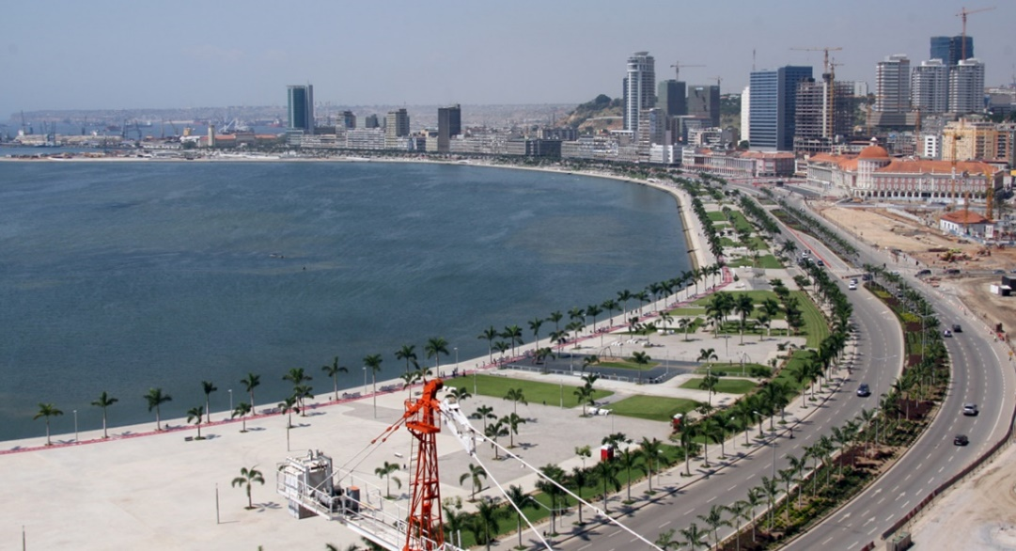

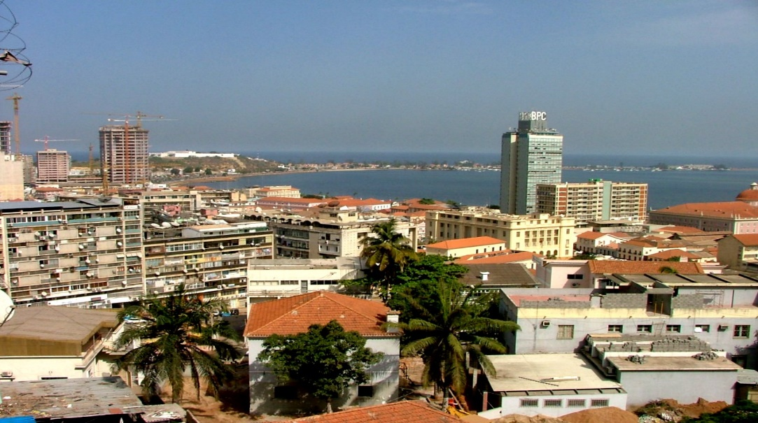
DO YOUR RESEARCH!

Slide 33

Housing Costs
$900 a month 1 bedroom apartment in Tampa
$2300 a month 1 bedroom apartment in London
$3000 a month 1 bedroom apartment in Djamenna
$4000 per month 1 bedroom apartment in Luanda
Example:
London is 70% more expensive than Tampa

Slide 34

If you plan on going abroad
YOU MUST BEGIN THE PROCESS 1 YEAR IN ADVANCE
Those who have not begin the process by Registration Deadline will not be permitted to travel overseas for course credit
You shall not Go!... for credit

Slide 35
Key Resources
Field Experience site: http://health.usf.edu/publichealth/academicaffairs/fe/index.htm
Somer Burke
Experiential Learning
(813) 974-6066
Jesse Casanova
Field Experience and International Programs Administrator
(813) 974-4247
Fehelp@health.usf.edu

Slide 36


