Slide 1
Building Quality Assurance into Clinical Trials

Slide 2
Objectives for Today:
Define Quality in Research
Describe How to Initiate Corrective and Preventative Action Plans
Describe Applications for Developing Core Competency for Research.
Notes:
Dissect the situations Cannot be done quickly or haphazardly.

Slide 3
Overview
Corrective and Preventive Actions
Scenarios for discussion
Components of Quality Research
Developing Core Competency in Clinical Research
Notes:
Why do research

Slide 4
QC, QA, QMS
Quality control (QC) and quality assurance (QA) systems together constitute key quality systems that are parts of quality management systems (QMS)
QA defines the standards to be followed in order to meet the quality requirements for a clinical trial
QC ensures that these defined standards are followed at every step
Introduction of an independent and objective audit of the QA/QC system and its outcomes

Slide 5
Notes:
Suggested Reading
The FDA does a good job of explain and educating about their expectations of clinical research
Shared responsibility for quality, but the quality systems approach emphasizes “management” (sponsor) responsibility
FDA defines quality as
“Quality” is characterized by the ability to
Effectively and efficiently answer the intended question about the benefits and risks of a medical product (therapeutic or diagnostic) or procedure
while
Ensuring protection of human subjects

Slide 6
Notes:
When you think of quality assurance in clinical trials what comes to mind? How do we fit all the pieces of research together to achieve great results and patient safety

Slide 7
What is the Purpose of Quality Management ?
Patient safety
Sponsors Role
Identified results of monitor findings
Risk Assessment/Evaluations
Notifications
Decisions
Actions
Notes:
What is the purpose of Quality Research
1. Provide information to academia ,Industry and Regulators
2. Provide regulators with sound information to make decision re: safety and efficacy of the disease, illness and prevention
3. Move Science forward to improve the quality of health improve outcomes, decrease mortality, improve quality of life.
4. To ensure investigators are following the protocol, following GCP and complying with regulatory requirements , entering correct and verifiable data
What is the sponsors Role?
1. Sponsors of a clinical trial monitor the progress of the clinical trials.
2. Monitors ensure that the data is accurate and carried out according to the protocol for patient protection.
3. When significant findings are identified as a result of monitoring it can be escalated for review by the sponsors to the clinical team and quality Assurance department.
4. Risk assessments are done and evaluations are conducted
5. Decisions are made regarding what actions should be taken: notifying regulatory authorities and/or ethics committees.
6.At all times safety and rights of the patient are the priority.

Slide 8
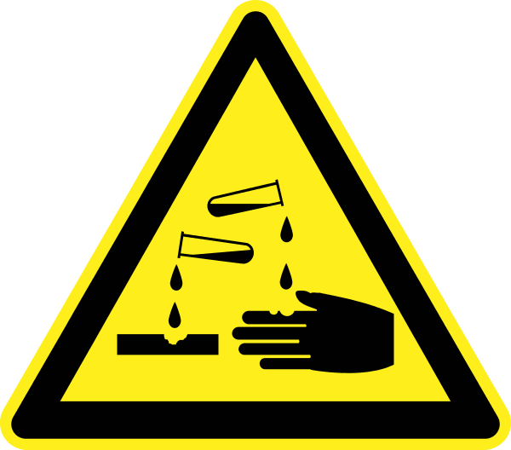
Possible Road Blocks to Quality Research?
Notes:
Identify road blocks to quality in the areas that you work in?Take a minute to think about trials you are currently coordinating?
How do you have Difficult or complex protocols? If so how do you manage them for them?
Do you feel adequately supported with education at your site to conduct your the trial?
Do you feel you able to accurately capture and identify AE SAE’s
Do you feel comfortable regarding FDA regulation and IRB Reporting?
Adequate staff to conduct the trial?
Do you have adequate PI over site in your trials
Informed consent not enough time?
Comprehension of participants.
Do you have good communication with your trial Sponsor?

Slide 9
Building the Framework for Quality
Analyze
Plan and prioritize
Control and Report
Monitor
Identify

Slide 10
Clinical Research Quality Is Designed to be Embedded throughout the trial
Standard Operating Procedures
Know the Protocol
Regulatory agency and ethics committee approval
Informed Consent
Training/Education
Adequate monitoring and audits
Notes:
Putting plans for managing logistics in place well before the first patient is key.
SOP’s know what they are where they are: How to consent, when to report what and to who. Create new ones when you see a process that could be improved or are no longer working for you.
When is the best time to review a protocol? Site selection and pre assessment?
Informed consent: Are you transparent with the consent risk?
Training : investigator meetings. Communication with sponsor.
Adequate Recording

Slide 11
Purpose of Quality Control SOP
Ensure compliance with SOPs, FDA, sponsor’s protocol and local regulatory bodies
Staff training of GCP, SOPs and federal/local regulatory requirements
Use Quality Improvement (QI) Program within the USF Division of Research Integrity and Compliance Office
Utilize standardized forms and checklists to ensure complete and accurate documentation
Conduct periodic internal QAs/ reviews to ensure compliance
Deficiencies found through internal QA or sponsor monitoring visits should be corrected
Documentation for each study should be reviewed periodically
Notes:
This includes:
Who performed each task
Degree of delegation of authority by PI
How and where data were recorded
Verification of protocol adherence
How study test article accountability and dispensation are/were maintained
Communications between sponsor and PI
IRB documentation, communications and approvals

Slide 12
Scenario Corrective Action Plan Required !

Slide 13
Define CAPA
Correction Action is any action taken to eliminate the cause of an existing non conformity, defect or undesirable situation in order to prevent reoccurrence.
Preventative Action taken to eliminate the cause of an potential nonconformity
Notes:
Correction Action is any action taken to eliminate the cause of an existing non conformity, defect or undesirable situation in order to prevent reoccurrence.
Preventative Action taken to eliminate the cause of an potential nonconformity
The purpose is to provide an system to assure the tracking and trending of issues requiring correction. The process will provide guidance on the requirements and use of the system and the procedures
Corrective and preventive action plans are linked to many fDA requirements
Revising, Replacing, Implementing, re education
The FDA looks for sites to have a policy on the process for CAPA

Slide 14
Corrective and Preventive Actions
Identify
Review
Analyze
Institute New Process
Implement

Slide 15
Corrective and Preventive Action
Potential problems should be identified and steps taken to avoid them
Discovery of a problem should trigger an immediate corrective action
Development of a plan to prevent recurrences. A reevaluation of the system should be performed to ascertain how the problem occurred-Root cause
Documentation to avoid any questions from an auditor

Slide 16
One Small Change Can Lead to Another

Slide 17
Beyond Compliance to Competency
Standardization and Streamlining
Training Requirement
Developing Team Approach
Assigning Acuity to Trial Conduct

Slide 18
Steps to improve quality in clinical research
Address Human Factor
System and Standardization
Integrated Plans
Education and Training
Beta Testing
Data Management
Audit

Slide 19
Developing Core Competencies in Clinical Research
Clinical Trial Operations
Research Product Development and Design
Scientific Concept and Research design
Ethical and Safety Consideration
Study and Site Management
Leadership and Professionalism
Communication and Team Work
Data Collection, Management and Informatics

Slide 20
Questions?

