Slide 1


Joint Commission
Levels of Maternal Care
Application Content & Resources
33
© 2021 The Joint Commission. All Rights Reserved.

Slide 2






Verification Process
FPQC - Intro to MLC Designation with The Joint Commission
Step 1 – Access Standards / Gap Analysis
Request the Standards - certification@jointcommission.org
Step 2 – Obtain CPGs & Develop PI Plan
Program overview, requirements and scope
Step 3 – Access Online App Site
Determine Ready Date and enter Volume/ADC data
Step 4 – Review Process Guide
Prepare for onsite review
15

Slide 3
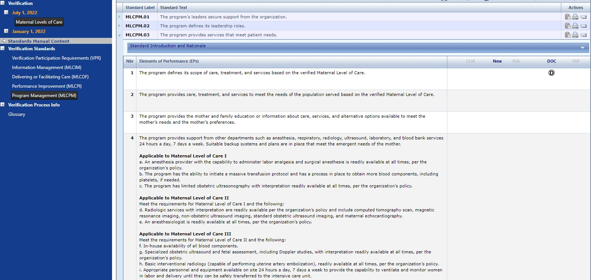
Step 1 - Access to Standards/Edition
FPQC - Intro to MLC Designation with The Joint Commission
16

Slide 4

Step #2 - Review Clinical Practice Guidelines
FPQC’s Intro to MLC Designation with The Joint Commission
ACOG Obstetric Care Consensus for Levels of Maternal Care
American College of Obstetrics and Gynecology Clinical Guidelines and Standardization of Practice to Improve Outcomes and Clinical Guidance
The Society for Maternal Fetal Medicine Publications and Guidelines
Association for Women's Health, Obstetric, and Neonatal Nurses Practice Briefs
Guidelines for Perinatal Care, 8th edition
17

Slide 5
Step #2 - Performance Improvement Plan
FPQC - Intro to MLC Designation with The Joint Commission
Briefly describe the scope of the Performance Improvement activities for your program.
Identify the composition of the management team – by profession and organization title.
Describe the current year’s performance improvement goals and objectives for the program.
Describe the activities that are currently underway to achieve or meet the current year’s Performance Improvement goals and objectives.
Describe the process for the program’s performance improvement plan including how the plan fits within your organization’s overall performance improvement plan, who has responsibility and authority for organization-wide performance improvement and how program specific data and information is shared across the organization.
18

Slide 6

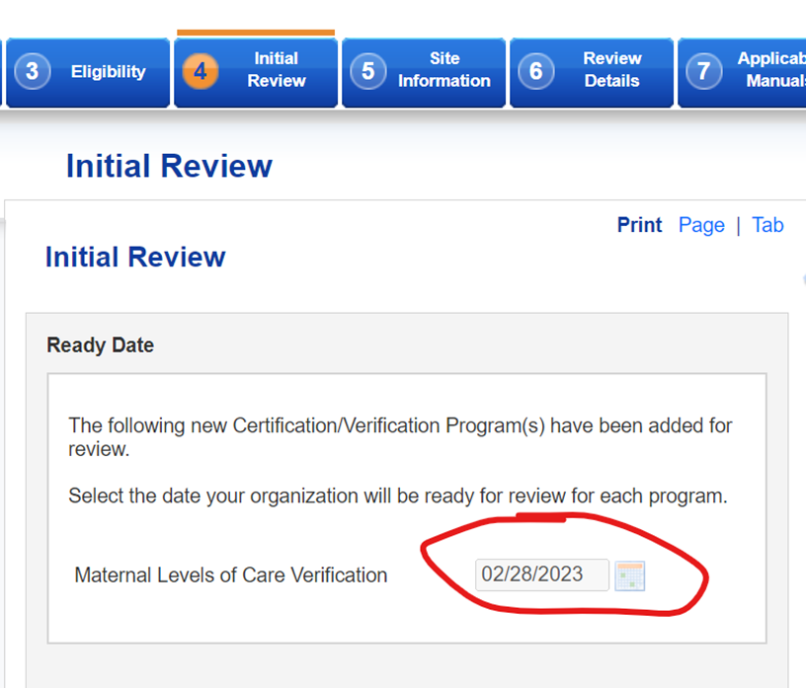
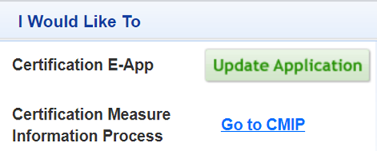
Step #3 - Connect Site Application Access

Slide 7

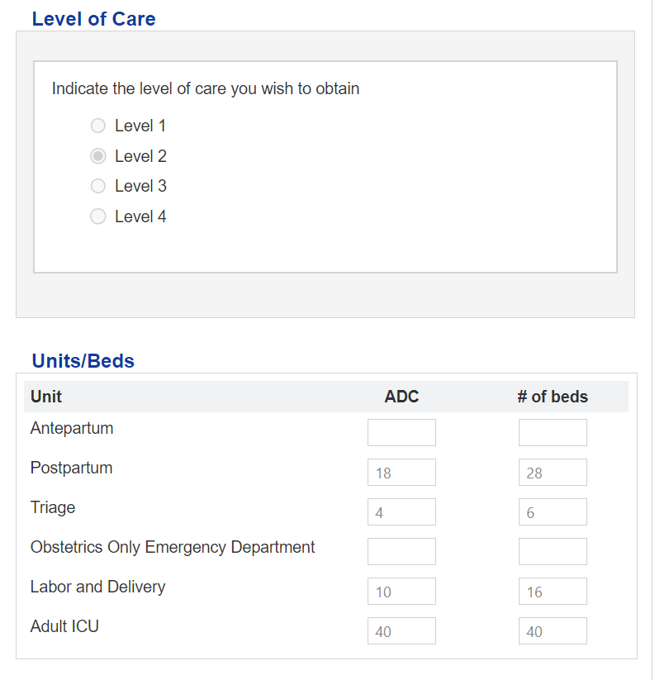
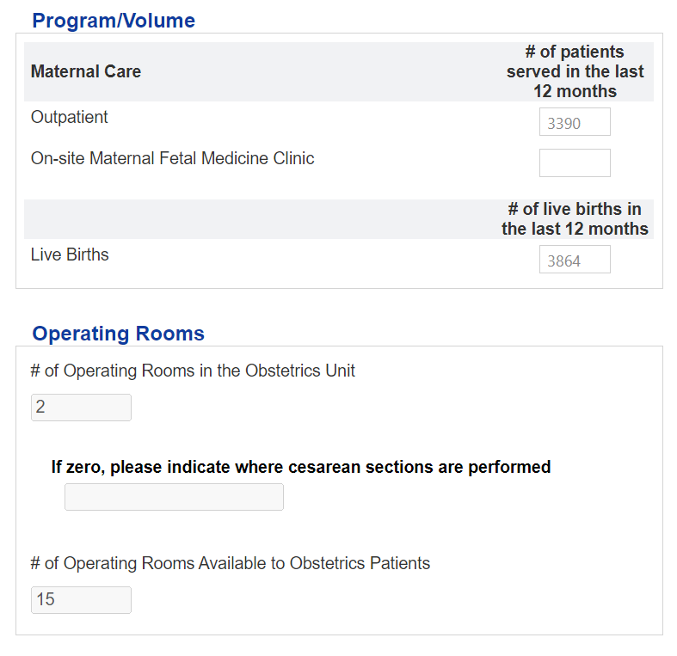
Step #3 - Enter Your Program Data/Volumes
© 2019 The Joint Commission. All Rights Reserved.

Slide 8
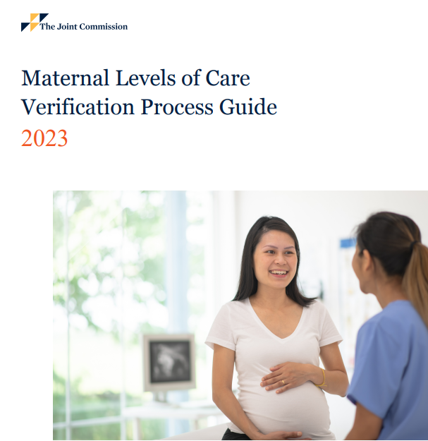
Step #4 -The Onsite Review
  How to prepare
    Review Process Guide
  The purpose of this activity guide is to inform organizations about how to prepare for the Disease Specific Care onsite certification review, including:
    Identifying ways in which the organization can facilitate the onsite review process
    Describing logistical needs for the onsite review
  Details provided
    The purpose of the activity
    Descriptions of what will happen during the session
    Discussion topics, if applicable
    Recommended participants
    Any materials required for the session

Slide 9
Joint Commission Reviewers
Provide best-in-class expertise and create a collaborative experience
for our certifying organizations
Our reviewers are subject-matter experts in the program being reviewed and provide enormous value for your organization:
Provide leading practices to
improve/grow the programs
they are reviewing
Conduct educationally
focused reviews
Lead a collaborative engagement
that helps to increase staff
awareness and education
Inspire staff to improve
the quality of patient care

Slide 10
The Onsite Review
  What to expect
    Tracer Methodology
  Patients selected to trace
  Using the medical record, processes and protocols as a guide
    reviewers go wherever the patients go
    patient arrival through discharge
  Walk through your program
  Engagement, discussion and observation with all levels of staff
    Closing Conference
  Final report will be presented and available through Connect®
  Any Requests for Improvement (RFIs) will be identified and explained by the reviewer
Elements of Onsite Review
Opening conference
Reviewer planning session
Individual patient tracers
Data/System tracer
Competency, credentialing and privileging discussion
Special issue resolution session, and report prep
Closing conference
60-day RFI Resolution Window

Slide 11
Let’s Review - The Steps to Becoming Verified
  Connect with your Associate Director at TJC to obtain the Standards
Contact certification@jointcommission.org.
  Pre-Application
Review Standards in E-dition® and analyze gaps
Identify Clinical Practice Guidelines
Complete Performance Improvement Plan
Establish a Ready Date
Select up to 5 Black Out dates
  Complete Application on Connect® portal
No Performance Measure data required
  The Onsite Review
30 days advance notice
Review most recent 4 months of data on performance improvements
1 reviewer, 1 day for Leve1 and 2
1 reviewer, 2 days for Level 3 and 4

Slide 12

Thank You!
Questions?
Your FL MOLC Verification
TJC Contact:
Brian R. Johnson, Ph.D.
Associate Director, Hospital Certification 630-792-5144
BJohnson@jointcommission.org
2222
© 2020 The Joint Commission. All Rights Reserved.

