Slide 1
Interprofessional Event Analysis
An ACGME Pursuing Excellence in Patient Safety Initiative
USF GME| Academic Year 2020

Slide 2
Objectives
Discuss importance of trainees in patient safety event analysis.
Describe process for patient safety event analysis and the trainee role in each step.

Slide 3
WHY is this important?
Culture of Zero Harm
You can't fix problems if you don't know they exist
Knowing how to address patient safety events is important for your future practice

Slide 4
Culture of Zero Harm
You can't fix problems if you don't know they exist
Knowing how to address patient safety events is important for your future practice
WHY is this important?

Slide 5
WHY is this important?
Culture of Zero Harm
You can't fix problems if you don't know they exist
Knowing how to address patient safety events is important for your future practice
Asch et al. Evaluating Obstetrical Residency Programs Using Patient Outcomes. JAMA. 2009;302(12):1277-1283. doi:10.1001/jama.2009.1356

Slide 6
WHAT is being done to address this?
Interprofessional event analysis – relevant & real-time¹
All interns & 1st year fellows
In their 1st year at USF
¹ Real-time means an event that occurred within the last 60 days at TGH

Slide 7
HOW do we make this happen?
Impart knowledge about patient safety events & reporting
Provide an event analysis toolkit
Facilitate interprofessional discussion
Provide feedback about outcomes of event analysis

Slide 8
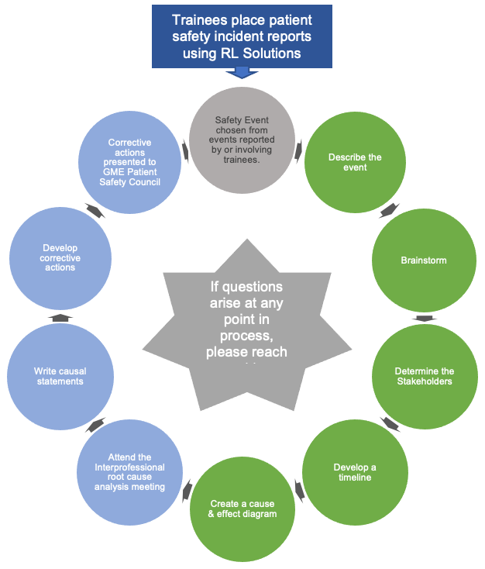
THE PROCESS

Slide 9
THE PROCESS
Reportable events
Results in harm/injury to a patient or visitor because of action or inaction by the hospital
Not consistent with routine operation of the hospital or routine care of patient(s)
Potential for accident, harm/injury, illness, or property damage (i.e., Near miss)

Slide 10
DO REPORT
DON'T REPORT
Medication safety events
Falls
Mislabeled specimens
Wrong patient
Wrong site surgery
Wrong procedure
Wrong treatment
Extravasation
Equipment failures
IT related issues
Dietary issues
Charting errors
Complaints about team members
Transfer due to progression of patient illness (e.g., CHF not responding to diuretics)
Skin integrity issues present on admission

Slide 11
DO REPORT
DON'T REPORT
Medication safety events
Falls
Mislabeled specimens
Wrong patient
Wrong site surgery
Wrong procedure
Wrong treatment
Extravasation
Equipment failures
IT related issues
Dietary issues
Charting errors
Complaints about team members
Transfer due to progression of patient illness (e.g., CHF not responding to diuretics)
Skin integrity issues present on admission
Submit event reports ASAP
(no later than 24 hours after an event has occurred)

Slide 12
What information should be included?
Limit to factual statements related to the event & any interventions taken in response
Don’t editorialize, speculate, or attempt to assign blame/causation
Avoid using adjectives

Slide 13
Event reporting in RL Solutions
Confidential, internal electronic or paper submission used for reporting of events for identification of patient safety issues and performance improvement.
Event reports may be discoverable
Don’t reference event reports or document “event report filed” in the medical record
www.psnet.ahrq.gov

Slide 14
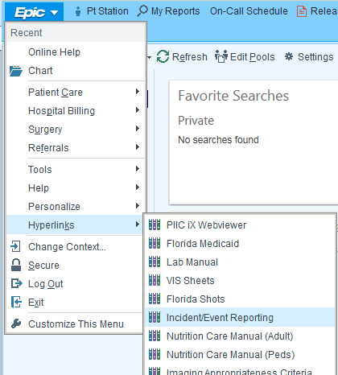
How To Report An Event (RL Solutions)

Slide 15
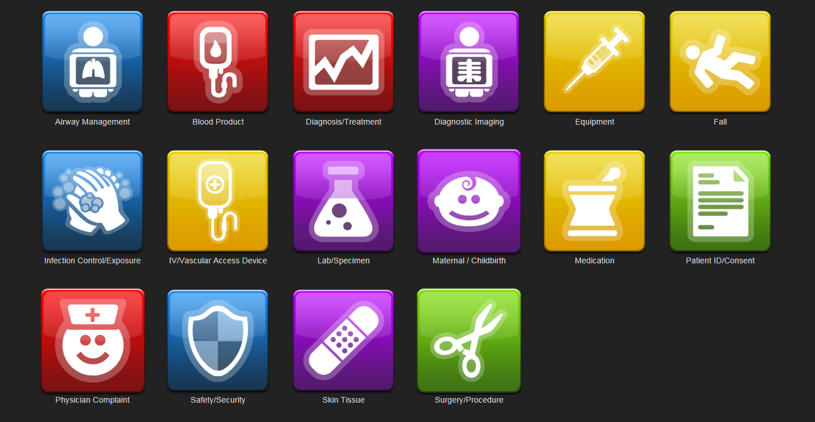
How To Report An Event (RL Solutions)

Slide 16
THE PROCESS
Register for an event analysis session

Slide 17
THE PROCESS
Confirm receipt of USF GME email with assigned event
Emailed 2 weeks before your timeslot
Reported by or involving trainees at TGH
Occurred within the last 4 weeks

Slide 18
THE PROCESS
Use the
USF GME Root Cause Analysis toolkit
Concisely describe important details
about the event
Event itself, involved staff, subsequent actions taken, or knowledge gained

Slide 19
THE PROCESS
Use the
USF GME Root Cause Analysis toolkit
Try to understand “what happened”
Use the list of trigger questions to help you

Slide 20
THE PROCESS
Use the
USF GME Root Cause Analysis toolkit
Who was involved (directly or indirectly)?
Should they be interviewed?

Slide 21
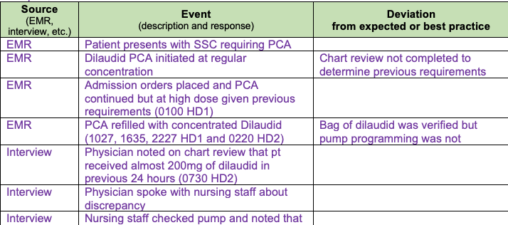
THE PROCESS
Use the
USF GME Root Cause Analysis toolkit

Slide 22
THE PROCESS
Use the
USF GME Root Cause Analysis toolkit

Slide 23
THE PROCESS
Goal: Review event & draft corrective actions with the interprofessional team
Your responsibilities during this meeting
Basic event description
Timeline
Causal statements
Active participant during discussion

Slide 24
THE PROCESS
Because of
x (the root cause),
y (the event)
occurred
Rules when writing causal statements
Clearly show the “cause and effect relationship”
Use specific and accurate descriptors for what occurred, rather than negative and vague
Human errors must have a preceding cause
Violations of procedure are not root causes, but must have a preceding cause
Failure to act is only causal when there is a pre-existing duty to act
Adapted from the National Patient Safety Foundation

Slide 25
Trainee responsibilities

Slide 26
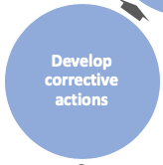
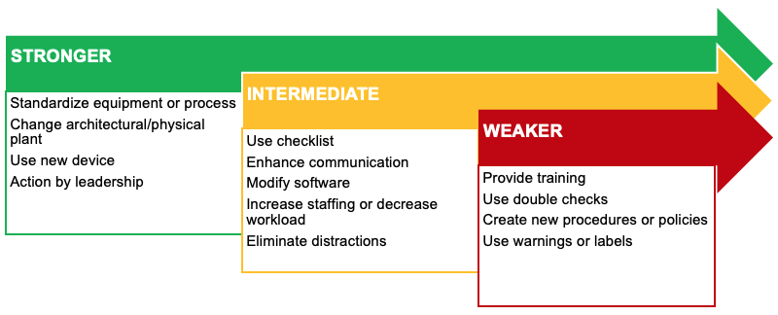
THE PROCESS
Choose corrective actions that
make it easier
for people
to do the right thing.

Slide 27
THE PROCESS
Trainees will be provided feedback about outcomes of event analysis

Slide 28
GME responsibilities

Slide 29
Event Analysis Process

Slide 30
What questions do you have?
We welcome feedback on this process and questions.
Please contact Jaimie Weber (jlweber@usf.edu) with any questions or concerns.

